Slide 1
SVM Classification

Slide 2
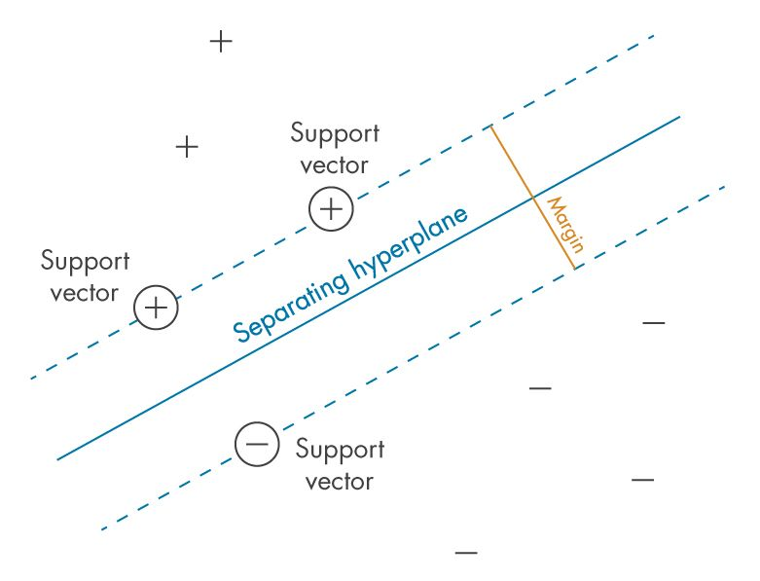
Support Vector Machines
Support vector machines are a linear-based classification model.
There’s regression versions, but those are less common.
They are based on creating a margin between the groups.
Aim to create the biggest ‘lane’ between the groups.

Slide 3
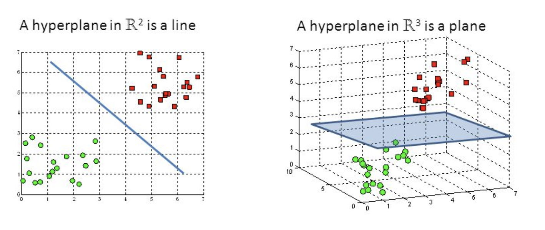
Hyperplane
The thing that does the dividing of the two sets is called the hyperplane.
This is the line in a 2D logistic regression – defined by the regression result.
The hyperplane is a plane that is 1 D less than the data.
The model looks to find this plane and use it to divide data.

Slide 4
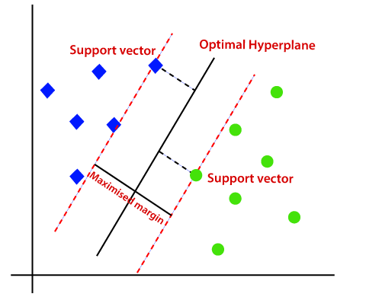
Support Vector Machines
A support vector machine is easiest to understand by picturing it.
It attempts to separate classes by drawing a division (a hyperplane) between two sets.
The points that define the separation are called the support vectors.
Everything on one side gets one label, everything on the other side gets the other.
The algorithm maximizes these margins – leading to the best possible separation.
Only the support vectors matter!

Slide 5
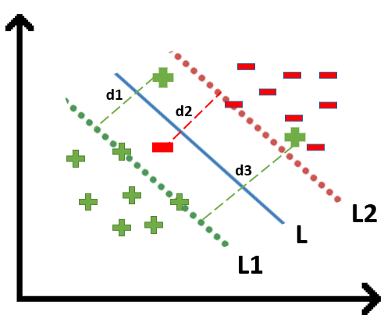
What if there’s not a Perfect lane?
Much of our data doesn’t have a perfect gap to divide on.
We can “soften” the margin for the SVM, or allow some misses.
This is done by hyperparameter C. More C, more fitted, smaller margins.
Less C, less fitted, more tolerant of violations of the margin.

Slide 6
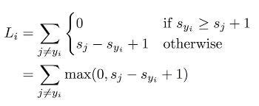
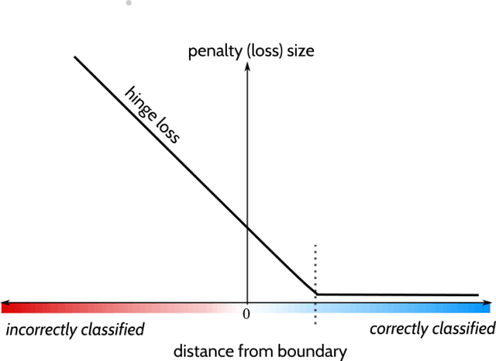
Cost and Loss
SVMs normally use a new cost function – hinge.
Hinge loss is defined as:
0, if ‘adequately’ correctly classified.
Increasing linearly while ‘close’ and wrong.
This penalizes separation of classes.
Things that are well on the side are 0 loss.
The more wrong we are, the loss scales.
Advantages – small data and outlier resistance.
Non-differentialbe – g.d. isn’t used – quad. Prog.

Slide 7
Linear models, Non-Linear Data
As we’ve seen with trees and basis functions, non-linear data needs a non-linear model to accurately capture the patterns.
Basis functions did a transformation for linear.
Basis transformation ‘captures’ the non-linear curve so the model can fit it.
SVMs have a similar transformation tool, the kernel.

Slide 8
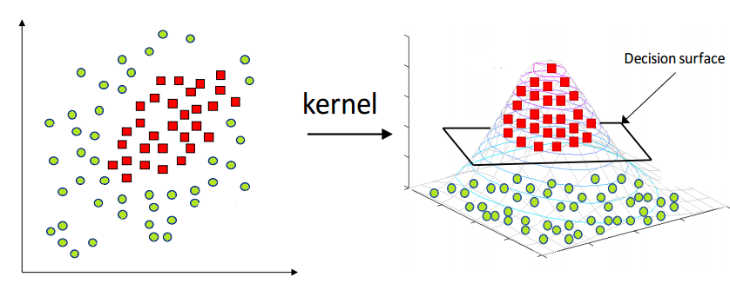
What if the split isn’t a Line?
As well, lots of data isn’t split by a nice simple line.
We can use a kernel – similar to a basis function in linear regression.
Transformation raises data to a higher degree (like a basis), and allows for different ways to draw the hyperplane.

Slide 9
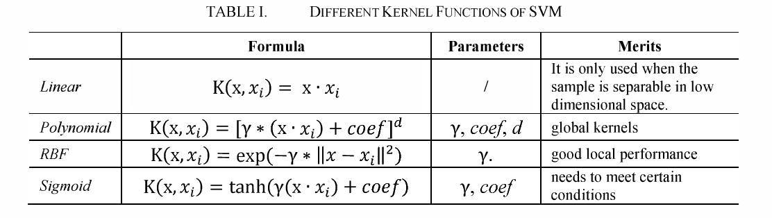
Kernel Choices
There are several kernel choices.
Generally, we need to test to know best option.

Slide 10
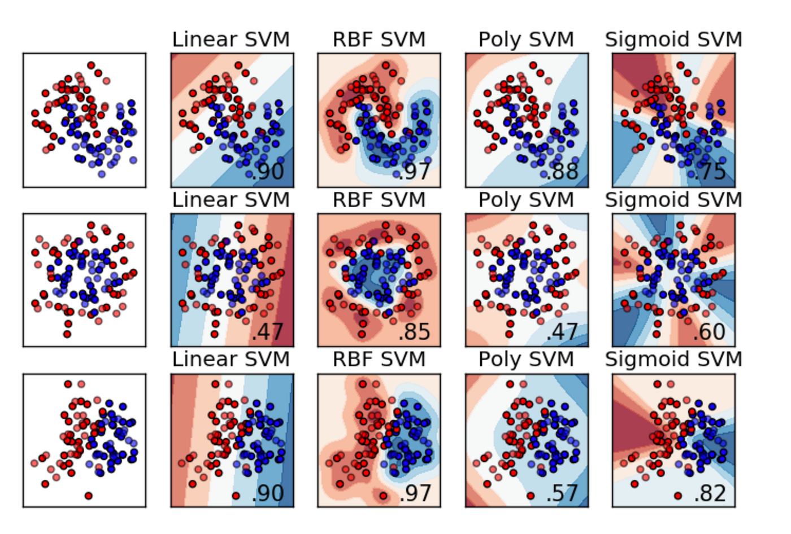
Kernel Results
Each kernel will do a different transformation.
In 2D, we can see what makes sense. In lots of D, we have to test.
Grid search makes this one pretty easy.
Results can swing wildly depending on kernel/data combo.

Slide 11
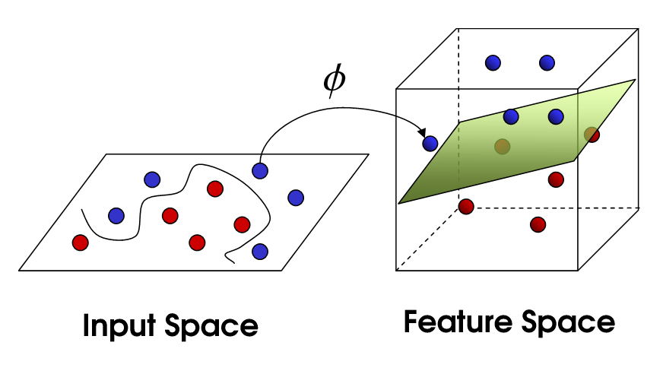
Dimensional Explosion
As with basis functions, this increase the dimensionality of the data.
The intuition is simple:
Can’t separate in 2D, make it ‘more D’, more space, we can then draw a plane to separate.
Same number of points.
There’s literally more empty space for HP.
We map the points from N-D to M-D.
This can take a minute, lots of math.

Slide 12
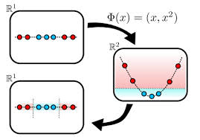
Easier to Split

Slide 13
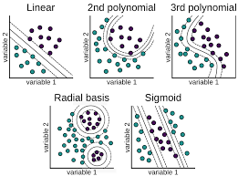
Kernels and their tricks
This process is done using the Kernel Trick in SVMs, it allows us to separate non-linear data.
Like a basis function in use, but with a shortcut.
We can specify as a HP:
Linear
Radial
Sigmoid
Polynomial
After kernel trick, sets may become linearly separable.

Slide 14
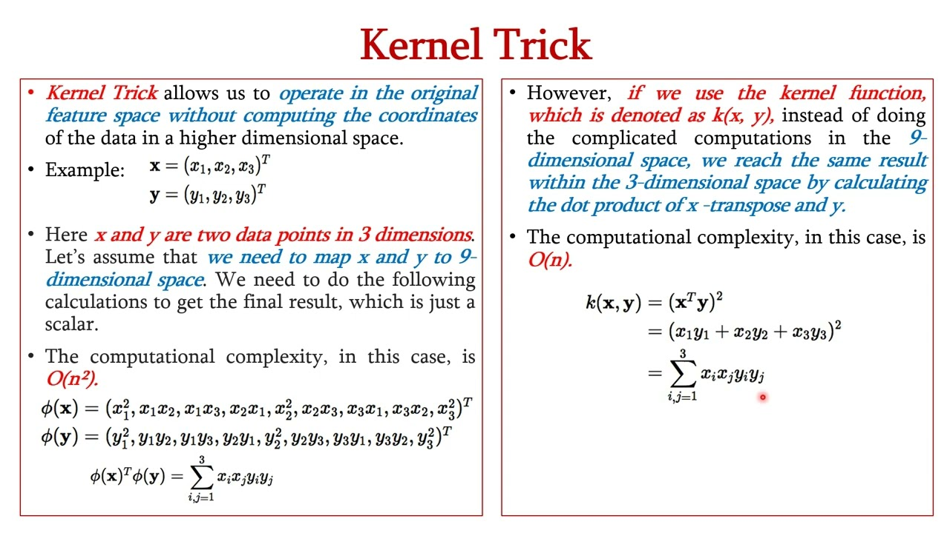
What’s happening

Slide 15
Turing Tricks…
The kernel trick is a mathematical shortcut that sidesteps the mapping math.
i.e. we can ‘make’ the data M-dimensional, without all the calculations.
This makes things run much more quickly.
Once in higher dimensions, division is typically easier.
This one is polynomial power of 2, same a basis LR.

Slide 16
Kernels are Tricky
The kernel trick saves calculations in mapping to a higher dimension space.
I.e. the kernel function needs to be applied to each record – lots of algebra.
The kernel trick is a shortcut of that mapping.
Get: data in higher dimensions.
Without: having to do all the math.
This makes this practical to use in more cases.

Slide 17
SVM Uses
Support vector machines are relatively widely used in real-life.
Often good at unstructured things like image or voice classification.
Marketing/sales related – spam, fraud, recommendation systems.
NLP related things like sentiment analysis.
These applications are/may be better with NN, if there is lots of data. If not, SVM competes.
For smaller datasets, an SVM might do a really good job where a neural network is still underfitted.

Slide 18
SVM – So Hot Right Now
Multiple classes – One vs rest, or one vs one. No softmax equivalent.
Pros:
Can be really accurate, and pretty flexible thanks to kernel tricks.
Good (potentially) with small-ish datasets, especially those with many features like images.
Stable – only different if the support vector change.
Cons:
May be slow on large datasets.
Noise and messy data may hurt accuracy if the margins are hard to define in the data.
Correct kernel requires testing via a gridsearch or similar.

