Slide 1
Today – real Neural Networks!
Basics of tensorflow/keras (we’ll do roughly ch3 today – it’s mostly code, short read):
Vscode to colab and back
Creating models
Adding layers
Basic optimization options – early stopping, dropout, regularization. We’ll tune more next time.
Need to do some exercises and try it out…
Versioning and Keras notes:
I’ll do most of the work in Colab – so what you’ll get is identical.
If running on your computer, details may vary (largely around name/imports)

Slide 2
Neural Networks with Keras and Tensorflow

Slide 3
Neural Network Libraries
Neural networks have libraries similar to sklearn, but there are some new concerns.
GPU acceleration – the big matrix math that is needed in neural networks is done much (much, much…) faster by GPUs (video cards) than by CPUs (regular processors).
To do any serious neural network training, we need a GPU of some sort.
nVidia GPUs are the king, and far beyond anything else, largely due to CUDA (next).
Apple silicon macs have tensorflow acceleration that you can enable.
Colab (or other online workbooks) offer GPU access, Colab is the easiest/cheapest solution.
Other GPUs like Radeons or Intel usually have something, but it tends to suck.
You typically install some variation of TensorFlow and get GPU friendly output.
The GPU operations utilize some faster set of commands than ‘normal’ operations. (CUDA)

Slide 4
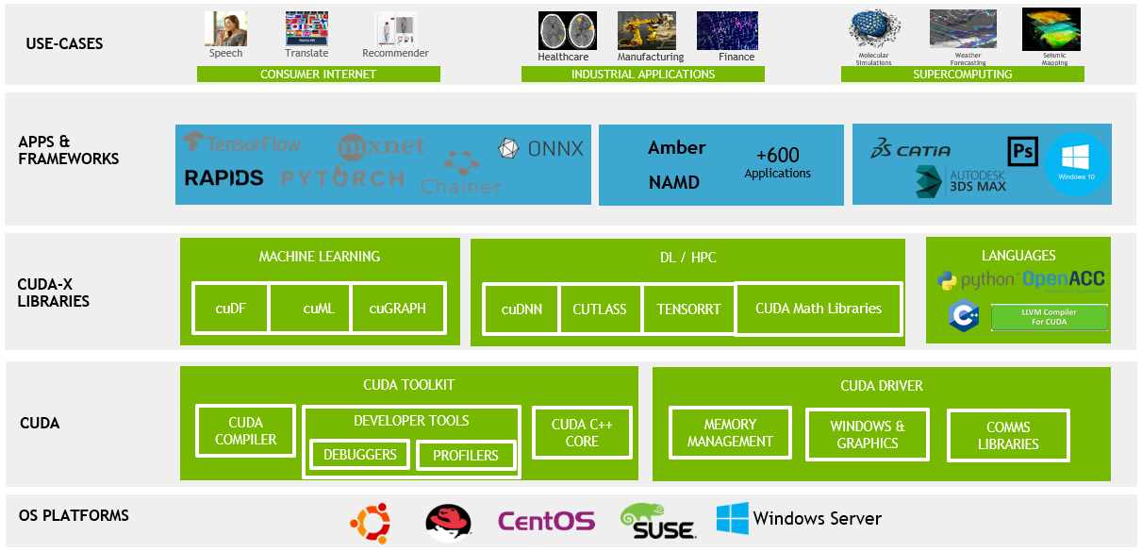

Slide 5
If this is something you want to do, what Hardware do you want?
The best overall solution (IMO) is a macbook pro/air + Colab or similar for big stuff.
Macbooks are accelerated enough for (most) trials, then you can use cloud for training.
Another GPU + Colab will probably work, thought support may vary.
If you want to train lots of stuff from scratch, get an nVidia GPU.
Look up speeds, there’s tensorflow/pytorch benchmark pages out there.
There’s no (effective) replacement for CUDA, so even fast hardware tends to lose out.
If you’re doing lots of stuff, having your own might be cheaper (though I’d hesitate unless you want the GPU for other stuff too, Colab is really fast, and upgrades things.)
There are hard limits for running models – they must fit in GPU memory.
There are colab competitors out there, some give free time, some cost less, etc…

Slide 6
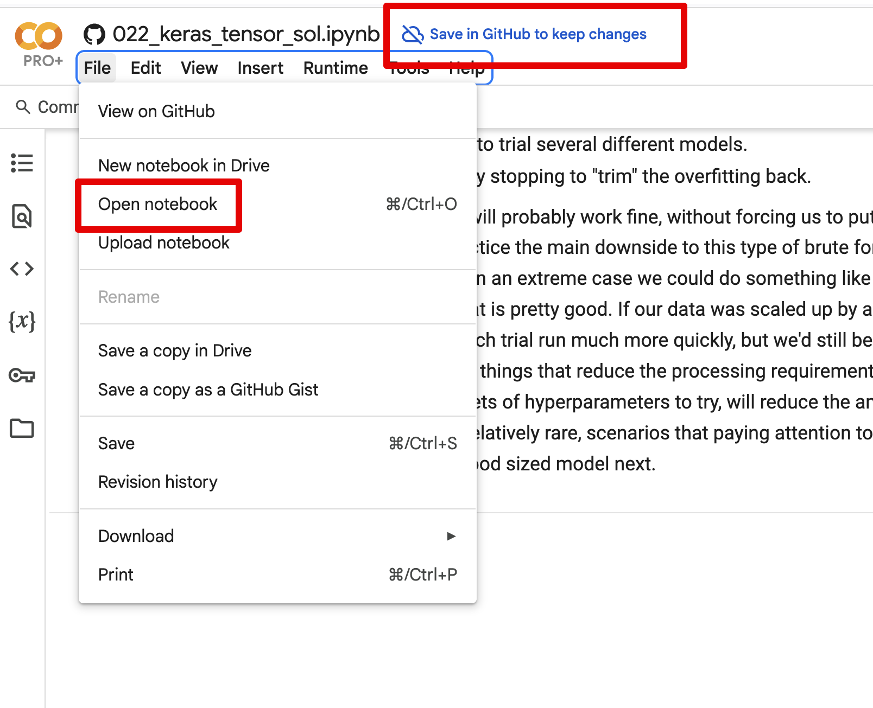
Coding in Colab
For me (and I assume most) we can use Colab for the NN stuff.
We can use things from GitHub and VSCode relatively easily.
I generally prefer to:
Code and run small tests locally. (Ifs for ‘in colab’ may help).
Push to my repository.
Open in Colab and run for real.
On Colab, use GPU runtimes for speed.
Acceleration – runtime -> change runtime type for GPU.
For now, what they give free is fine.

Slide 7
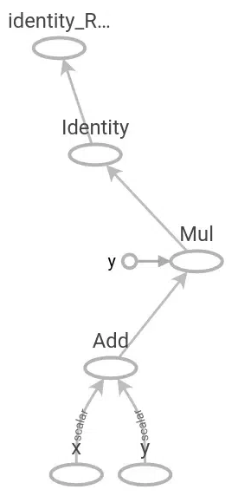
Introduction to Tensorflow
Just like sklearn provides a library of predictive models, tensorflow does similar for NN.
Tensorflow was developed by Google in 2015, it is free and open source.
Uses a graph internally to store the structure of a network.
Provides layers, loss functions, etc… allowing us to make NNs without coding the innards.
Calculations are offloaded to C++ modules, which are faster.
TensorFlow basically allows you to not do all the math by hand in making a neural network.
TensorFlow is still relatively low level (kind of like C vs Python).

Slide 8
Enter Keras…
Keras is an even higher-level library that provides an easier API for TF.
It’s pretty much all Keras now, at least as far as the labeling.
Originally a separate product, now integrated with the core of TF.
Keras can be used with other backends like pytorch.
The good:
Using Keras is relatively easy.
The bad:
Many things may have different names or convetions depending where they originated.
Everything that has changed names since I made this, and made me hate myself.
If you need to look something up, Google “Keras my_thing” and you’ll probably find it.
We don’t really need to differentiate between TF/Keras most (all??) of the time.

Slide 9
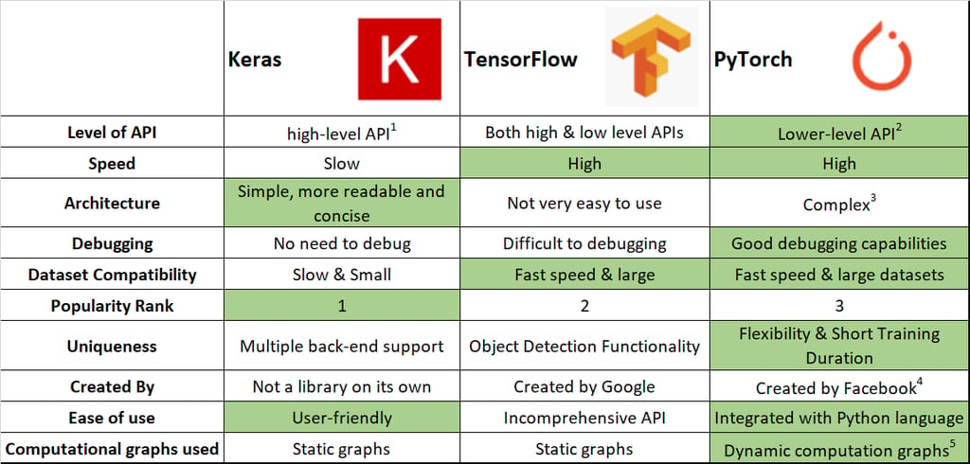

Slide 10

Using Keras and Tensorflow
When creating a NN with TF we don’t need to care about internal calculations.
We specify what the model is, what the layers are, and configure them via parameters.
Dot products and transposes can be ignored.
Starting point is creating a model, we’ll always use a Sequential one.
Other types of models allow for us to customize that internal stuff.

Slide 11

Please Cry for Me!
They seriously made the naming conventions and documentation with keras/tf so confusing…

Slide 12
Keras Documentation
The keras documentation is at https://keras.io/api/
It is generally pretty good and reasonably clear.
There are some pretty good examples for many things.
It also has slightly older documentation from TensorFlow.
This also comes up a lot if googling.
Lots of this stuff is very good, especially for more basic problems (like ours).
In general, the older stuff works the same, with minor changes:
Import and naming of stuff tends to change, function doesn’t.
Some things get superseded, but that is less common than name/place changes.

Slide 13

Creating a Tensorflow Model

Slide 14
Constructing a Tensorflow Model
To construct a tensorflow model we need to do a few more steps than with sklearn:
Create the model object itself.
Add layers (~ like a pipeline of steps, but including the ‘innards’ of the model).
Compile the model, specifying loss calculation info and what metrics to track.
Fit (train) the model.
Check the training/testing accuracy by epoch.
Note: some data preprocessing may be more easily done with a pipeline outside of model that only transforms. Especially since we are used to that, not so used to TF.
In real applications we can build custom layers to do some prep stuff – we won’t, just be aware.
We can also build some of the prep stuff into a dataset object, we’ll do this later.

Slide 15
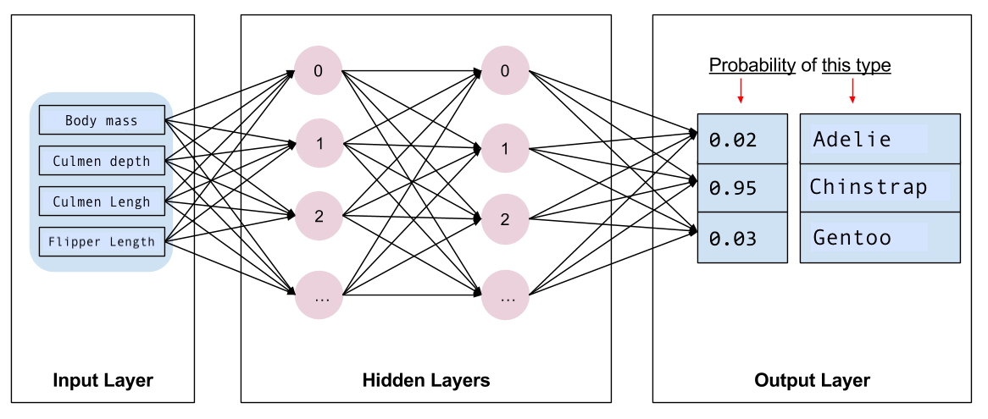

Slide 16
Data Prep Pipes and Neural Nets
We can theoretically use/make a layer for most things that a pipeline does.
Encode, normalize, scale, etc…
Where and how this is actually done varies.
In simple examples, it is all over the place, often ad-hoc.
We can, later, create datasets that can manage large data and process steps.
These can handle large amounts of data easily – out of memory data.
We can plan for processing times to maximize resource utilization.
Tl;dr – we don’t care much about preprocessing details now, it’ll change with datasets.
You need to do it, just pick a spot – usually just before the modelling part.

Slide 17
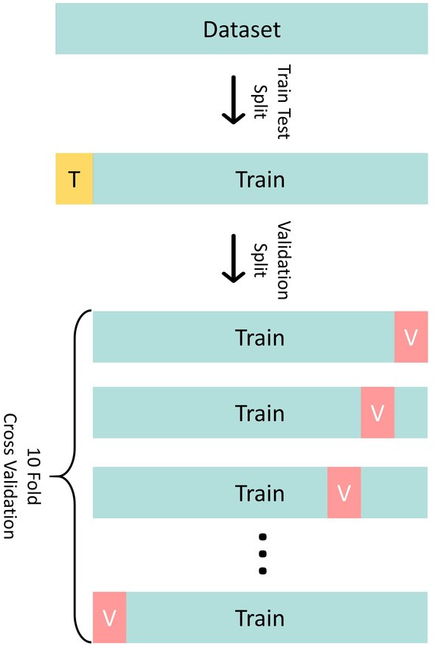
Validate my Validation!
With neural networks we use the validation set more.
The test set is held entirely aside, to evaluate performance.
Internally, the model uses the training data:
Split for cross validation similar to before.
We can specify that split, 20% is a reasonable start.
Small validation sets can lead to ’jumpy’ results.
As data gets bigger, percent needed for val/test shrinks.
We generally look to the validation whilst training.

Slide 18
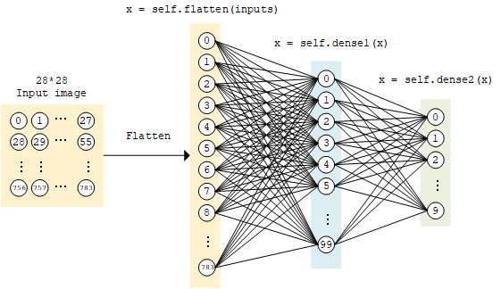
Add Layers

Slide 19
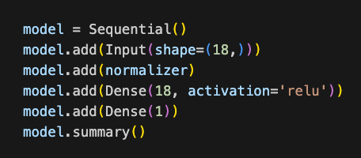
Layers
The most critical object for making our neural network is the layer.
We always have an input and output, and an arbitrary number of hidden.
TF has many types of layers:
Dense – the “standard” layer that is fully connected.
Preprocessing layers such as normalization.
Data manipulation layers such as flatten.
Activation layers (we don’t generally need these, we can tell the dense one to use activation).
Other weird ones we’ll look at next week or the week after.
In the first layer we need to specify the input shape.
In subsequent layers we just need to specify the output dimension (it auto-adapts the rest).
The connections between the layers (weights, bias, gradients) is handled for us.

Slide 20
Input Layer
One thing we saw when doing a neural network by hand was the attention required to the shape of the input data.
In tensorflow we can make this easier by using the input shape and flatten layers.
On the first layer of the network we can specify input_shape as a parameter:
This will ensure that the network “knows” the shape of the data.
This parameter is the shape of one record.
When we are using multidimensional data (for now) we can make the first layer flatten:
The flatten layer will take in the original shape and flatten it to 1 x whatever.
This allows us to avoid manual reshaping.

Slide 21
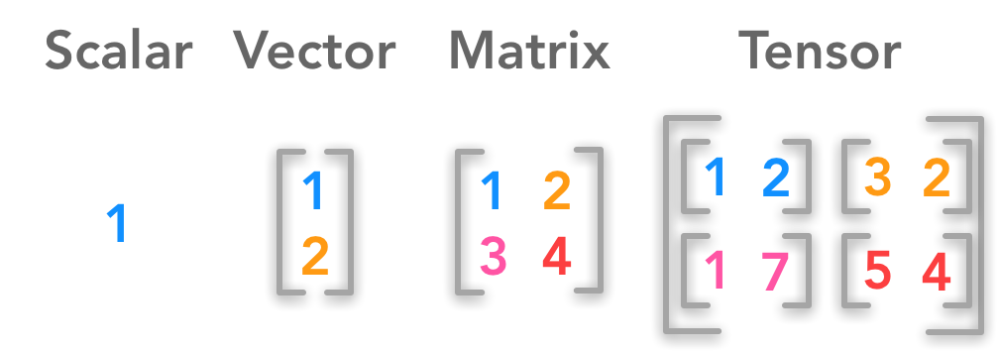
Tensors and Input Layer
Data can be in multiple dimensions.
The input layer defines the shape to expect.
For now, we’ll use something like (18,) which means just flat 18 features.
Later, like with images, we’ll specify the shape of each image, and the batch size in here.

Slide 22

Hidden Layers
We can have any number of hidden layers.
A reasonable number to test is 1-5.
The number of neurons in the hidden layers is also flexible:
Commonly see flat sizes until the output layer.
Also common to “filter down” the sizes.
Exact setup is not deterministic, we’ll look at it more next week.
We’ll usually use “relu” for activation, we’ll look at these more later as well.
Reasonable approaches:
Set # of neurons for all layers to input size. Start with 1 hidden layer, add until overfit.
Lean towards a larger model and use regularization techniques and early stopping.

Slide 23
Assorted Layers
There are many other layer types, we’ll look at some later.
There are different types of ’main’ layers for different model types.
E.g. layers that deal with data in 2D directly without flattening.
There’s layers for prep stuff – encode, normalize, etc…
There’s layers for tuning stuff – dropouts, regularization….
Many of these actions can be embedded in ’normal’ layers, or made separate.
We can embed regularization in a dense layer.
We can also add it as it’s own layer, for example, to do it as a separate step somewhere.

Slide 24
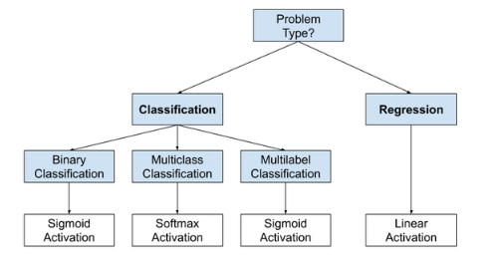
Output layer
The output layer is largely rules based depending on the output:
Binary classification: output size = 1, activation = sigmoid.
Multiclass classification: output size = # classes, activation = softmax.
Multilabel classification: output size = # classes, activation = sigmoid.
Regression: output size = 1, no/linear activation.

Slide 25
Compile
The compile step ”builds” the model from all the layers and other components.
We also specify loss info for the gradient descent:
Loss: What loss metric to use.
Optimizer: Which algorithm to use for the gradient descent.
Metrics: Which metrics to track (beyond loss). We can list any number, from train or validation.
Optimizer – we’ll use adam for the most part.
Different optimizers mostly seek for more efficient methods to converge. Adam is the current most popular and is pretty good in all respects. It is safe to just use this one.
This is more important in NN than regular GD– finding a solution can be slow, so this matters.
Metrics – we can specify a list of metrics for the algorithm to track.

Slide 26
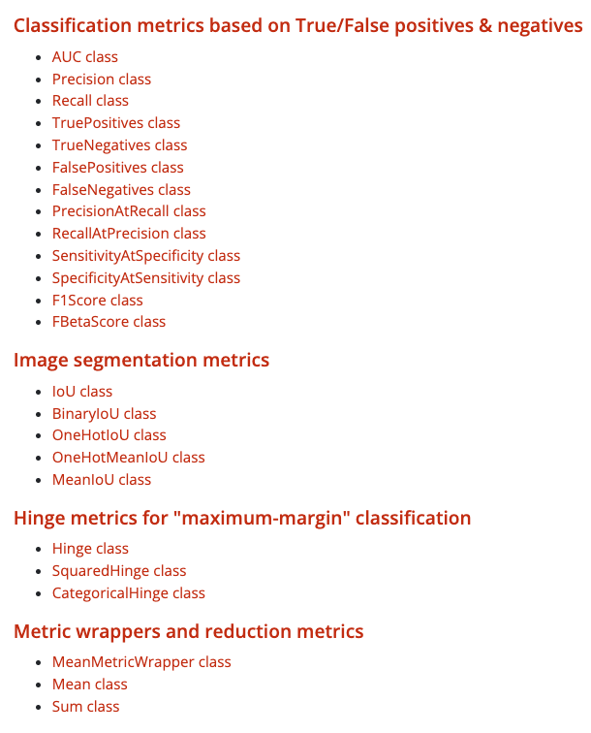
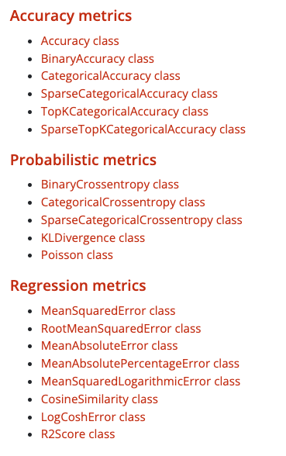
Metrics
We can tell the compile to track a set of metrics.
We can also make our own.
We can call them by the object name, or an informal name like “accuracy”.
We can also ask for a list with any number of metrics.

Slide 27
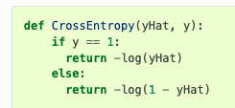
Loss
We can choose between many loss functions, they work just like in sklearn.
Regression:
MSE
MAE
Classification:
Binary cross-entropy
Categorical cross-entropy
Cross entropy is the general default. We’ll use this unless given a reason not to. We’ll look at other losses later on.
Note: these things are annoyingly named in tensorflow, some have several names.

Slide 28
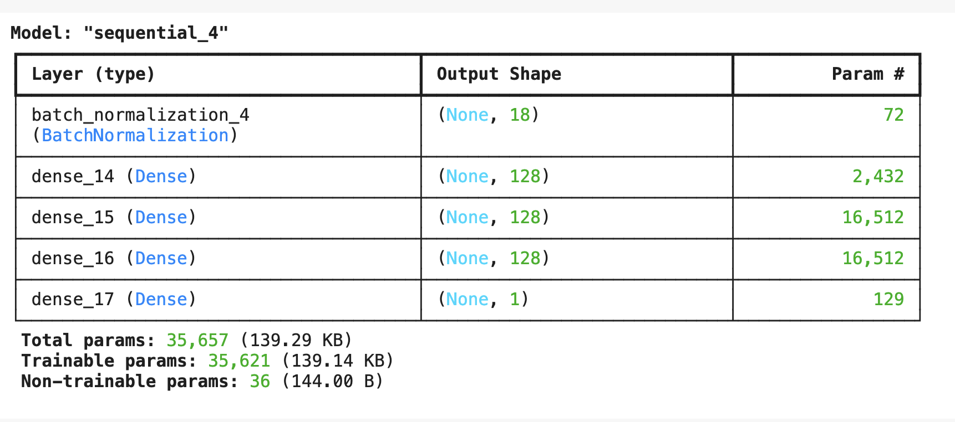
Summary
The summary gives us the structure of the model.
The shape shows us the dimensions of layers.
The first none is nothing, this is 1D data.
The Trainable Params are the total number of weights of the model – its capacity.
These weights are what gets trained. Can be GBs+.
If we have weights, we have ‘the model’.

Slide 29
Fit
The fit step trains the model once made and compiled with loss settings.
Epochs – number of rounds of training to execute.
We’ll look at early stopping, to stop when the model is best.
Batch size – how many records to process before updating weights.
Larger batch sizes generally complete faster.
Batch size is limited by hardware (memory) constraints.
Works just like in gradient descent – smaller is more “jumpy”
Rule of thumb for now – try 50 to 150ish. More later in tuning.
Needs to be grid searched for a true answer. Recommendations vary widely.
Validation – we can specify the share of data to run validation on.

Slide 30
Recall – Stochastic Batches
Remember the inner working of gradient descent.
We do a prediction (forward pass) with all the data, tabulate error, then adjust weights.
The weights are adjusted once per batch. In ‘regular’ GD, batch = all data.
In neural networks “all the data” can be very large.
We often limit batches, for several reasons.
We may not be able to fit the data in (GPU) memory at all. E.g. with images.
Time to run one epoch may be super large. (Possibly days or weeks).
The batch size is one of the settings we need to consider in neural networks:
In larger cases it will be constrained by physical limits of the system like RAM.
For performance, things vary, but smaller batches empirically trend better (as of a few years ago).

Slide 31
Callbacks
In the fit function, we can add a callback.
A callback is an action that happens at each batch/epoch end (normally).
We’ll deal with callbacks a bit more with tuning larger models.
Can be used for anything – such as saving progress, writing logs, generating outputs…
We usually use one for early stopping.
If the metric doesn’t improve, stop.
These callbacks can automate a lot of work and allow training to be unmonitored.

Slide 32
Model History
Tensorflow models also return a history that we can use to graph/examine.
We can build simple plotting functions to do this easily.
Generally want to look at training history:
Detect overfitting/underfitting with train/val loss.
See how many epochs are needed.
For larger/real examples, we can set the training to log progress to start/stop.

Slide 33
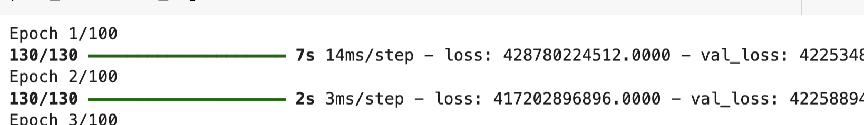
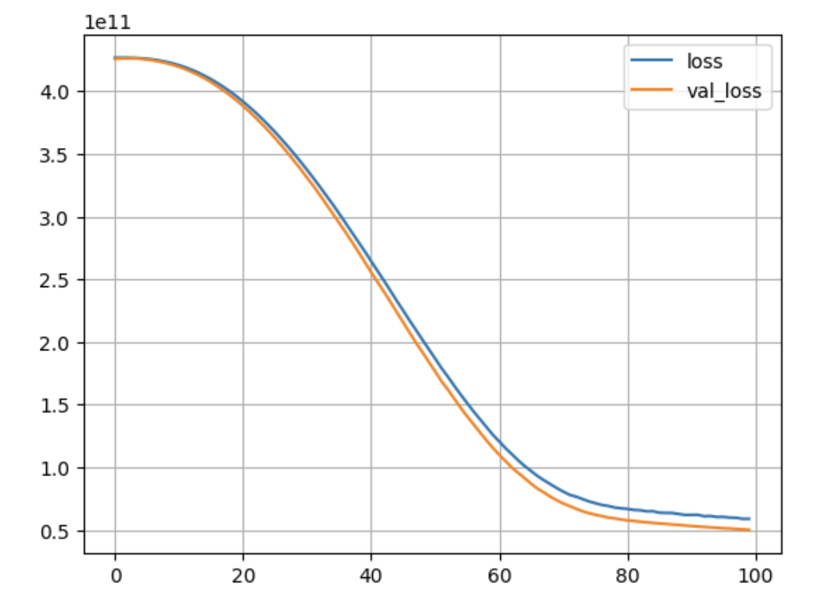
Verbosity and Outputs
The verbose parameter controls the feedback we get mid-training.
Training can take a while, so it can be nice to have some updates.
Metrics defined in compile get reported each epoch.
Post training, we look at a training/validation loss plot.
There’s a small function you can copy/paste to generate this from the history.
Think about the meanings of the diff. losses…

Slide 34
Making a decent Model
Tuning a neural network model is more complex than a sklearn stats model.
There are far more potential changes that can be made.
The performance is less predictable, and the changes are interdependent.

Slide 35
Fighting Fit
Some techniques we can use to improve fit in a model are:
Regularization – we can enable L2/L1 regularization in layers.
Dropout – remove nodes on the fly. Similar in concept to bootstrapping in forests – parts of the model are removed each batch, preventing them from having excess influence. It forces the other parts of the model to learn.
Early stopping – stop the model’s training before it overfits. Also makes our lives easier, since our model will stop when done.
For now, make it 1-3 or so hidden layers, add regularization, use early stopping.
We’ll do more of this next time.

Slide 36
Layer Flexibility Notes
Note that the layers we use have some (optional) stuff built into them.
Regularization.
Activation.
We can (but don’t usually) split these apart in some scenarios.
E.g. do normalization after regression by pre-activation.
This is mostly for context – we might see either in practice, they are interchangeable.

Slide 37
Keras Model Conclusion
Using keras based networks has a different process than the sklearn ones.
The process is largely the same, but the details of the steps differ quite a bit.
We need to create the structure of the model and build it first.
We can monitor more during/after the training process.
Performance of neural networks is very adaptable – they do their job well.
Highly complex models lead to more need for tuning work.
Model structure.
Details such as optimizer, activation, and learning rate.
Regularization and other fit techniques.

