Slide 1
Housekeeping
Today – let’s make some maps.
Installing geopandas and making a backup environment just in case.
Spatial data basics.
Geospatial and geopandas basics in tableau – load, map, calculate.
Otherwise:
Next time, or two, we’ll cover pipelines and clean this data more efficiently.
That’ll require some inheritance and fun object stuff.
Take a look at the doc for “sklearn pipelines” for info, there’s a readable article.
If things seem ok, keep chugging, if something is confusing, please ask so we can target it.

Slide 2
Geopandas notes….
I had weird errors trying to install dependencies on osx – the os version was wrong.
This means that some stuff under the explore() function won’t work for me.
It’ll probably work for you, particularly on windows.
I’ll try to figure this out over Christmas and we can do it next semester.
In any case, you can try geopandas_dataframe.explore():
It is more modern-map like.
You’ll probably need to install some stuff, the error message will give a pip command.

Slide 3
Spatial Data

Slide 4
What is Spatial Data?
Spatial data describes the position in physical space:
Where someone is located on a map.
The boundaries of a city.
Two main types of data we’ll look at:
Points – the latitude and longitude of a specific point on a map.
Areas – the boundaries of a region, such as a city, province, or country.
(Bonus) Lines – a connection of points, like a bus route. (We won’t use this much).
Spatial data, for our concerns, is relatively simple!

Slide 5
Geopandas
Geopandas is the tool that we’ll use to handle spatial data.
It is a library that is basically pandas + geospatial capabilities.
We use a similar dataframe to regular pandas.
Geopandas extends pandas with a few special specific capabilities:
Plotting – it knows that information goes on a map, and will natively plot it.
Spatial joins - we can connect data based on spatial data, such as if a point is in an area.
Distance – we can calculate distance, accounting for the curve of the earth.
Outside of the specific stuff, a geodataframe is a pandas dataframe, sans the geo.
The plotting stuff is on top of matplotlib and shapely, common base libraries.

Slide 6
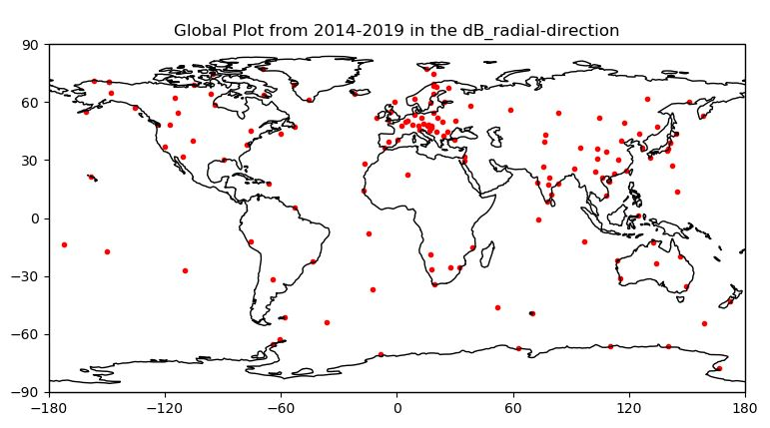
The world is a Scatter Plot
We can think of the globe as being a giant scatterplot.
Latitude and longitude are x and y coordinates.
Things are located at certain coordinates.
Regions cover spans of the plot canvas.
Geopandas abstracts out the globe specific stuff like the earth being round.

Slide 7
CRS and Encoding
The Coordinate Reference System is our most annoying thing to deal with.
This basically tells the system how the points relate to space.
We can see and set the CRS, and occasionally need to.
Docs say that when reading in lat/lon we should use .set_crs(epsg=4326)
To get areas and distances in meters, change to 6933
This is something that will wait mainly for your specifics to care about.
You need to pick the right thing for good results, but you don’t know yet.
Can vary regionally, so we might need one for our area. (Compare Greenland vs Africa for why)

Slide 8
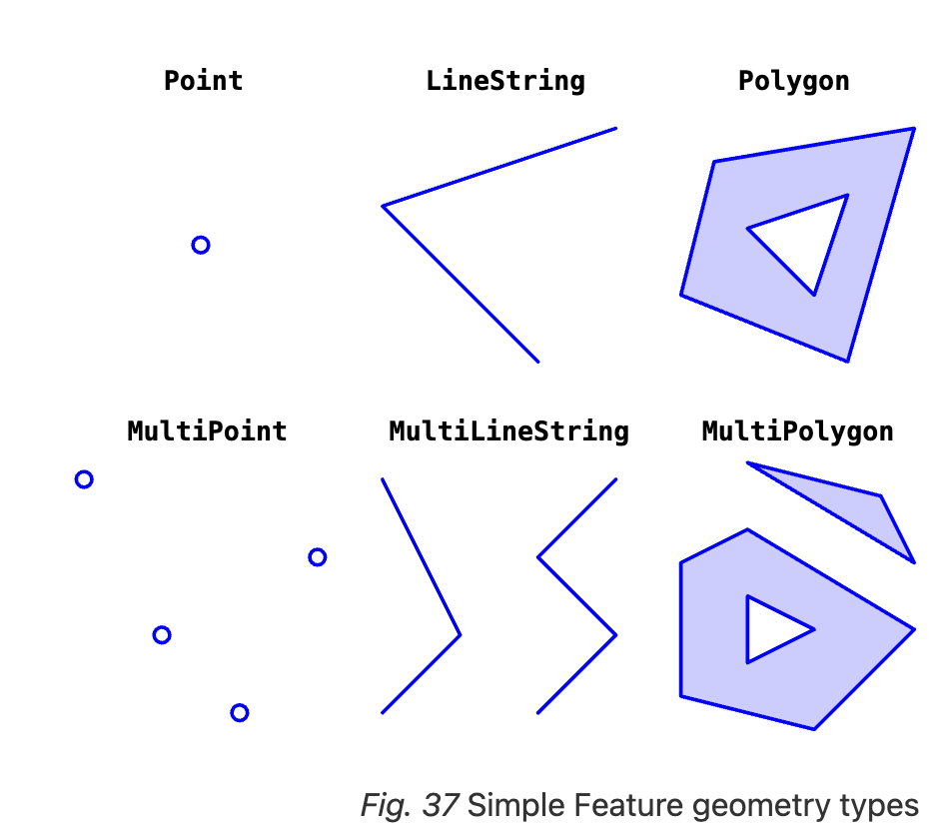
Geospatial Objects
Geospatial data is based on geometric objects.
Polygons (areas)
Points
Lines/paths
Each of these is a datatype, based on lat/lon:
A point is a lat/lon combination.
Polygons and paths are assemblies of them.

Slide 9
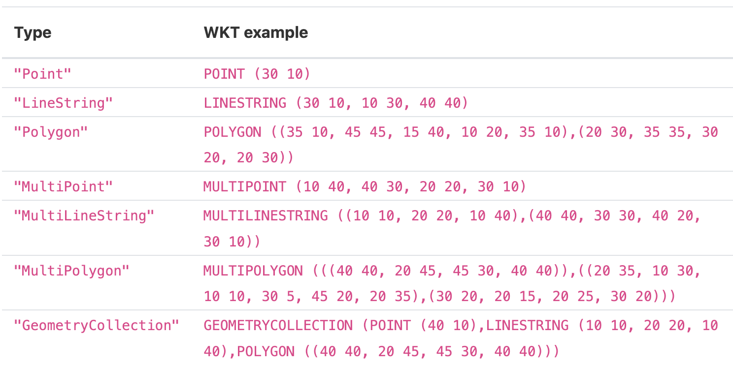
The actual data…

Slide 10
Dealing With the Data
In general, there’s a little data manipulation needed, which we don’t care about much.
There are different formats, and sometimes we need to convert between them.
For example:
Convert lat and lon into a point, using a gpd function.
There are different encoding systems, we can use gpd functions to swap between them.
We might need to investigate options to ensure our data is properly interpreted.
We won’t really worry about this much, unless needed.
Assume that if something valid gets an error, we need to do some investigation and correction.
The ‘geometry’ column is what will be automatically mapped by default – not magic.

Slide 11
Points
Points are pretty simple, an xy location on a plot.
We can create points from the latitude and longitude with a gpd function.

Slide 12
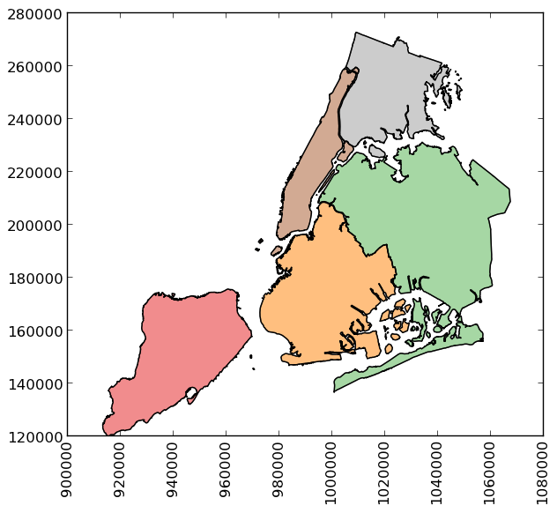
Polygons
The most unique data we need to deal with are polygons.
These define areas on a map – neighborhoods, countries, etc…
Effectively a series of coordinates that draw an outline.
Every “region” on a map is defined like this.
There’s no preexisting definition for Canada – it is defined by some outline of points on a map.
Can find them by Googling:
“[area] shapefile” or “[area] kml”.
Polygon or multipolygon datatypes.

Slide 13
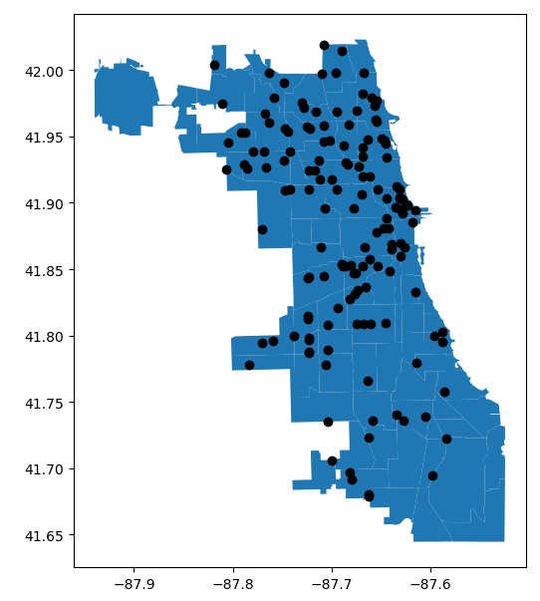
Layer and Combine
We can layer as much stuff on a map as we can read.
The zorder controls the top/bottom.
Any layer can be colored according to other val.
For a shaded filled map that’s called a choropleth map.

Slide 14
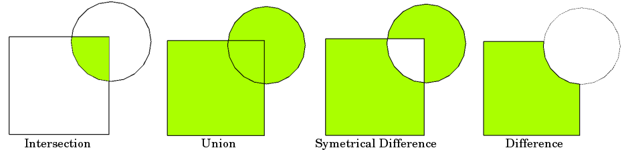
Polygon Math
We can also do a lot of math with areas and their overlap with overlay().
This works just like set math.
Overlap of coverage of different fire stations.
Symmetrical difference of places not covered by fire stations.

Slide 15
Other Stuff
There are all kinds of other operations we can find in the Geopandas documentation.
Some things that might pop up are:
Buffer around an area.
Find the centerpoint of an area.

Slide 16
Spatial in Analytics
We can use spatial data like any other data, some likely scenarios:
Use points to generate distance.
Use spatial regions to ”bin” bin points into regions.
Determine if areas overlap each other.
Any of these constructed values can be a feature, or even a target.
Constructing features is probably the most likely use for ML uses.

Slide 17
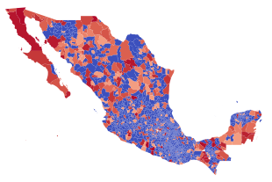
Visualizations
Visualizing geospatial data is obviously useful.
We can include interactive GUI bits to make a semi-interactive map.
Other tools can do fancier than the plots here.
Explore is one, if it works for you.
Make maps, they impress people.
Variations like heatmaps are possible with a little math.
Side note: we can also prep and export data for Tableau, et.al.

Slide 18
Constructing Features
One of the big things we can do is make features from the spatial data.
E.g. area of a lot for predicting prices, number and distance of fire stations for insurance, etc…
This is an area of creativity, some things are obvious, others aren’t.
E.g. distance to ‘closest’ store or average distance to 3 closest being important for predicting a customer at our bank.
It may make sense to make multiple features - distance to fire station + # within 5km.
What is useful will probably vary a lot, likely distance, intersection, or size variants.

Slide 19
In the Real World
GIS - Geographic information systems is an old and large area of study.
”Geography people” have used this data and tools for ages to do spatial tasks.
Location based information is emerging as useful in predictive applications.
Predictive policing attempts to forecast where crime is likely to occur.
Applications like Google Maps forecast traffic patterns.
Farmers have predictive tools to optimize crop growth via things like soil hydration.
Location data from cell phones was used to predict COVID spread.
I saw this in a documentary that I don’t remember the name of, so grain of salt.
The CIA allegedly uses movement patterns to identify people to drone strike.
GPS data being embedded in almost all person movements will open the door to far more applications in the near future.

Slide 20
For Us... Well… For you
The project next semester will involve you using real estate data as a source.
You’ll need to ultimately do two things:
Some analytics stuff and present it.
Mapping will obviously be a big thing for the presentation part.
Constructing features from location data is likely to be a big thing for analysis.
Try to be a bit comfortable with using and manipulating data now, so the analysis part is easy.
You’ll likely need to learn a little about whatever specific aspect you need.
Side note: I’d consider planning, from the start, making something presentable for portfolio.
People like and relate to real estate, maps are appealing, and it is easier to make something cool.

Slide 21
You can pull, it’s 027…

