Slide 1
Programming
For Data science

Slide 2
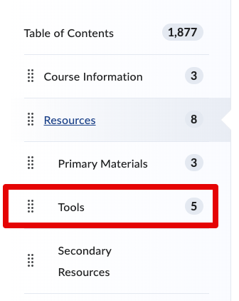
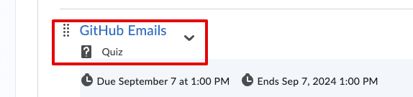
Data 3550 - Programming
You’ll need to do some stuff, please start, we’ll go at 12:10.
<- There is a list w/ links on the LMS at the image location.
Please install:
Anaconda (Google “anaconda data science”).
Git (not GitHub).
Create an account on GitHub.
Enter the email used from GitHub “GitHub emails” quiz on the LMS.

Slide 3
About me
Education:
Computer Science
Education – Secondary Math
MBA
Work:
Built much of the data science stuff at NAIT.
Worked on enterprise software, largely ETL, integration, and reporting.
Fun:
I travel, cook, and sports.

Slide 4
What is this Class for?
Learning how to program in Python.
Programming is a tool we need for analytics.
Building skills and experience to make the other ML classes possible.
Backfilling things that are challenging from those other courses.

Slide 5
Goals
Get everyone comfortable with basic programming.
Ideally to the point where you can search -> read documentation -> implement for new concepts.
Build familiarity with the tools and resources used in data science.
Allow you to work through the content of the other DS classes efficiently.

Slide 6
Grades and Assignments
36% - 6 labs.
Easy regular practice.
42% - 3 exams.
Theory and coding under time constraints.
22% - 2 assignments.
Larger scale projects.

Slide 7
Materials
Class-to-class: main workbook repository.
Workbooks with text, examples, exercises for in-class.
Textbook(s): Python for Everyone & ThinkPython (alt)
On Moodle as PDF, link to repository versions.
Recommend reading through chapter/section as we go.
Texts have extra exercises that are good as needed.

Slide 8
Keys to Success
Practice – coding is like learning a language, you need practice.
There will be a wide range of how challenging this stuff is.
Start early – you will encounter challenges that you need to work through and solve, leave time for that.
Break it up – every large program is just a bunch of small lines.
Some concepts may take longer to click, that’s normal.

Slide 9
Help
Research.
The end goal is for you to be able to learn how to do/use things by reading their documentation or examples. Try to work towards that, then…
Use class time.
Especially if things are difficult, work through examples with the chance to get help.
Help each other.
If things make sense to you, helping others helps you as well.
Ask questions.
If something doesn’t make sense, ask. Don’t be shy.

Slide 10
Ai/Copilot/Chatgpt
AI tools can likely do lots of the work, largely correctly.
These tools are fine for using, poor for learning - you need to understand what they are doing first.
Great to speed yourself up doing drudge work.
If you can’t explain it and troubleshoot it, don’t use it.
You need to get used to figuring out solutions mentally, so they make it hard to learn if you rely on them that much.

Slide 11
Positive Notes
Programming is our tool, not our goal.
Don’t need to become savants, just need to be competent.
Driven (mainly) by what we need to do for analysis.
Work to explore challenges in other projects.
Easy class in a vacuum, though may still be challenging.
Somewhat flexible – the more you get, the more we can do.

Slide 12
Tools
We have a few tools to use, and these can be a little annoying at times.
To some degree, this comes with the territory.
These things are industry relevant, so the experience has some value.

Slide 13
Tools - Anaconda
Anaconda is a package of a bunch of ds stuff.
Python, tools, code libraries, etc…
Most of what we need to develop code.
Download and install this first.

Slide 14
Tools – VS Code
VS Code is the IDE (integrated development environment) we’ll use.
Where we write, run, and observe code.
Integrates with GitHub for managing files.
Should come in Anaconda.

Slide 15
Tools - GitHub
Online repository for code.
This is where my stuff is posted for you.
You can build a portfolio as you go.
We’ll also use it for tests/labs/asns for continuous integration.

Slide 16
Tools – GitHub Education Assignments
Submissions will go through GH Education.
Allows for Continuous Integration:
Your code is tested as you submit for correctness.
You have a constant idea of what is working/not.
Very common in real world. Decent resume point.
Checks output of your code, not code itself.

Slide 17
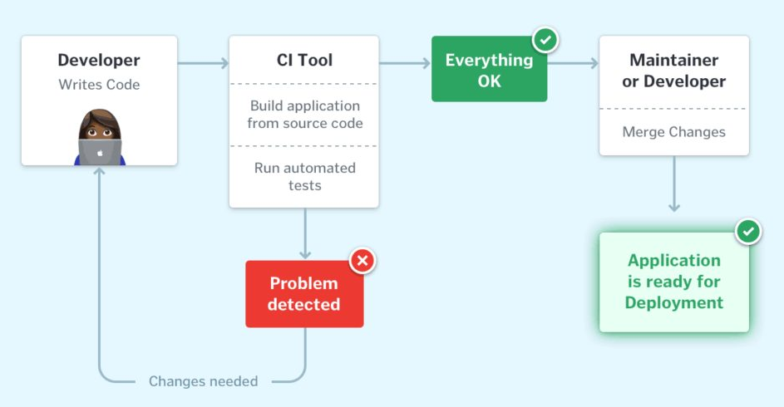
Continuous Integration

Slide 18
Today
Overview/intro.
Tools and resources.
Play with some code.

Slide 19
Common Initial Issues
Need to DL and install Git separately.
Registry entry for Python to work.
GitHub command for uname/email needed.

Slide 20
But First – Think Not in Code
We want to start out thinking in pseudocode – steps written in plain language.
Start with what we want to do, in detailed steps.
We can then look up how to translate each step to code.
Easier and more transferable than memorizing code.

Slide 21
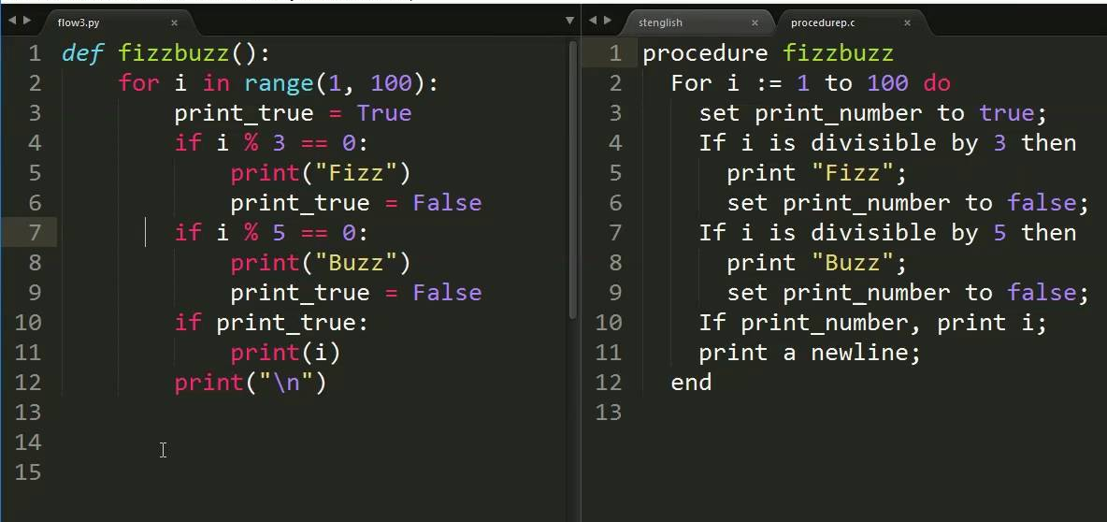
Pseudocode

Slide 22
Pseudocode
Pseudocode is just what we want to do, in English.
Think first, then translate to code.
Build the logic without worrying about syntax.
Aim for singular steps – one action only.
We can always look up how to do one thing in Python.

Slide 23
Check Yo’ Self
Along with pseudocode, we want to consider testing.
How do we check that our outcome is correct?
What is “good” and what is a “failure”?
A – (Usually) look at the values, and check:
Look at variables window as code runs.
Print the value of variables step by step.

Slide 24
Self-Testing
If we know the start/end, we can test our code:
Do we end up where we need to?
If not, we can check each step (line) to find the mistake.
I.e. print out value/test, or use debug tools each line.
Once we find where things go wrong, we know the line.
Much easier than fixing a complex process directly!

Slide 25
E.g. Name Order Swap (First Last -> Last, First)

Slide 26
Programming is simple!!
Learning programming can be hard and frustrating.
We can minimize that and make it simpler.
Mostly->take data, do stuff to it, send it off. Deterministic.
Where are we now? What is the goal? How do we check?
What steps are needed to go start->end?
How do we do each step in code?

