Slide 1
Housekeeping
Lab 2 Review:
Example solution in repository.
I’ll go over a few common points that I saw, please ask if something doesn’t make sense.
Lab 3 – there is a dropbox up, I had it labeled “Asn 3” by mistake for a while.
Exam next time:
Open book. Normal browser.
90 minutes. Approximately 35-40 questions. Mostly MC, might be a couple of SA.
“knowledge” questions, what does this code do? What is the issue in this code?
Similar in complexity to the lab stuff, our class examples are more complex.
Basics of python and programming – basic variables, common operations, data structures, string manipulation, debugging, logic controls, loops.

Slide 2
Arrays

Slide 3
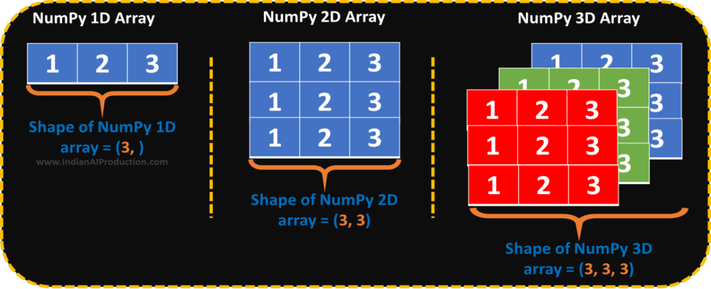
What’s an array?
An array is a data structure that is largely like a list, with some differences:
Arrays are of a fixed size.
Arrays have a fixed data type.
Arrays can’t be changed, but the objects in them can be.
Arrays are iterable and can be used with “normal things like for loops.

Slide 4
But… Why?
Arrays are one of the building blocks of data structures.
More relevant for lower-level languages than in Python.
Arrays are of a fixed size, and are placed into a window of that size in memory.
The ability of a list to grow requires resources, an array is set.
Arrays can be way faster as you can address memory locations directly.
Python manages the memory locations for us, but behind the scenes it is fast.
An int is normally 32 bits, so an array of ints has values at “0”, “32”, “64”…
A list needs to find “the next item” each time.
Before things like lists existed, we didn’t have a choice.

Slide 5
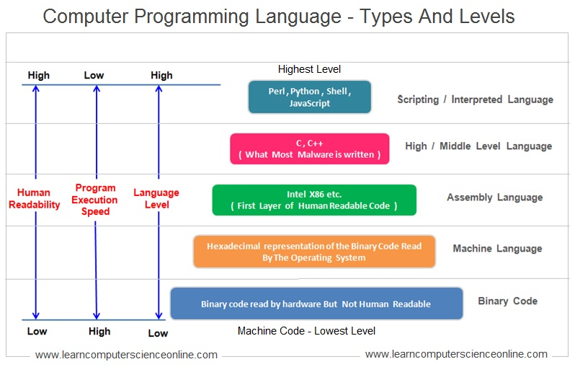
Language Level

Slide 6
Levels of Abstraction
Programming languages (and concepts) have varying degrees of abstraction.
Higher levels are things that are made to be understandable to humans.
Languages like JavaScript, Python, or C#, and C++ (mostly). Easier to debug. Slower.
Concepts like lists, objects, and inheritance. Abstract representations of real things.
Seen in code that is meant to be understood and shared, where perf. Isn’t critical. (Loose).
Lower levels are things that are made to be understandable to computers.
Languages like assembly, Basic, C (kind of). Harder to debug. Faster.
Lacking abstract representations in favor of specific locations in memory or code.
Often seen more in things that need to be efficient – i.e. ML libraries are written in C++.
The tools we use for data science are high-level, we focus on concepts.

Slide 7
Levels and Arrays
We can think of where arrays came from hand-in-hand with thinking about the language.
Assembly (and below)
We move data into and out of a spot (a physical address) in memory. Hard and annoying!
Low level languages.
We maintain a pointer to the correct spot in memory. Annoying and easy to mess up.
Gain abstractions like indexing.
High level languages.
No need to worry about memory locations at all. Language handles logistics, we have limits.
Higher level data structures like Lists.
No constraints from physical memory are needed (though they may be desired).

Slide 8
Code Execution
Computers are machines and they only understand machine code.
Languages need to be “translated” down into machine code to actually run.
This is broadly true, there can be more than one step. Code->assembly->machine.
Interpreted languages like Python.
The interpreter reads the python code and generates machine code on the fly.
Compiled languages like C++.
The complier translates the entire program to machine code to generate an executable.
Helps efficiency – compliers can find many ways to improve performance.

Slide 9
Building the Array
We can build the concept of the array up from this.
Start with several memory addresses with our data.
Add the ability to treat the data as one object, with indexing offsets.
Add the ability for the array to manage it’s own “innards” – memory, length, etc…
Allowing it to be dynamic (a list).
We add an additional layer of abstraction, or remove some detail we need to manage ourselves at each level, making it easier to use.
Easier is better in most cases. Making code readable and fixable is more important than fast.
For places we need speed, we can sub in something more simple, like an array.

Slide 10
Python Arrays
The arrays that we use are provided by a package called numpy.
Commonly imported with a “np” alias.
Numpy is a scientific computing package.
Commonly used and often required for machine learning work.
Data fed into a model is often an array, even if we prepare it before making it an array.
When doing lots of calculations inside a model, the speed matters.
We want to get the benefits of the array (speed).
The limitations of an array are between positive and neutral – fixed type and length.

Slide 11
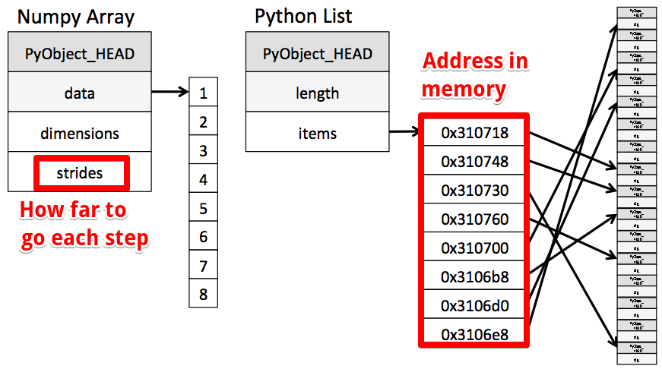

Slide 12
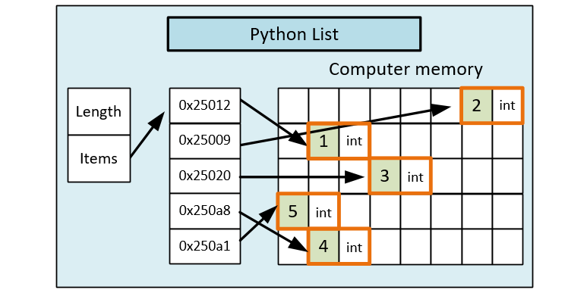

Slide 13
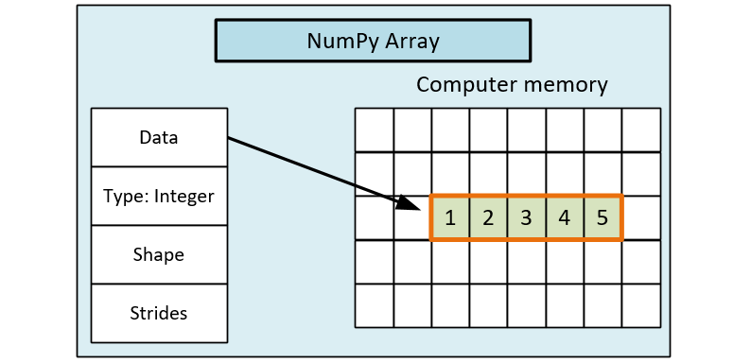

Slide 14
Multi-Dimensional Arrays
Arrays can also exist in 2+ dimensions.
Each dimension adds an additional “[ ]” or “,” for that dimension’s index.
array2D[0][0] or array2D[0,0] both get the first element.
Commonly seen with images – a normal image is X * Y * 3 (RGB color depth).
Similar to a list of list, but all dimensions are “full” – no different length rows.
Can get annoying to manipulate manually.
Operations and logic is still the same.
It becomes hard to impossible to visualize the data as we manipulate it.
In practice, we usually rely on set operations – flatten and then reverse that flatten.
We can slice and dice an array to get a part of it…

Slide 15
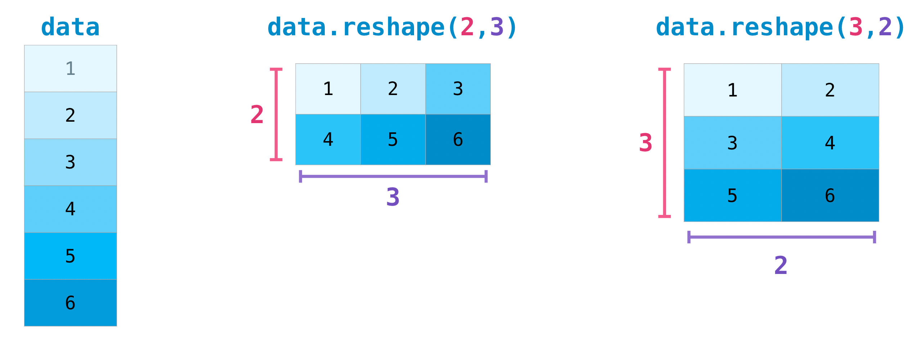
Reshaping
We can reshape arrays when needed, such as flattening an array for a ML model.
The reshaping always counts left to right, then down.

Slide 16
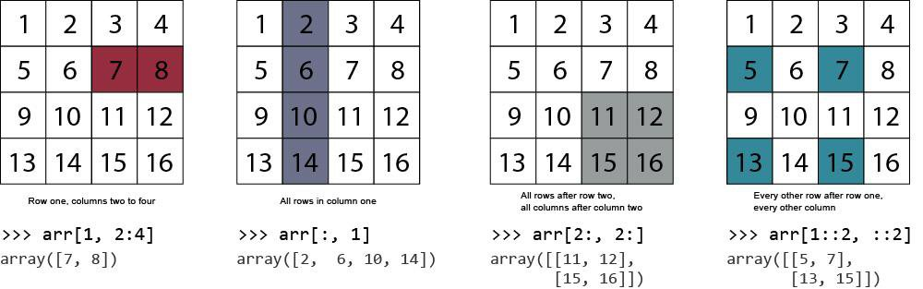
Slice and Dice
We can slice using the “:” to span range for each dimension.
The “::2” changes the stride, or gets every “X” item.

Slide 17
Array Conclusions
Arrays are something that are a core concept of computing in general.
With high-level languages, we can usually side-step the restrictions of arrays.
Inability to grow, inflexibility in what it can hold.
Lists, vectors, etc… are all easier to use as they handle some details for us.
In data science, we generally interact with arrays when feeding data to a model.
The ML algorithms “want” an array of the data.
The set data types are not an issue, nor is the inability to grow.
The speed and direct math operations are very useful for mass calculations.
Arrays are mostly interoperable with our other data structures.

