Slide 1
Housekeeping
Test:
Probably a bit too easy, you all did very well. Please don’t paste real code in for pseudocode.
Lab 4:
Solution in repository, I’ll look at it in a min.
I have a few left to mark, mostly fine so far, some details like loop exit conditions were common.
Lab 5:
I didn’t push the date back early enough, but I set it for this weekend.
To compensate for that, I’ll make the lab marks best 5/6, so you have a throwaway.
Today – more software engineering in poker:
Test driven development basics.
Importing files.
Intro to refactoring (mainly for a bit later).

Slide 2
Test Driven Development

Slide 3
Import our Code
Right now we have been inefficiently copy/pasting the game code into different files.
We can put all the classes for the game into a .py file and import that, as we do with standard libraries.
Importing things touches on the idea of a Namespace.
Namespaces are basically the world of what exists inside the interpreter when code runs.
When we import things we add new stuff to that namespace.
We need to be attentive to what we are adding, so we can then grab and use it.
Import FILE -> we import the FILE as the item of focus, and need to use dot notation to find parts inside that file.
From FILE import MODULE -> we import the MODULE as the item of focus, so it “exists”.

Slide 4
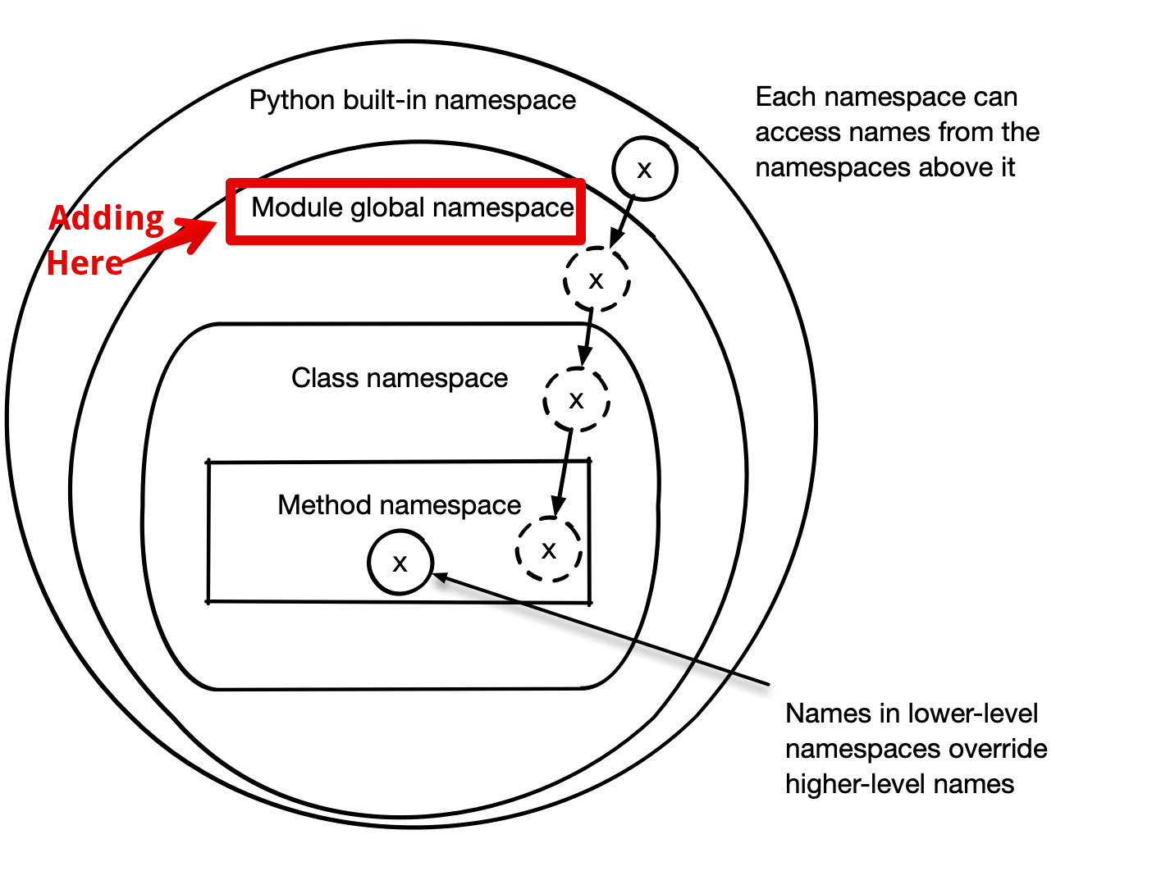

Slide 5
Testing
Testing code is generally a good idea.
Organizing the testing can help both with testing and with development.
What if we define a really good test of what we need code to do? Then anything that does it is a success.
This concept is called Test Driven Development – we first define what success is, then we work on making our code do that.

Slide 6
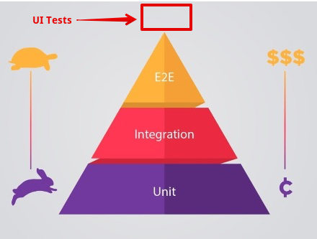
Test Types
We can split testing into several types.
Unit testing is testing one ‘thing’, like a function.
Integration testing test a subprocess, a set of functions, or some part of a larger system.
End-to-end tests an entire system, beginning to end.
Time and complexity can get extreme in some cases.
An end-to-end test of large data pipelines or a full program may take a long time and/or cost lots of money.
Organized code can push testing down the pyramid.
Functions can be tested separately, walls of code can’t.

Slide 7
Test Driven Development - Test First
One strategy that we can use is to build tests in advance of actual coding.
Test driven development starts with defining what “good enough” is.
Anything that passes the test is satisfactory.
As long as the test is complete, this will give a correct result.
Works for an individual function, subprocess, or entire program – just with different tests.
Build a testing harness that checks what a function needs to do, then work on something that will meet those needs.
The process of thinking about all the pass/fail scenarios can also be valuable.
Makes it much easier to distribute tasks, or even outsource work to others.
We can layer these tests as we work, allowing us to test parts or the whole easily.

Slide 8
Testing Mechanics
The only thing that really matters is that we can see if the tests passed or not.
The assert statement can be used to check things, and throw an exception if it isn’t true.
There are other testing libraries that can automate this.
Unittest and pytest are standard common testing libraries.
If you do software development it is likely your company will have some tool/process/standard.
Details vary, but the idea is the same for all, basically a series of asserts with a nice log.
We’ll focus on doing the testing by hand, not external tools.
Test harnesses can be built in repositories like GitHub, to test on commit.
Pytest integrates easily and can be configured to automatically test new things, or regression.

Slide 9
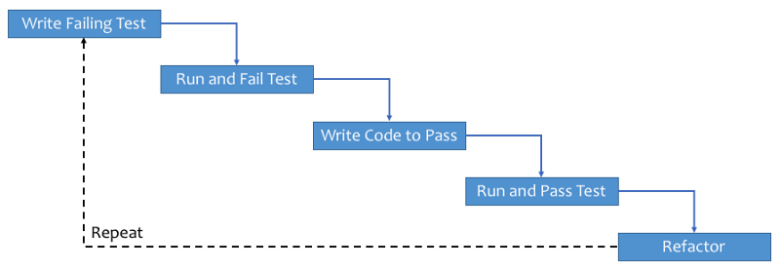

Slide 10
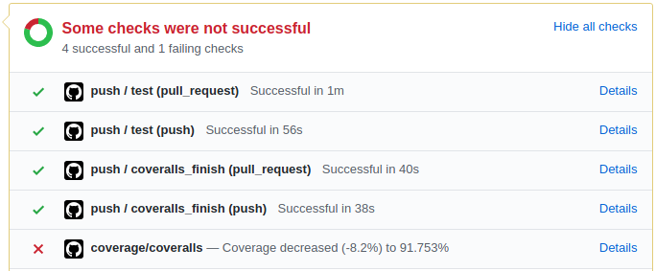
Github Actions Based Testing

Slide 11
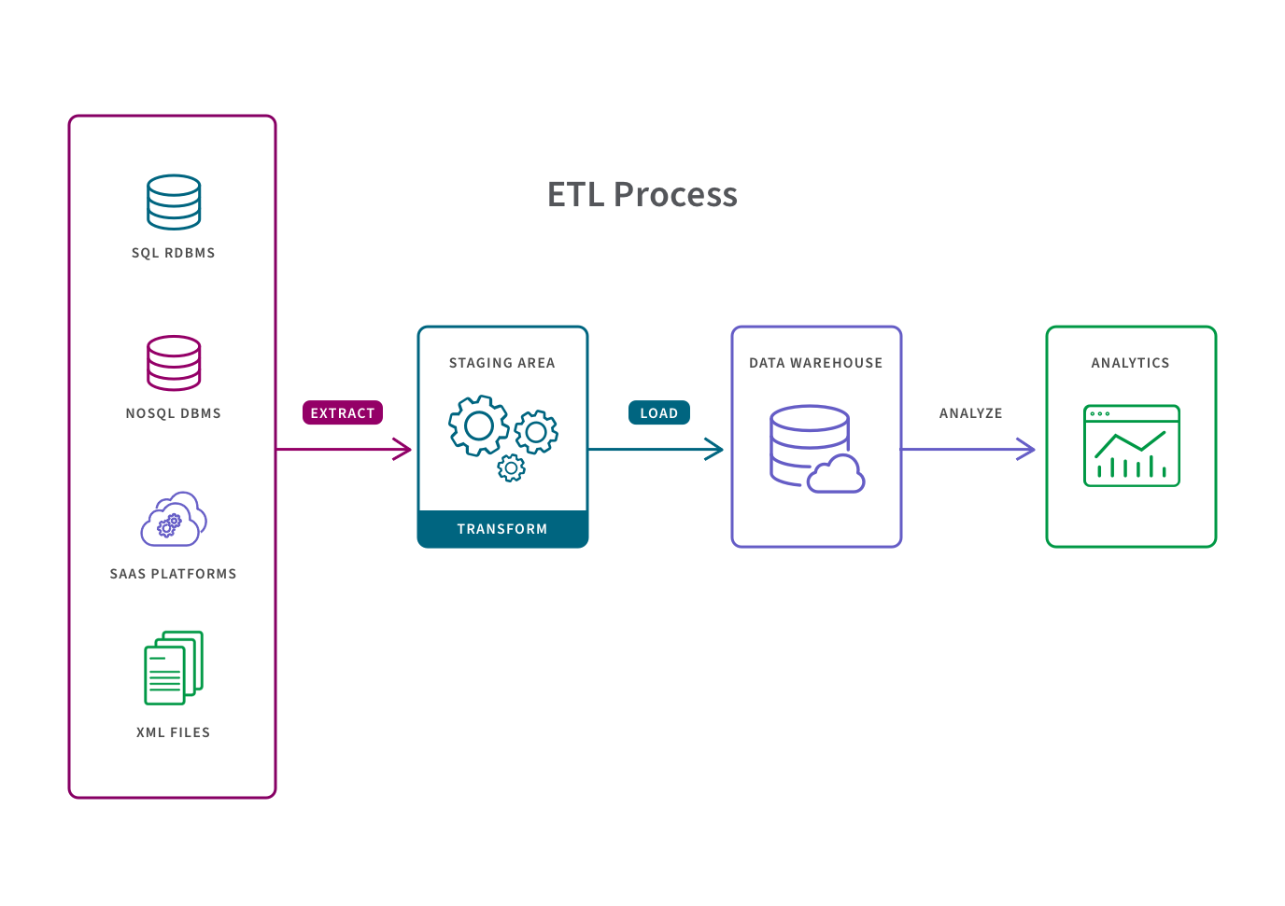
In Data Science
In data science, this translates well to one of the main “code heavy” parts – data pipelines:
We know the starting point – what the incoming data looks like.
We know the end result – the format we want/need our data in.
As long as we connect the two, we are successful.
Tests of output format can be defined.

Slide 12
Make it better - Refactoring
Refactoring is the process of changing code so that it works the same on the outside, but is ‘better’ on the inside.
Better means more readable, easier to debug, or more organized.
Think agile – make it work, then make it better. Working is better than elegant.
Data science coding is largely exploratory, we can build an ok solution and improve.
We want to refactor working and tested code, after we are confident it is good.
When doing object-oriented development:
Where something “lives” – certain attributes or methods might be better in another class.
Some methods may be made static or not static.
Inheritance relationships may be different from what you initially thought.

Slide 13
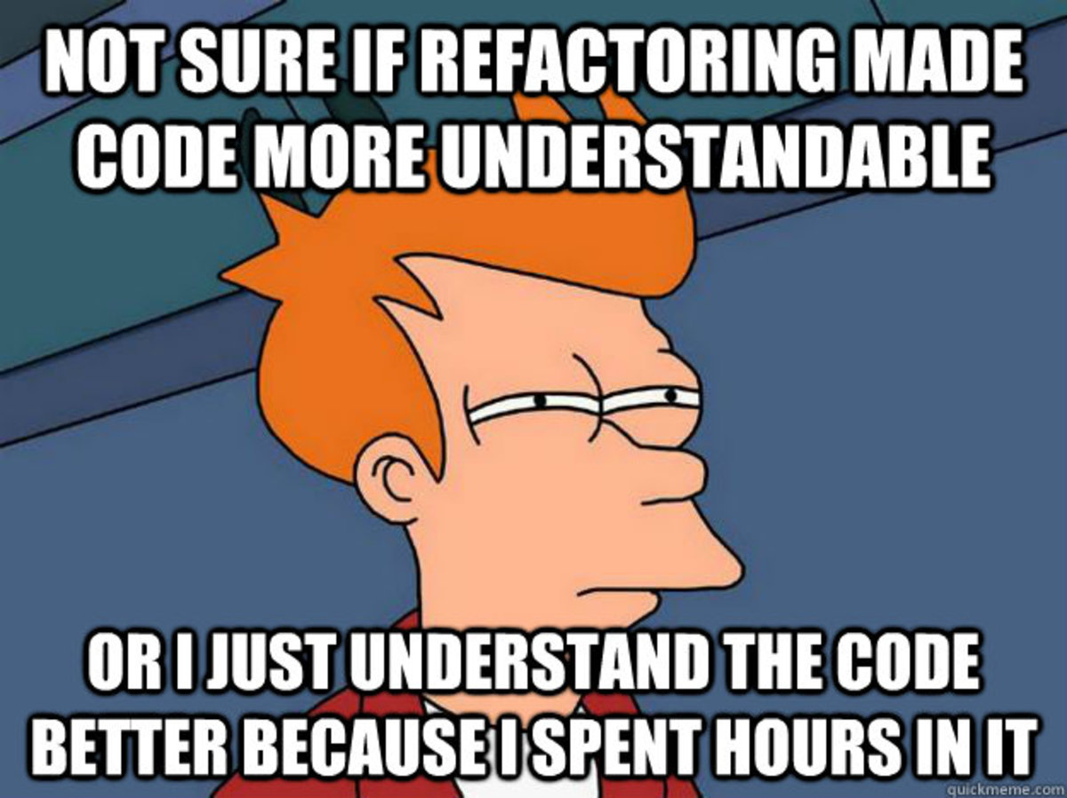

Slide 14
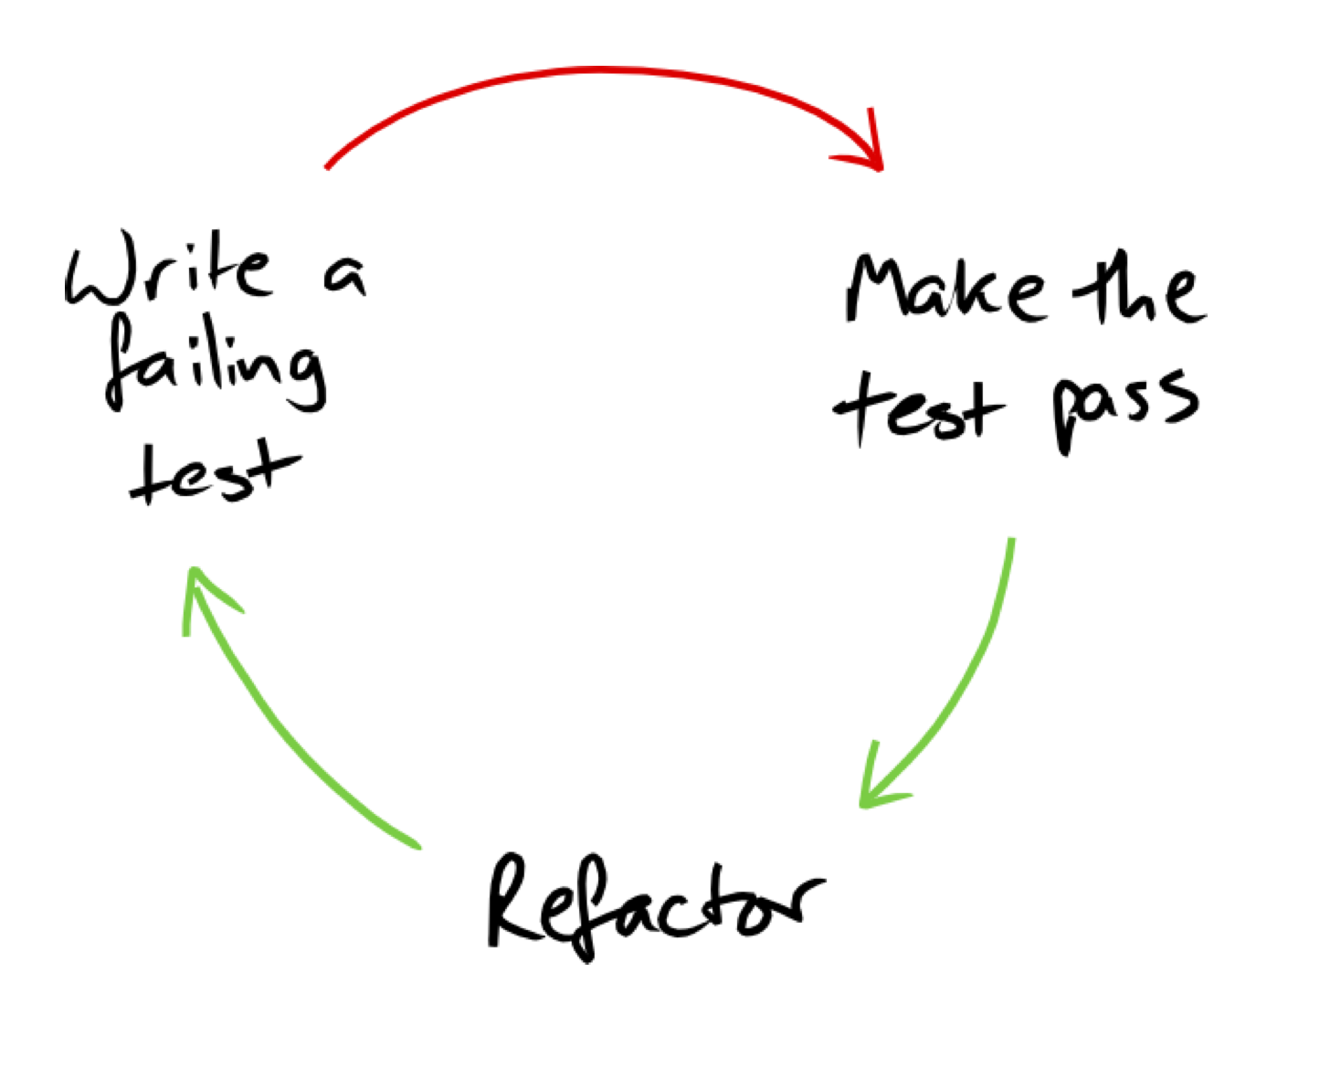
Test Driven Refactoring
Test-driven development fits well with refactoring.
Better if code is encapsulated into classes and functions.
We can constantly rerun our tests as we change things in refactoring.
Lowers the “risk” of refactoring, as it’s easy to know things still work.
Note: for things with large datasets, it is probably good to take a sample for frequent tests.
Also works with Agile ideas – constantly working code that is constantly improving.

Slide 15
Software Development Skillz
Rigid software engineering processes are rarely required in data science work.
Many things are exploratory and experimental, with most work never reaching production.
Development teams for making models aren’t usually large.
Agile development management concepts do translate well and are helpful (imho).
Using classes and functions for each distinct piece of functionality.
Defining success (test cases) for each function, even if we can’t/don’t define passing fully.
Focusing on making a working solution at all times.
Improve code to be better as improvements emerge.
Test driven development relies on being able to write good tests, which might not be possible in all cases.

Slide 16
Let’s Code - Build some more Poker
We are almost ready to fulfill our inner gambling addiction via Python!!
We can add a couple of classes to our program, a player and a game.
We focus on some unit tests for our player.
We can focus on some integration, and eventually end-to-end, for the game.
For the player:
What are the specific things that a player needs to do, how do we test that?
For the game:
What are the specific things that the game needs to do, how do we test that?
For integration testing, what are the outcomes of larger processes, how do we test that?
The ideal is to test everything, but we don’t need that for it it be useful. (Try, then improve).

