Slide 1
My Fantasy Team is a Travesty Update
Assignment #1:
Look at a few of the details.
Today:
More (the last big part of) inheritance and objects.
Abstract classes and methods.
Assignment #2:
Read data, do some processing, write some results – fairly realistic!!
Please read and ask on anything that doesn’t make sense initially.
Ideally, most people can get some of the starting points done in class (i.e. ABC stuff).

Slide 2
Inheritance #2

Slide 3
Assignment 1 key Points
Data processing and cleaning.
Several problems with messy data, most notably the rupee sign.
The sign will likely cause a column to be interpreted as a string/object.
Solution – info to get type, if it is not a number we know it is not processed properly, start cleaning – slice off that mark, pull out numbers, etc… Identify issue, then define solution.
This is something we normally need to consider for each value – like in stats making models.
Top rating.
If the data is saved in a container in the Inventory, we just need to sort.
If we need to sort, we can define __lt__ in the objects (products).
So, if we can compare products, and we have a collection of them, we can sort.

Slide 4
Assignment 1
Container structure:
Each product contains one product – many attributes for each.
The inventory is a container of products – we need some internal container (dict, list, etc…) to hold many products, as well as the other functionality of the objects.
I used a dictionary:
Product name as key, product and stock level as tuple in the value.
This isn’t “correct”, the values can be arranged differently.
Need to track what each attribute “belongs to” – stock is not a product thing.
Could be a “stocked-product” object to sit there.
Similar to the refactoring in databases – including the “connecting” table/object.
Keeping this type of stuff straight is useful in loading datasets later on.

Slide 5
Asn 1
Testing and building the process.
Can I read a line of data?
Can I take that line of data and make an object from it?
Can I add all the data from that line that I need to my object?
Can I add methods/functionality one by one?
Can I combine these product objects into a list or something, so they can be sorted or looped?
Can I make an object that holds a bunch of these product objects?
Does the functionality like compare work between products in our container?
Can I add methods/functionality one by one to the container object?

Slide 6

More Inheritance

Slide 7
Variable Types
In Python, we often pay little attention to the type of object we use:
Different iterable data structures are largely interchangeable.
We might not convert text data we’ve imported, unless needed for a calculation.
For example, if we are printing some values in a list, we can just have print(item) without worrying about what the item is.
If we want to print an item, it (normally) “knows” how to print itself.
Ever one of those items is “capable” of what is asked of it, no matter the type.
This is one of the benefits of OOP – we don’t need to know how to do something, the item knows.
In this case, all the objects are ”strings” for this purpose – they do the needed string stuff.
I.e. Each object can do whatever we need a string to do (here – not always), so what’s the difference?

Slide 8
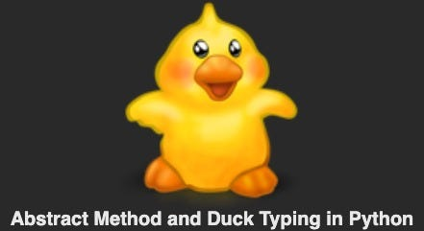
Duck Types
These show examples of Duck Typing:
If it walks like a _____, and talks like a _____, then it is a _____.
As long as an object can do what is asked of it, then it is as good as one of those objects.
I.e. if we have a function that finds the largest number in a list, and we give it a Series, that function will (probably) work, so a Series “is” a list in that case. It quacks and walks like one.
In the card game stuff we made an iterable – as long as it does iterable stuff, it is one.
In other programming languages this isn’t true, you need to declare a type for each object.
E.g. float a = 4.56 rather than a=4.56 like we’d do now.
We don’t need “An X”, we just need something that can do that stuff.

Slide 9
Abstract Base Classes (ABC)
Abstract base classes are a tool to help make inheriting functionality easier.
ABCs are classes that define some functionality, but can’t exist as their own thing.
I.e. we can’t instantiate a new object of an ABC class, it must be extended.
ABCs compliment Duck Typing:
We can “implement an interface” of an ABC to make it “act as one” of what we inherit.
When asking things like isinstance(), this will make them provide the right answer.
“As long as we provide this stuff, then our object can function as this object”.
As long as we implement whatever is “needed” then our object will act as the ABC.

Slide 10
ABC Implementation
Any object that provides __iter__ and __next__ is an iterable.
Officially, “An object capable of returning its members one at a time.”
So, an iterable isn’t a specific thing, it is a set of requirements that a thing meets.
Anything that complies with the requirements is effectively an iterable.
Objects can meet the requirements of multiple types of functionality at one time.
The ABCs are basically certificates to signify that an object is qualified to be something.
E.g. my dad’s a welder, he tests to signify that he is a “pressure welder”, “titanium welder”, “contained space welder”, “alumminum welder”, “b pressure welder”, etc…
He’s not different, but he’s now “usable” in any of those roles as he meets the requirements.

Slide 11
Collection Class ABC
Many ABCs exist in the collections, which are how data structures are implemented.
There are ones for Sequences (lists), Mappings (dicts), etc…
We can extend from some ABC base to make a new data structure.
In that data structure there are some things we must implement for it to work.
There are other things we get for free from the inheritance.
This data structure will be usable wherever the other structures are.
If making a new data structure, this is normally better than extending the built-in types.
There are things done to the built-in one for performance that make them “weird” in some cases.
We can build our object on top of one of these, and use most of the premade functionality.

Slide 12
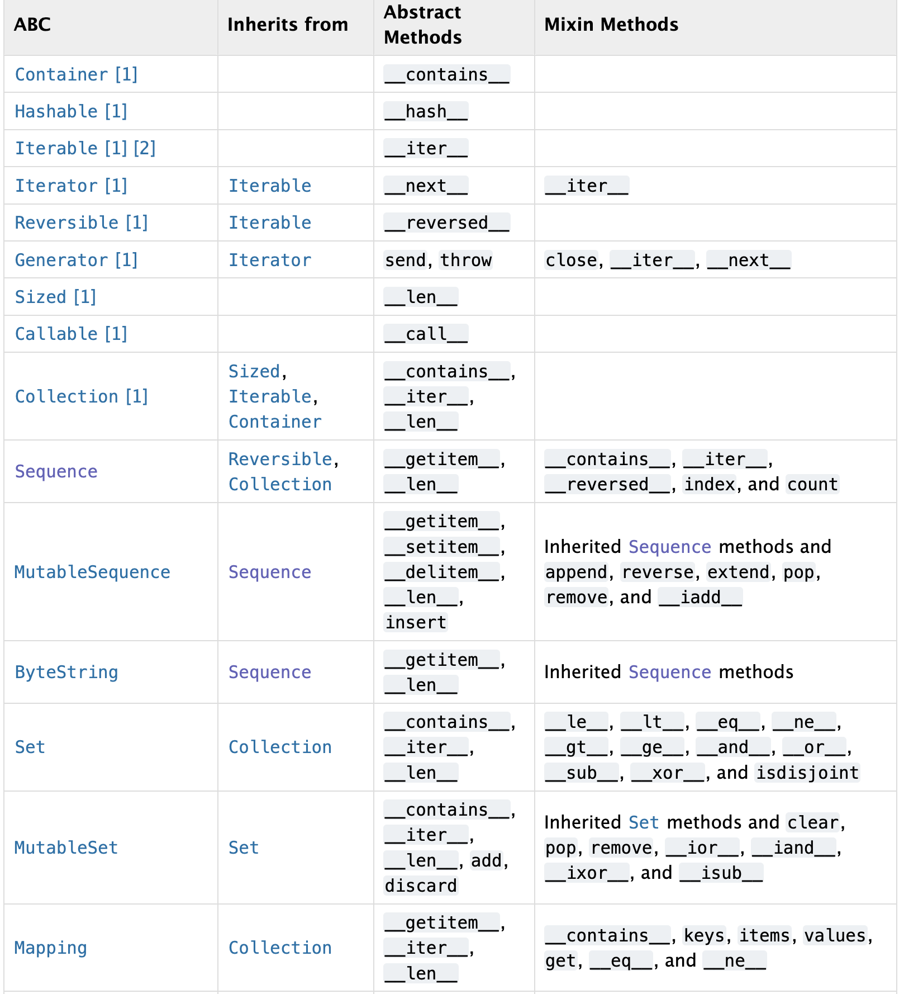
Implementing ABCs
To use an ABC we need to implement all the abstract methods listed.
These are ones that are empty in the parent.
If we think about it, this is the stuff that is unique that we need to make it work.
The mixin column is what we “get” for free.
Mixins are something we can ignore the details of.
We are effectively also inheriting default implementations of all this stuff.
We can use it or override them as needed.

Slide 13
Decorators
Absctract methods use Decorators, a label that adds functionality to items.
The static method labels that we’ve used before are a decorator.
The decorator is like a configuration switch, that tells Python to do something different.
In parent classes, abstract methods have a @abstractmethod decorator.
This indicates that this MUST be implemented to allow a class to be instantiated.
In general, decorators are fairly commonly seen in more complex code.
If we’re comfortable with what the limited subset that we see do, that’s fine.

Slide 14
Method Resolution Order
When inheriting from multiple locations we can quickly make things confusing.
Most notably if we have different classes with the same named method.
If there is a conflict, we need to know which one to call.
The order default will be bottom up, and left to right.
If something exists in a subclass, that’ll be called before a parent class.
If something is inherited from multiple locations, the one listed first is used.
This can get very complex in some cases, it isn't something that is super important for us.

Slide 15
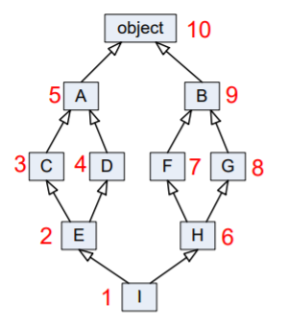
It Can Get Messy…
Very large inheritance hierarchies are possible, though likely not worth the hassle.
“Pure” object-oriented development would have large hierarchies.
Person -> Employee -> IT_Employee -> Programmer→ SR_Developer.
Functionality would be defined once, then inherited.
Objects would be a compilation of many parents.
Many scenarios will truncate this, possibly with a “type” and/or conditionally used variables.

Slide 16
In Data Science…
In most of our model development work in data science heavy use of objects is not mandatory.
We need an OK understanding because we are using objects, but don’t usually need to make classes.
Model development, data exploration, cleaning, and testing can be coded with/without classes.
It is up to you if/when to wrap things into classes, (functions for that matter).
Where OOP concepts may come more into play is in deployment.
If interacting with other systems (e.g. DB->pipeline->model->predictions->business thing) it becomes more likely wrapping objects into formal classes is better/easier/needed.
Testing and maintenance is generally much easier if things are encapsulated.
Organizations will normally have some sort of standards on how things are structured.
As a rule of thumb, if it is reused several times – function. If it is “grouped several times” – object.

Slide 17
Some DS Examples
When dealing with large datasets like images, the data pipelines can involve lots of work.
Create new classes that can translate a subset of data to provide the correctly formatted input.
A base class can do the main functionality.
Child classes can deal with variations – subFolderDataset, httpDataset, databaseDataset…
Each object provides a consistent input (defined in the parent) even though each is given a different source, and must take different actions there (list files, download stuff from the internet, do an sql query, etc…).
Any dataset object can be passed in, and they will work interchangeably.
This isn’t required, but I’d argue that it may be easier to make and maintain.

Slide 18
Closing
More advanced usage of inheritance (and “language flair”) can be a blessing and a curse.
We can model reality more closely in code, minimize duplication, and improve flexibility and reuse.
We might make things more confusing and hard to debug if not careful.
Things become less literal – we rely on functionality that we can’t see written in front of us.
We need to be ok with object inheritance at a basic level.
Know and understand the relationships, be able to call the correct methods and interchange objects.
Create classes in cases of no or simple inheritance.
The more complex stuff is more of a nice-to-know thing.
If you do a lot of coding you’ll probably see it, also in some examples that are more complex online.

