Slide 1
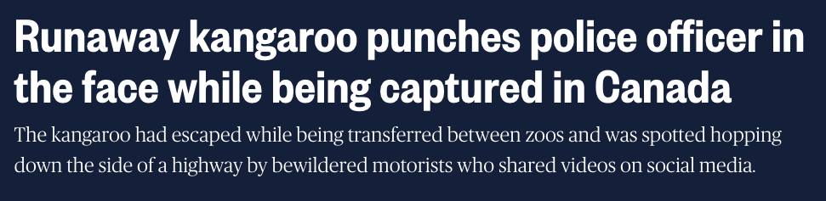
Housekeeping
It’s finally (almost) over!!!!!!!!!!!!
Next time is a test, yay!
Lab 6:
Sample solution is up.
This one takes a while to mark, I might finish tonight. Looks good so far.
Assignment – ask if you have any questions.
Today - Refactoring, APIs, more GUIs:
Simple topics and examples.

Slide 2
Refactoring

Slide 3
Our Card Game…
Our card game has been a slowly evolving software engineering project.
Pretend I’m the client, my desires are everchanging and unclear.
We have built the functionality bit by bit, starting from very basic parts.
Because of this, the structure of the code isn’t ideal.
Some parts overlap or are redundant because our needs evolved.
Some parts are no longer needed as they’ve been superseded.
We didn’t build it with one solid goal, we started and then added bit by bit.

Slide 4
Refactoring
Refactoring is rewriting code to be more readable, organized, or maintainable without changing the actual functionality.
Refactoring is an umbrella concept, and can include things such as:
Renaming variables or functions for consistency.
Moving a method from one class to another.
Changing static status for items (e.g. if a method doesn’t need to have a “self”, remove it).
Generating functions from repeated blocks of code.
Refactoring is the programming equivalent of cleaning up messy data.
This isn’t a process that has an “end”, it’s like editing for a writer.

Slide 5
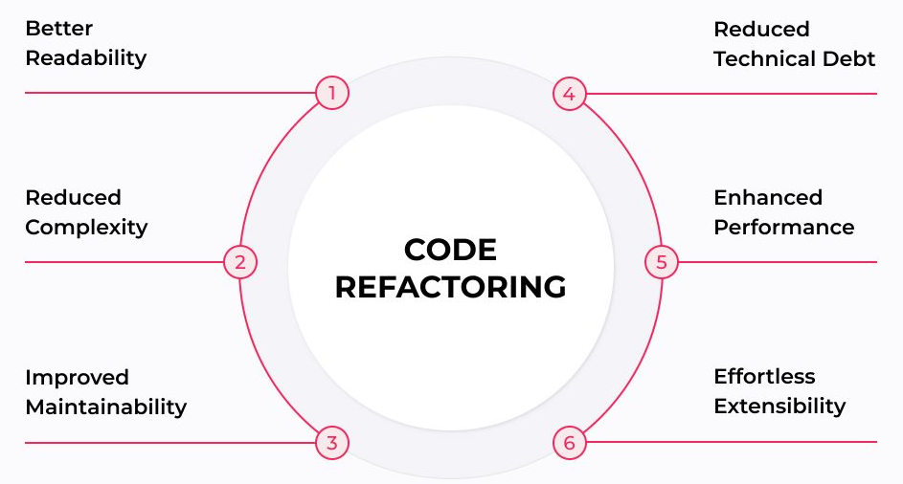
Refactoring Benefits

Slide 6
Problems with Agility
Agile software development generally maintains a working partial solution.
Frequent revisions or improvements to things that are already written.
Solutions created targeting a partial set of objectives.
Target solution is changing after things have already been created.
Agile means that we should expect to have code that can be problematic.

Slide 7
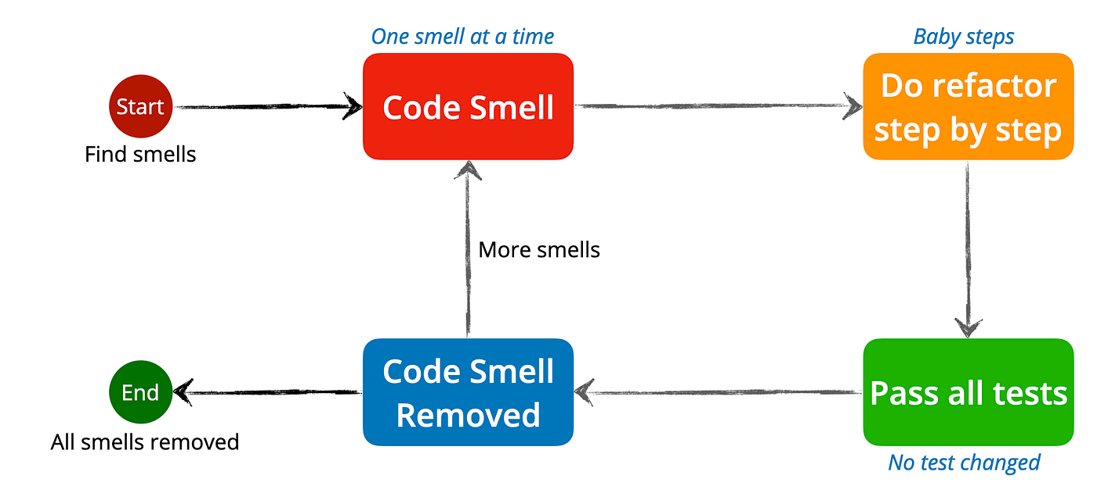
Refactoring Test-Driven Code
Refactoring holds the most potential benefits for messy code.
It is way more difficult to deal with messy code though.
Code that is well designed makes reorganizing it easier.
Functions can be replaced easily.
Tests will still work.
Moving chunks around is easier.

Slide 8
Basic Refactoring Steps
Refactoring documentation often refers to problems as “smells” – things to correct.
We don’t have a specific set of things to do, we just need to make it smell good.
This is something that is easier with feel and experience.
(In other languages indentation and spacing is a big one for readability, but since indents matter in Python, we’re less likely to have issues)
In data science applications, our most complex code bits such as a data pipeline are also things that we can test for functionality relatively simply.
For data pipelines, checking that the data is the correct structure does most of the work.
For training models, examining results, or making new predictions, we can check if it happens.
We should usually be able to refactor post exploration. (E.g. make a function to clean phone#)

Slide 9
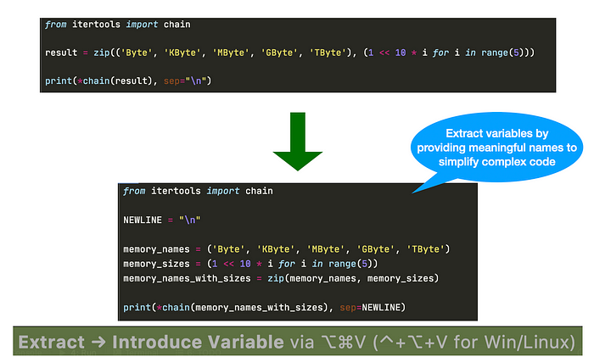
Simplifying with variables

Slide 10
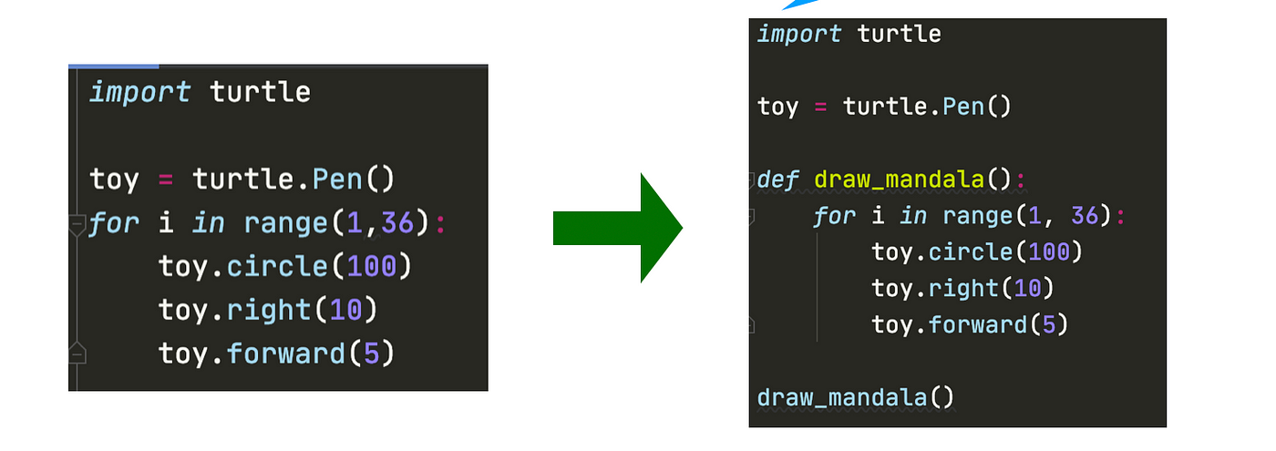
Code block to Function

Slide 11
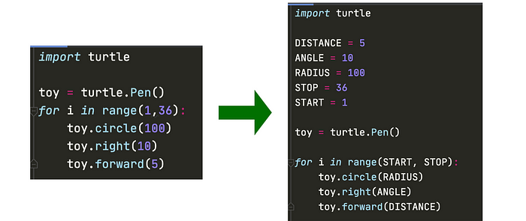
Adding Constants

Slide 12
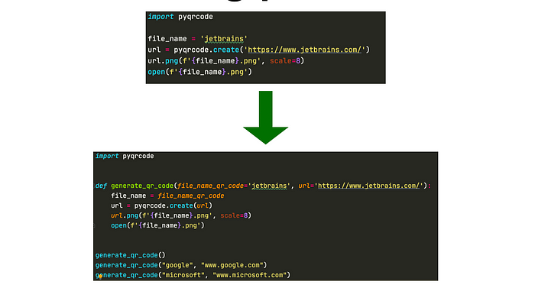
Parameterization

Slide 13
Automated Refactoring
This isn’t something that we’ll delve deeply into, but many tools exist.
Extract parts of code that can be made into a function.
Many IDEs have assorted built-in tools to refactor.
VS Code can extract methods and variables or rename things in bulk
Other plugins can provide more functionality.
I randomly saw a link to a VS Code plugin from MS that looks useful, Gather:
“Gather analyzes notebooks and helps users extract only the relevant code segments needed to re-create a particular cell output. ”
I just saw this a couple of days ago, I haven’t used it much, it is simple.

Slide 14
Game Changes
During the refactoring process we’ll make a change to help work with the GUI.
Make all inputs/outputs go through the game object.
GUI buttons will trigger a method call to the game object, which will then do everything internally.
All usage of the other objects, such as the hands of cards and the bank balances, will need to go through a request to the game object.
We are making things more abstract and “user oriented” with these changes.
The GUI interface doesn’t need to worry about internals, only about “user side” actions.
Using the game logic will now be more detached from the details.
I’ll organize some GUI code, extract some methods, add constants, and move things.

Slide 15
Interface Creation
While refactoring we can also think of constructing an interface for our game.
Our GUI based notebook is the “controller” of the game.
The code in the .py is the logic of the game.
We could swap out the controller, as long as it sends the same commands.
Everything (well designed) works like this:
The interface presents options for what we can do, how to do it, and what to expect.
The details of how any of that happens is irrelevant.
To use something, we only need to care about the interface with it.
If we document with docstrings and comments, that can be rolled up with doc tools.

Slide 16
Application Programming Interface
An API is a published standard of how to interact with a system.
Most objects, functions, and programs have the exact same concept:
There is a specific set of things that this object does.
There is a specific set of ways to interact with it.
When we use a published library we are complying with their API.
The documentation tells us exactly what classes and methods we can call and what they do.
Connecting to some other real program (a web server, some vendor application, our Moodle site, a data warehouse) is the same:
There is some API that tells us how to create a connection, send commands, and interpret responses.

Slide 17
Model View Controller
We can extend this idea to think more about separation of parts of code.
One framework for this is MVC – Model View Controller.
MVC says that we should break the logic of our program into 3 separate parts:
Model – the data. This is more logical when working with databases, but for us it is the classes the store our deck of cards and players.
View – the presentation of the data, such as our widget GUI.
Controller – the “brain” of the program, such as our poker logic.
Each of these parts can change independent of each other:
E.g. our widget GUI can be replaced with a real GUI for a different view.
Similar concept to abstraction and encapsulation we are used to – a black box approach.

Slide 18
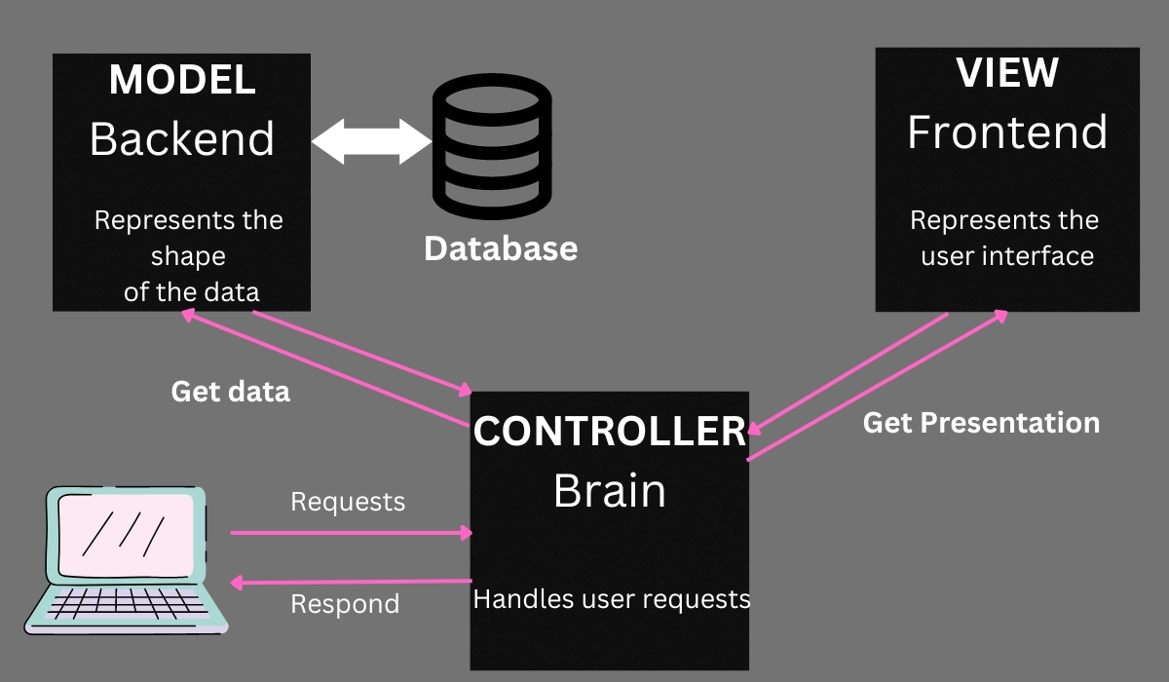

Slide 19
MVC Ideas and Software Design
The concept of MVC is applied very commonly in software development.
In most/all cases the thought patterns of this can help us.
Focus on input/output, then figure out how to connect the two.
If we are writing a function, it gives us an easy way to define tests.
If we are building larger chunks, it leads us to define a standardized interfaces.
In data science, we want to maintain a similar separation in many places:
The data should be its own thing, not connected to any other part of the process.
The model and its training should be able to be swapped, so we can compare.
The resulting predictions are independent of the pipeline used to make them.
Each part can be swapped out for another with the functionality maintained.

Slide 20
For the Near Future
Of all the programming stuff we talked about, DS will generally demand more from:
Dealing with data structures, we’ll be making more complex ones later on for large data.
Manipulation of results, values, etc… in arrays/df/series/other…
Pipelines/grid search and their basic construction.
Some inheritance and object oriented stuff, though not everywhere.

