Slide 1
Numpy
Numerical Computing in Python

Slide 2
What is Numpy?
Numpy, Scipy, and Matplotlib provide MATLAB-like functionality in python.
Numpy Features:
Typed multidimentional arrays (matrices)
Fast numerical computations (matrix math)
High-level math functions

Slide 3
NumPy
Stands for Numerical Python
Is the fundamental package required for high performance computing and data analysis
NumPy is so important for numerical computations in Python is because it is designed for efficiency on large arrays of data.

Slide 4
NumPy
Numpy provides
ndarray for creating multiple dimensional arrays
Internally stores data in a contiguous block of memory, independent of other built-in Python objects, use much less memory than built-in Python sequences.
Standard math functions for fast operations on entire arrays of data without having to write loops
NumPy Arrays are important because they enable you to express batch operations on data without writing any for loops. We call this vectorization.

Slide 5
Why do we need NumPy?
Python does numerical computations slowly.
1000 x 1000 matrix multiply
Python triple loop takes > 10 min.
Numpy takes ~0.03 seconds

Slide 6

NumPy Overview
Arrays
Shaping
Mathematical Operations
Indexing and slicing

Slide 7



Arrays
Structured lists of numbers.
Vectors
Matrices
Images
Tensors
ConvNets

Slide 8

Arrays
Structured lists of numbers.
Vectors
Matrices
Images
Tensors
ConvNets
$$\left[\begin{matrix}p_{x} \\ p_{y} \\ p_{z}\end{matrix}\right]$$
$$\left[\begin{matrix}a_{11} & ⋯ & a_{1n} \\ ⋮ & ⋱ & ⋮ \\ a_{m1} & ⋯ & a_{mn}\end{matrix}\right]$$

Slide 9

Arrays
Structured lists of numbers.
Vectors
Matrices
Images
Tensors
ConvNets

Slide 10
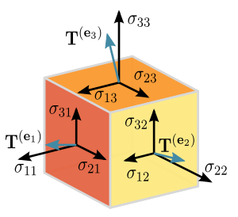
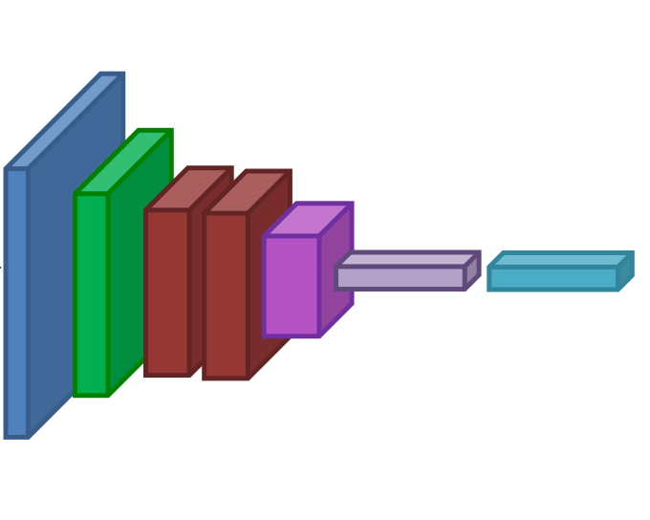
Arrays
Structured lists of numbers.
Vectors
Matrices
Images
Tensors
ConvNets

Slide 11
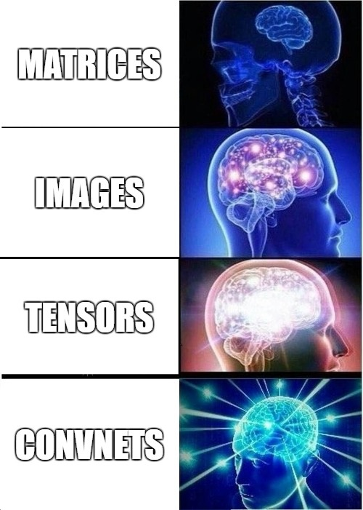
Arrays
Structured lists of numbers.
Vectors
Matrices
Images
Tensors
ConvNets

Slide 12
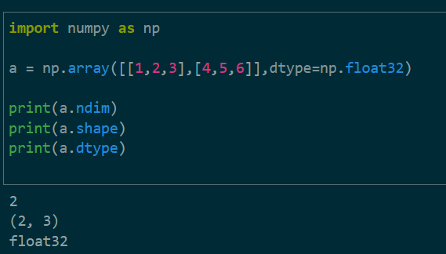
What are Arrays?
Arrays can have any number of dimensions, including zero (a scalar).
Arrays are typed: np.uint8, np.int64, np.float32, np.float64
Arrays are dense. Each element of the array exists and has the same type.

Slide 13
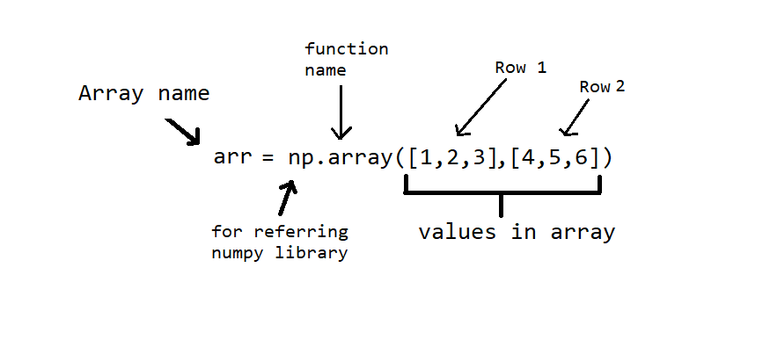
Create Arrays
np.ones, np.zeros
np.arange
np.concatenate
np.astype
np.zeros_like, np.ones_like
np.random.random

Slide 14
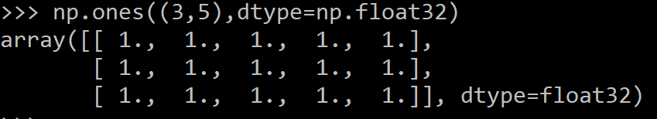
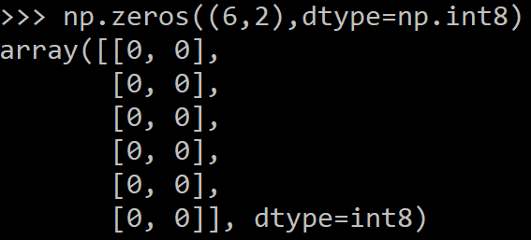
Arrays, creation
np.ones, np.zeros
np.arange
np.concatenate
np.astype
np.zeros_like, np.ones_like
np.random.random

Slide 15

Create Arrays
np.ones, np.zeros
np.arange
np.concatenate
np.astype
np.zeros_like, np.ones_like
np.random.random

Slide 16
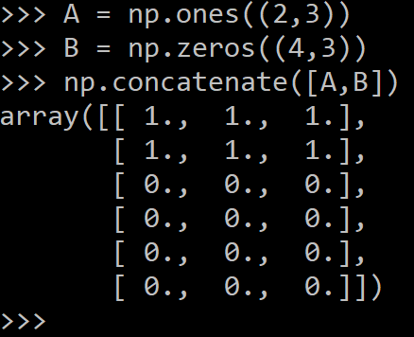
Create Arrays
np.ones, np.zeros
np.arange
np.concatenate
np.astype
np.zeros_like, np.ones_like
np.random.random

Slide 17
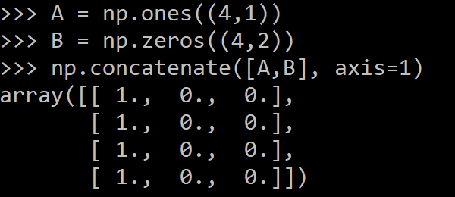
Create Arrays
np.ones, np.zeros
np.arange
np.concatenate
np.astype
np.zeros_like, np.ones_like
np.random.random

Slide 18
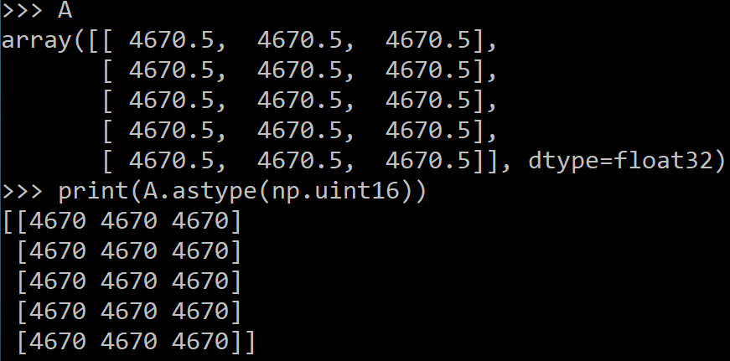
Arrays, creation
np.ones, np.zeros
np.arange
np.concatenate
np.astype
np.zeros_like, np.ones_like
np.random.random

Slide 19
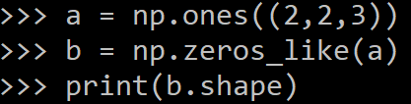
Create Arrays
np.ones, np.zeros
np.arange
np.concatenate
np.astype
np.zeros_like, np.ones_like
np.random.random

Slide 20
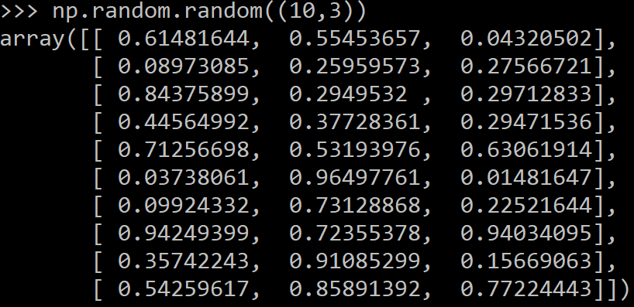
Create Arrays
np.ones, np.zeros
np.arange
np.concatenate
np.astype
np.zeros_like, np.ones_like
np.random.random

Slide 21
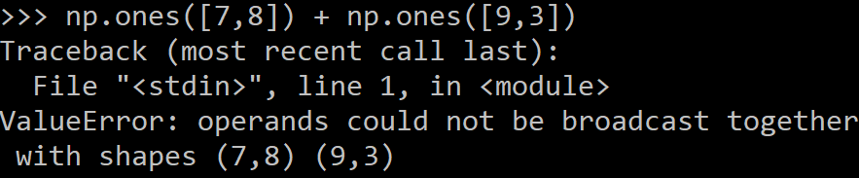
Create Arrays
Must be dense, no holes.
Must be one type
Cannot combine arrays of different shape

Slide 22
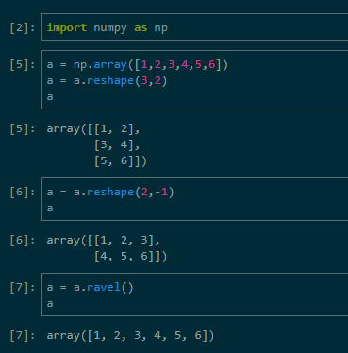
Shaping
Total number of elements cannot change.
Use -1 to infer axis shape
Row-major by default

Slide 23
Return values
Numpy functions return either views or copies.
Views share data with the original array.
The numpy documentation says which functions return views or copies
Np.copy, np.view make explicit copies and views.

Slide 24
Mathematical operators
Arithmetic operations are element-wise
Logical operator return a bool array
In place operations modify the array

Slide 25
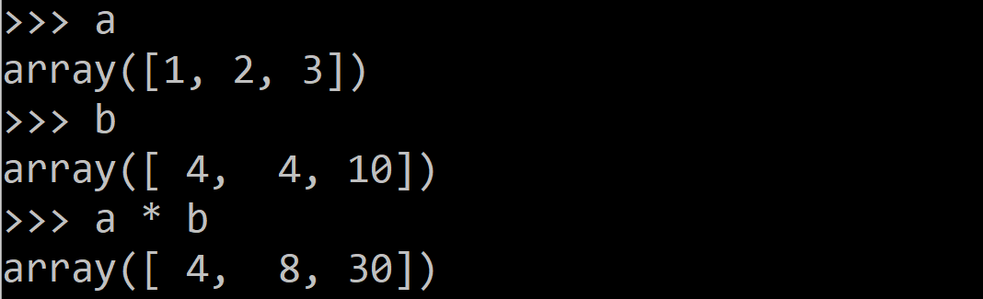
Mathematical operators
Arithmetic operations are element-wise
Logical operator return a bool array
In place operations modify the array

Slide 26
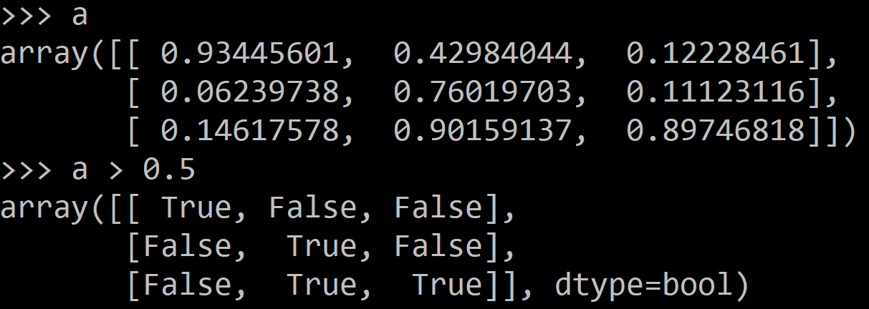
Mathematical operators
Arithmetic operations are element-wise
Logical operator return a bool array
In place operations modify the array

Slide 27
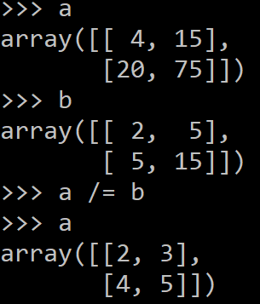
Mathematical operators
Arithmetic operations are element-wise
Logical operator return a bool array
In place operations modify the array

Slide 28
Math, Universal Functions
Also called ufuncs
Element-wise
Examples:
np.exp
np.sqrt
np.sin
np.cos
np.isnan

Slide 29

Math, universal functions
Also called ufuncs
Element-wise
Examples:
np.exp
np.sqrt
np.sin
np.cos
np.isnan

Slide 30
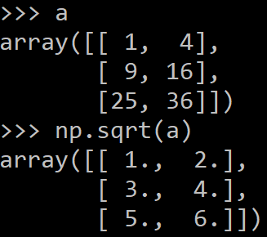
Math, universal functions
Also called ufuncs
Element-wise
Examples:
np.exp
np.sqrt
np.sin
np.cos
np.isnan

Slide 31
Indexing
x[0,0] # top-left element
x[0,-1] # first row, last column
x[0,:] # first row (many entries)
x[:,0] # first column (many entries)
Notes:
Zero-indexing
Multi-dimensional indices are comma-separated (i.e., a tuple)

Slide 32
Slicing
I[1:-1,1:-1] # select all but one-pixel border
I = I[:,:,::-1] # swap channel order
I[I<10] = 0 # set dark pixels to black
I[[1,3], :] # select 2nd and 4th row
Slices are views. Writing to a slice overwrites the original array.
Can also index by a list or boolean array.

Slide 33
Python Slicing
Syntax: start:stop:step
a = list(range(10))
a[:3] # indices 0, 1, 2
a[-3:] # indices 7, 8, 9
a[3:8:2] # indices 3, 5, 7
a[4:1:-1] # indices 4, 3, 2 (this one is tricky)

