Slide 1
Predictive Analytics Foundations
Lecture 7 - 8

Slide 2

Lecture 7-8
Introduction to Exploratory Data Analysis
Intro to Pandas
Series, DataFrames, and Indices
Slicing with loc, iloc, and []
Demo

Slide 3


Audience Q&A Session
ⓘ Start presenting to display the audience questions on this slide.

Slide 4

John Tukey on EDA
John Tukey (1915-2000) was a Princeton Mathematician & Statistician and an Early Data Scientist.
Coined/Introduced:
Fast Fourier Transform algorithm
Box plot
“Bit” : binary digit
Exploratory Data Analysis
[Data Analysis & Statistics, Tukey 1965; Image from LIFE Magazine]
Notes:
divide-and-conquer algorithm that recursively breaks down a DFT
John Tukey, Princeton mathematician and statistician, inventor of the Fast Fourier Transform and father of Exploratory Data Analysis. Also coined the word “bit”.
Emphasis courtesy Jeff Heer, U. Washington

Slide 5

EDA is like detective work:
Exploratory data analysis is an attitude, a state of flexibility, a willingness to look for those things that we believe are not there, as well as those that we believe to be there.
Notes:
divide-and-conquer algorithm that recursively breaks down a DFT
John Tukey, Princeton mathematician and statistician, inventor of the Fast Fourier Transform and father of Exploratory Data Analysis. Also coined the word “bit”.
Emphasis courtesy Jeff Heer, U. Washington

Slide 6
Exploratory Data Analysis (EDA)
“Getting to know and understand the data”

Slide 7
Exploratory Data Analysis (EDA)
“The process of transforming, visualizing, and summarizing data to:
Build/confirm understanding of the data and its provenance
Identify and address potential issues in the data.
Inform the subsequent analysis.
Discover potential hypotheses … (be careful…)
Provenance: origin of data; methodology by which data were produced

Slide 8
Exploratory Data Analysis
EDA is an open-ended analysis.
Informal, no specific idea of what we are looking for.
Be willing to find something surprising!
Contrast with confirmatory analysis:
Questions are fixed in advance.
Allows for more rigorous statistical analysis.

Slide 9
Lecture 7-8
Introduction to Exploratory Data Analysis
Intro to Pandas
Series, DataFrames, and Indices
Slicing with loc, iloc, and []
Demo

Slide 10
Pandas
We will use pandas to:
Read in data from Excel.
Manipulate data in spreadsheet.
Visualize data (we will also use another Python package called ggplot to do this).
Filter and aggregate data from spreadsheet using SQL

Slide 11
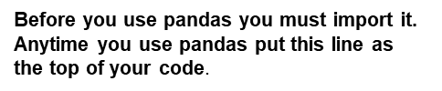
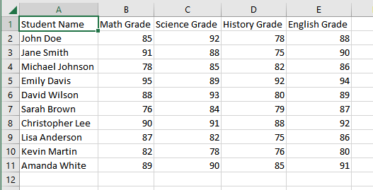



Reading Data From Excel
I have the following data saved in the file “grades.csv”:

Slide 12

Reading Data From Excel
So, what is df_grades and how does it store the data?
Typing the name of any variable at the end of a code cell will display the contents of the variable.

Slide 13
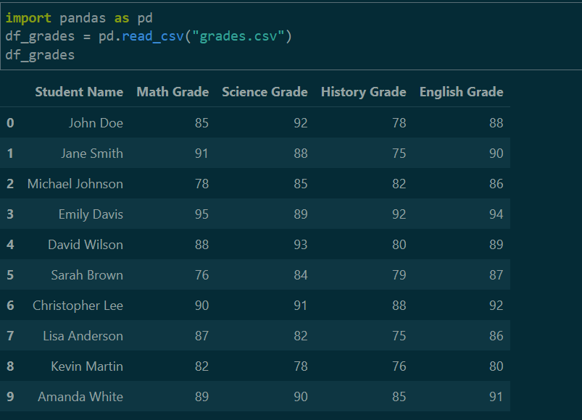
Reading Data From Excel
So, what is df_grades and how does it store the data?
df_grades is a pandas dataframe.
The data is stored in a tabular format very similar to excel.

Slide 14


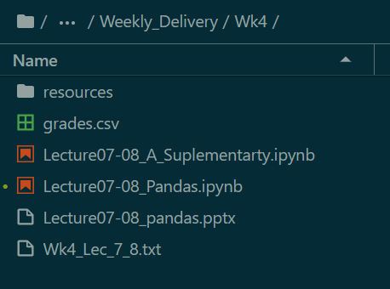

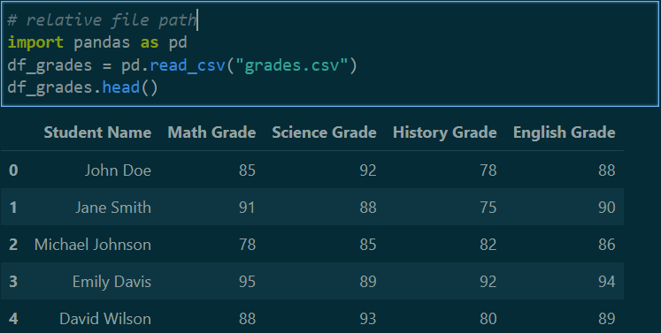
Reading Data From Excel
Data file
Jupyter notebook

Slide 15

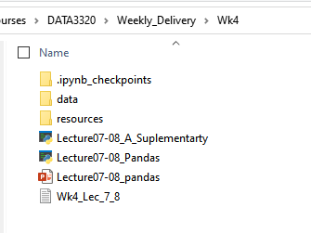
Reading in Data From Excel
Now grades.csv is in data Folder
Jupyter notebook

Slide 16
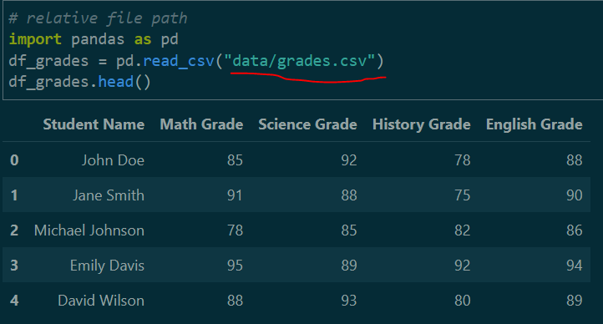
Reading Data From Excel
“/” separates directories

Slide 17
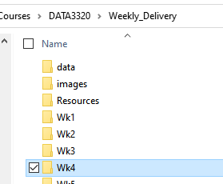
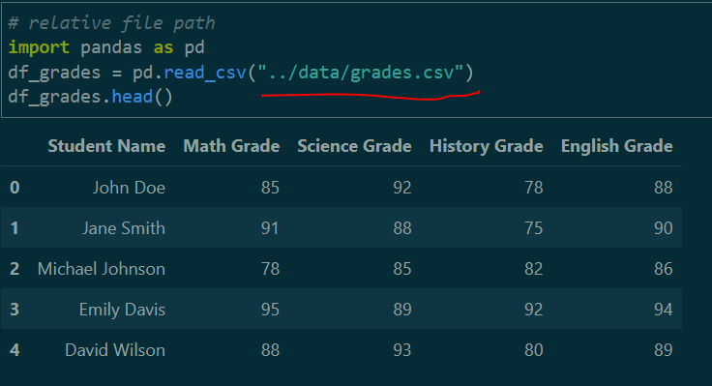
Reading Data From Excel
Now grades.csv is in Data Folder
Jupyter notebook in Wk4 folder
“..” = go back one directory

Slide 18
The head() Method
If the data is really large you don’t want to print out the entire dataframe to your output.
The head(n) method outputs the first n rows of the data frame. If n is not supplied, the default is the first 5 rows.
I like to run the head() method after I read in the dataframe to check that everything got read in correctly.
There is also a tail(n) method that returns the last n rows of the dataframe

Slide 19
Lecture 7-8
Introduction to Exploratory Data Analysis
Intro to Pandas
Series, DataFrames, and Indices
Slicing with loc, iloc, and []
Demo

Slide 20
What is a Pandas Series?
A Pandas Series is a one-dimensional labeled array data structure provided by the Python library, Pandas.
It is a fundamental building block for data manipulation and analysis in Pandas and is often used to store and manipulate data in various forms.

Slide 21
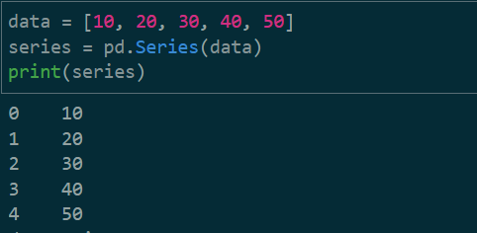
What is a Pandas Series?
Creating a simple Series from a list.

Slide 22
Indexing and Labeling
Index labels are unique identifiers associated with each element in a Pandas Series. They can be either explicitly specified or automatically generated.
Automatic Indexing: By default, when you create a Series, Pandas assigns integer-based labels starting from 0 to the elements in the Series. These labels are similar to row numbers in a spreadsheet.
Custom Indexing: You can also specify custom labels for the Series by providing an index argument when creating the Series.
Data Alignment: Index labels are used to align data during operations between multiple Series objects, ensuring that data is matched correctly based on their labels.

Slide 23
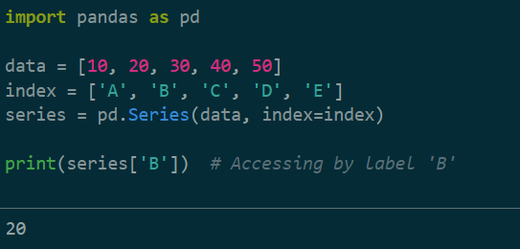
Indexing and Labeling
You can use square brackets [] to access elements by their labels.

Slide 24
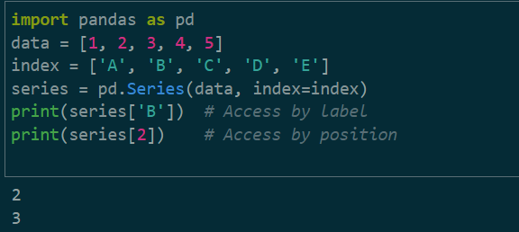
Accessing Data
Accessing elements by label and position.

Slide 25
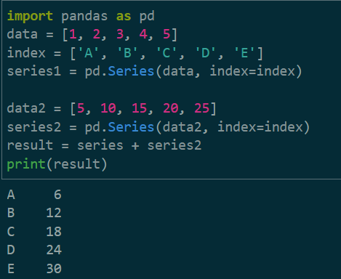
Operations on Series
Adding two Series together.

Slide 26
What is dataframe?
Creating a DataFrame in Pandas is a fundamental step in data analysis and manipulation.
A DataFrame is a two-dimensional, labeled data structure that resembles a table or spreadsheet.
It is capable of holding data in various formats, making it a versatile tool for working with structured data.

Slide 27
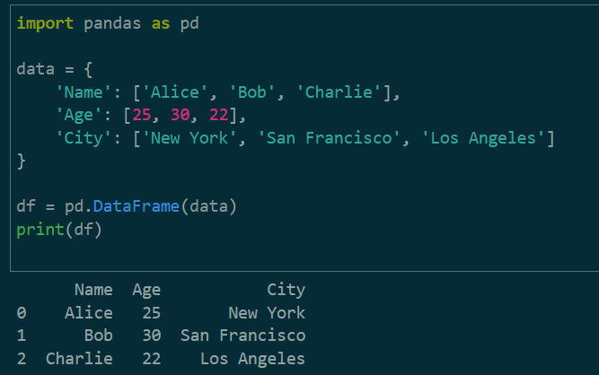
Creating Dataframes
From dictionary

Slide 28

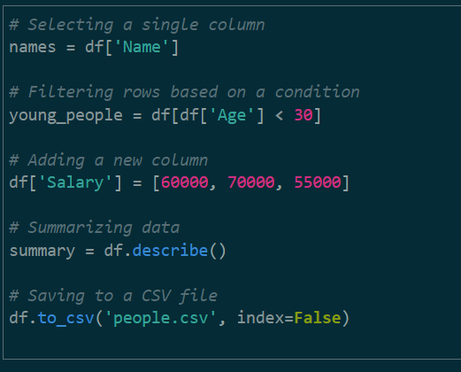

Dataframe Operations

Slide 29
Lecture 7-8
Introduction to Exploratory Data Analysis
Intro to Pandas
Series, DataFrames, and Indices
Slicing with loc, iloc, and []
Demo

Slide 30
Indexing and Slicing Dataframe
Slicing in Pandas is a powerful technique for selecting specific rows and columns from a DataFrame. You can achieve this using different methods:
1. [ ]
2. .loc[ ]
3. .iloc[ ]

Slide 31
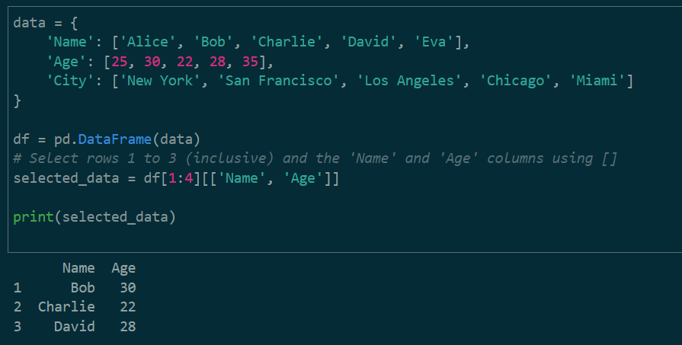
Slicing with [ ]
You can use square brackets [] for basic slicing by specifying both row and column selections using labels or integer positions.

Slide 32
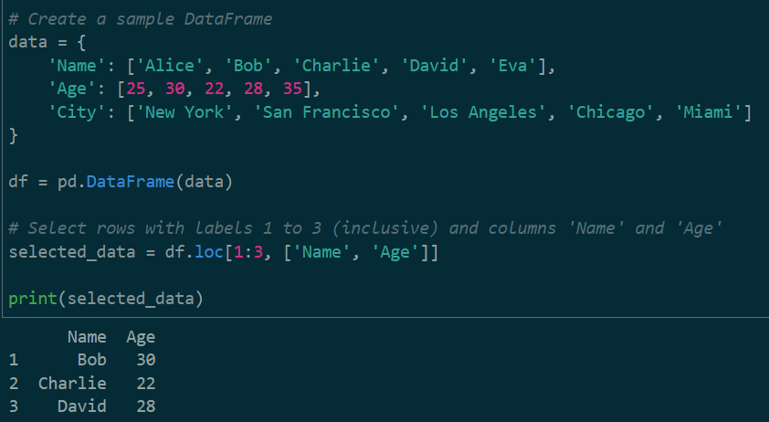
Slicing with loc (label-based indexing)
.loc[ ] is primarily used for label-based indexing, which means you select rows and columns by specifying their labels (names).

Slide 33
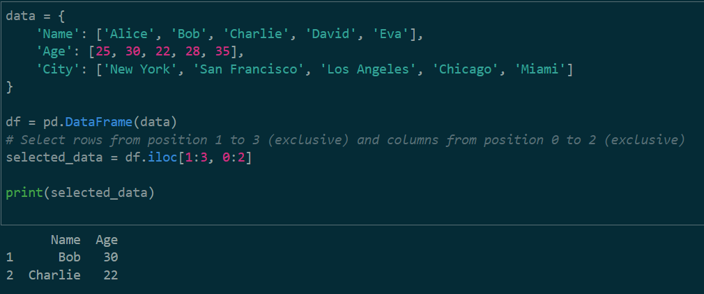
Slicing with iloc (integer-based indexing)
.iloc[ ] is used for integer-based indexing, where you select rows and columns by specifying their integer positions (0-based).

Slide 34
Indexing and Slicing Dataframe
It's important to note the key differences between these methods:
loc uses label-based indexing for both rows and columns.
iloc uses integer-based indexing for both rows and columns.
[] can be used for basic slicing with labels or integers but is less versatile than loc and iloc.
Your choice of slicing method depends on whether you prefer label-based or integer-based indexing and the complexity of your data selection requirements. Each method has its strengths and use cases, so it's helpful to understand all of them for effective data manipulation in Pandas.

Slide 35
Lecture 7-8
Introduction to Exploratory Data Analysis
Intro to Pandas
Series, DataFrames, and Indices
Slicing with loc, iloc, and []
Demo

Slide 36

Demo

