Slide 1
Classification

Slide 2
Introduction to
Classification

Slide 3
What is classification?
A machine learning task that deals with identifying the class to which an instance belongs
A classifier performs classification
Classifier
( Age, Marital status,
Health status, Salary )
( Perceptive inputs )
( Textual features : Ngrams )
Test instance
Attributes
(a1, a2,… an)
Discrete-valued
Class label
Category of document? {Politics, Movies, Biology}
Issue Loan? {Yes, No}
Steer? { Left, Straight, Right }

Slide 4
Classification learning
Training
phase
Testing
phase
Learning the classifier
from the available data
‘Training set’
(Labeled)
Testing how well the classifier
performs
‘Testing set’

Slide 5
Generating datasets
Methods:
  Holdout (2/3rd training, 1/3rd testing)
  Cross validation (n – fold)
    Divide into n parts
    Train on (n-1), test on last
    Repeat for different combinations
  Bootstrapping
    Select random samples to form the training set

Slide 6
Evaluating classifiers
Outcome:
  Accuracy
  Confusion matrix
  If cost-sensitive, the expected cost of classification ( attribute test cost + misclassification cost)
  etc.

Slide 7
Decision Trees

Slide 8
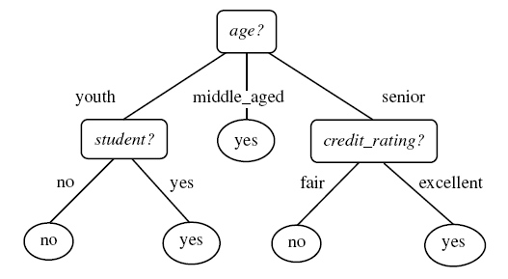
Example tree
Intermediate nodes : Attributes
Edges : Attribute value tests
Leaf nodes : Class predictions
Example algorithms: ID3, C4.5, SPRINT, CART
Diagram from Han-Kamber

Slide 9
Decision Tree schematic
Training data set
a1 a2 a3 a4 a5 a6
a1 a2 a3 a4 a5 a6
X
Y
Z
Impure node,
Select best attribute
and continue
Impure node,
Select best attribute
and continue
Pure node,
Leaf node:
Class RED

Slide 10

Decision Tree Issues
How to avoid overfitting?
Problem: Classifier performs well on training data, but fails
to give good results on test data
Example: Split on primary key gives pure nodes and good
accuracy on training – not for testing
Alternatives:
Pre-prune : Halting construction at a certain level of tree /
level of purity
Post-prune : Remove a node if the error rate remains
the same without it. Repeat process for all nodes in the d.tree
How does the type of attribute affect the split?
Discrete-valued: Each branch corresponding to a value
Continuous-valued: Each branch may be a range of values
(e.g.: splits may be age < 30, 30 < age < 50, age > 50 )
(aimed at maximizing the gain/gain ratio)
How to determine the attribute for split?
Alternatives:
Information Gain
Gain (A, S) = Entropy (S) – Σ ( (Sj/S)*Entropy(Sj) )
Other options:
Gain ratio, etc.

Slide 11
Lazy learners

Slide 12
Lazy learners
‘Lazy’: Do not create a model of the training instances in advance
When an instance arrives for testing, runs the algorithm to get the class prediction
Example, K – nearest neighbor classifier
(K – NN classifier)
“One is known by the company one keeps”

Slide 13
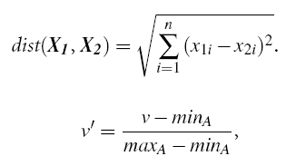
K-NN classifier schematic
For a test instance,
Calculate distances from training pts.
Find K-nearest neighbours (say, K = 3)
Assign class label based on majority

Slide 14
K-NN classifier Issues
How good is it?
Susceptible to noisy values
Slow because of distance calculation
  Alternate approaches:
  Distances to representative points only
  Partial distance
Any other modifications?
Alternatives:
Weighted attributes to decide final label
Assign distance to missing values as <max>
K=1 returns class label of nearest neighbour
How to make real-valued prediction?
Alternative:
Average the values returned by K-nearest neighbours
How to determine distances between values of categorical
attributes?
Alternatives:
Boolean distance (1 if same, 0 if different)
Differential grading (e.g. weather – ‘drizzling’ and ‘rainy’ are
closer than ‘rainy’ and ‘sunny’ )
How to determine value of K?
Alternatives:
Determine K experimentally. The K that gives minimum
error is selected.

Slide 15
Decision Lists

Slide 16
Decision Lists
A sequence of boolean functions that lead to a result
if h1 (y) = 1 then set f (y) = c1
else if h2 (y) = 1 then set f (y) = c2
…. else set f (y) = cn
f ( y ) = cj, if j = min { i | hi (y) = 1 } exists
0 otherwise

Slide 17
Decision List example
Class label
Test instance
( h i , c i )
Unit

Slide 18


Decision List learning
R
S’ = S
- Qk
( h k, )
1 / 0
If
(| Pi| - pn * | Ni |
>
|Ni| - pp *|Pi| )
then 1
else 0
For each hi,
Qi = Pi U Ni
( hi = 1 )
Set of candidate
feature functions
Select hk, the feature
with
highest utility
U i = max { | Pi| - pn * | Ni | , |Ni| - pp *|Pi| }

Slide 19
Decision list Issues
What is the terminating condition?
Size of R (an upper threshold)
Q_{k} = null
S’ contains examples of same class
Pruning?
hi is not required if :
c _{i} = c _{(r+1)}
There is no h j ( j > i ) such that
Q i = Q j
Accuracy / Complexity tradeoff?
Size of R : Complexity (Length of the list)
S’ contains examples of both classes : Accuracy (Purity)

Slide 20
Probabilistic
classifiers

Slide 21
Probabilistic classifiers: NB
Based on Bayes rule
Naïve Bayes : Conditional independence assumption

Slide 22
Naïve Bayes Issues
How are different types of attributes
handled?
Discrete-valued : P ( X | Ci ) is according to
        formula
Continous-valued : Assume gaussian distribution.
      Plug in mean and variance for the attribute
      and assign it to P ( X | Ci )
Problems due to sparsity of data?
Problem : Probabilities for some values may be zero
Solution : Laplace smoothing
For each attribute value,
update probability m / n as : (m + 1) / (n + k)
where k = domain of values

Slide 23
Probabilistic classifiers: BBN
Bayesian belief networks: Attributes ARE dependent
A directed acyclic graph and conditional probability tables
Diagram from Han-Kamber

Slide 24
BBN learning
(when network structure known)
Input: Network topology of BBN
Output: Calculate the entries in conditional probability table
(when network structure not known)
???

Slide 25
Learning structure of BBN
Use Naïve Bayes as a basis pattern
Add edges as required
Examples of algorithms: TAN, K2
Loan
Age
Family
status
Marital
status

Slide 26
Artificial
Neural Networks

Slide 27
Artificial Neural Networks
Based on biological concept of neurons
Structure of a fundamental unit of ANN:
w0
threshold
w1
input
output: : activation function
p (v) where
p (v) = sgn (w₀ + w₁x₁ + … + w_{n}x_{n} )
wn

Slide 28
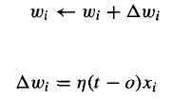
Perceptron learning algorithm
Initialize values of weights
Apply training instances and get output
Update weights according to the update rule:
Repeat till converges
Can represent linearly separable functions only
n : learning rate
t : target output
o : observed output

Slide 29


Sigmoid perceptron
Basis for multilayer feedforward networks

Slide 30
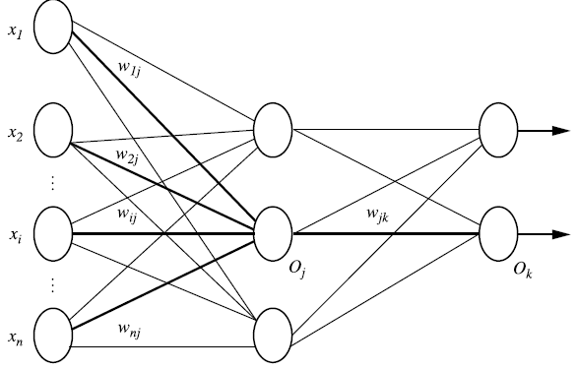
Multilayer feedforward networks
Multilayer? Feedforward?
Input layer
Hidden layer
Output layer
Diagram from Han-Kamber

Slide 31
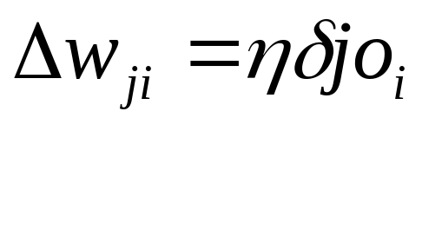
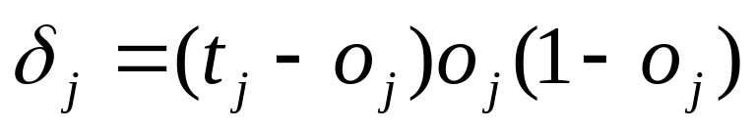

Backpropagation
Apply training instances as input and produce output
Update weights in the ‘reverse’ direction as follows:
Diagram from Han-Kamber

Slide 32
ANN Issues
Learning the structure of the network
Construct a complete network
Prune using heuristics:
  Remove edges with weights nearly zero
  Remove edges if the removal does not affect
  accuracy
What are the types of learning
approaches?
Deterministic: Update weights after summing up
Errors over all examples
Stochastic: Update weights per example
Addition of momentum
But why?
Choosing the learning factor
A small learning factor means multiple iterations
required.
A large learning factor means the learner
may skip the global minimum

Slide 33
Support vector
machines

Slide 34
Support vector machines
Basic ideas
Margin
“Maximum separating-margin classifier”
+1
Support vectors
-1
Separating hyperplane : wx+b = 0

Slide 35
SVM Issues
SVMs are immune to the removal of
non-support-vector points
What if n-classes are to be predicted?
Problem : SVMs deal with two-class classification
Solution : Have multiple SVMs each for one class

Slide 36
Combining
classifiers

Slide 37
Combining Classifiers
‘Ensemble’ learning
Use a combination of models for prediction
  Bagging : Majority votes
  Boosting : Attention to the ‘weak’ instances
Goal : An improved combined model

Slide 38
Bagging
Total set
Classifier
learning
scheme
Classifier
model
M 1
Majority
vote
Class Label
Training
dataset
D
Classifier
model
M n
Sample
D 1
Test
set
At random. May use bootstrap sampling with replacement

Slide 39


Boosting (AdaBoost)
Total set
Error
Classifier
learning
scheme
Classifier
model
M 1
Weighted
vote
Class Label
Training
dataset
D
Classifier
model
M n
Sample
D 1
Error
Test
set
Weights of
correctly classified instances multiplied
by error / (1 – error)
If error > 0.5?
Selection based on weight. May use bootstrap sampling with replacement
Initialize weights of instances to 1/d
`

Slide 40
The last slice

Slide 41
Data preprocessing
Attribute subset selection
  Select a subset of total attributes to reduce complexity
Dimensionality reduction
  Transform instances into ‘smaller’ instances

Slide 42
Attribute subset selection
Information gain measure for attribute selection in decision trees
Stepwise forward / backward elimination of attributes

Slide 43
Dimensionality reduction
Number of attributes of
a data instance
High dimensions : Computational complexity
instance x in p-dimensions
s = Wx W is k x p transformation mtrx.
instance x in k-dimensions
k < p

Slide 44
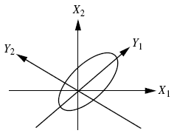



Principal Component Analysis
Computes k orthonormal vectors : Principal components
Essentially provide a new set of axes – in decreasing order of variance
Eigenvector matrix
( p X p )
First k are k PCs
( p X n )
( p X n )
(p X n)
(k X n)
(k X p)
Diagram from Han-Kamber

Slide 45

end of slideshow

