Slide 1
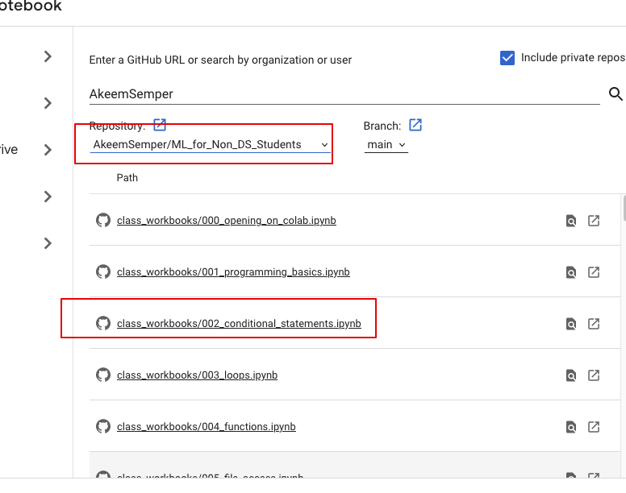
Today:
Data types:
Review and more context.
Conditions:
Doing something different depending on some condition.
Short theory, then look at code.
Stuff you should read - P4E (Ch1, 2, 3 skip 3.7)
There are some little exercises at the end of the chapters that are simple practice.
The first days of programming are a little scattered, by late next week we’ll have enough basics down that we can do useful stuff. It makes more sense then, but we need to learn a few building blocks.

Slide 2
Programming
The Beginning

Slide 3

Variables

Slide 4
Variables
Last time we started to play around in Python notebooks and focused mainly on variables.
Variables are what our program “knows”, or the values that are held in its memory.
Variables have:
Names that we use to refer to them in our code.
Values that are the actual thing that we want to remember.
Types, depending on if they are numbers, strings, or some other object.
Our programs will create some variables holding the info our program uses/needs, then do some stuff to those variables, and finally use or view the results.

Slide 5
Object Orientations
This will make more sense in a couple of weeks, but I want to bring up the idea of objects.
In Python, everything (numbers, strings, lists, etc…) is an object.
An object is an example of a class:
We have classes, or types of things that can exist. Strings, integers, Booleans, and other objects we’ll create soon etc... Are all different classes, or types of things that can be made.
Each individual thing we make is an object, of a particular type.
Each of our variables refers to one object.
This is “object-oriented programming” – we create objects of different types, then do things to them.

Slide 6
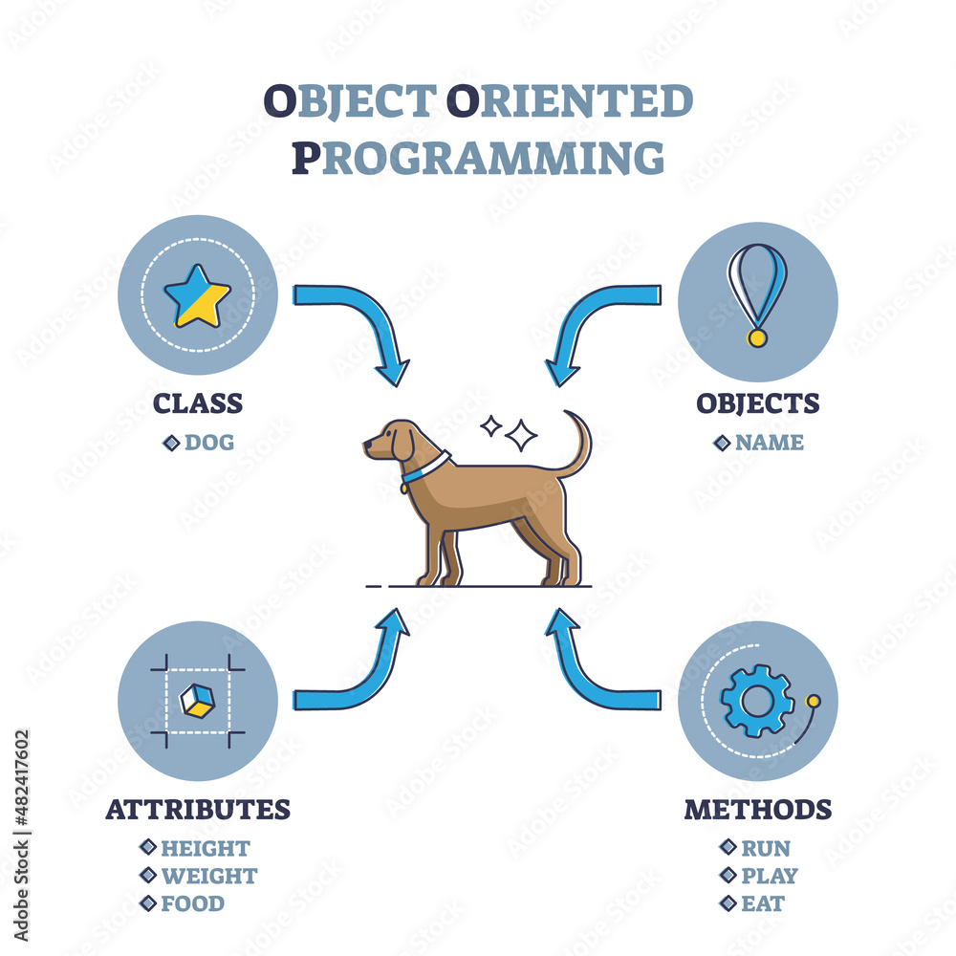

Slide 7
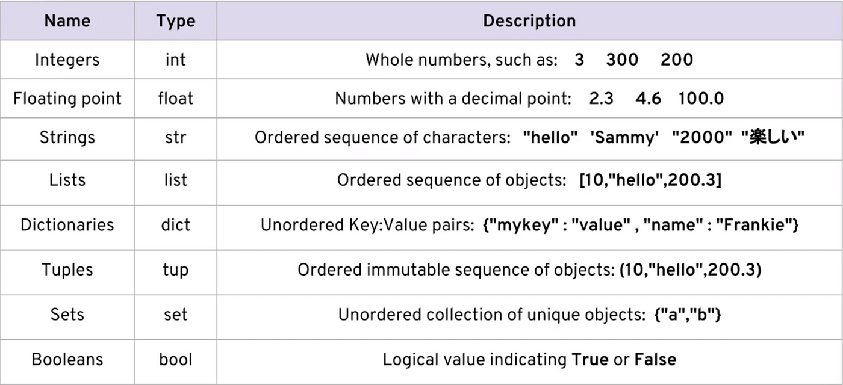

Slide 8
Data Type Objects
Each of these types of variables is an instance of a different class.
I.e. it is a specific type of ”thing”, and each thing behaves differently.
When we use an object, the way that it behaves varies depending on what it is, e.g.:
4 + 3 = 7
“four” + “three” = “fourthree”
Each object has different “abilities” (methods) as well as data (attributes):
Integer objects have addition defined as addition, string objects have addition defined as concatenation.
Basic types are simple in this way, other things are more complex:
E.g. an “order” object in Amazon’s sales system might have a “return” ability which makes a label, issues a refund, updates the customer’s history, etc…

Slide 9
Data Structures
Another type of object we can assign to a variable is a Data Structure, or an object that holds other objects. Think of them as containers that hold objects/variables.
We’ll look at Lists and Tuples now, you’ll encounter others soon.
Data structures are common when we have more than one of something.
E.g. we can have a list of products in an order.
Data structures add another layer to referring to a variable:
The data structure itself is a regular variable, referred to by it’s name. E.g “customer_list”.
The data structure also provides some way to refer to which object inside the container.
For lists and tuples we use an index – the position number in square brackets.
Container_variable_name[position_number_of_object]

Slide 10
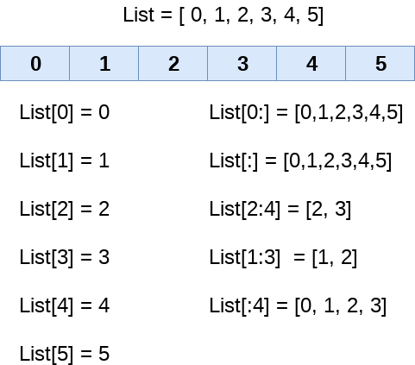
List Indexing
Lists are 0-indexed. (The first position is 0)
We can also slice portions of a list:
The left side of the colon is the start (inc)
The right side is the end (non-inc)
Blank is “no constraint” on that end.
It’s good to be comfortable with this, especially when we get to multiple dimensions (it comes up in NN a bit), but it isn’t urgent to be fluent.
Lists can return their length, most d.s. have some “length” type function to give the size.

Slide 11
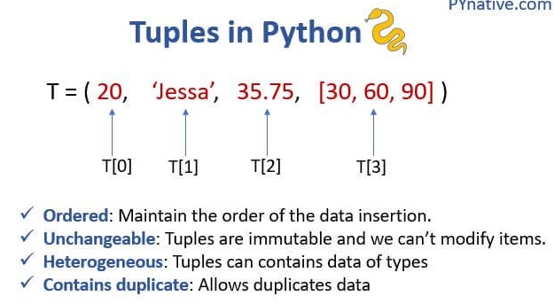
Tuples
Tuples are commonly used to package together a small number of objects that “belong” together logically.
E.g. two floats for latitude and longitude, two strings for first and last names.
Declared like a list, but with round brackets.
Tuples are immutable – they can’t be changed. A new one needs to be created.
Tuples have the same index system as lists do.
Often used when a function returns 2+ values:
E.g. get_location() could return (lat, lon) as a tuple.

Slide 12
Data Structure Use
Data structures are very common, we rarely want to hold many individual items as their own distinct variables, if there are many of something, we want it in a list or similar.
Many data structures, including a list and tuple, are iterable:
Means that they can provide their items one at a time.
Important in looping.
Data structures allow for more generic code that is more reusable:
Things can be written to get “the next” or ”the first” item from a data structure and do something to it.
Never need to hard code what we are grabbing, just the next in the stack…
Add/remove are generic actions, we don’t need to care about the details – more abstraction is usually good.

Slide 13
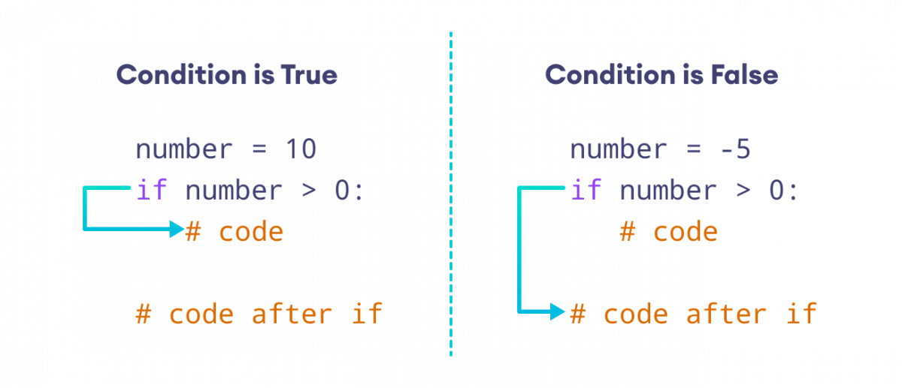
Conditional Flow
One of the most important things we need to make useful programs is the ability to have conditions in our logic flow.
I.e. do one thing is some cases, something else in other cases.
The core idea in conditional flow is the “if” statement:
Conditional statement – something that can evaluate to true or false.
Different actions to go in either case.
This allows our programs to “decide”
Indentation is critical here (and in Python):
Everything indented is “in” the if clause.
The end of indentation ends that clause, and starts “after”.

Slide 14
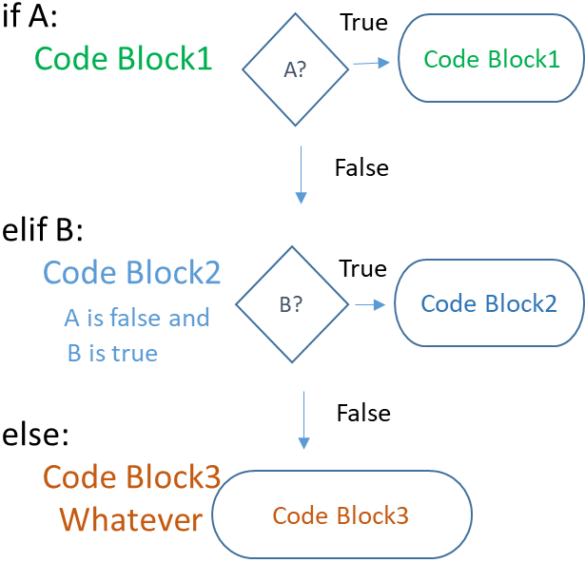
What Else?
If statements usually, but not always, finish in an “else” clause.
The else clause will execute if the ”if” (or elifs…) does not.
Elif, or “else, if” bridges the gap between the if and else clauses.
Elif is another “if” statement, dependent on the one before it.
This will perform the if check only if the previous if or elif was false.
The typical structure is:
If
Elif
…
else

Slide 15
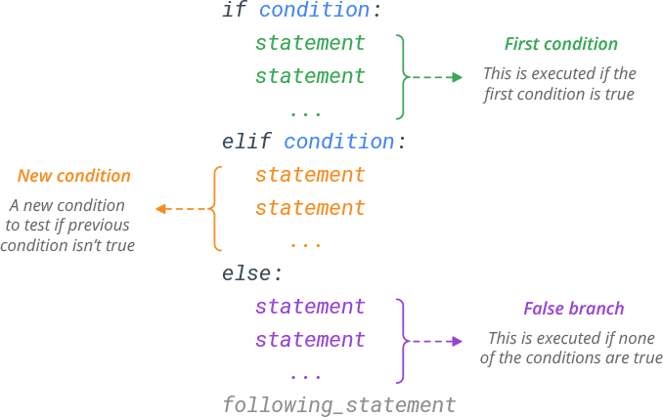

Slide 16
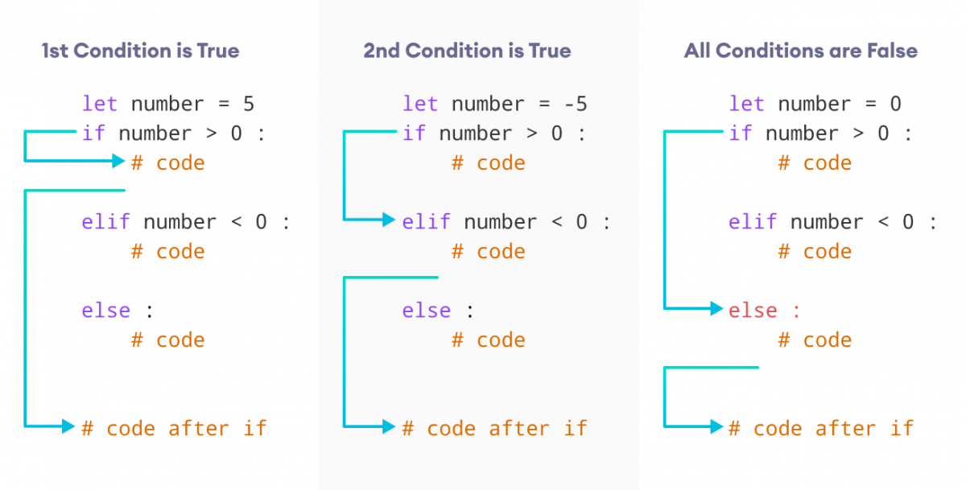

Slide 17
Boolean Logic
Conditional execution depends on Boolean logic.
Each condition must evaluate to True or False.
Most conditions are simple (i < length), but not all are:
Conditions can have multiple possible outcomes – multiple elif.
Conditions can have complex logic – nested or compound conditions.
Think – heart attack risk:
Depends on multiple factors – age, sex, weight, BMI, blood cholesterol, etc…
Risk level determinations need complex logic – “this” or “this”, ”this” or “this and that”, etc….
E.g. risk is high if you have diabetes and are BMI > 30, or if blood pressure and weight are high…

Slide 18
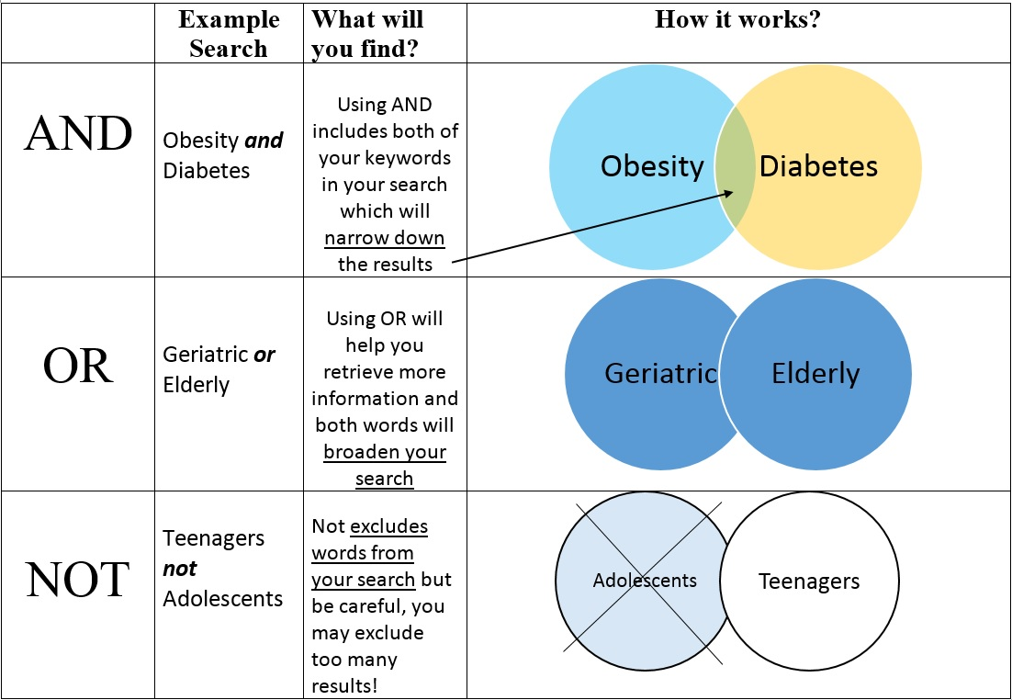
Priority is:
NOT
AND
OR

Slide 19
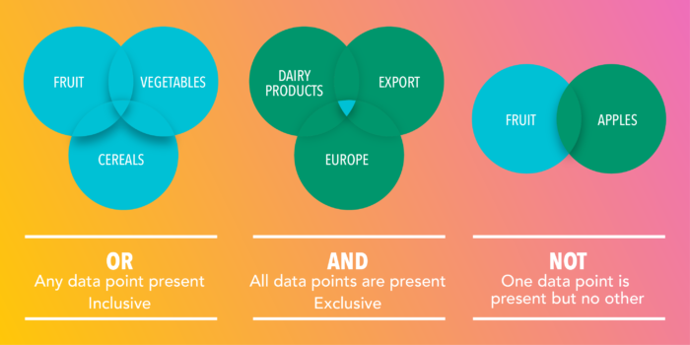

Slide 20
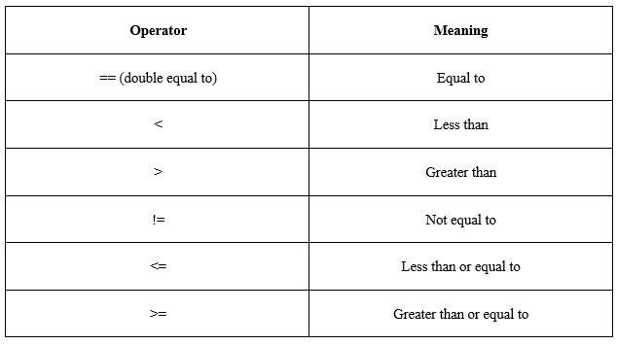
Relational Operators
The logical conditions can be anything that evaluates to true or false.
Relational operators are what we can use to make comparisons.
E.g. i < len(list) is a common comparison if repeating in a loop.
Note: comparisons use == double equal. One equal sign is assignment.

Slide 21
Boolean Fun Time!!!!
We’ll try some exercises to test our logical mettle.
We can also peek at running Python from the command line.
From VS Code, click Terminal -> New Terminal.
Type “python” and hit enter.
This is a python live interpreter. Each line we type and enter is like a one-line notebook cell.
You can run one of the statements to check it. You can also use a notebook cell.
Try to think it through, then run a check in Python.

Slide 22
Free Logic Puzzles!!!
True and True
False and True
1 == 1 and 2 == 1
"test" == "test"
1 == 1 or 2 != 1
True and 1 == 1
False and 0 != 0
True or 1 == 1
"test" == "testing"
1 != 0 and 2 == 1
"test" != "testing"
"test" == 1
not (True and False)
not (1 == 1 and 0 != 1)
not (10 == 1 or 1000 == 1000)
not (1 != 10 or 3 == 4)
not ("testing" == "testing" and "Zed" == "Cool Guy")
1 == 1 and not ("testing" == 1 or 1 == 0)
"chunky" == "bacon" and not (3 == 4 or 3 == 3)
3 == 3 and not ("testing" == "testing" or "Python" == "Fun")

Slide 23
Testing
Conditionals are one of the first things that are likely to need substantial testing.
We want to think about how we’d test as we create more complex things.
Consider how we verify if it works or not as we think about how to do it.
Likely along the decision boundaries or edge cases, especially for complex logic.
For conditionals, we can consider:
What is each ”normal” outcome?
What is on the “edges” of each condition? Are there “holes”, especially with complex logic?
What are values at the limits in any direction?
What happens with an unacceptable input?

Slide 24
Testing and Debugging
Testing code is a very large and complex topic, but it doesn’t need to be.
We can start with some simple tools now:
Construct test data – e.g. for a conditional, try one of each outcome, things along the edges of the decisions, and limits/odd values. We can then run these and see if it is correct.
Print statements – we can weave in print statements to tell us useful things, then comment them out when it works. E.g. print which “if/elif” clause we are in, along with the values.
Break apart code into blocks – we can break lines of code into individual blocks and execute them one at at time. Isolate things line by line. Combines well with the variable viewer.
Debugging pairs with reading documentation to allow you to do anything you heart desires!!!

Slide 25
Pseudocode
As logic starts to get complex, a good idea is to think in pseudocode – of an English/programming hybrid.
Try to break down the steps of what you need to do, but ignore the syntax.
Suppose we want to return the sum of the square roots of two numbers.
Temp 1 = root(number 1)
Temp 2 = root(number 2)
Result = temp 1 + temp 2
Each line is the correct step, we can then look up how to write that in code.
Break each step down into the smallest pieces you can logically, write some “code” of what those steps are, translate this into actual real code, repeat if one step was more complex than you originally thought.

Slide 26
Conclusion
Conditional code is critical in allowing our programs to be smart.
If/elif/else provides us a lot of flexibility.
Understand Boolean logic for conditions.
Think of potential spots for error.

