Slide 1
Housekeeping
Today:
Real Machine Mother F*cking Learning! (020 and maybe 021)
Linear least squares -> linear regression.
Intro to sklearn regression (and statsmodels regression).
The processes using the sklearn stuff carry through the ML stuff.
Linear regression error calculations (depending on time).

Slide 2
Linear Least Squares, Regression, and More Fun Stuff!!! Part 1.

Slide 3
Linear Regression and Predictive Models
Most people have done linear regression before – it is making a line of best fit.
Result – y = m*x + b line.
M = slope, b = y intercept.
This process is also a simple predictive model – we provide X and get a prediction for Y.
The “regression calculation” uses the training data to “learn” how to generate Y from X.
That’s the machine learning bit.
The process of creating a regression is almost the same as other models, we’ll do later.

Slide 4
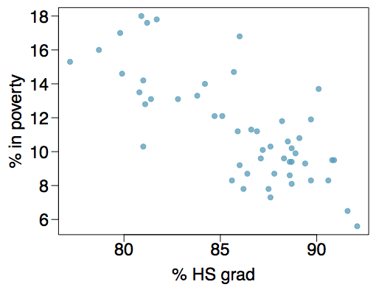
Poverty vs. HS graduate rate
The scatterplot below shows the relationship between HS graduate rate in all 50 US states and DC and the percent of residents who live below the poverty line (income below $23,050 for a family of 4 in 2012).

Slide 5
Poverty vs. HS graduate rate
The scatterplot below shows the relationship between HS graduate rate in all 50 US states and DC and the percent of residents who live below the poverty line (income below $23,050 for a family of 4 in 2012).
Response variable?
% in poverty
Explanatory variable?
% HS grad
Relationship?
linear, negative, moderately strong

Slide 6
Poverty vs. HS graduate rate
We could draw a line of best fit… but how do we know exactly where it goes?

Slide 7
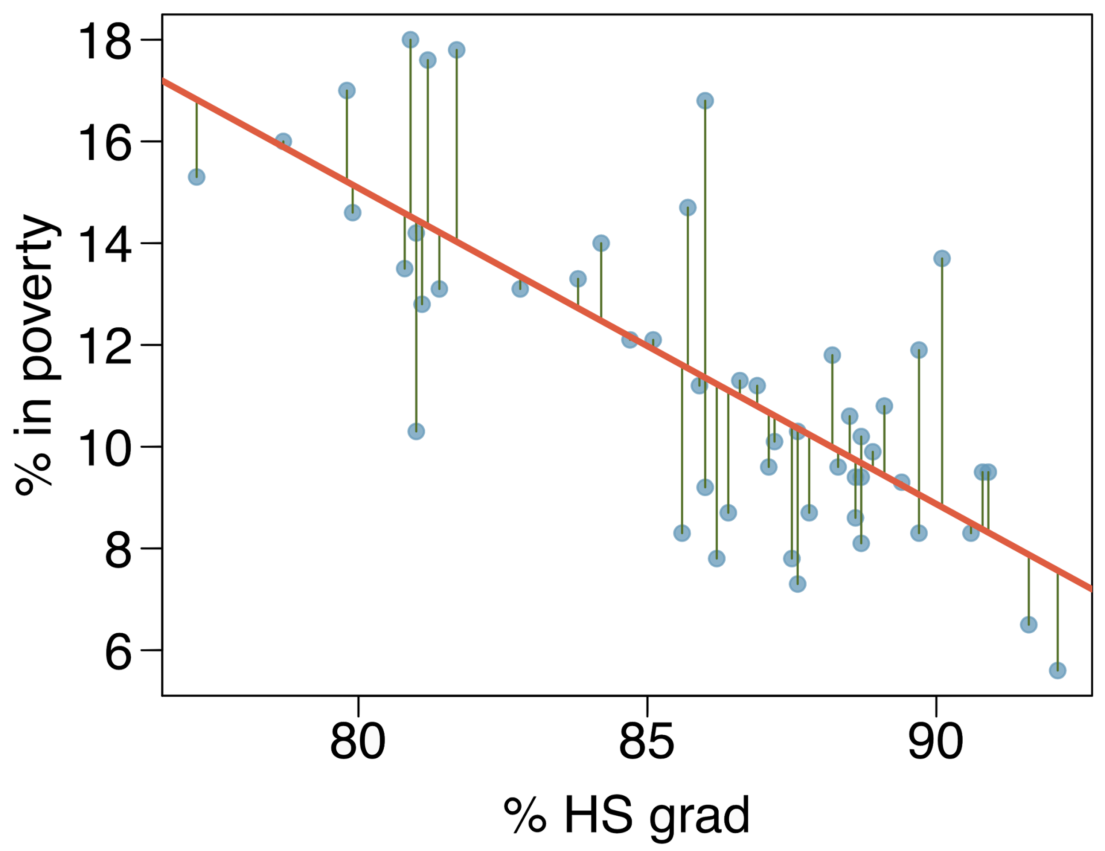
Residuals
Residuals are the leftovers from the model fit:
Data = Fit + Residual

Slide 8
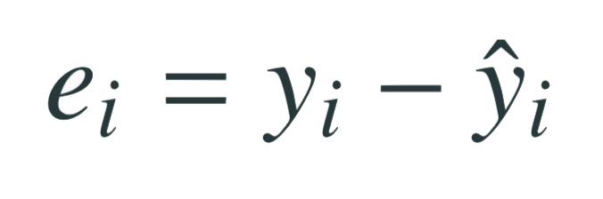
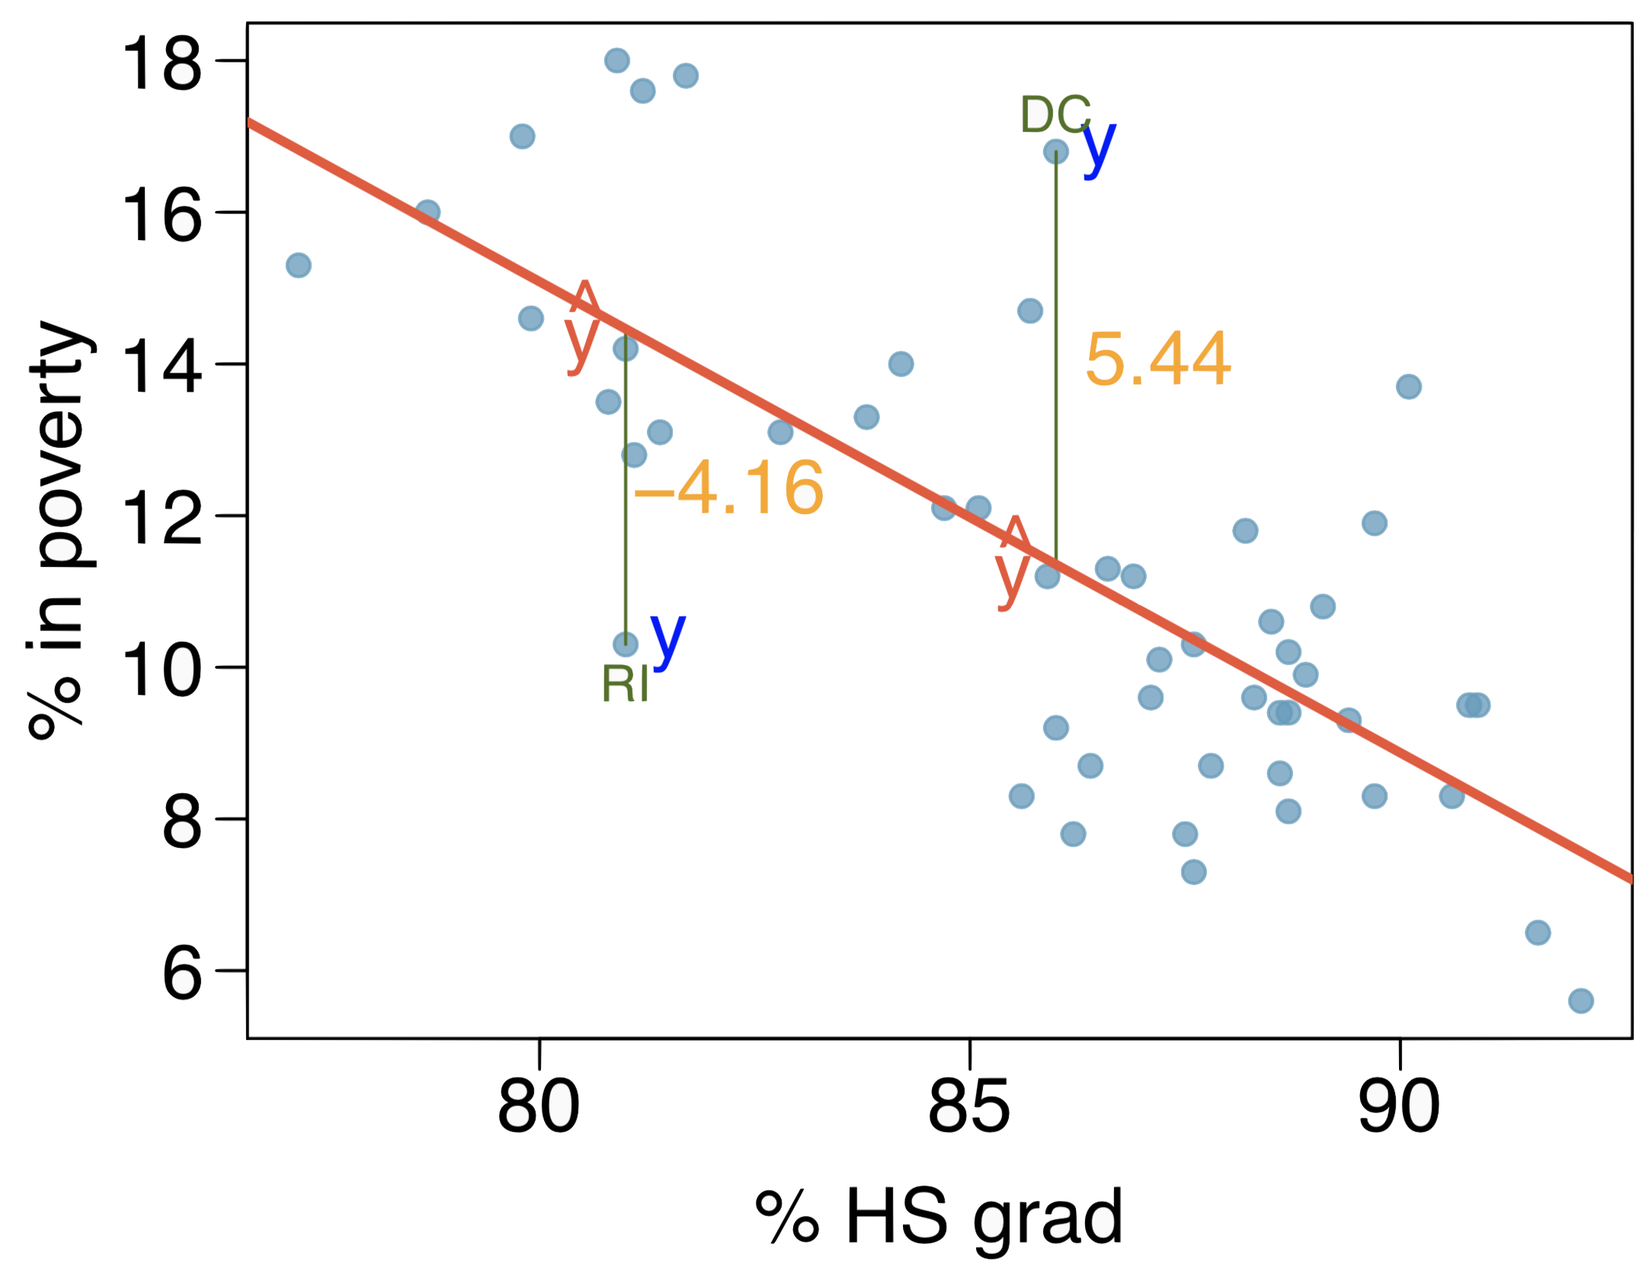
Residuals (cont.)
Residual is the difference between the observed (y_{i}) and predicted ŷ_{i}.
% living in poverty in DC is 5.44% more than predicted.
% living in poverty in RI is 4.16% less than predicted.

Slide 9
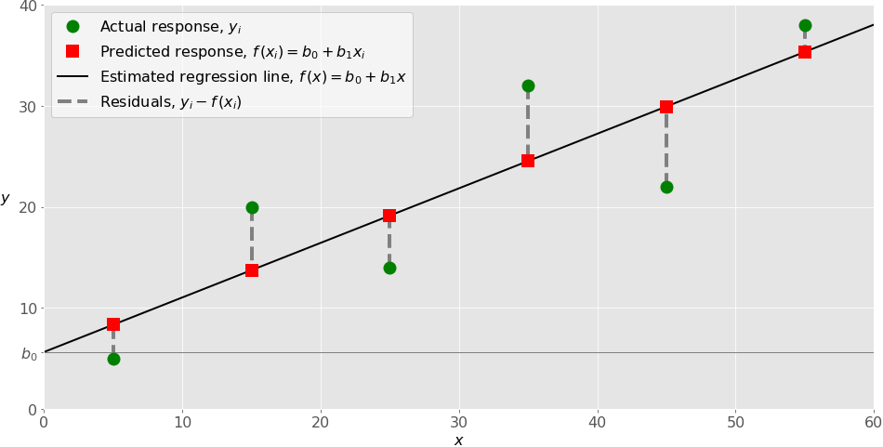

Slide 10
Linear Least Squares
The line can be defined by the intercept and slope.
We generate a line that minimizes the square of the residuals.
Why?
Small differences matter less than big ones.
Squaring deals with negatives.
Computationally efficient. (Mattered more in the past)
Is (potentially) a good estimator for slope and intercept.

Slide 11
How to find the minimum of the residuals squared?
This is the “learning” part of machine learning.
This step is the main thing that differs between other models – the math changes.
We can use:
LeastSquares from thinkplot.
StatsModels function.
Scipy functions.
Probably many other packages.
The model (best fit line) is defined by the slope and intercept.
Add any X value to those two and you can predict Y.
The training process finds the ”best” calculation to do so.

Slide 12

Poverty vs. HS graduate rate
The linear model for predicting poverty from high school graduation rate in the US is
The "hat" is used to signify that this is an estimate.
It is an estimate because this isn’t a definitive calculation to calculate the value of poverty – it is a prediction of what we expect the rate of poverty to be, given a value for HSgrad.

Slide 13
Residual analysis
The generated residuals are also helpful to us in a few ways.
We can graph the residuals along with X to examine.
We want this pattern of residuals to not have any patterns in it – to be more or less randomly spread out.
Why?

Slide 14
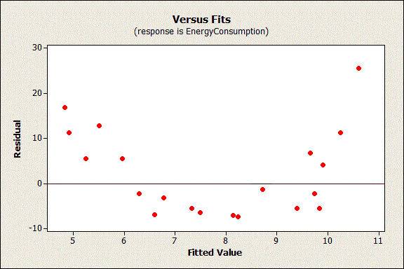
Why Random?
If there’s a pattern in the residuals it tells us that there’s some relationship here that isn’t captured in our actual model.
Middle predictions too high, ends are too low.
This pattern should be in the model!
Residuals should be:
Uncorrelated with a variable.
Uncorrelated with each other.
We shouldn’t be able to predict residuals.

Slide 15
Other Packages
Linear regression is performed by many existing packages, such as StatsModels, Scipy, and Scikitlearn.
The book uses StatsModels when multiple regression starts.
Which you use mostly doesn’t matter, it is a personal choice.
We’ll use both StatsModels and Scikitlearn:
Statsmodels provide more stats data in the output, so we will use that sometimes.
The scikitlearn is probably more relevant experience for ML stuff.
I think going forward I might replace some of the statsmodels examples in future workbooks with sklearn one. The interface is easier, and it is more relevant to ML.

Slide 16
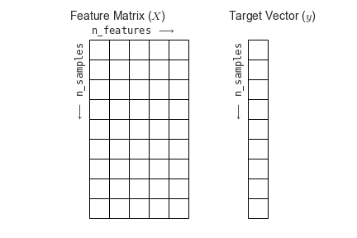
Shapes and Arrays
One thing we need to pay attention to a bit more is the data structure and the shape.
Most things we’ve used take anything ‘iterable’ or anything that is list-like.
Often (but not always) in machine learning we need arrays, usually of a certain shape.
Some tangible differences are:
Use np.array() to create arrays of the data – usually one array for x(s), one for y.
Ensure the arrays are “vertical”, print it and/or use .shape to look.
.reshape(width, height) can reshape the arrays to what we need.

Slide 17
Conclusion
We can train our models to predict Y, given X.
In this case, the model is a simple algebra equation.
This is a simple version of all the more complex ML work to come later.
The residuals give us information on how good our model is.
Accuracy and reliability of the predictions…. Next time.

