Slide 1
Housekeeping
There’s a test next time.
MC guide is on Moodle page.
There will be a code bit, I’m writing it tonight.
Today (011):
Practice with regression.
Exploring data a bit more.
Feature Scaling.

Slide 2
Data Prep and Regression

Slide 3
Distribution and Stats
Exploring our data (exploratory data analysis – EDA) is important to machine learning.
We learn if there are any problems in our data (wrong types, blanks, errors, etc…)
We can see if there is any data we want to be modified, such as filtering outliers.
We learn what our data looks like – min, max, mean, dispersion, distribution.
We need to do the “fix problems” part to make things work properly.
Having data that is ‘clean’ (consistent data, correct types, no blanks/errors) is required.
We want to do the “understand the data” part to be more effective and efficient.
This isn’t needed, but it does help, and that will grow as you become more comfortable.
Understanding the data can help guide our decisions (vague, I know).

Slide 4
Exploration Helps Us
Even though we aren’t experts yet, we can see a few uses for our understanding.
Dispersion – if we have a feature that is always the same (or close), that’s likely not useful.
Dispersion #2 – if we have natural “clumps” in the data, maybe those should be groups?
Outliers – do the extreme values make sense or not, and should we keep them?
Correlation – if things are highly correlated with the target, they are likely useful.
Knowing these things can help us, but we don’t need them to proceed.
Our understanding can also lead to some more dramatic steps…

Slide 5
Using Median-bAsed Logic
We generally look at the mean when looking at the average of data.
The median is another option, which is more outlier resistant.
50% of the values are above the median, 50% below. It does not matter how much higher or lower though.
In many cases, particularly with real-world data, the median may be more useful.
Financial data across a population often is better served by the median.
We can use this idea in our exploration and data preparation.

Slide 6
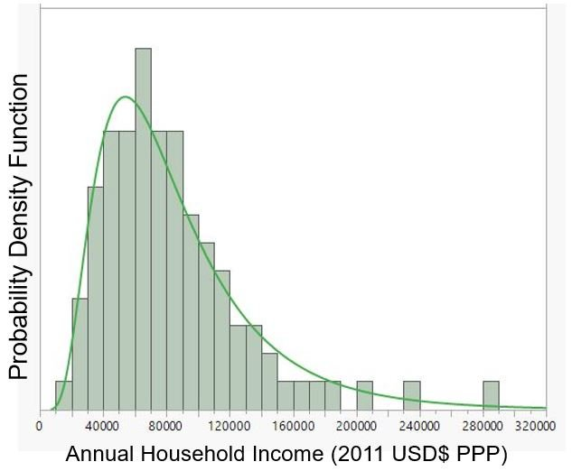
Skew
Things like income often follow a pattern like this – they are ‘skewed’.
The distribution pattern is often log-normal.
In these cases the mean is greater than the median.
It is ‘pulled’ by the higher values.
The ‘clump’ of most records ends up grouped fairly tightly, compared to a bell curve.

Slide 7
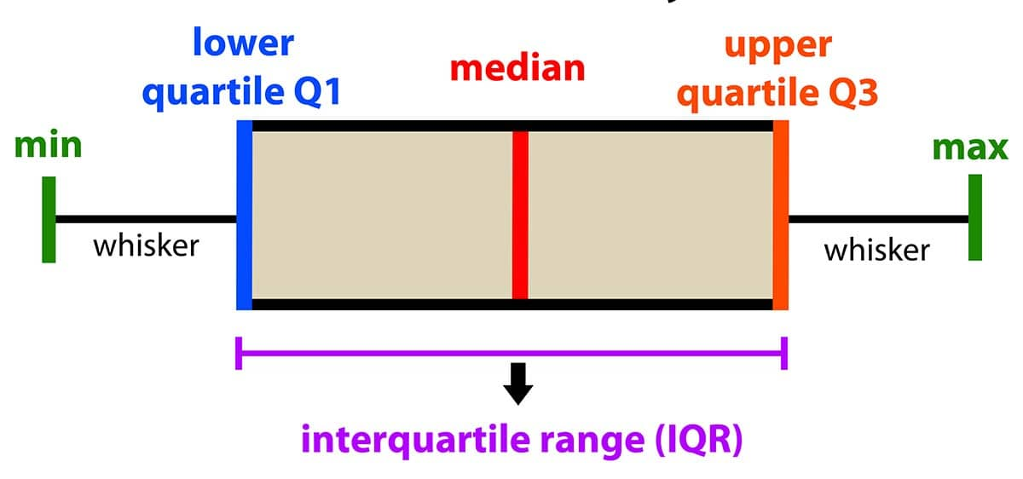
Boxplots
Boxplots are another visualization that can help us explore the data.
An alternate look at the data this is in a histogram.
The IQR interquartile range is a common value that shows us where the middle 50% of data lies.
Is it clustered or widely dispersed?

Slide 8

Ok, but Why?
What’s the point of all of this?
We can use what we see here to help make some changes to the data, or transformations.
As with other things, we may notice this in our exploration and apply some changes.

Slide 9
Transformations
Transformations on data are just operations that we do to our data before using it.
I.e. each feature has some values, we might run them through a function to get the data we use to make predictions.
This seems weird, as we are changing the data, which often feels wrong.
We don’t really care at all about the data itself that we’re using to predict, all we care about are the results of the predictions.
So, transformations modify the data we’re using to make it better for our predictions, even if the changes make the data less “correct” with respect to the original values.
There is not a set of “do this”* transformations, it is situation dependent.

Slide 10
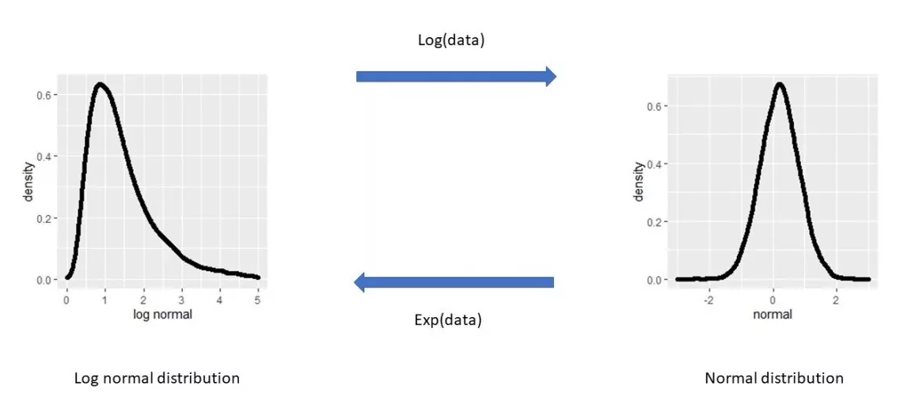
Example – Skew With Log Transformations
One common thing we can do is to remove skew in a value with a Log Transformation.
We take skewed data and use the log of that data instead of the original.
The result is normally a more normally distributed feature.
Ok, but still… why?

Slide 11
Autobots, Roll-Out!
What happens here and how does it help?
In several models (the details are largely beyond our scope) there is an assumption that data is normal, so if things are normal we’ll get better results.
It also makes the residuals – errors of each prediction – more consistent.
In the original, the amount of error above/below isn’t even.
In the transformed version, it is.
In models that use an iterative process to ‘work towards’ and answer, this helps a bunch.
Note: with our simple linear regression the impacts are minor, the other model part will make sense soon.

Slide 12
Using transformations
If we think a transformation is helpful, we can try it and see the results.
Use a function or just a line of code to change that variable before it goes into the model.
If we want the “real” value, we need to undo this.
If we did a log transformation to a target, our predictions would be on a log scale.
We could use the opposite of a log, exp(), to get the value back on the real scale.
When transforming features, we don’t need to convert back.
This is something that may be helpful, or may not, we need to test.
Note: this is more significant for more stats-y work, less with large ML models.

Slide 13
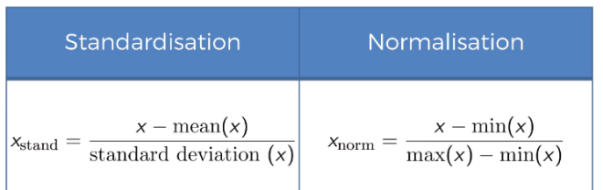
Common Transformation – Feature Scaling
There is one transformation that we almost always want to do – feature scaling.
Feature scaling takes our input features and puts them on the same scale, or range.
There are two common options:
Standardization – each feature is set to a mean of 0, and std of 1.
Normalization – each feature is shifted to be between 0 and 1.

Slide 14
Why Scale
Again, why would we do this?
In short, if features have a very different range, one can “dominate” and make the model perform poorly. Suppose a bank is offering a loan, and a model predicts interest rate.
Recall, a linear regression prediction is y = m1*x2 + m2*x2 +b.
If X1 is ’net worth’ the range may be -$500k to $50 million or something.
If X2 is ‘age’ that range is 20 to 100ish.
The raw size of the income numbers “overwhelm” the other term.
Different types of models and data can be impacted different amounts by this.
Simple linear regression, not much, other models, quite a bit.

Slide 15
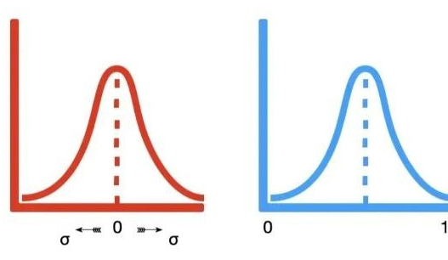
Results
The results of data scaling is that all of the features are on the same scale, either:
Centered at 0 with standardization. Or
Boxed between 0 and 1 with normalization.
This means that the actual x values going into the y-mx+b equation are on the same scale, so if one was really large, that impact is negated.
Models will generally perform better:
Accuracy can and often does improve.
The speed of a model finding a solution gets far better (important later on).
We almost always want to do some scaling.

Slide 16
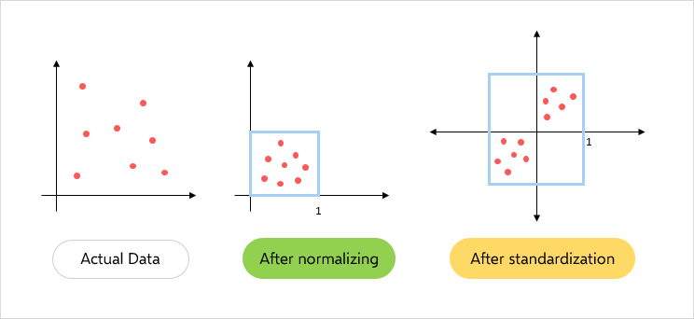

Slide 17
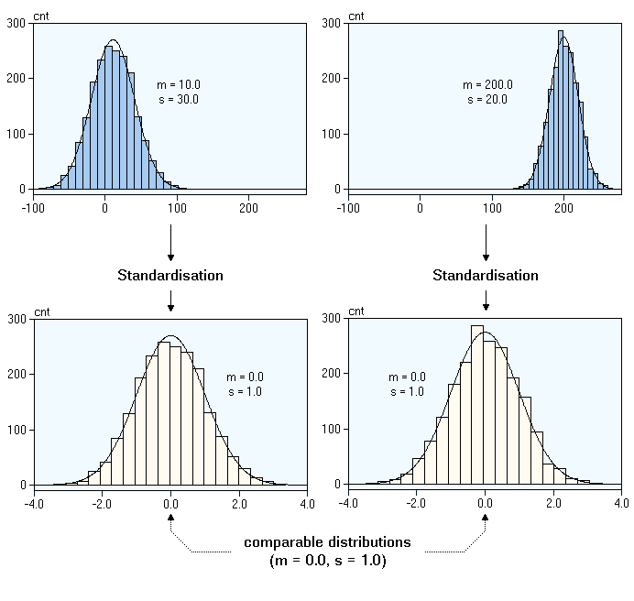
Data Example
The two features pictured here are obviously different in their original range.
After standardization, they are similar.
This lets our model consider the impact of all features in a comparable way.

Slide 18
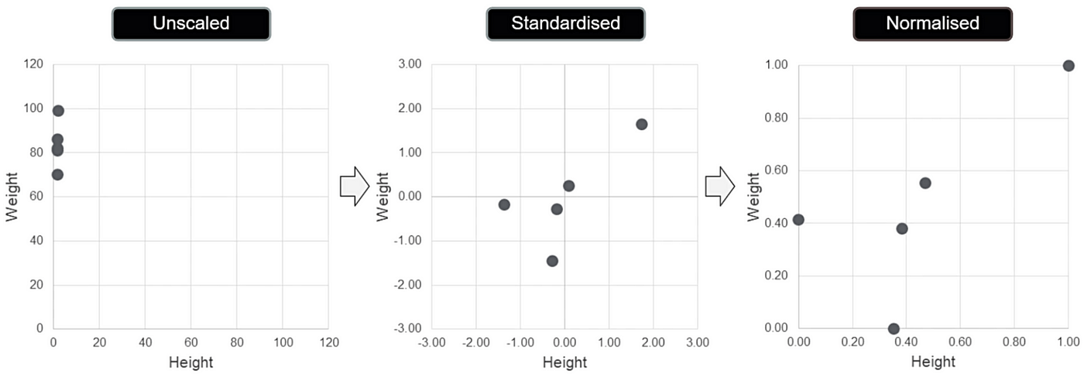
Comparison

Slide 19
Feature Scaling Usage
We generally use feature scaling all the time, there aren’t really any downsides.
Which one do we use?
There is no “true” answer, we test and observe the performance.
If the data is roughly normal to start with, standardization will likely be better.
The steps in code are simple.
Make a scaler object, using the sklearn module.
Fit the scaler to the training X data, so it learns what the new scale should be.
Transform the test data, so it is on the correct scale.
Once this is done, nothing else changes. (Note: no need to scale y, generally).

Slide 20
Transforming for Fun and Profit
Making transformations to the data we use for models is common.
We can learn from our data exploration, stats knowledge, and domain knowledge.
Does it look like any ad-hoc transformations may be useful.
We pretty much always rescale our features.
Prevents one value from “taking over” the importance.
Allows more elaborate models to find their solutions more quickly and reliably.
There’s no real drawback.

