Slide 1
Housekeeping
Today – trees (017)
Classification trees
Tree logic, theory, and background math at a high level.
Using trees (very little changes in code).
Under and over fitting and mitigation with HP tuning.

Slide 2
Trees
They Grow

Slide 3

Preamble
Train-test split and cross-validation.
We can use train-test split to get training and testing data.
The training score is how accurate the model is on the predictions for the data it is using.
The test score is how accurate the model is on the data that was held aside.
We can also use the grid search cv in its place.
The data will be split into k sets, one used for testing each round.
These two can also be combined and used together.
The cross-validation will do its thing, but only the test data is used for it.
The test score is generated from the data held aside from the cross-validation.

Slide 4
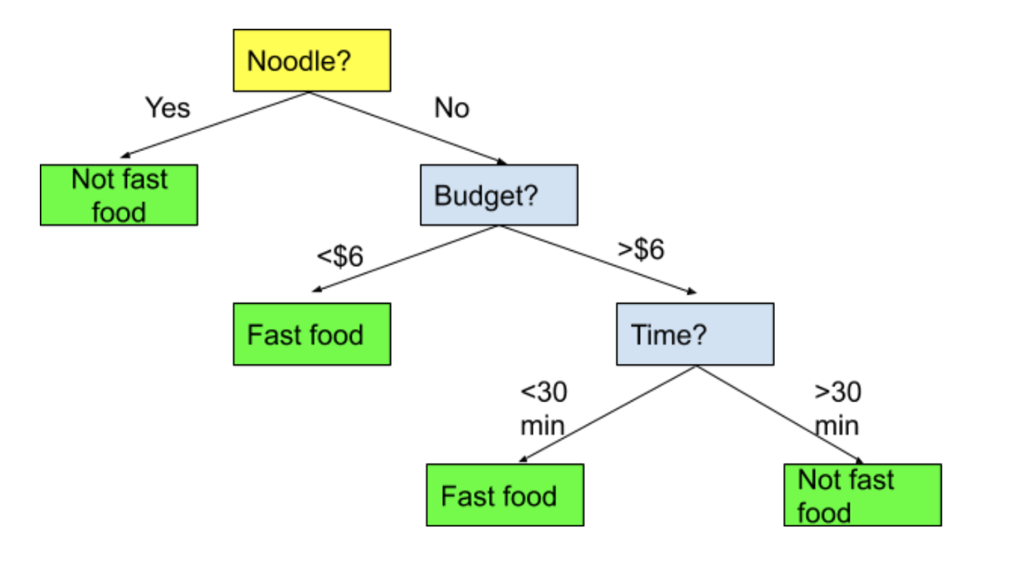
Trees
Trees are one of the simplest to understand models in machine learning.
A tree is just a series of if statements, until a decision is reached.
Once the tree is made, making a prediction is dead simple, just follow the tree and make decisions.
We’ll look at classification trees first, regression are similar once we understand classification.

Slide 5
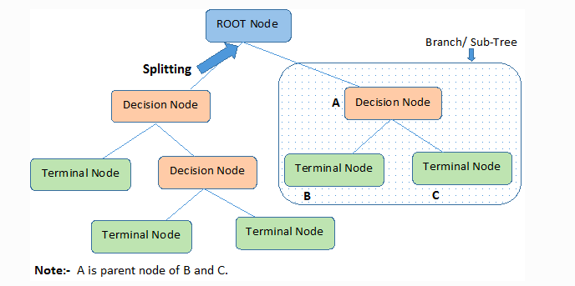
Tree Parts
The parts of a tree are simple and tree like:
Node– each point.
Decision – node where a split is made.
Terminal/leaf – node where a value is determined.
Brach/Sub-Tree – a segment of a larger tree.
Depth – how many layers the tree has.
Samples – number of items in that node.

Slide 6
Building the Tree
The decisions and the cutoffs are created by looking at the features for the criteria that will do the “best job of deciding” – or that will split the group most sharply.
For example:
You are classifying people as horse jockeys or basketball players.
You know their height and hair color.
Height does a better job of splitting the records.
Those >6ft are almost all bball playters.
Those <6ft are almost all jockeys.
Your choice would be to divide the data based on height.
The algorithm finds the decisions that maximize this separation.

Slide 7
Criteria
The criteria for how good the separation can be defined by different metrics.
Gini.
Entropy.
The math behind each is different, the idea is the same.
Gini is the default.
When the algorithm creating the tree is deciding how to split at one node, it picks whichever feature/criteria that does the best at improving the metric.
In classification, that means each side of the split becomes the most ‘pure’.
In regression, that means that the MSE is the lowest.

Slide 8
Scenario
If we have 4 red gumballs and 0 blue gumballs, that group of 4 is 100% pure.
If we have 2 red and 2 blue, that group is 100% impure.
If we have 3 red and 1 blue, that group is either 75% or 81% pure, if we use Gini or Entropy respectively.

Slide 9
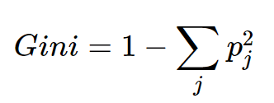
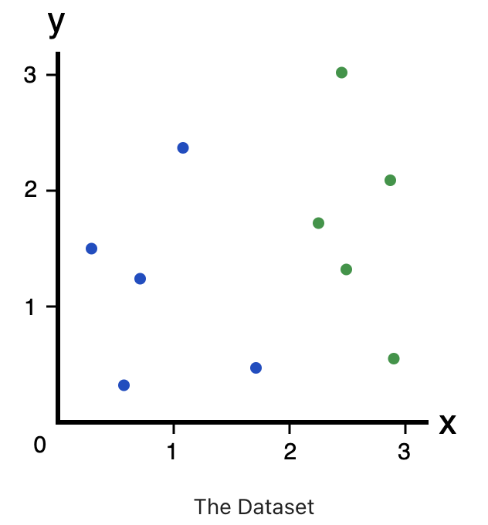
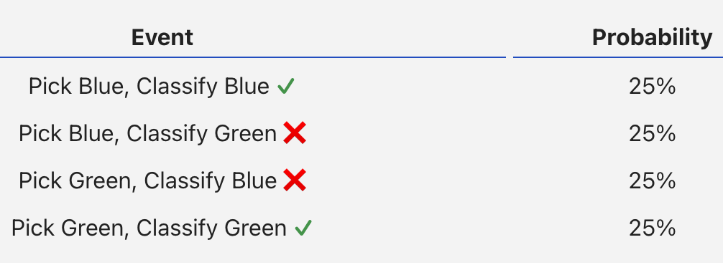
Gini
Gini measures how often a randomly chosen element from the set would be incorrectly labeled.

Slide 10
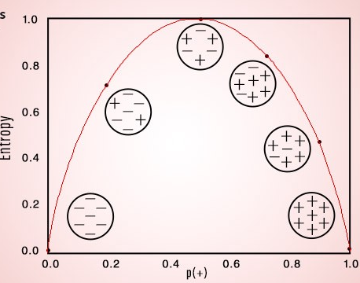
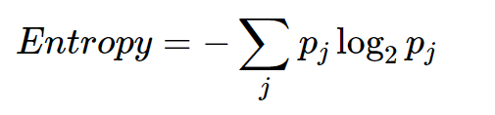
Entropy
Entropy is similar to Gini – a measure of impurity.
Created to convey the idea of information – the lower the entropy the more “information” it conveys.

Slide 11
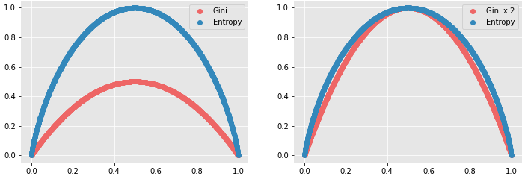
Splitting Decision
The algorithm looks for the decision that maximizes information gain or purity.
Gain = Gini/ENT before the split – Gini/ENT after the split
The split is the one that makes the tree more pure after.
Maximize discrimination with the division.
The series of the decisions makes the tree sequence of decisions.
In practice Gini and Entropy will usually give close to the same results

Slide 12
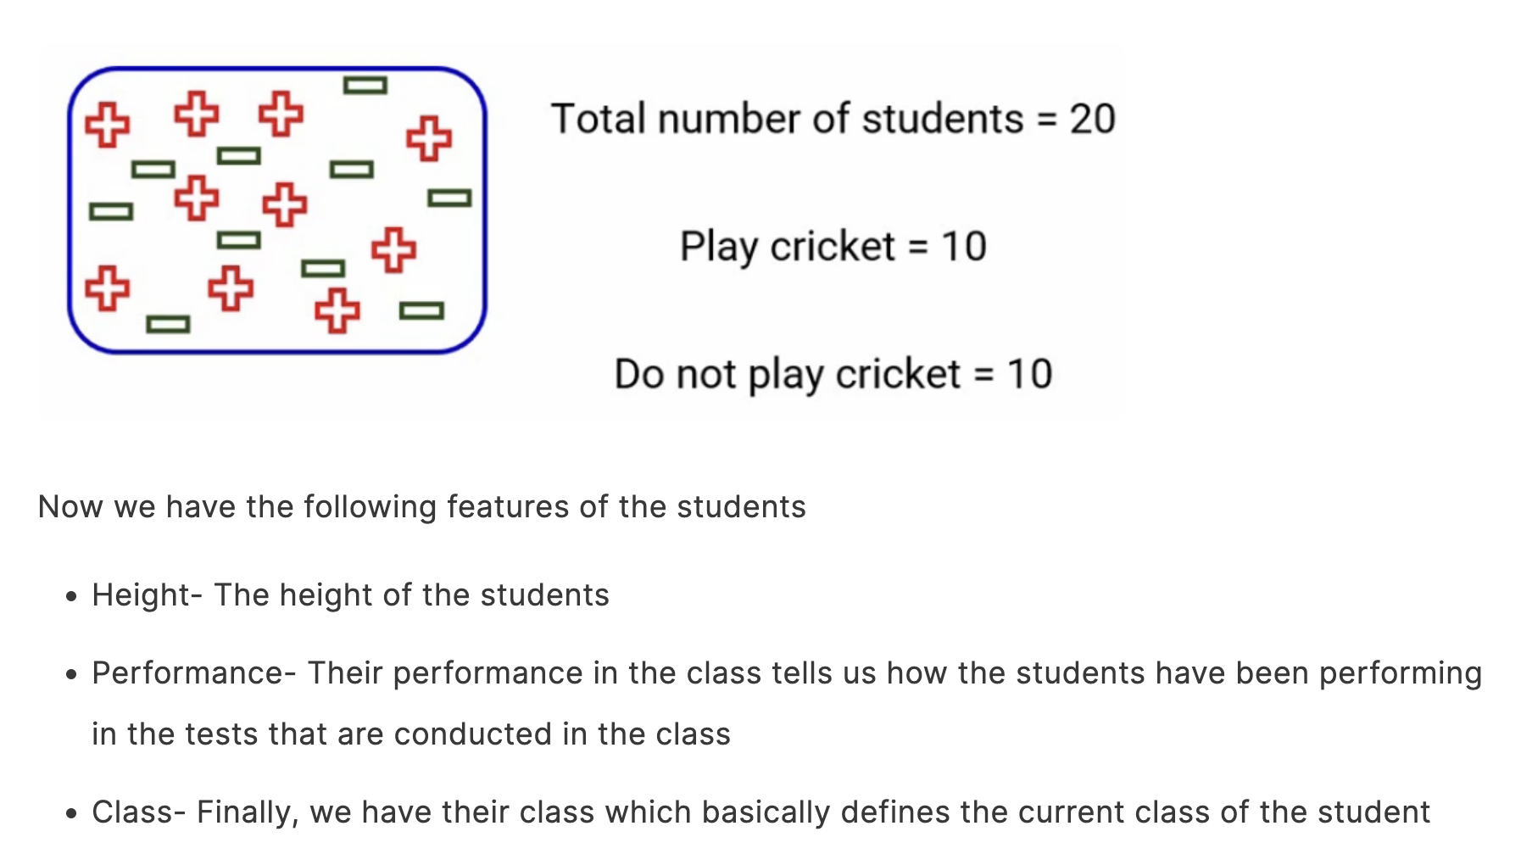

Slide 13
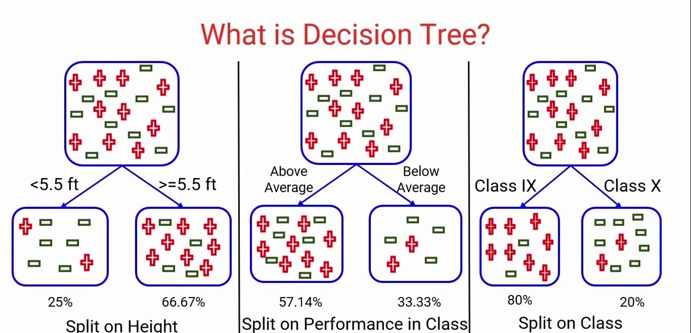

Slide 14
Woody Goodness
Tree benefits:
Simple, understandable, and mirrors human decision making.
Handles non-linear relationships.
Non-parametric (Meaning they aren’t based on prior assumptions, like normality).
Explainable – we can follow the exact logic of the decisions.
Data prep is minimal – no need to encode or scale data (inheirently).
Generally computationally efficient with large datasets when making predictions.
Can be acceptable in scenarios (finance, insurance, etc…) where a black box model isn’t.
A human can explain how a decision was made, this is less true with most models.

Slide 15
Barky Badness
Trees have some disadvantages:
Non-robust – small changes in training data can generate wildly different trees.
I.e. a small difference in train-test split can yield different split points, which can then lead to a very different tree. Even if the end results perform almost identically.
Prone to overfitting (though we can combat that when we code them).
Training with large datasets can be time consuming, especially when attempting to limit overfitting.

Slide 16
Overfitting and Underfitting
We call a model that is too tailored to its training data to be ‘overfitted’ or ‘overtrained’.
In many/most ML models, balancing over/underfitting is a primary concern.
Allow a model to learn enough so that it can make accurate predictions.
Constrain that growth so the model doesn’t become so specialized that it only predicts what it has already seen.

Slide 17
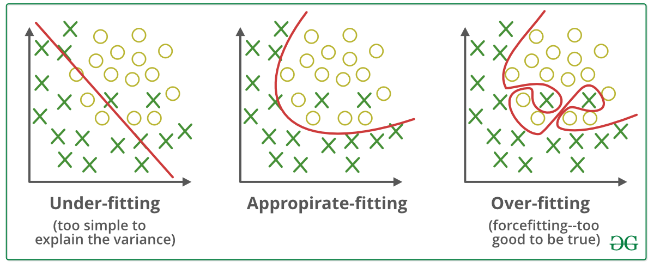

Slide 18
Observing a Tree’s Growth…
Trees are ‘greedy’ – they will try to get as accurate as possible without limits.
This means that if a node has 2 values, a 1 and a 0, the tree will split to two nodes of one item.
A tree working to get every single prediction correct in the training data is new.
Regression models will try to generate a model that is “down the middle”.
Regression models can’t really adapt to small differences in the data like a tree can.
Regression models need to take an “average” for the line to go down the middle, trees can adapt to ”pick out” values with much more precision.
One concern is that if a model is able to get so accurate on the training data, what happens when we have new data that it is trying to predict.

Slide 19
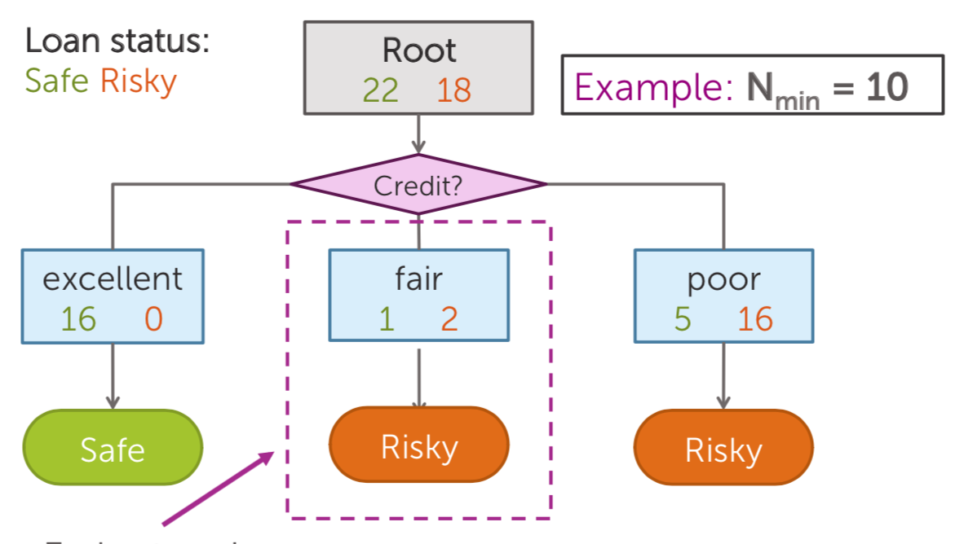
Example of Overfitting and Hyperparameters
The middle box has 3 items in it.
If we don’t limit the tree, it’ll split those into two perfect nodes.
The model would be “overfitted” to this specific data, and not general.
Hyperparameters can constrain this over adaptation.
Min samples to split, max depth, min samples per node…
We want the model to learn, but not go ”too deep”.

Slide 20
Fitting analogy
Suppose I was a predictive model that predicted if someone will pass a class.
My features (X values) are everything I can know about students – academic and demographic.
If I have a small tree (e.g. 3 levels), I’m probably going to decide based on attendance, HW, reading the text, etc….
If I have an unlimited size tree, I will split each of those nodes to get to 100% accuracy, using whatever I can to do so.
Seat in class, hair color, etc….
My model is overly customized to the specifics of this one class.
This model is not generalizable, it works well for one exact example.
We want to stop a model before it gets overfitted, or too tailored to one dataset.

Slide 21
Hyperparameters are ready to Help!!

Slide 22
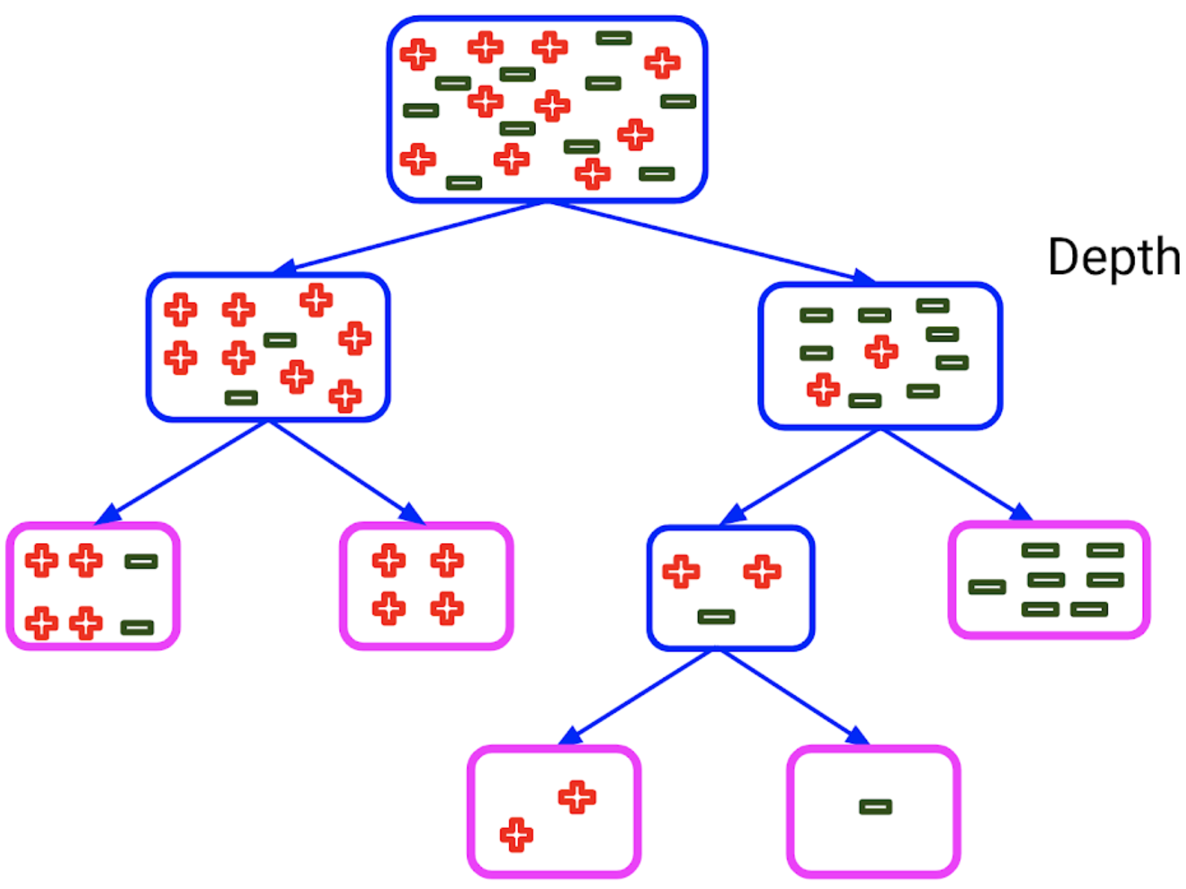
Making Better Trees - Hyperparameters
Hyperparameters are basically the settings that the algorithm uses while making a model.
Each algorithm has a different family of hyperparameters.
We can create different models with different HPs.
These models may perform very differently.
Tree hyperparameters can help us tailor our tree models:
Maximum number of levels in the tree.
Gini vs entropy for splits.
Minimum number of samples in a node to allow it to split.
Maximum total number of leaves.

Slide 23
So Many Parameters!
Parameters are the things that the model learns internally while training.
In a tree – split criteria.
In other models – weights, values, centers, etc… (This will make more sense later)
Hyperparameters are the things the model is told from the developer.
The rules on how the training process can run.
Settings for how it does its job.
Creating a model will require [model type + HP choices].
We often want to compare different HP sets against each other.
Soon we’ll look at tools to automate testing and comparing HP settings.
Can use HP settings to mitigate over/under fitting in a model.

Slide 24
Tuning the Model
We want our model to:
Learn the data well, so it can make accurate predictions.
Not become overly customized to the specifics, so it can make good predictions on new data.
We want to balance overfitting and underfitting.
Trees can tend to overfit if we don’t constrain their growth.
E.g. if a node has a T and F, just split so each node is perfect.
We want to let our tree fit to data, but limit how far it can go.
The model can get to near 100% in training, we want to constrain that growth.
The most common thing we’ll do with tuning is limiting overfitting.

Slide 25
Fitting a Tree
Our tree models are more complex than regression – they can learn more complex things.
Hyperparameter tuning of our tree is more significant:
The hyperparameters give us many different ways to limit this growth of the model.
We can try different combinations to find a good balance.
Training vs testing vs cross-validation:
A training score that is much better than a testing score is an indicator of overfitting.
The model has learned too much, and is excellent at predictions in training, but does poorly on new data.
A testing score that is much better than a training score is an indicator of underfitting.
The model hasn’t learned enough about the training data to make accurate predictions.

Slide 26
Tools for a Good Fit
For trees, hyperparameter tuning is our primary tool.
We have many HPs that impact different aspects of how the tree is allowed to grow (learn).
More aggressive constraints = less overfitting.
A grid search can automate this, as there are many combinations.
There are other techniques that apply with other ML models (for context):
Regularization – limiting the ability of a model to grow. We’ll see this with ccp_alpha in trees.
Early stopping – don’t allow the model to keep training after some cutoff.
Dropout – remove parts of the data (at times) so a model can’t overtrain to it.
We force a tree to be accurate, with fewer possible decisions to do so.

Slide 27
Tree Conclusion
Trees are a very useful type of model, that can work better than regression sometimes:
Can handle non-linear relationships by default.
Able to be very adaptable, i.e. able to learn more complex relationships in data.
Can be explained – a human can walk through the decision.
More advanced ensemble (more than one model combined) models use trees as a base.
Tree issues still exist:
Tend to overfit – to become too customized to the exact training data.
Unstable – small differences in randomness in training can result in very different models.
More variability in what results – we need to run trials more than with regression.

Slide 28
Cost Complexity Pruning
Cost complexity pruning is a way to reduce the complexity of a tree after it is made.
CCP finds the leaves that are least beneficial.
The complexity parameter is used to define the cost-complexity measure, Rα(T) of a given tree (or branch of a tree) T:
Rα(T)=R(T)+α|T|
Where |T| is the number of terminal nodes in T and
R(T) is traditionally defined as the total misclassification rate of the terminal nodes.
Parts of the tree that were least helpful are pruned.
Acts to limit tree size like hyperparameter limits, but dynamically based on the tree.

Slide 29

Be More Alpha
In the CCP equation Rα(T)=R(T)+α|T| the alpha-t is a penalty.
The larger the number of terminal nodes gets, the larger the penalty.
The larger alpha gets, the larger the penalty.
Effectively removes things that have many terminal leaves.
Larger trees will generate larger penalties in branches.
Tends to limit overfitting, as it stops large branches from being developed.
Adding a penalty to “size” is a common strategy.
If a split is going to happen, it needs to “overcome” the penalty incurred by increasing the number of terminal nodes ( |T| increases ).
R(T) needs to decrease, or more accuracy, to overcome alpha-T increase.

