Slide 1
Unsupervised Learning and Clusters

Slide 2
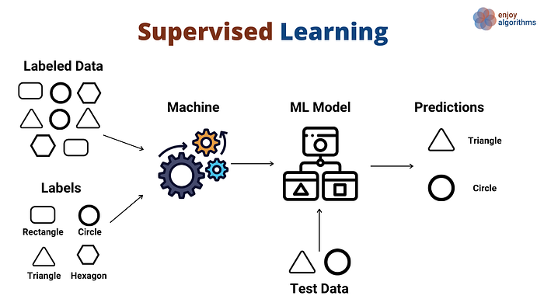
Less supervision
Everything we’ve done up to now has been Supervised Learning.
In supervised learning, we know the potential outputs in advance.
Supervised learning is a machine learning technique in which we fit the model with both inputs(features) and outputs(labels) of the data.
Both regression and classification are supervised learning.

Slide 3
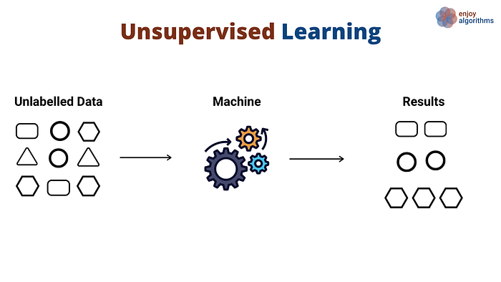
Unsupervised Learning
In unsupervised learning, we don’t have the target values of the training data up front.
Explores patterns in the data.
Common types:
Clustering (grouping similar things)
Dimension reduction (reducing the # of features).
Association (looking for common shared things – customers who buy things, song recommendations).

Slide 4
Why and How
Unsupervised learning is common and can work with or without supervised learning.
We may not know exactly what we are looking for.
Searching through Amazon customer data to find similar customers.
We may not have labels at all, so we have no choice.
This may help as a step in a larger process.
We can make data smaller, to display it or process it faster.

Slide 5
Clustering
Clustering seeks to group data into clusters that are similar to each other.
The features we feed the model are what are calculated for similarity.
The patterns of similarity we can find with clusters and large data are far more in-depth than we can do by hand.
For example, suppose we are in marketing for a car company.
We have a bunch of data about customers – age, purchases, address, job, etc…
We can feed the customers into a clustering algorithm.
We get segments of similar customers, and we can then target advertising to them differently.

Slide 6
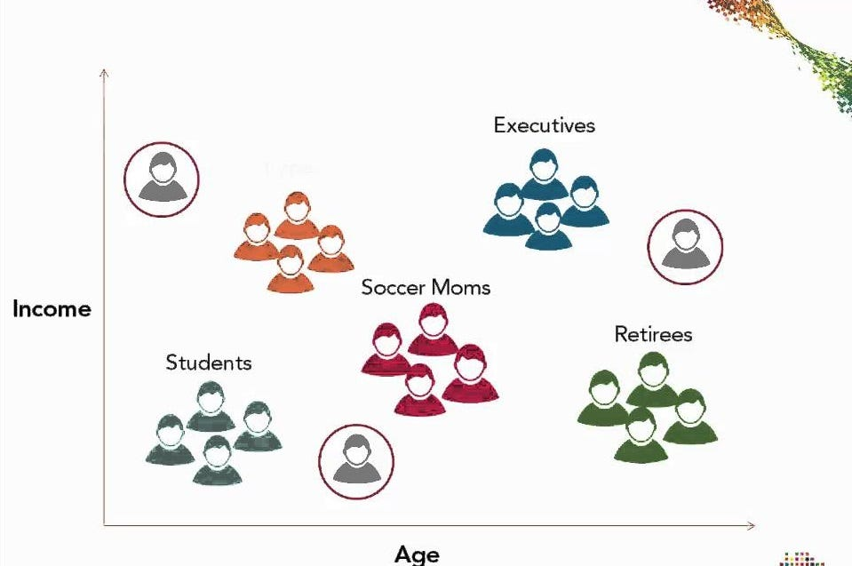

Slide 7
Using Clusters
This is the same idea as looking at our data, and sorting them into groups.
The relationships we can find with lots of data are far more obscure.
We may be able to predict that “25m Firefigher” and “29m Stockbroaker” might both fall into the same segment who wants a sports car It may be harder to identify other people who might end up with similar shopping patterns, but different demographics. Maybe people who got divorces or are balding may end up falling into the same customer.
In large applications (FB, Google, Amazon) this can be quite smart.
Marketing never really has a high “hit rate”, so raising the likelihood of targeting the right people is very valuable.

Slide 8
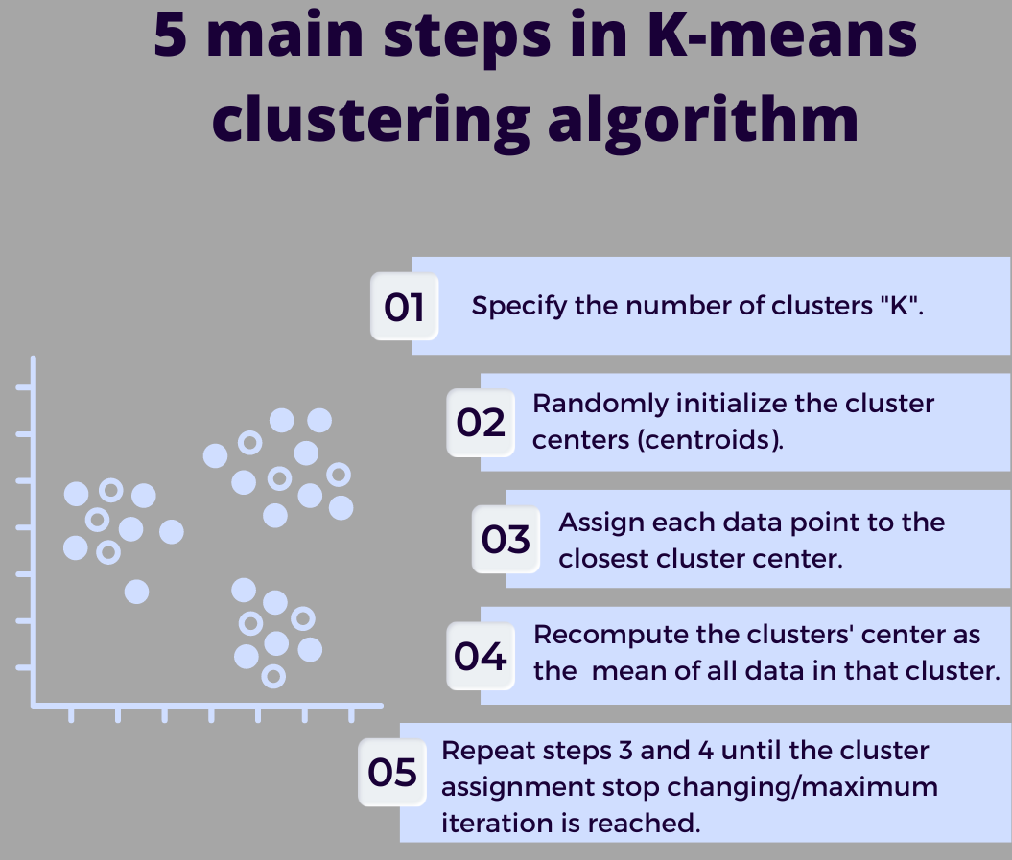
Creating Clusters
There are several algorithms that can create clusters in different ways.
We’ll look at K-mean clustering.
In sklearn, we just need to feed the algorithm the data and the number of clusters to make.
The process here creates the clusters iteratively.

Slide 10
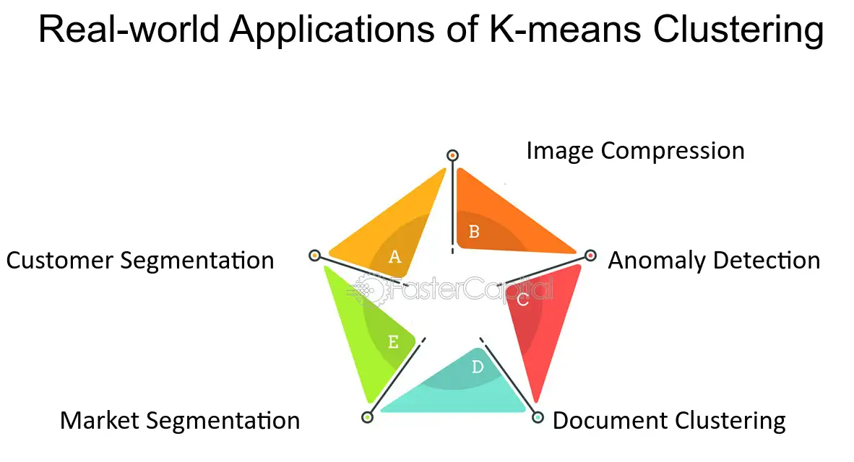
Conclusion
Clustering is common in many domains.
Marketing and customer management are the most prevalent.
Fraud or anomaly detection is another.
Cluster all financial transactions at a bank.
Most will cluster into several similar groups – mortgage payments, ATM withdrawals…
We may get small groups or anomalies (ungrouped items) that are worthy of investigation.
This generally uses algorithms other than k-means, but the idea is the same.
Large companies with billions of transactions can become very good at this. Amazon started offering it as a service to banks that use AWS cloud, so they can learn from many banks.

