Slide 1
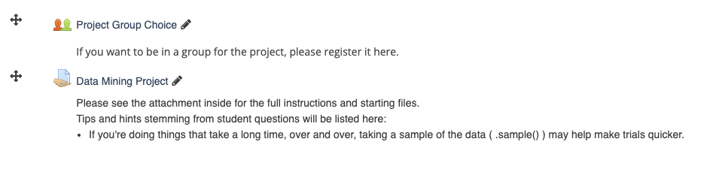
Today
Ensemble Models:
Forests
Bootstrapping
Project is up – groups of up to 3, if you want.
There’s a test in a week.
Cutoff point here.
I’ll write a guide – ML basics – model types, error, fit, data processing, results…
MC and a few short answers.
Pretty straightforward.

Slide 2
The Forest and the Trees

Slide 3

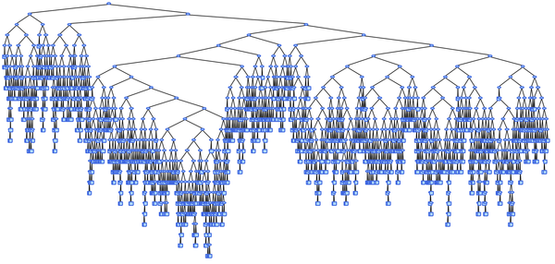
Trees
Trees allowed us to make predictions that are transparent and simple.
Trees suffered in their lack of stability and tendency to overfit.
What’s better than a tree?
A forest!!!!

Slide 4
Ensemble Models
Ensemble learning models are just combinations of more than one model.
Ensemble models can be split into bagging and boosting.
Bagging:
Creating different models in parallel.
E.g. a forest is a bunch of parallel trees.
Boosting:
Using results of one model to improve later ones.
This is a little more involved.

Slide 5
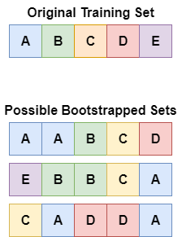
Bagging Ensembles
Bagging starts with creating ‘bootstrapped’ data sets.
Each dataset is the same size as the original.
Each set selects random items from the dataset WITH replacement.
Each dataset may have 0 or more copies of each training row.
Each dataset is built from the same ‘stuff’ as the original, but the balance is different.
“can encourage the individuals of an ensemble to explore features that may otherwise not be considered”
Can also limit a selection of features in each dataset.
I.e. select a random subset of features for each training set.

Slide 6
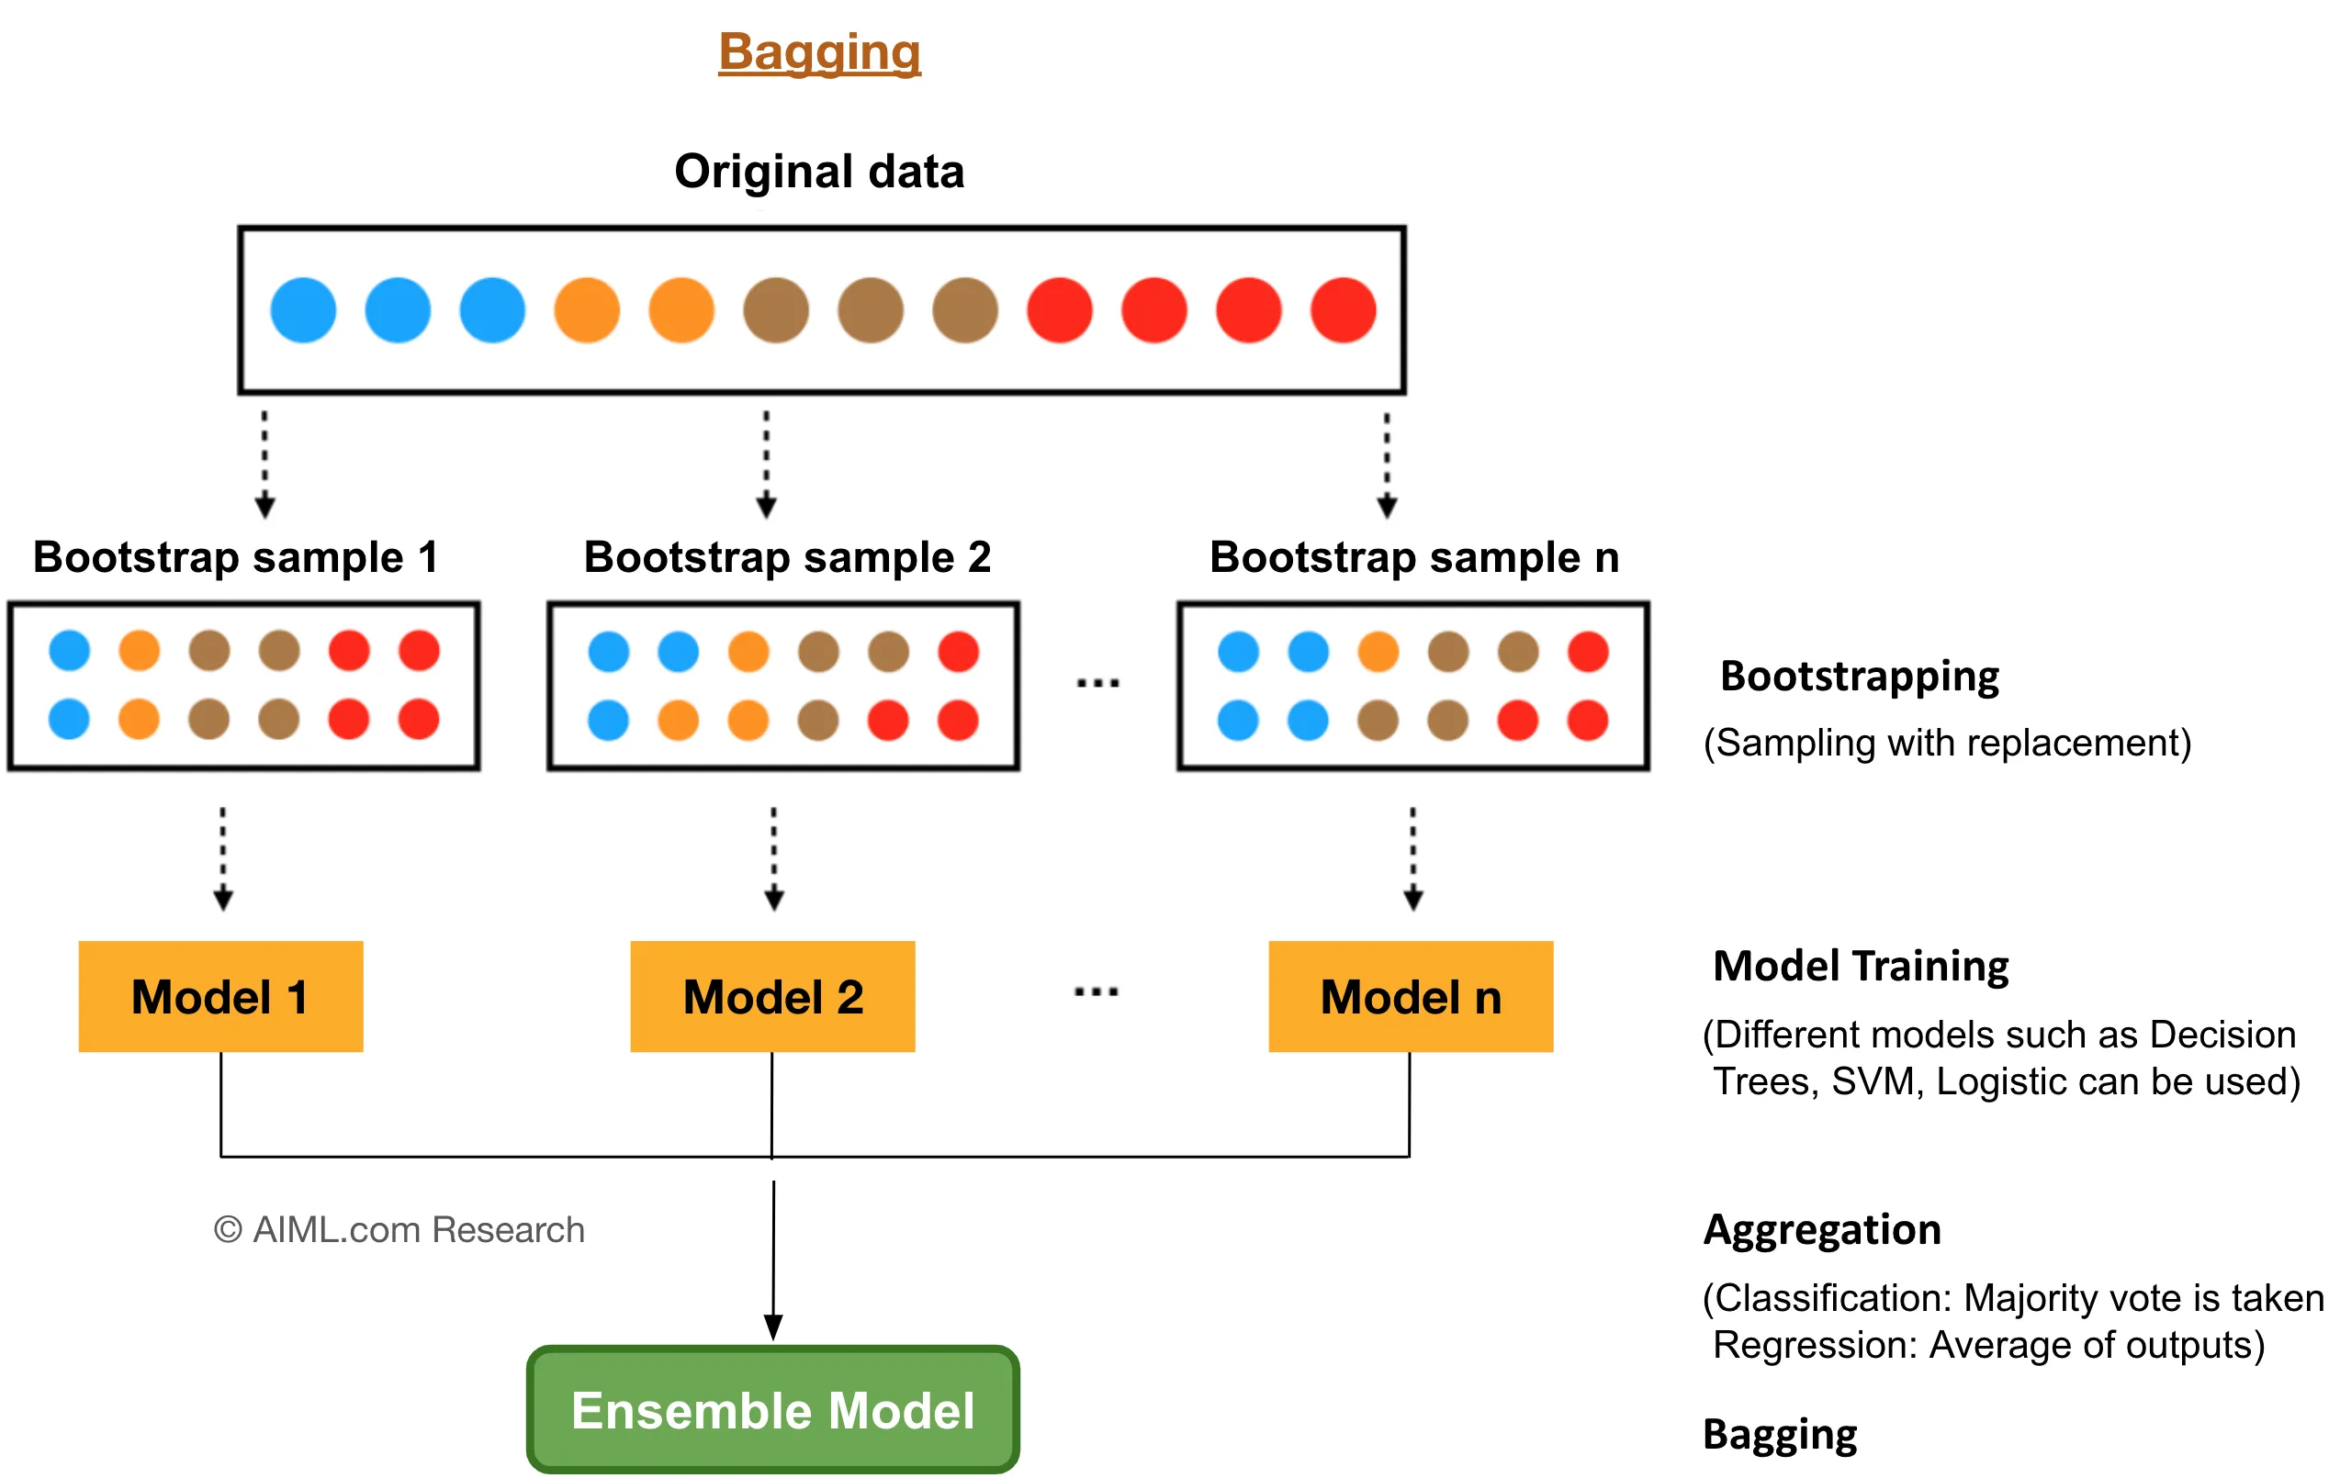

Slide 7
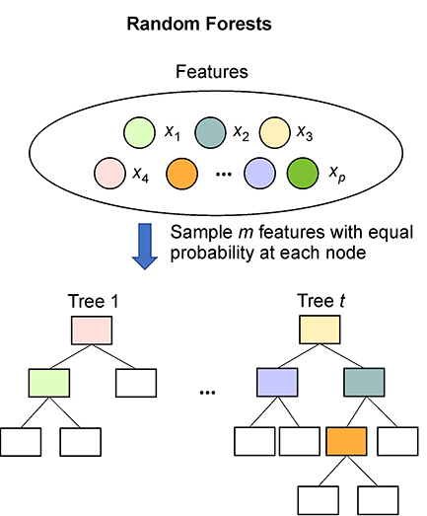
Features
Ensembles also generally only use a subset of features for each model.
Can also be done per node (i.e. each node can only select from M features).
Each model only has a few features, so it can’t overfit much.
Sometimes it has to make decisions based on other stuff.
Combined with bagging, each model is predicating based on a different subset of the training data.
Gains fit with # of trees, not depth of trees.

Slide 8
Forests
Forests are an ensemble of multiple trees. (Default is 100).
Each tree is created from a random bootstrapped selection of data.
Each tree makes its own predictions on the test data.
The predictions are voted (or averaged, for regression) to create a final result.
Result:
The random variation in tree results due to splits is neutralized.
Less variance in results.
Individual overfitted trees will be “outvoted” for final results tabulation.

Slide 9
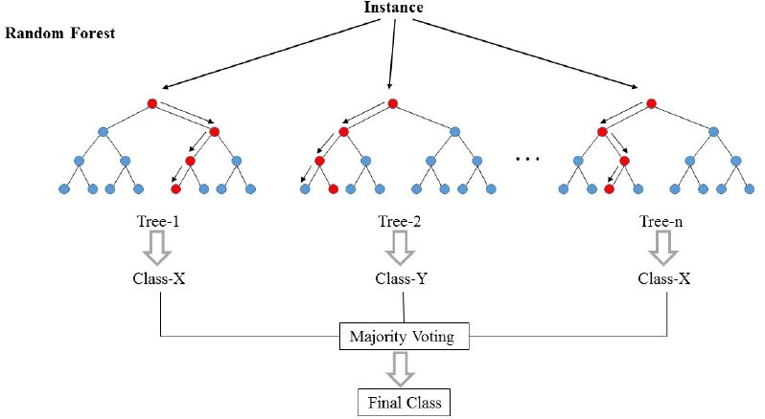

Slide 10
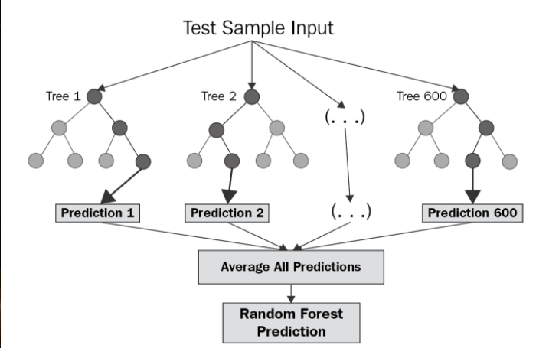

Slide 11
Forests
Can be both accurate and simple.
Not really explainable in the same way that trees are though.
Combining multiple models with a specific weakness can mitigate that weakness.
Trees often overfit if they are accurate.
Multiple trees from different training sets fights this.
Boosted (adaboost, xgboost) tree models are very accurate.

Slide 12

Boosting

Slide 13
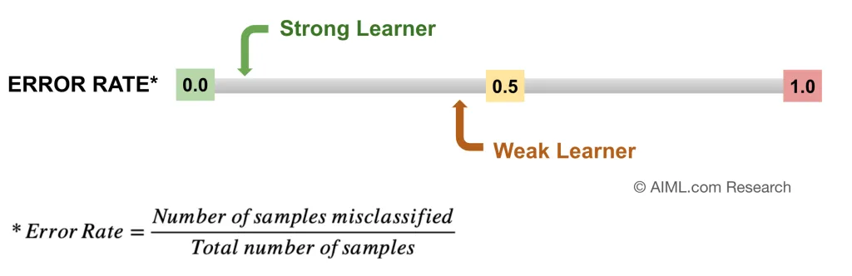
Weak vs Strong Learners
Most machine learning models, including regression and tree ones, are strong.
This means that they do “much better than baseline”.
Weak learners are smaller, simpler, models that do barely better than baseline.
1 or 2 layer tree, regression with small number of X, etc…

Slide 14
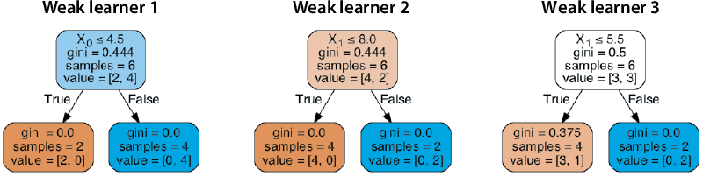
Why be Weak?
So why would anyone care about a weak learner, like a 2-level tree?
Weak learners are fast to process, which matters when we have lots.
Weak learners don’t overfit – they don’t have enough capacity to. E.g. 2 or 3 features and decisions.

Slide 15
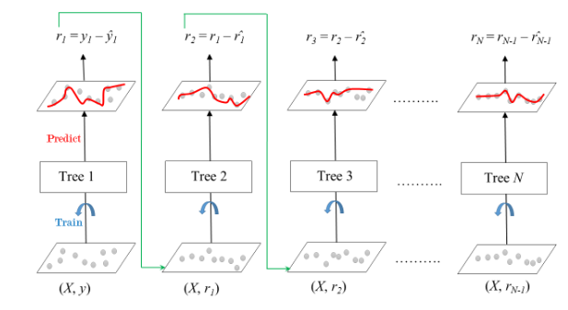
Stack Weakness
Boosting ensembles work by combining many weak learners, in sequence.
In gradient boosting, each model will:
First round – prediction is just the mean of all values.
Be fitted to the residuals of the previous model (i.e. where the ensemble has error).
‘Chain’ its adjustment onto the prediction.
Each ‘corrects’ the current prediction a little.
The ensemble gets the fit of a tree through #s.
Overfitting is avoided because only error matters.

Slide 16
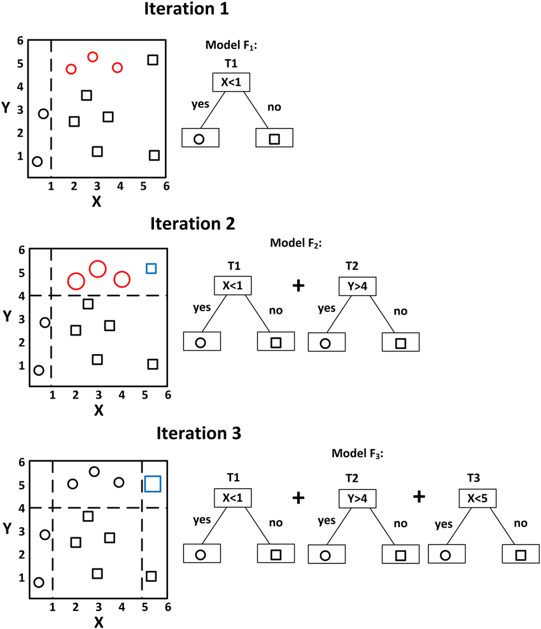
Boosting
Boosting is another type of ensemble model.
Boosting is sequential, one model feeds the next one.
The most prevalent models use gradient boosting – one model fixes another’s residuals.
These models tend to be near state of the art:
The tree base is able to fit very well to data.
The smaller size of the models prevents overfitting.
The focus on error allows for adaptation, but only where the model was wrong before.

Slide 17
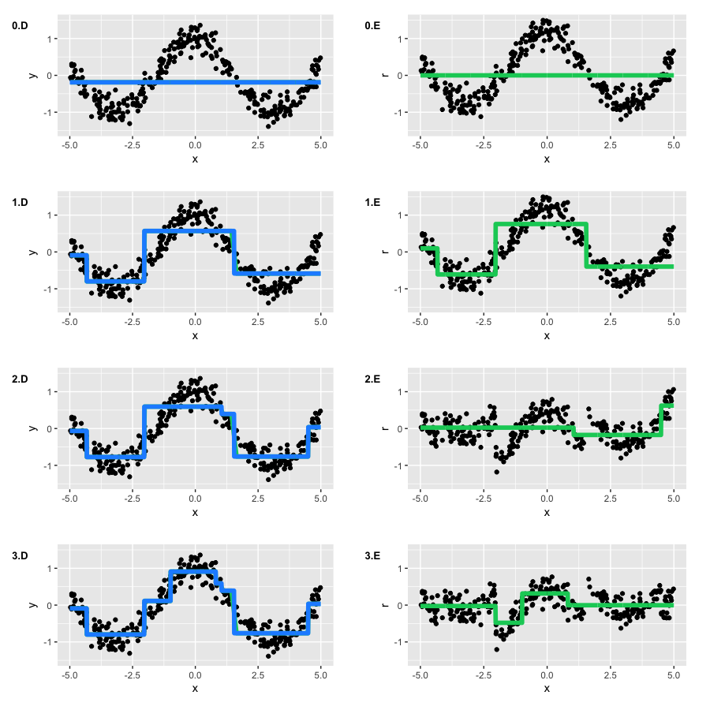
Results:
Each iteration makes the model slightly more fitted.
The values that have high residuals are what are ‘targeted’.
Blue – ensemble model.
Green – residual model.

Slide 18
Conclusion
Boosting models are generally the best overall for smaller tasks.
Large things like image and speech are likely better with neural networks.
Smaller projects, or things using tabular data are likely to be best with something like Xgboost.
Ensembles combine many models to mitigate their weaknesses.
Bagging uses many models in parallel, with bootstrapped datasets.
Varying what each model does/sees allows for better fits with less overfits.

