Slide 1
Housekeeping
Assignments:
Regression one is generally decently done.
Common – cleanup of data, check data after, verify what is happening (print values/status)
Classification assignment – let’s look at it, file on Moodle. Walkthrough/Q+A at end.
Today:
Regression trees.
Tree pruning.

Slide 2
Regression Trees

Slide 3
Review - Trees
Trees are a relatively simple concept of a predictive model.
All the data “goes in” the top.
The predictions are the values in the leaf nodes.
Each record is routed to a leaf node via a series of decisions.
What those decisions are get determined by whatever does the best job of minimizing error – i.e. making pure subsets.
Trees are more flexible than regression, but prone to overfitting – being too tailored to the exact training data seen by the model.
Need to utilize techniques to limit the overfitting.
We want a model that is good on general ‘new’ data, not one that ‘memorized the answers’.

Slide 4
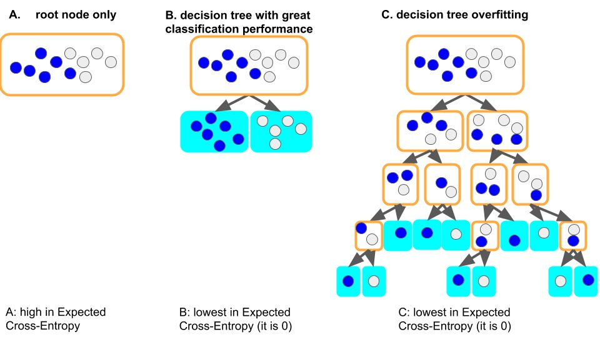

Slide 5
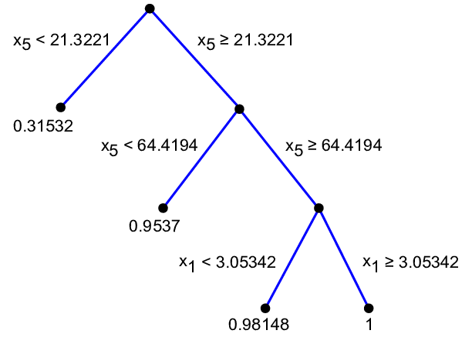
Regression Trees
We can use a tree to do regression as well.
The logic of how a tree works remains the same, some details change:
The split decision minimizes MSE not purity.
The predication of each leaf node is the avg. value in that node, not a class label.
Practical usage is not really any different in sklearn.
Same syntax, prep, pipelines, etc…
Note: the features for class/reg trees can always be anything, type is referring to the target only.

Slide 6
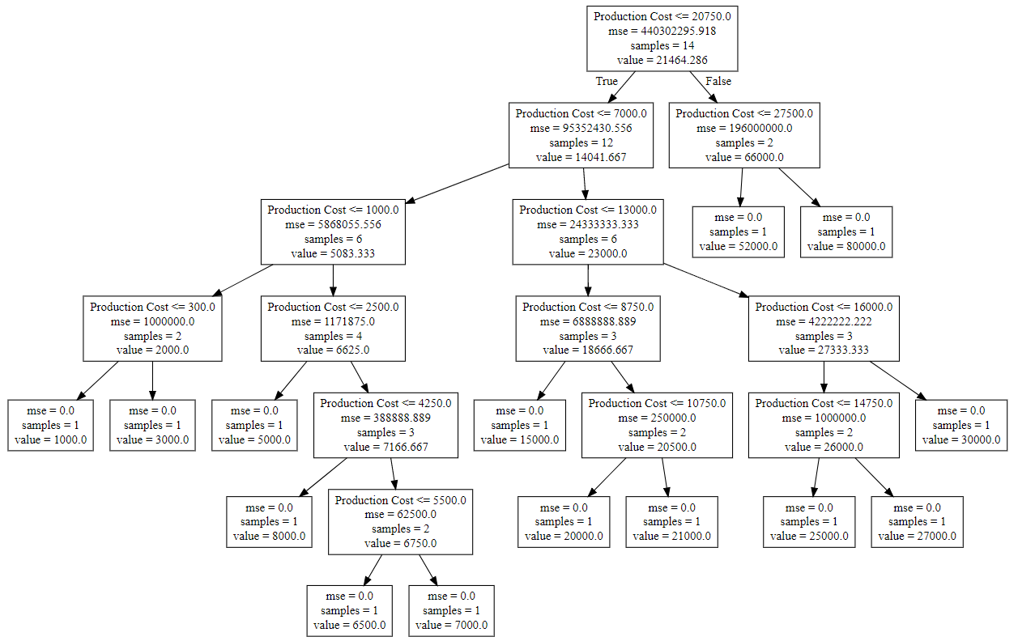
Regression Tree Structure

Slide 7

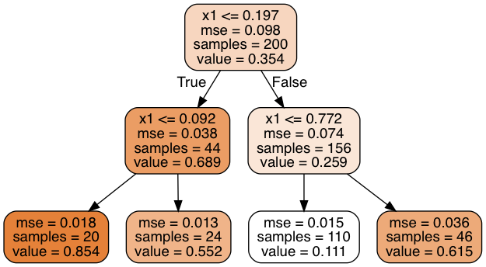
Deciding Splits
The split decision in a classification tree is based on the purity of the resulting nodes.
I.e. the goal is to split all True values from all False values.
The feature and split point (if numeric) are whatever does the best job of discriminating.
The split decision in a regression tree is based on the MSE of the result.
The algorithm will split the data so the MSE of the two nodes is minimized.
Note: the concept of having an algorithm work to minimize/maximize something, and allowing that something (cost) to change, is common in machine learning.

Slide 8
Leaf Node Predictions
Just like a classification tree, the regression tree predicts based on the value of the final leaf node.
In a classification tree it is the predominant class of that node.
In a regression tree it is the mean of the values in that node.

Slide 9
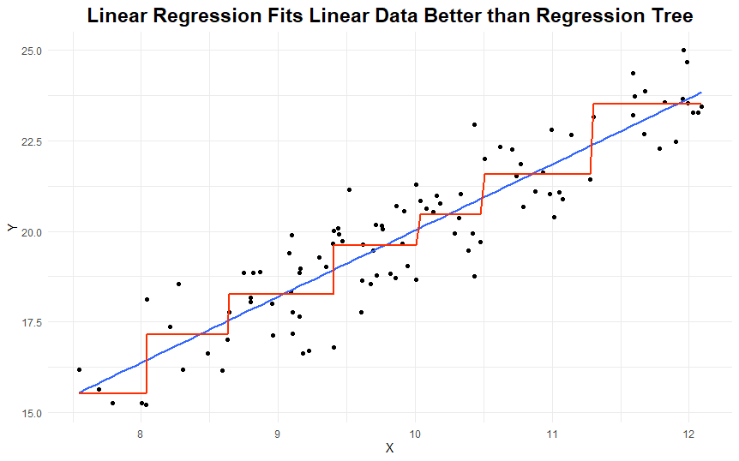
Regression Tree results
The predictions of a regression tree are different from a linear regression – they are discreet.
A linear regression’s predictions are continuous.
Each ‘step’ of the line is one leaf node – not a smooth curve.
Regression trees are limited:
They can’t extrapolate beyond data they see.
Only good over a limited range of inputs.
The number of possible predictions is constrained.
Regression trees can adapt to any relationship “shape”, not just linear – what is predicted (y) varies more w.r.t. X.

Slide 10
Extrapolation – Keep Going…
The inability to extrapolate is one of the stat-y things we can notice in EDA.
The properties of the data are going to impact the performance of models.
We can only make predictions that are the mean of previous target results.
Scenario 1 - Predicting student performance in school.
The range of the target is 0 to 100 (or 0-4 GPA), we have records all over that range.
Scenario 2 – Predicting total sales in dollars of a new car we developed.
The range of the target is 0 to unknown. Our training data likely doesn’t blanket the range.
Training data likely previous models, competitor cars, etc…
If our car is a huge hit, we can’t predict “off the charts” results – linear regression could.
These types of things can help guide model choice, are often subtle to notice.

Slide 11
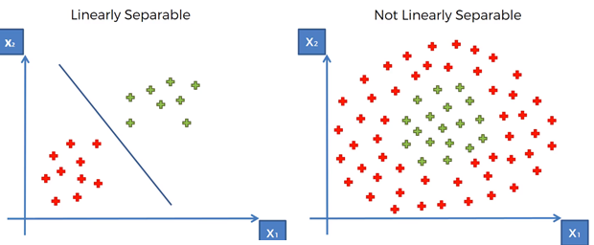
Another example
We’ll explore this more when we hit SVM’s, but data-model matching (kind of) matters.
Trees can adapt to data on the right, but can’t project to data outside its inputs.
Data exploration/stats knowledge can initially guide this, then performance can finish it.

Slide 12
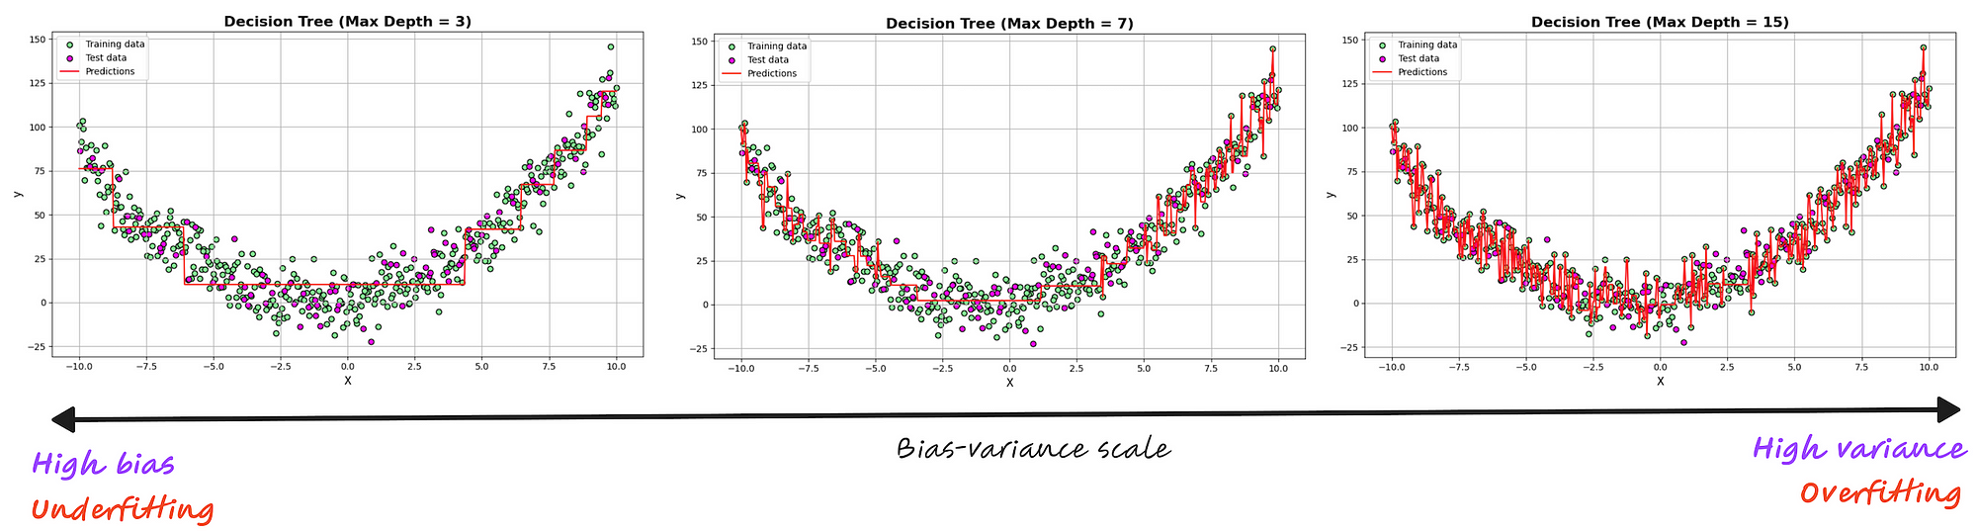
Regression Tree Fits
Like a classification tree, regression trees will overfit without limits.
For regression, that can mean one node per output value (i.e. the model gets MSE to 0)
Anti-overfitting things like HP limits, pruning, or forests are maybe more important here.

Slide 13
Error in predictive modeling
Bias Error:
Error due to assumptions made in the modelling process.
Generally results in underfitting.
E.g. assuming a linear relationship.
Variance Error:
Error due to variations in the training data.
Generally results in overfitting.
E.g. different training sets for trees generate very different models.
Irreducible Error:
Error that we can’t fix through modeling, it in inherent in the data.
May be able to fix it by cleaning data (removing outliers, correcting missing data, etc…)

Slide 14
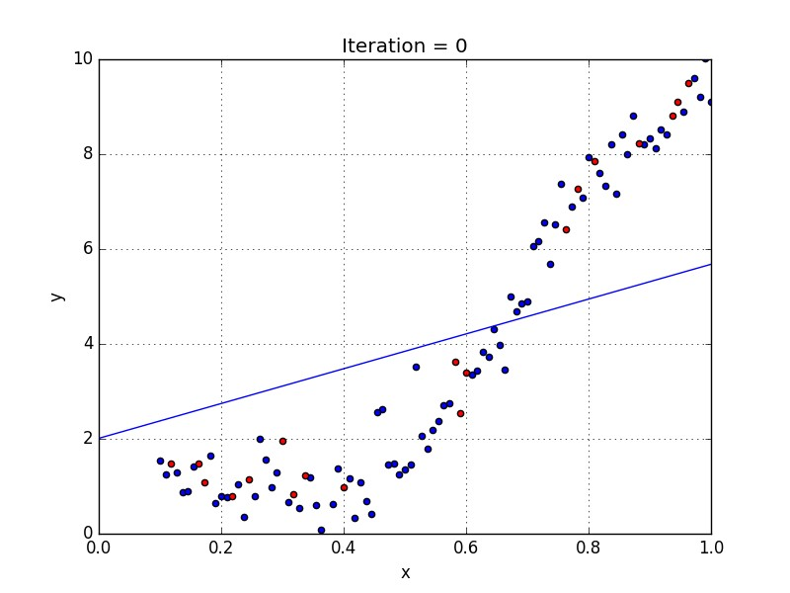
Bias Error – Model Assumes Linear Model is Underfitted

Slide 15
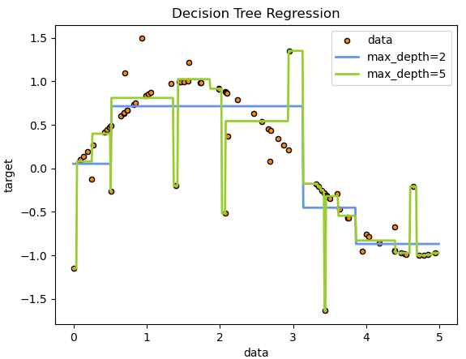
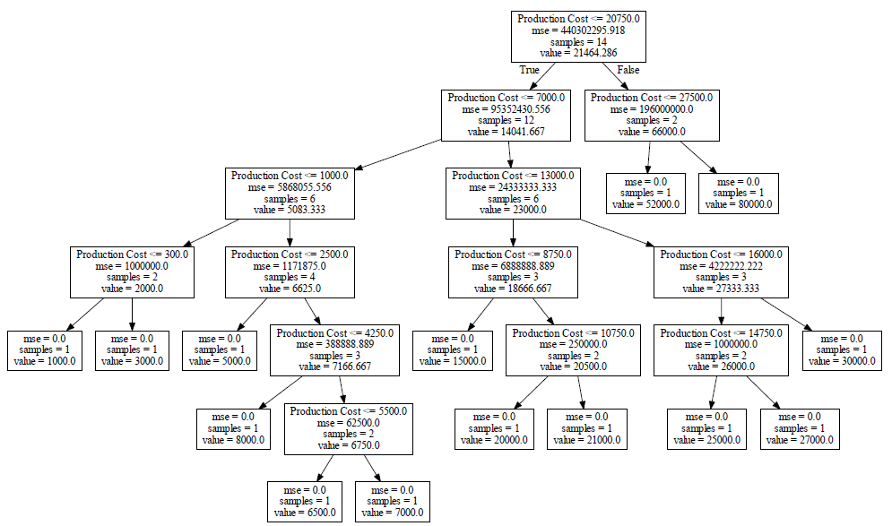
Variance Error – Tree that is Overfitted

Slide 16

Balancing Act
A good model requires a balance between Bias and Variance.
If we have too much bias our model won’t be adequately tailored to the data.
Simple models have high bias.
If we have too much variance, the specific training sample data would impact the model’s predictions too much, and it may be wrong with different data.
Complex models have high variance.

Slide 17
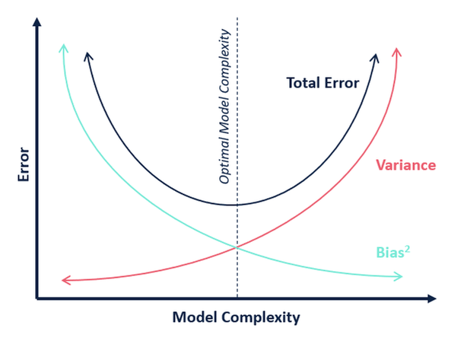
Bias Variance Tradeoff

Slide 18
Finding the balance
ML algorithms are generally “greedy” – they’ll try to get as accurate as possible.
E.g. a tree, without any limits, will try to make a model that perfectly fits training data.
Our goal is a model that is both accurate and generalizable.
We want this accuracy, but limit it to try to achieve the sweet spot.
How?
Cross validation.
Hyperparameter values with grid searching.
Early stopping (big in neural networks).
Regularization. (E.g. tree pruning and regularization in linear regression)

Slide 19
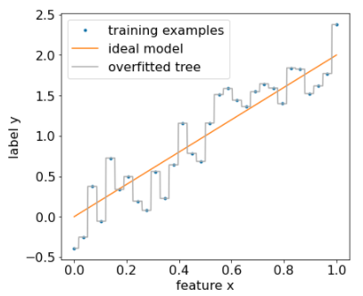

Slide 20
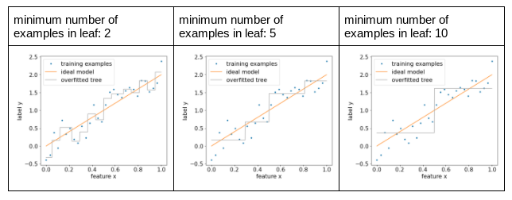

Slide 21
Regularization in Regression Trees

Slide 22
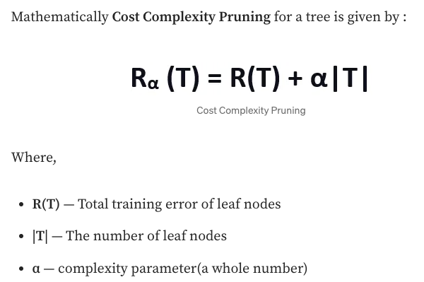
Cost Complexity Pruning
When looking at classification trees we saw pruning.
Pruning is a form of regularization – a technique to reduce variance in a model.
Regularization adds a ‘penalty’ term to the cost.
Instead of minimizing cost, minimize cost + penalty.
The penalty here is a ([HP constant] * [# leaf nodes]).
Acts to increase the cost as the tree grows larger.
For the tree to grow, the cost needs to shrink enough:
In a normal tree, any improvement will make a split.
With pruning, improvements need to exceed the penalty.

Slide 23
Pruning in Practice
Suppose:
A node has an MSE of 4 right now.
Splitting will yield a weighted average MSE of 3.5.
This split only happen if the penalty term is < .5 – if not, the improvement is too small to be worth it.
Pruning limits overfitting in a similar way to other techniques, by limiting growth of the model.
We don’t really know ahead of time which option (depth, split HPs, pruning) will be best.
A grid search testing different options will probably be the best.
Incentivizes a model that is both correct and small.
Both growing (adding complexity to the model) and being wrong will negatively impact the cost.

Slide 24
Conclusion - Regression Trees
Regression tree strengths and weaknesses are similar to classification trees:
Strengths: adapt to any relationship, able to be very accurate, explainable, fast.
Weaknesses: overfitting by default, improvements limit interpretability, limited output values.
Regression trees are also commonly used in gradient boosting models that are top class.
If the output domain is limited, relationships in data are non-linear, and interpretability is important, reg trees are a strong option.
In most other cases, some other model will likely win out.
Trees are more common in classification.
The concepts of model size, fitting, HP tuning, regularization, and cost carry over to other models.

