Slide 1
Stuff
Feature selection.
Theory basics
How to.
Images in data.
Representing images.
Using images as features for models.
Multi-class classifications.

Slide 2
Feature Selection

Slide 3
Detour – Sparse vs Dense
One thing that is mentioned regularly is a sparse or dense matrix.
Sparse matrices are mostly 0, dense matrices are not.
E.g. one hot encoded data with many classes makes a very sparse matrix.
The difference is in how they are treated (sometimes) in code.
Sparse matrices can be represented differently in storage:
Storage space can be more efficient.
Processing speed can be quicker.
We don’t really need to think about it much, it is a concern with large amounts of data.
E.g. Sklearn data needs to fit in RAM.

Slide 4
Feature Selection
Until now, we haven’t worried too much about feature selection.
Outside of regularization built into algorithms.
We’ve seen some pretty wide data, with lots of features.
We can select some features to help our models.
We can build this selection into pipelines to make things slick.

Slide 5
Feature Selection Basics
In general, selecting features won’t improve a model’s net performance very often.
Feature selection allows us to have simpler models:
Fewer features can make for less data, quicker execution, lower cost, or more transparency.
We want to include the things helpful to an accurate prediction, exclude those not.
The metric for helpful can change:
Basic statistics or inspection – does this value vary enough or is it clearly useless?
Correlation-ish measures.
Model determinations from internal measures, such as tree feature importance.
Performance of the actual model with/without.
All feature selection is basically different methods of calculating and testing this.

Slide 6
Inspection
We can reject some things out of hand.
Obviously useless stuff like “Arena Name” in predicting sports outcomes.
Some data may have external concerns for accuracy, availability, etc…
We can also consider cleaning judgements.
If we have a column with a large number of missing values.
If there’s a column where there are many errors…

Slide 7
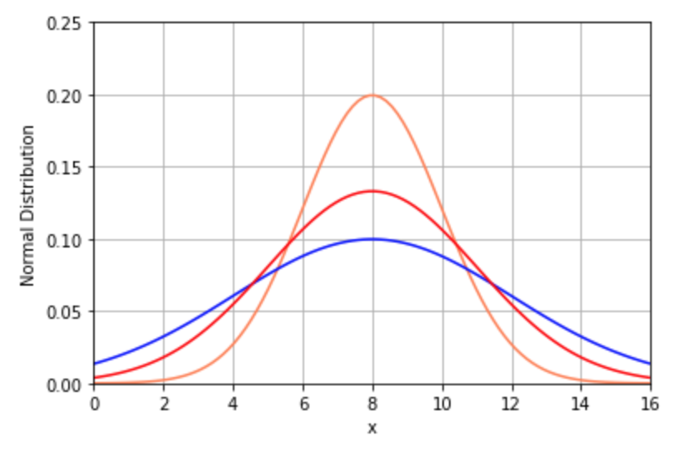
Variance
Values that don’t vary much are a candidate to be removed.
E.g. if hair color is a feature for a model, it might not be useful in Japan where it is almost always black.
”Years of primary schooling” may not be a useful feature for most of Canada, where it’ll be 13 (k-12) for most people in most places.
If a value never changes, it doesn’t help us predict.
For categorical, we can look at counts.

Slide 8
Univariate Selection
Univariate selection looks at the characteristics of one variable at a time.
Based on correlation – the more a feature is correlated with the target, the more likely it is to be predictive.
Regression:
F_regression (correlation)
Mutual_info_regression (information gain)
Classification:
F_classif (ANOVA)
Chi2 (~correlation)
Mutual_info_classif (information gain)

Slide 9
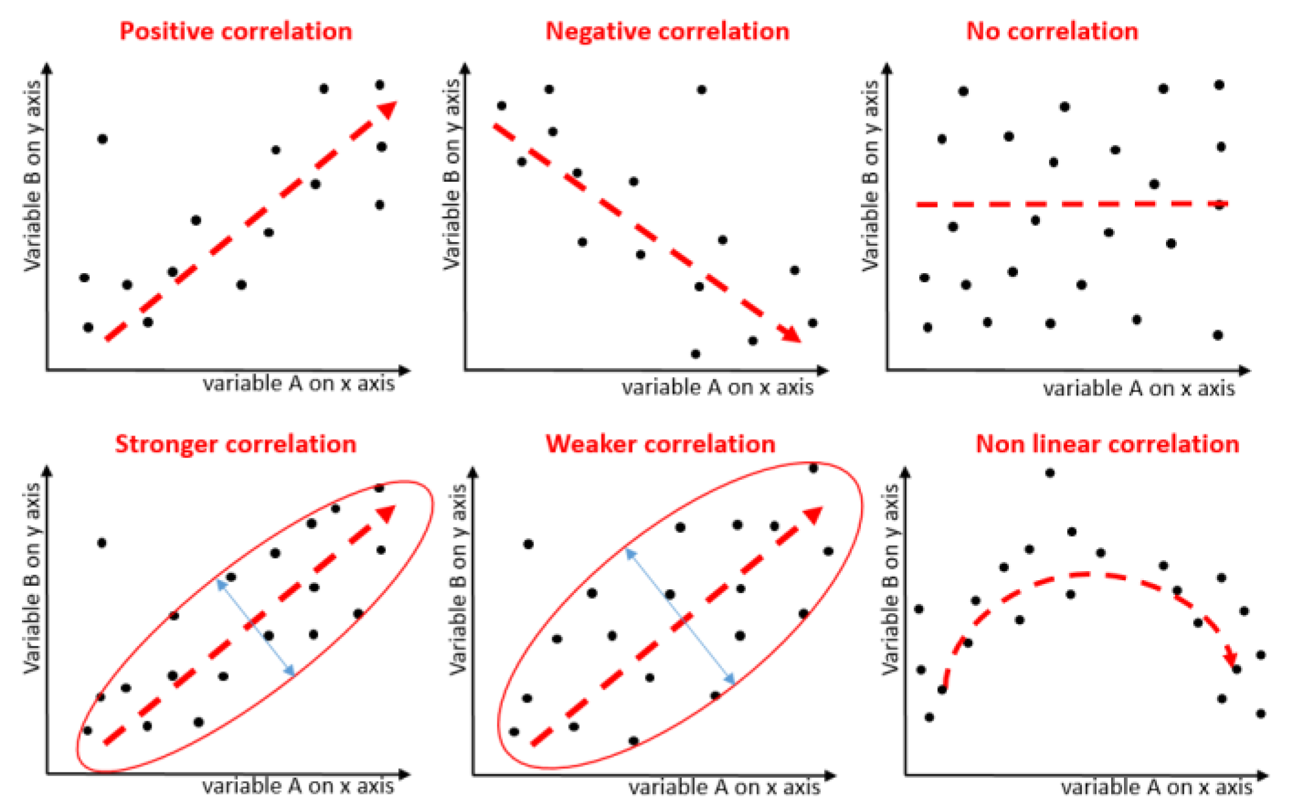

Slide 10
Univariate Implementation
Select k best: select the best k features based on the metric.
Select percentile: select the best percentage of features based on the metric.

Slide 11
Internal Selection
One type of feature selection we have used is the “built in” selection in models.
Trees and Lasso regression both select out less important features.
Lasso models are a variety of linear regression, that use regularization (penalty on cost).
Select from Model:
Select from model lets us “borrow” the feature selection of algorithms and apply it as a filter.
E.g. we can use a tree’s feature importance as a step to select features, then pass that dataset to a different model to predict.

Slide 12
Recursive Elimination
Recursive elimination does what it says, removes features one at a time.
The entire feature set is modeled.
The least important feature is booted.
Rinse and repeat until the criteria for # of features is reached.
RFECV – Implements a “grid search” with cross validation to choose number of features:
Will choose number of features with the best score.
Good for pipelines! Auto-select the best set of features.

Slide 13
Using Feature Selection
Feature selection can be important.
We want to remove anything that is actively bad.
In most cases, it is good to remove other stuff that is not all that helpful.
Feature selection will rarely cause accuracy scores to jump.
Some feature selection is done by us in exploration – what isn’t useful here?
We can also create a filter in the data preparation process.
Only features that meet X criteria can be used.
We can define dynamic criteria in some scenarios, using pipeline tools.

Slide 14
Feature Selection’s Buddies
PCA – extracts portions of the “value” from each feature, composes into new features.
Not feature selection as none of the features actually goes away.
Can provide many of the same benefits, or better. E.g. example with pixels.
Bigger/better models – large models, like neural networks, can learn their own feature selection given data.
Complex scenarios may allow the model to learn this better than is possible with this manual stuff.
The smart AI models you see doing cool stuff play by different rules, as they have lots and lots of data.
Simple is (usually) better – in most cases if you can get almost all the performance with simple data/simple models, that’s a win.
Feature selection will make more of an impact with smaller, simpler models and data.
Can unlock better performance on large models by allowing quicker trials.

Slide 15

Image Data
One special type of data we can use with models are images.
Image data seems totally different from a dataframe or array… at first glance.
If we represent the data in an image in a dataframe-ish format, we can use it.
In a black and white picture:
Each pixel is a feature.
Each pixel has a value for ‘darkness’ (usually 0-255).
We just need to make it 1D for an array:
Flatten the 2d down to a row for modelling.
Reshape it back to rectangle for number usage.

Slide 16
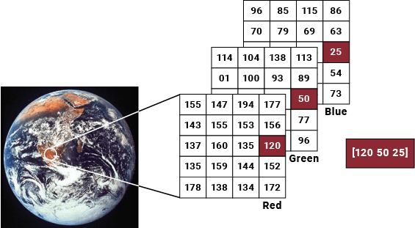
In Color…
Color images can be encoded similarly, normally with more than one layer – one for each component color.
The most simple is RGB – Red, Green, and Blue each have a layer.
This is similar to how any ‘natural’ thing is stored.
‘Smarter’ models can process images to capture 2D info from them – ours can’t.

Slide 17
Multiclass Classification
With our images, we can classify into more than 2 classes.
We’ll do an example with 10 classes.
The logic behind this is the same as with 2 classes:
Calculate the probability of each value being in each class.
The most probable is the actual prediction.
The math is more elaborate.
The code is the same.

