Slide 1
Housekeeping
Project
Q+A?
Regularization in regression

Slide 2
Linear Regression with Regularization

Slide 3
Errors in Modelling
Bias Error:
Error due to assumptions made in the modelling process.
Generally results in underfitting.
E.g. assuming a linear relationship.
Variance Error:
Error due to variations in the training data.
Generally results in overfitting.
E.g. different training sets for trees generate very different models.
Irreducible Error:
Error that we can’t fix through modeling, it in inherent in the data.
May be able to fix it by cleaning data (removing outliers, correcting missing data, etc…)

Slide 4
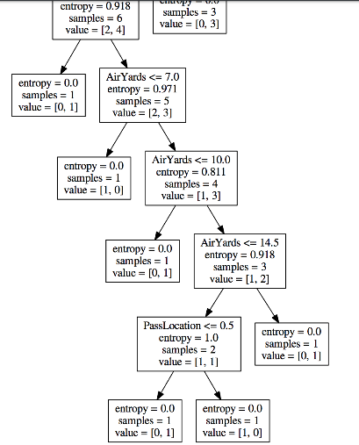
Variance Error – Tree that is Overfitted

Slide 5
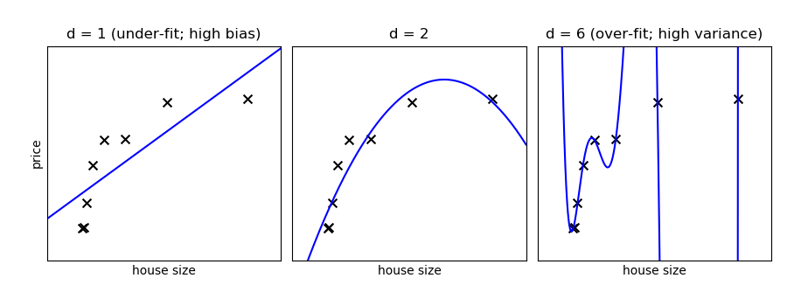

Slide 6
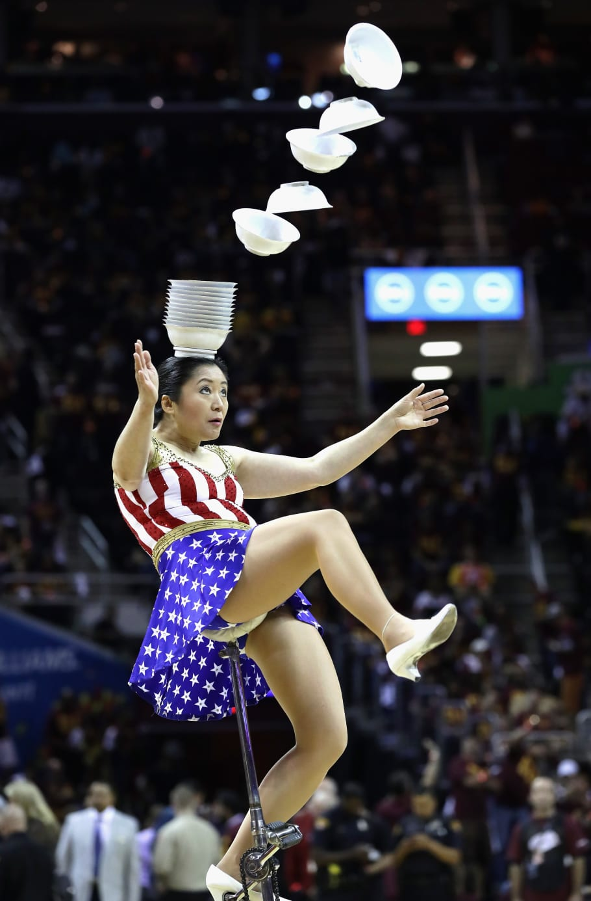
Balancing Act
A good model requires a balance between Bias and Variance.
If we have too much bias our model won’t be adequately tailored to the data.
Simple models have high bias.
If we have too much variance, the specific training sample data would impact the model’s predictions too much, and it may be wrong with different data.
Complex models have high variance.

Slide 7
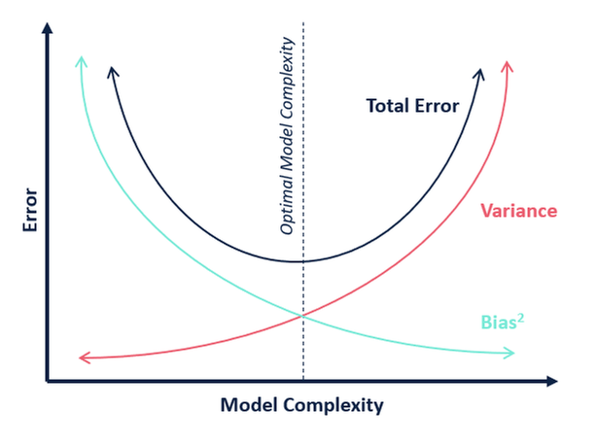
Bias Variance Tradeoff

Slide 8
Finding the balance
ML algorithms are generally “greedy” – they’ll try to get as accurate as possible.
E.g. a tree, without any limits, will try to make a model that perfectly fits training data.
Our goal is a model that is both accurate and generalizable.
We want this accuracy, but limit it to try to achieve the sweet spot.
How?
Cross validation.
Hyperparameter values with grid searching.
Early stopping (big in neural networks).
Regularization. (E.g. tree pruning and regularization in linear regression)…

Slide 9
Regression Coefficients
The regression process, closed form or gradient descent, finds coefficients.
E.g. y = m1*x1 + m2*x2 +…. B
The process determines those m values, and the b.
The algorithm finds these coefficients by determining what set of them minimizes the squared residuals.
Our new friend the cost function!

Slide 10
Regularization
Regularization modifies a model by changing the cost function.
A ”penalty term” is added to the cost function.
Now the regression algorithm isn’t minimizing the residual squared error, it is minimizing the new cost.
Regularization types:
L2 – Ridge. Adds a penalty based on the square of the coefficients.
L1 - Lasso. Adds a penalty based on the absolute value of the coefficients.
ElasticNet – a weighted combination of the two.
This incentivizes smaller coefficients, lowering overfitting.
Large coefficients are unlikely to generalize well.

Slide 11
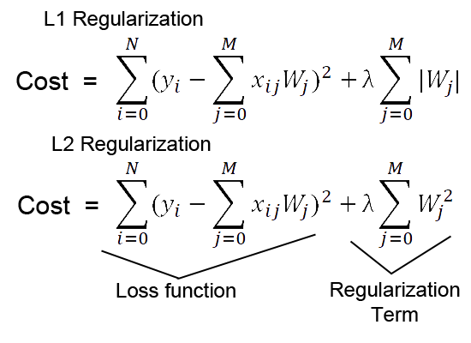
Cost Functions
The regularization term is the last bit.
The alpha value controls the amount of regularization, as a hyperparameter.
Elastic net is just some proportional (the ratio is an HP) blend of the two.

Slide 12
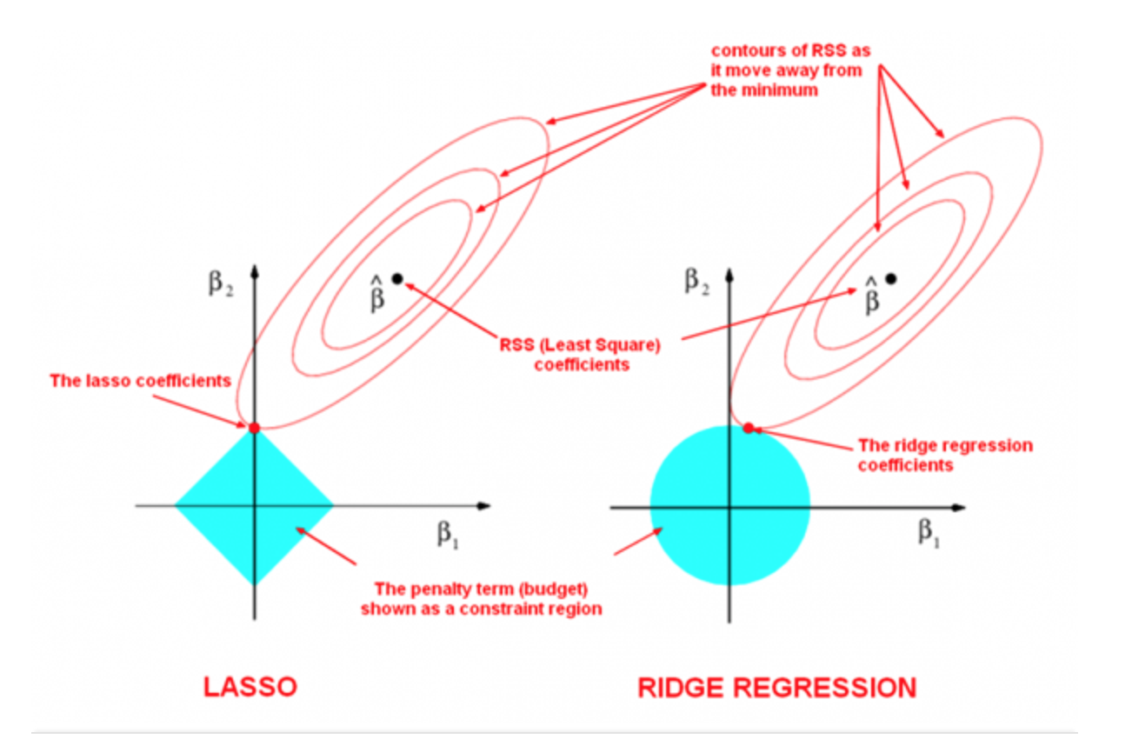
Result – not optimal solution, compromised Solution
Model has two X – B1, B2.
Lowest cost is ^B.
Lowest penalty is origin.
The combined sol is the compromise – more error from each, until they intersect.

Slide 13
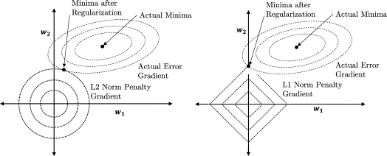
Result – not optimal solution, compromised Solution
Model has two X – W1, W2.
Lowest cost is the point.
Lowest penalty is origin.
We need one val for W1,W2
The combined sol is the compromise – more error from each, until they intersect.

Slide 14
Impact
Models are limited from becoming over fitted, as it is “hard” for coefficients to grow.
Very large coefficients are likely to be overfitted and distort the model.
Also a reason why scaling is important for linear models.
Difference:
L1:
Reduces coefficients to 0 – good for feature selecting.
No closed form solution - estimation like gradient descent needed.
More robust to outliers.
L2:
More computationally efficient, especially in larger models.

Slide 15
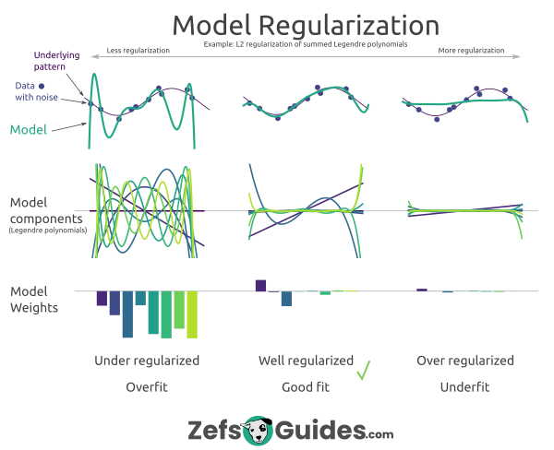

Slide 16
Implementation
Ridge, Lasso, and ElasticNet are all sklearn packages that do their names.
Other cost-function based things may use regularization in the background:
SGD has a penalty hyperparameter that imposes regularization.
Other linear models (e.g. SVM) do the same.
Neural networks often use a regularization penalty.
For us, we can use the model and tune it via a HP, like pruning.

Slide 17
Regularization Applications
Regularization is very commonly used, in many different scenarios.
Models like neural networks use linear models as their core:
Regularization is often included as an HP, and may be enabled by default.
Allows for a reduction in overfitting to be applied as the model is being trained.
Neural networks deal with data that is large and complex.
Image recognition, text classification, image/text generation, etc…
A 24 megapixel image (iPhone default) is 72 million+ features!
Models may have billions of parameters (we have N features + 1) to learn complex things.
Overfitting concern is like a tree, but more dramatic.

