Slide 1
Housekeeping
Questions / ambiguities on assignment or other stuff.
Class inheritance part 1. (Ch 15-18ish in book, but not all)
Simple intro to inheritance as a concept, with some examples and exercises.
We’ll do some slightly more elaborate stuff next time.
We’ll revisit inheritance in a couple of weeks, and look at the more complex stuff.
The ideas behind this can be confusing and important, so I think having some space is easier.
We’ll ultimately try to do something similar to 18.2 as an exercise next time

Slide 2
Inheritance
It Ruins Society!

Slide 3
Object Oriented Programming
Objects oriented programming is built on a few concepts, some we’ve looked at.
Abstraction:
We can present “user friendly” abstractions of objects, and hide the inner implementation.
E.g. we don’t need to worry about how a list is printed, we can just ask for what we want.
Encapsulation:
We can “wrap” an entire object (attributes and methods) into one unitary item.
E.g. a dataframe isn’t a “grid of values” that we interact with, we interact with the object.
Polymorphism (a little bit today):
Different objects can be processed different through the same interactions.
E.g. when adding strings and integers, the same operation does different actions.
Inheritance:
We can create subtypes, or extend classes to make them different. More on this now…

Slide 4
OOP Building Blocks
These pillars are the foundation of object-oriented programming.
In OOP we orient our thinking and code around objects that represent ‘real’ things, and manipulating them. Contrasted with orienting our program around functions.
Building code around “capable” objects has many benefits:
Code is more reusable, as we can reuse or adjust objects in many scenarios.
Code is more readable, as we build most of the details into the objects, and present an easier interface with methods and attributes named in more plain language.
Code is easier to debug, as fewer things are “touchable” directly, rather we go through pre-made methods to do things like update variables. These have (presumably) already been tested.
In Python, everything is an object, so these thought patterns are inherent.
Data science stuff is less object oriented, in general, than ‘other’ domains.

Slide 5
State
One concept to explicitly look at when we talk about objects is their state.
The state is basically what that specific object “has”, or it’s instance variables.
The state of an object makes up what makes it unique. E.g. two Person objects have different names, ages, addresses – their state is different.
The constructor function initializes a new object, or creates its state.
Each different object that is created has its own state, that defines it.
When method calls are made to the object, we are (often) modifying its state.
In OOP our program creates the objects that model the real scenario at hand, then each step is some manipulation of the state of its objects.
E.g. a sale creates a ”transaction” object, a name change changes an attribute, loading a product on Amazon’s site reads the state of a ”product” object and displays it.

Slide 6
Inheritance
We have used classes to make objects that can hold information and abilities.
Sometimes we have classes of things that are very similar or have overlapping qualities.
For example, in an LMS like Moodle there are many classes:
Some are normal in-person classes.
Some are online virtual ones like this.
These classes share lots of things (id number, time, semester) but differ in others (room, sharing URL, etc..)
We could make classes that model these objects, and they would be very similar.
Most of the attributes would be identical, like time, semester, course, etc…
Programmers are lazy, and repeating code is bad – there must be a better way.

Slide 7
Hierarchy
Class
ILT Class
Virtual
Web Self Dir.
We can approach this problem by looking at objects in a hierarchy.
In-person and virtual classes are both classes.
In-person and virtual classes are not really the same type of thing.
We have a type of thing, a Class, that has some features.
Time, instructor, semester, course…
We have two other types of things, ILT and Virtual, that are subtypes of a Class.
Each one is a class, yet each one is a different object.
We say that an ILT class extends, is a child of, or inherits from the Class object.

Slide 8
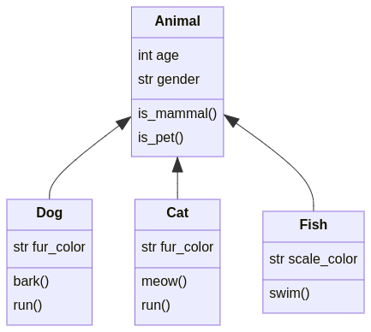
In the Animal Kingdom

Slide 9
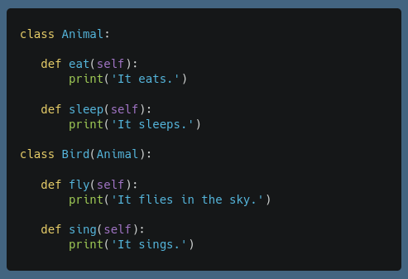
Inheritance
In programming, this hierarchical relationship is inheritance.
We can make a class that inherits some other class:
The original is called the parent class, the new one is a child.
Our new class is everything the parent is, along with whatever else we want to add or change.
Inheritance is indicated by putting the parent class in the class signature.
An Animal can eat and sleep.
A bird can eat, sleep, fly, and sing.
A bird “is an” animal.

Slide 10
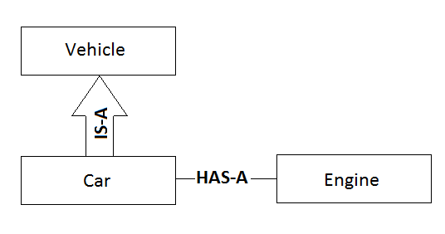
Is-a and Has-A
We say that a subclass has an “is a” relationship with its parent.
E.g. a Dog “is an” Animal.
A dog is a valid animal object, it is just also more than that.
When something holds or contains some object, we say it has a “has a” relationship.
E.g. a Dog “has an” string attribute for fur color.
A dog holds another object, in this case it is a string but it could be any object, in its attributes.

Slide 11
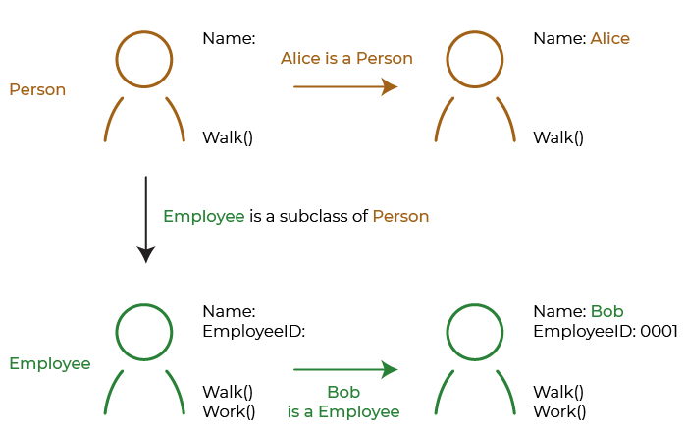

Slide 12
Making Subclasses
We can make a subclass by just putting the parent class in the class declaration.
Most things about working with a subclass don’t really change, but there are a few special considerations…

Slide 13
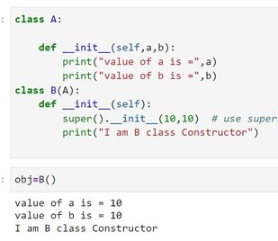
Construction and Super()
When creating an object we call the constructor to set the initial state.
State is what the object “is” - mainly setting the instance variables.
When creating a child object, we have a 2 (or more) step process:
Make the parent.
Add the child parts.
I.e. when we create a “Cat” we are making an animal, and adding cat stuff on like meow().
The super() function call will go call the method in the parent.
Super is an inheritance specific special method that will find “this method” in the parent.
Super can also be called in other methods, and will call the parent version directly.
In a constructer we usually super(), then set any child specific attributes.

Slide 14
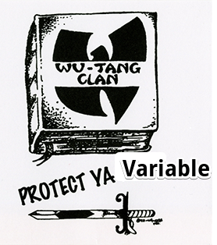
Protected Attributes
Inheritance is also the place where the third type of variable is used.
Public (normal) variables are available outside classes.
Private variables are only available within a class (nominally).
Protected variables are available within a class and its subclasses.
Like private variables from the outside, and normal variables from the subclass perspective.
For example, consider employees at Air Canada (more or less actually true):
Employees have normal attributes like name, ID, etc…
“Flight Crew” (pilots and flight attendants) add additional security permissions and ‘protected’ clearance information.
Pilots add even more private information for security clearance.
The lesser clearance level information for pilots is visible to the Pilot object, but hidden to the outside world.

Slide 15
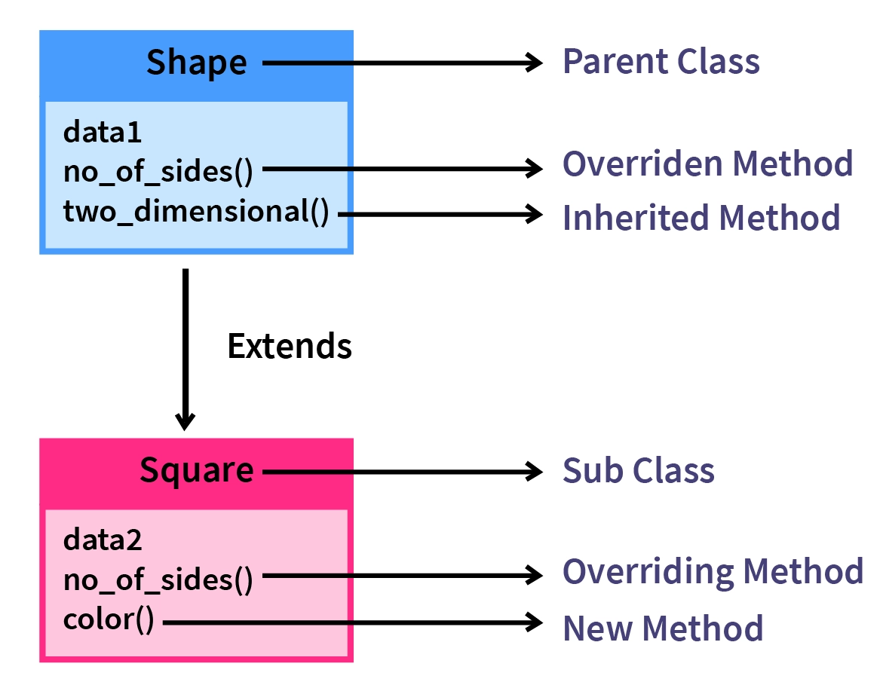
Method Overriding
Like with operators and string functions, child classes can override their parent’s methods.
If declared, the child methods will take precedence.
If the child doesn’t provide a method, the interpreter will look up the chain until it finds a match.
We can change or redefine behavior for a child:
We’re used to this for “generic” things like eq, str, add, etc…
Any other method that a parent class provides can be overridden in the same way.

Slide 16
Polymorphism
When we redefine methods to work differently for different objects we are using a concept called polymorphism.
Polymorphism is the theory that a single interface can act differently with different types.
E.g. adding strings and adding integers is the same interface, different actions.
In Python, this touches on the idea of the Duck Test.
Everything is an object, and we often inherit from base classes, and we have weak types.
Methods and operators can be overridden to redefine actions for each object.
So, it is a duck as long as it can do all the duck stuff. Or if it looks and quacks like one.
Or, an object is a certain type as long as it is never asked to do something it can’t.
E.g. if we read a value from a CSV into a variable and print it, that var could be string or float.

Slide 17
Conclusion (for Now)
Inheritance is a key building block of object-oriented programming.
There are several ‘extensions’ to this simple inheritance that we’ll look at later.
Classes can inherit from multiple other classes.
Syntactical “sugar” to make things more streamlined.
When we create objects, there is no inherent answer on what is a class and subclass.
E.g. should Amazon have books and a type variable, or fiction and non-fiction subclasses?
As a rule of thumb, if we want things to ’behave differently’ we should consider a subclass.
If some methods or actions need to work differently, we can consider a subclass.
If we find ourselves “wrapping” logic around other objects (e.g. if this, then do that), consider it.

