Slide 1
Housekeeping
Assignment:
Questions, issues, problems….
Last time:
Look at potential solution.
Today:
File and system access.
Navigating file systems.
Accessing remote files, compression, downloading, etc…
Easy and mostly informational – we can always look up the details of what to do.

Slide 2
Interacting with the OS

Slide 3
Python Environment
Our code runs locally inside of a python environment.
That environment in turn runs on our machine.
There is no direct connection from our code to machine.
To access local (i.e. on the PC) stuff we need to use some other tool/library.
There is a library that will exist in the environment that has file access functions.
Inside of that library there is a function that interacts with the underlying machine.
The details of that “access machine” bit is a request from code->library->env->os
Each install of Python on a machine provides its own “version” of this stuff.
I.e. opening a file is different on a Mac/PC, but the same for us.
The Python install on each OS has the OS specific bits in it.

Slide 4
OS interactions
There are many reasons we may want to interact with the system that we are using.
Get information about the system, such as if there is a GPU for machine learning.
Read and write from files.
Dynamically behaving differently depending on the system running the code.
Python is a high-level language, so we use abstractions of the physical system.
We don’t natively have access to anything outside of the environment of Python where our code is running, so we need to use something to reach beyond that.

Slide 5
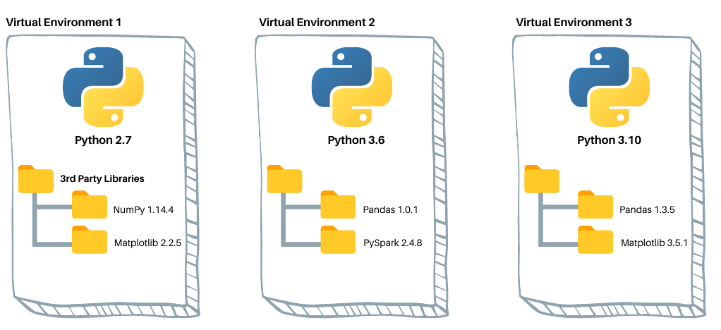
Side Note – Python Environments
Each of these environments is its own thing and they are all independent of each other.
In real life, an application can define its own environment:
Exact versions of each package installed.
Control what’s there to prevent conflicts.
Ability to test on a fixed environment.
Our code is fixed, we pick which environment we want to run it in.
This lets the code be portable.

Slide 6
File and Folder Access
Accessing files on disk is the number 1 usage of system related things for data science.
Some libraries will do the file access stuff for us:
Pandas will read CSV/Excel/whatever files into a dataframe.
Other libraries for ML (e.g. Keras) have similar libraries to load data.
We sometimes need to interact with the files/folders directly for some reason.
E.g. we need to arrange some stuff before using it, save logs to some special location, or place output into a specific folder.
The OS library is a built in Python tool that provides lots of system access tools.
There are others, many built on top of this basic functionality.

Slide 7
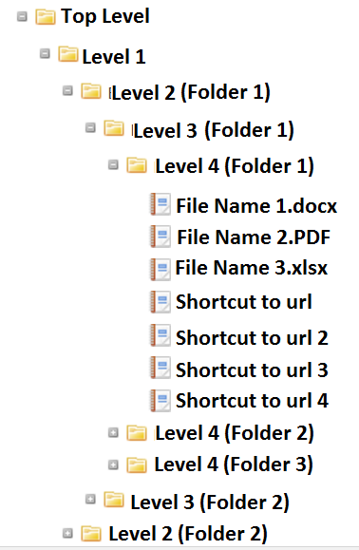
File system Navigation
File systems on computers are hierarchical.
We can “see” where we are.
To change we need to go up (../) or down (into a folder).
The position in the file system is a pointer.
A pointer is a common programming thing, mostly from older stuff, that is a value that tells you where to go for something.
Our current directory pointer points to the folder we are in.
Different OS’s will have different structures and defaults.
Note: we normally want to work within one folder (inc. subfolders).

Slide 8
File System Cont.
Main file system actions are pretty simple – change directory, make/delete directory, make/delete a file, list the contents of a directory.
Each navigation command has it’s own function in the os library.
Documented on the Python API page
These are all “basic” commands, meaning they are not the “friendly” versions in the OS.
No error checking, confirmation, easy shortcuts… The OS manages some details for us.
E.g. a folder must be empty to be deleted, a file can’t be open to be moved…
One notable function for navigating the file system is walk – it will “walk” up or down through folder levels.

Slide 9
Read and Write
Once we navigate to the file we want, we can edit it.
We can natively read and write anything that is text based.
CSV, txt, tsv, etc…
These text files are literally just that, text, even with different extensions.
Other files, such as Excel/Word/PDF/etc… require a library that translates for us.
Simple reading and writing of files can be done with the os library.
E.g. if we wanted to write all of the errors from our program into a log file.
This all relies on the locations pointer that tells us what folder we are in.
That pointer doesn’t reset itself every time code is run, it “belongs” to the session.

Slide 10
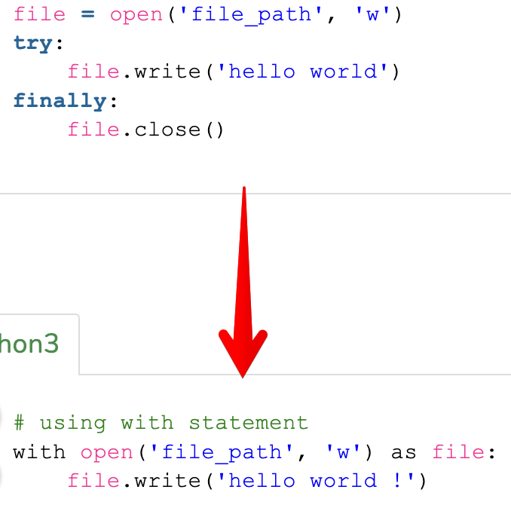
Come !!With!! Me
File reading/writing operations often use weird syntax - “with”.
With is a shortcut that can make the error prone file stuff easier.
With “handles” maintaining the connection to a file.
To access a file we need to find it, open it, lock* it, release it, then close the connection (so others can use the file).
File access is exception prone (e.g. missing file, disk removed…)
The two examples are equivalent.
With ensures that the writing is done ‘in’ the file that is open, and that it closes that connection when that part is done.
“Maintain this file connection as long as needed, then close it."

Slide 11
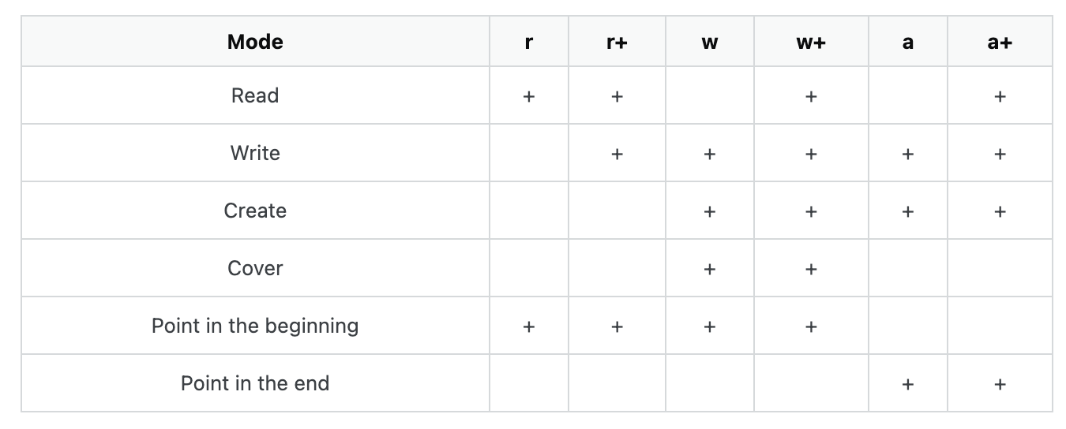
Read/Write Access Options
The arguments listed here give different permissions for reading/writing.
Can also go directly to the end.
Reading and writing to a file like this is annoying to do.
We usually use a more purpose-built library that does this for us like Pandas.
If we are doing something small like writing errors to a log or similar, this works well.

Slide 12
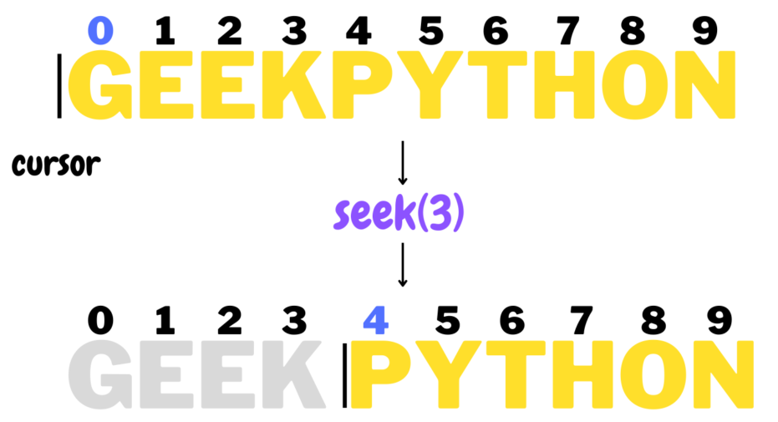
Seek/Tell
While in a file, we move around just like a cursor in word.
If we want to do anything, that thing will happen at our current position.
If we are working in a file, we may need to move around.
Seek and Tell can tell us where we are, and take us where we want to go.
Tell gives us back the position in the file.
Seek takes us to a new position, offset be some value from a reference.
The reference is either the start, where we are now, or the end.

Slide 13
Remote Data
We can also connect to remote files on the internet or remote folders.
The library we use to make the connection depends on the target:
OS read/write work with a file system that’s mounted – or available in finder/explorer.
Urllib (and many others) works with HTTP – i.e. on the internet.
Ftplib works with FTP (file transfer protocol), an older file server protocol.
Pyodbc (and many others) work with ODBC – i.e. generic database connections.
The steps to connect and read/write will differ slightly with each.
Maybe with an interim step of copying a file locally, then loading from that copy.
Once data is loaded into some data structure in our code, it doesn’t matter the source.

Slide 14
Compression
We can also compress and decompress files like zip, tar, etc…
Very useful with large structured datasets as they compress very well.
Largely repetirive text data is an ideal candidate for a zip for other archive.
Passing around data online ca be much more efficient with compressed data.
Pandas can directly handle zip files with read_csv.
Our code can download and unzip a dataset directly into a folder.

Slide 15
Conclusion
File and system access is generally pretty easy.
We need to take special care when doing so.
There are few, if any, restrictions on what you can change or delete.
It is easy to target actions to the wrong locations.
Use the minimal needed permissions when taking action.
File system access is a good place for exception handling.
Errors are frequent with file access and it probably doesn’t make sense for a program to die if someone removes a USB stick or if the WiFi briefly drops.

