Slide 1
Housekeeping
Test - Sample solution file is in the repository, pull yours to update. We’ll look at it.
Today:
Searching and sorting - generally, pretty simple, little code for you, several examples.
Passing functions in functional coding, more big O, size/speed/cost thoughts. (ch13)
End of Class and Next Time:
Look back at the poker example, make sure things are ok in your minds.
Next time we can start to look at creating a GUI that uses that functionality.
Fun reading: https://ipywidgets.readthedocs.io/en/8.1.2/examples/Widget%20Basics.html
Similar idea to using any ‘display’ library to make an app, website, dashboard, etc…

Slide 2
From Here on Out…
Solidify code skills:
Most directly required: making/using functions, manipulating data structures (df/series/array), using libraries, testing/troubleshooting.
Workbooks and the think python book have review exercises at the end, these should be ok.
Focus on trying to read from documentation and implement based on that.
Read/review/ask/whatever to make sure that you’re reasonably comfortable.
Next week and week after we’ll do some pipelines (good self check) and then visualization.
If there’s specifics that you need/want to cover/review, we can work them in.
The pipeline stuff is at the core of what we need for ML, so it is a good self-check.
Exam – code will be multiple inheritance (in some way).

Slide 3
Test Tendencies
Most of the code, by volume, looked ok.
I attempted to estimate a reasonable grade based on the fraction that was done/good.
I capped the “it doesn’t pass tests but looked ok” code to 5.5/7, roughly 80%.
Some common things:
A few people just missed return statements at the end of a function.
Error checking – divide by 0. I think this may have caused a fatal error for some.
Some people had low # of commits, largely ok-ish code, and passed 0 tests.
Likely did most of it, committed, then saw everything fail (due to error), and it’s hard to pinpoint.
It’s easier to build incrementally, so parts pass and then you can see if changes break it.

Slide 4
Searching, Sorting, and Stuff

Slide 5

Organizing Stuff
We can have large data structures, but how do we find/organize stuff?

Slide 6
Sorting
11 | 9 | 17 | 5 | 12
Suppose we have some numbers that we want to sort into ascending order.
What do we do?
We can likely intuit some reasonable answer, likely something like:
Compare the first value to others.
Place it in its spot.
Or some variant due to ordering…
Whatever you thought of is a sorting algorithm.

Slide 7
Sorting algorithms
Sorting algorithms are the passion project of the nerdiest grad students.
We have several different approaches to the idea of sorting.
Depending on the data that we have, different approaches might be more efficient.
Note, the details of the sort are independent of what less/greater/equals means.
The definition of those comparisons in the object define that.
Sort (generally) can be used with anything that defines its own comparisons.
All of these algorithms do the exact same thing, in different ways.

Slide 8
Selection Sort
One very simple algorithm is the Selection Sort algorithm.
Find the smallest element in the data.
Swap it with the first element.
Increment the starting point by one, repeat.

Slide 9
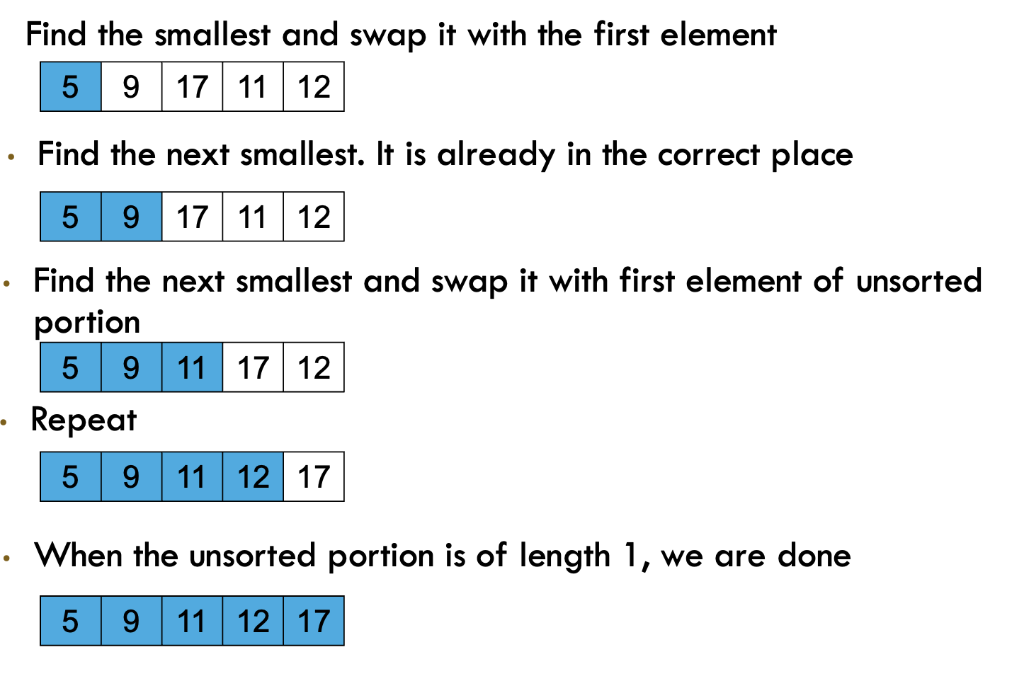

Slide 10
Selection Sort Performance
We can think of the time that it takes to do this in terms of caparisons performed in the sorting process.
Selection sort steps:
Finding the smallest element requires N-1 comparisons (each element against each other).
Finding the next smallest requires N-2 (each against each item remaining).
Next requires N-3….
As N grows we need to do ~N comparisons per item times ~N items.
The performance is N^2 or O(n2).
This is an approximation, we ignore the details and focus on order of magnitude.
This is probably pretty slow for large datasets…

Slide 11
Merge sort
Mergesort works by splitting the data in two, then recombining the results.
This should trigger fond memories of… recursion!!!
Base – one item, return it.
Recursive – return the result of the two halves, in order.

Slide 12
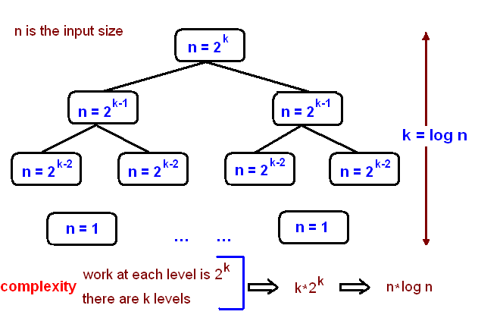
Merge sort Big o
Merge sort performance tends better as data grows.
The splitting of data in two is a good indication that the performance may be logarithmic in some way.

Slide 13
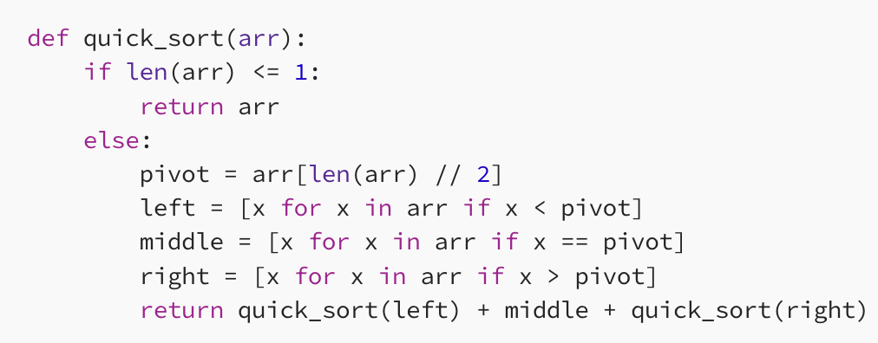
Quicksort – it is Quick!
Quicksort is one of the most common sorting algorithms.
Chooses one value as a ‘pivot’, divides the data less/greater than that, and repeates.
N*log(n) on average, ‘in-place’ meaning it doesn’t copy the data.

Slide 14
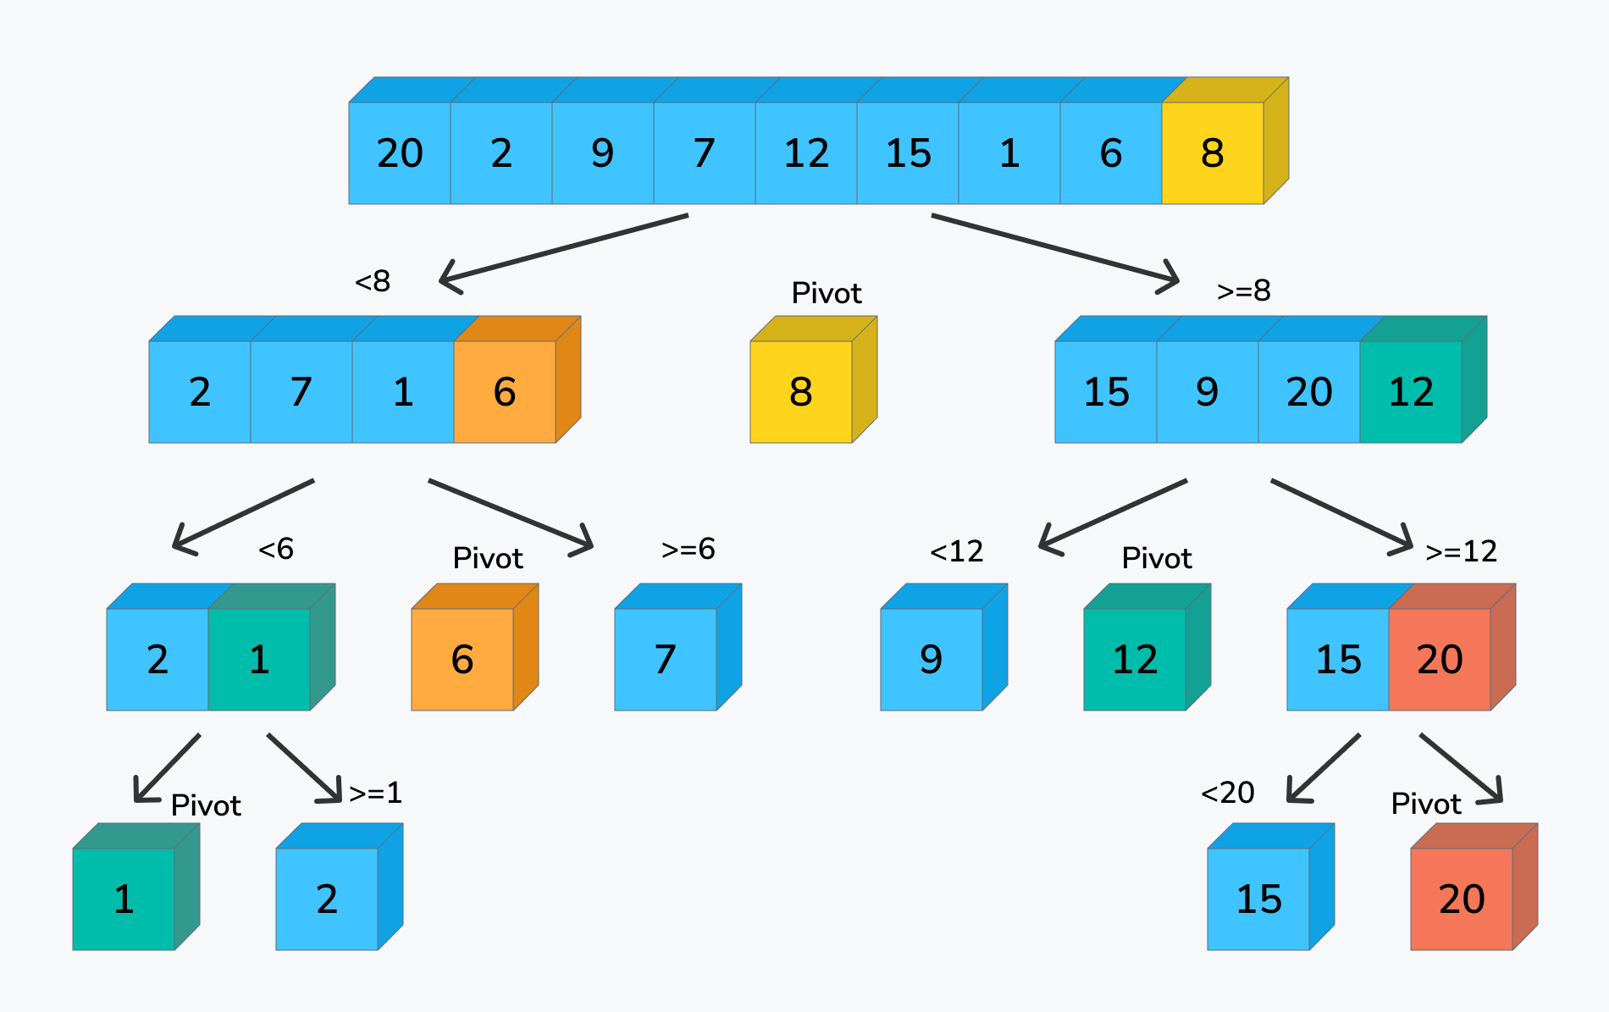

Slide 15
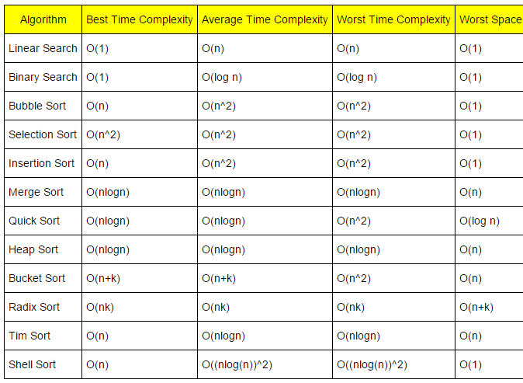
Big O Approximations
The Big O notation is meant to capture a rough estimate of time.
The exact details are ignored as they don’t matter much when things grow.
Nested looping is the one thing to really try to avoid.
For sorting we can think of the number of comparisons as the driver of speed.
Other algorithms are similar – accessing data is an “action”.

Slide 16
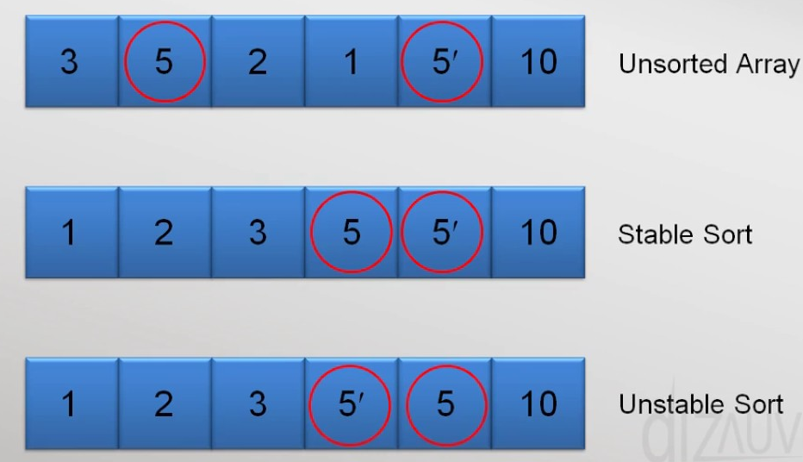
Other considerations
Memory is another consideration when sorting.
Some algorithms sort in-place, or they don’t need to store more data in memory.
Others increase memory usage by copying data.
If using very large data, this can be a consideration that matters – we may not be able to double a dataset’s memory space.
Stability
If we have ties, the order of the ties may be kept (stable) or ignored (unstable).
This may matter, in some cases. In DS we often split/combine large datasets. This is a consideration in several other places.
Stable sorts maintain order when there are ties.

Slide 17
Other Sorting Algorithms
There are lots of sorting algorithms out there.
If you’re ever “lucky” enough to take math-computer science, nerds love ‘em.
The Wikipedia page for Sorting Algorithms has a solid list.
This used to matter more as resources were precious.
Sorting is generally a solved problem for most cases we may encounter.
The default sorts are fine for all by a few edge cases.
We don’t sort all the time in data science work.
If we are able to define lt and eq for our classes, we get the rest for free.
It is special cases – frequent sorts, large data, edge case distribution where we may care.

Slide 18
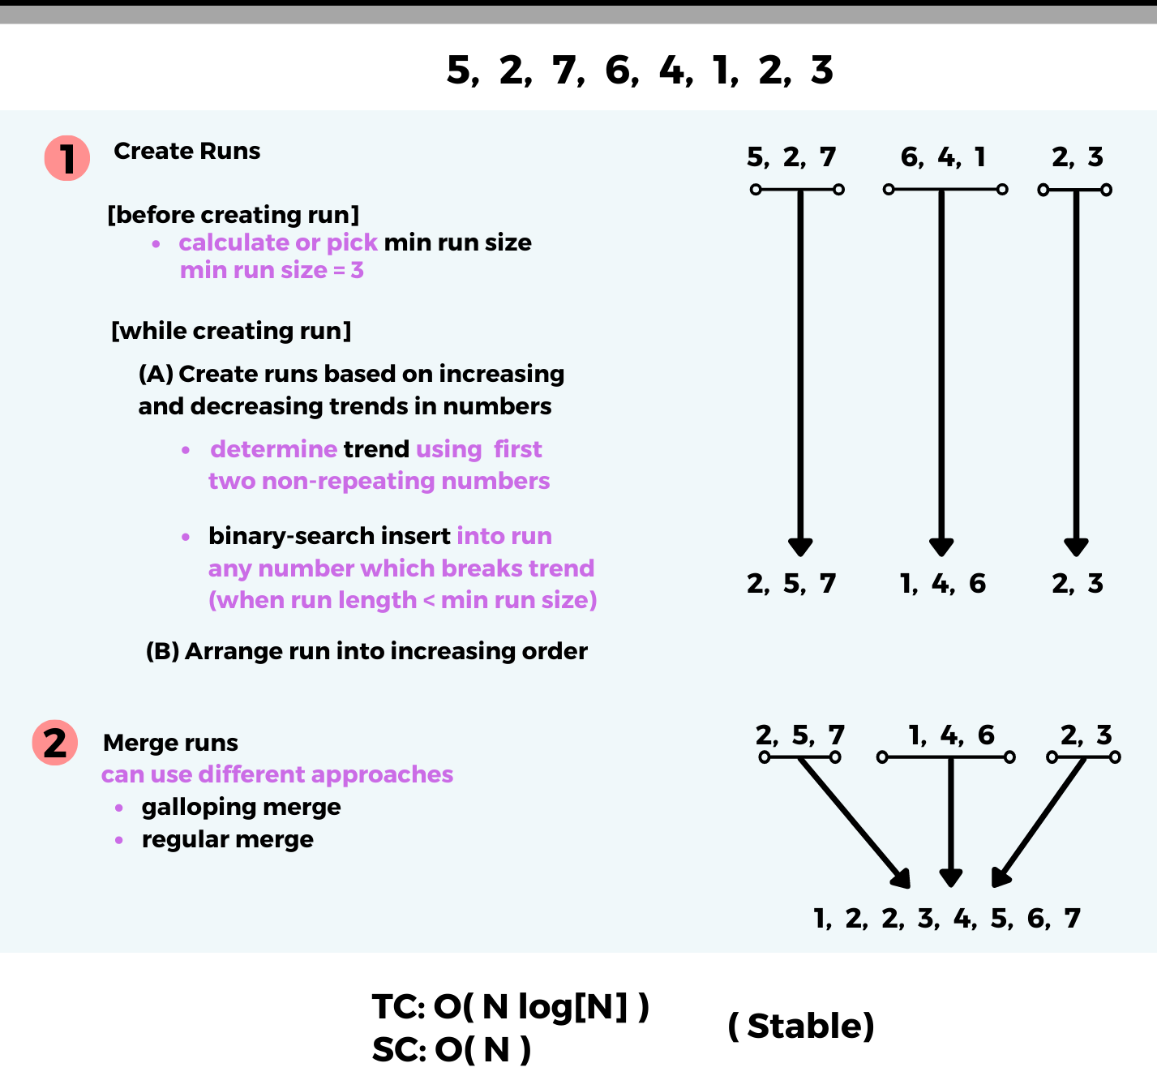
In Python?
Python's sorted method uses a hybrid sorting algorithm called Timsort.
It was made by Tim.
This generally performs well in most cases.
Sorted subsets save time – no moves needed.
Reverse sorted subsets are reversed.
A hybrid of merge and insert.
Data often has sorted parts, this saves time.

Slide 19
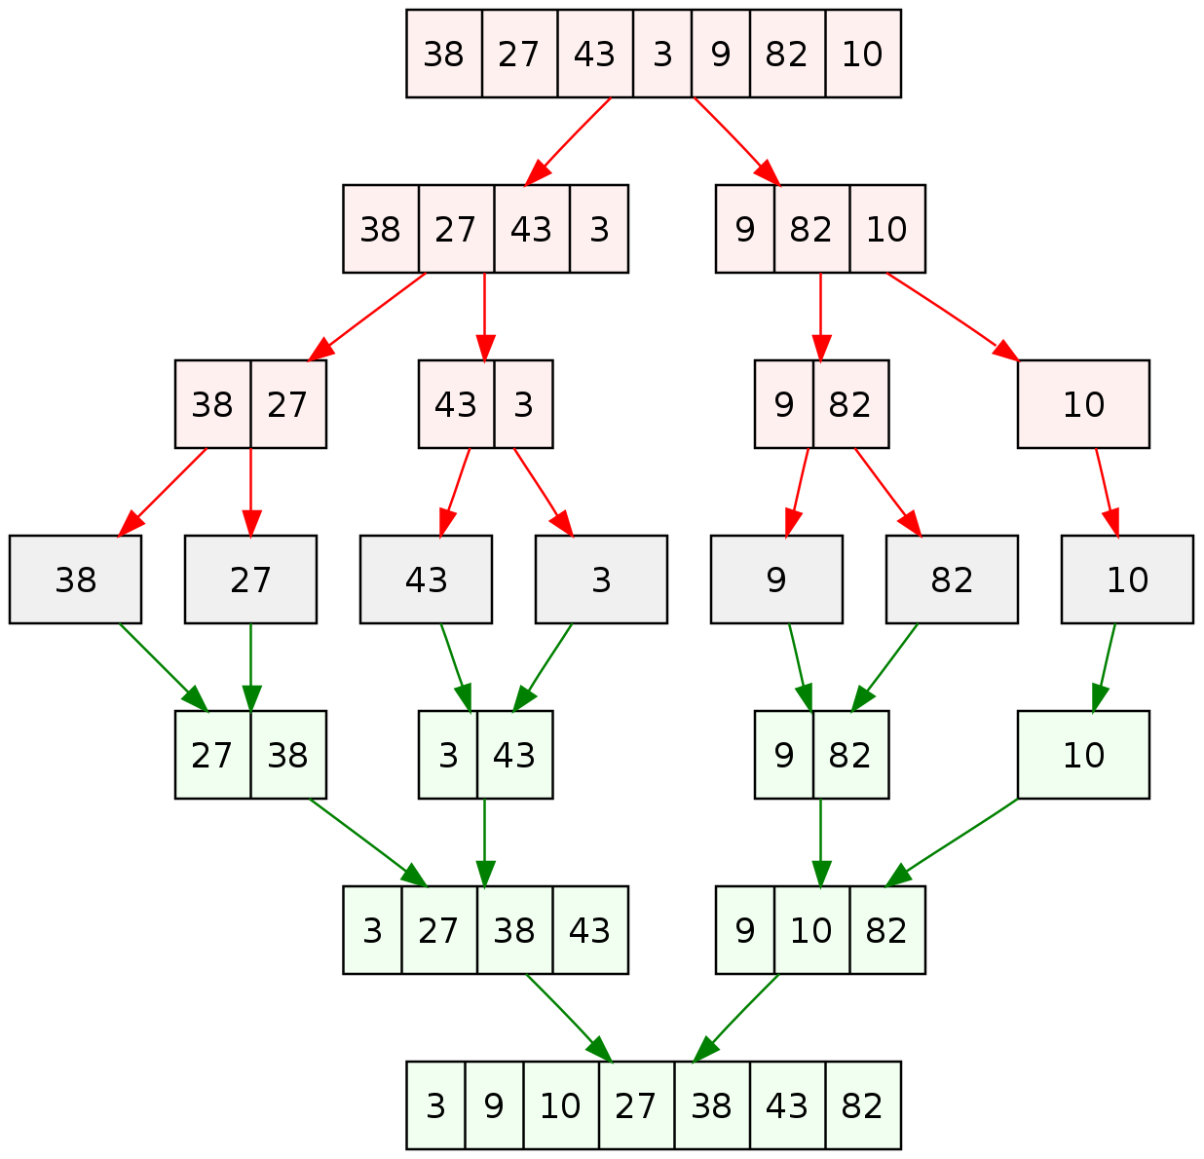

Slide 20
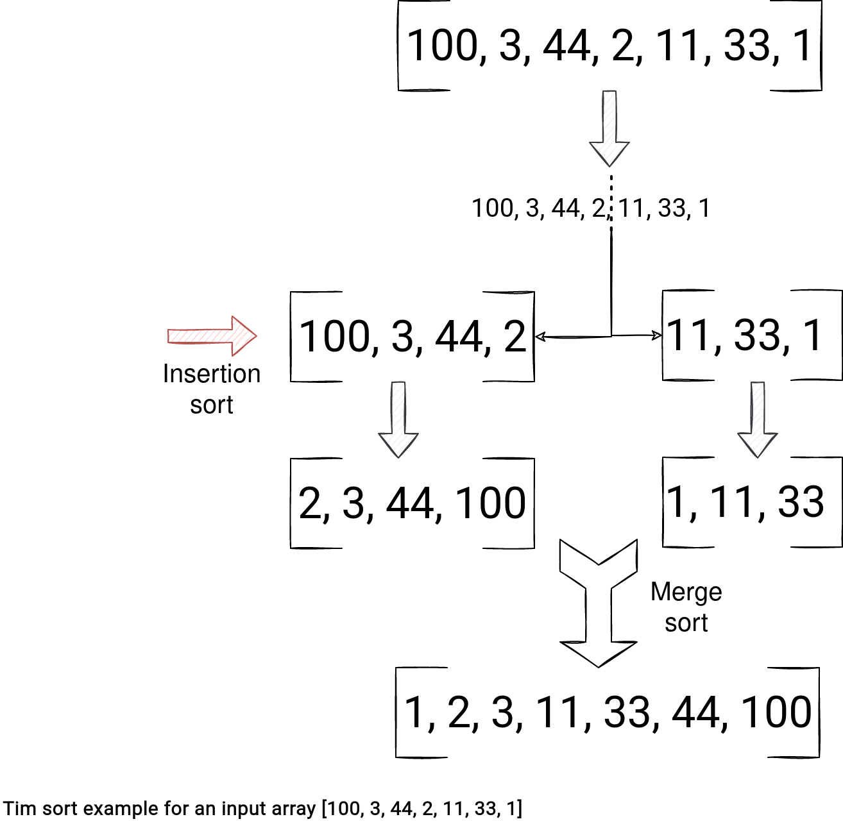

Slide 21
So what do I use?
For the most part sorting is a solved problem, we can use the built-in tools.
There are specific edge conditions where algorithm matters:
“Natural” start of the data is worst case scenario for an algorithm (maximizes actions)
Specific resource constraints such as memory size.
In real scenarios, lots of large/expensive sorts are major decisions:
Likely solution will be specific to exact demands in that case.
Likely some combo of storing data in a db with an index, maintaining interim datasets (to batch resorts), and bulk operations to make changes.
E.g. LMS HR data – learners indexed by ID. Changes queued in custom ds, processed at night.

Slide 23
Searching
Closely related to sorting items is searching for them.
Just like sorting, performance can vary widely.
Suppose we have:
A data structure of numbers.
One value we want to find in that data structure.
What can we do?

Slide 24

Linear Search
Basic searching for an item is a Linear Search – we check every item to see if it is what we are looking for.
This is, obviously, O(n) – for each item we need to do a thing.
In small cases - no worries, mate! In very large datasets, crikey!

Slide 25
Binary Search
It is far quicker to search for something in a sorted list.
We can eliminate half of the possibilities after each check.
Binary searching tends towards O(log(n)).
Each comparison divides the amount of data to look at by ~2.
If we pay the cost of sorting a data structure, searching is fast.
That sort, or maintaining the order as items are inserted, has a cost.
Balance is determined by real world details.

Slide 27
Hash
Hashing is something we don’t need to focus on in massive detail.
Hashing is a mapping performed by a (hash) function.
An object goes into that function.
A value is returned that can be used “like” an index to specify location.
Each object gets a unique hash (there can be conflicts, that’s out of scope).
That hashing action always takes the same amount of time – O(1).
We can add, remove, or retrieve an item in O(1) time.
Requires objects be “hashable” – most items are, data structures may not be.
I.e. they can be put through the function and generate a value.
Hash based things are fast at items like lists are fast at indicies.

Slide 28
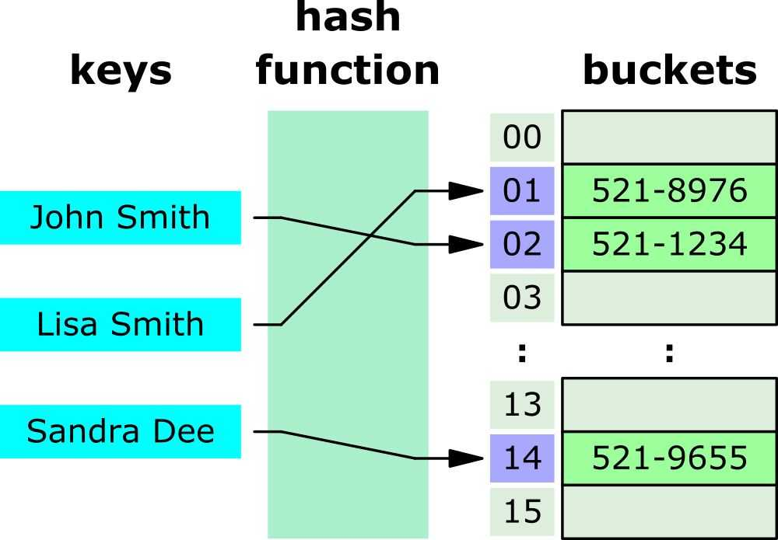

Slide 29
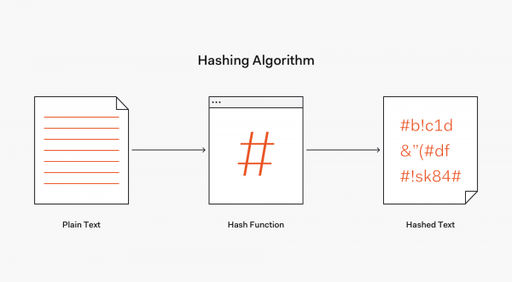
Using Hashes
Hashing is something that exists, quietly, in several places.
Checksums for downloads and file verification.
A slightly changed file will have a different hash.
Can has something ‘with’ the modified date, to safeguard.
Storing passwords and other cryptography.
Passwords generate a hash, but knowing the hash doesn’t show the password value.
Potentially partially negated with modern tools.
Used in some crypto mining stuff.

Slide 30
Data Structure Stuff Selection
What we need to do with data determines the correct choice of how to store it.
For us in DS, we use DF and arrays, moving to specialized tools as data grows.
For other scenarios, other demands dictate what to use:
If things are constantly being added (people registering for a raffle) – a list is good.
If we need to see unique items – a set is good.
We need to do lots of math – an array is good.
Frequent retrieval of arbitrary values – a dictionary may be good.
These structures are generally interchangeable, but using their strengths helps us.
We can avoid writing code to simulate what other structures do naturally.

Slide 31
Search, Sort, Structure, Selection
Choices on searching, sorting, and storing are both trivial and critical.
For the most part, things will work fine with any option (especially in python).
If we pick something that has worst case scenarios for your code, results can be slow.
This allows us to separate concern over making something, and concern on performance.
Start with what works and makes sense, then evaluate if changes are needed.
Performance is usually constrained by a few steps, often looping ones – target those.
The real-world constraints will define what to do (if they occur):
In ds, we’ll hit limits on memory size, reading data from disk, preprocessing, and training.
Other programs are likely limited by reading everything, mass updates, etc…
Depending on useage, this can change – e.g. incoming data format for sorting.

Slide 32
Generators
Brief note on generators… a different way to do the same things.
Good example of interchangeable objects.
Generators are a data-structure adjacent type of structure.
They provide data to a loop, function, whatever…
Generators work like any other iterable from a user’s perspective.
They don’t hold the data like a data structure does, they gather it as it is demanded.
I.e. a generator will read data from disk, but only a chunk at a time, such as each loop.
A data structure would have all data read into it, then used in the loop.
Why? Generally to make things faster when the data is large.
If data > memory we can’t load it all, or we can have disk access ‘timed’ for efficiency.

Slide 33
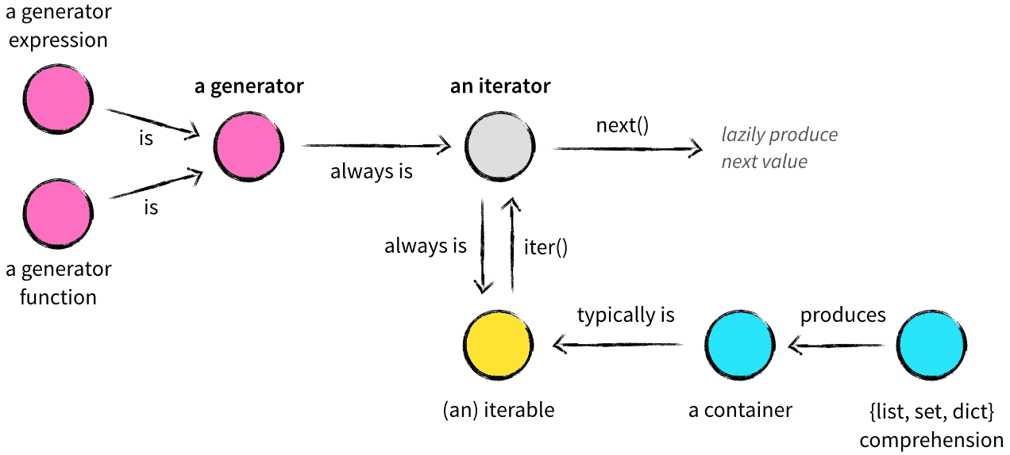

Slide 34
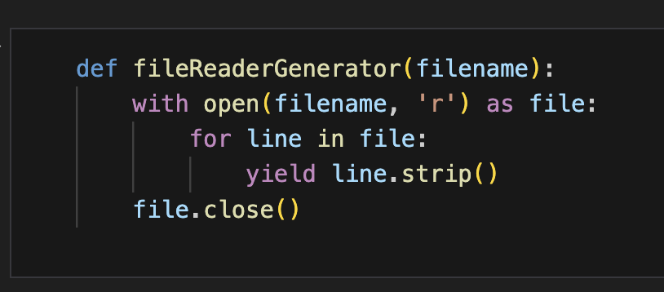
Generator Parts
Generators generate through the yield keyword.
Typically something similar to this.
Can build in any action we need:
Processing like the strip() command.
E.g. clean data, transform images to different format, pull a chunk of stuff from a database, etc…
This will happen one chunk at a time, not all at once.

Slide 35
In Data Science…
In data science, these considerations mainly come up with accessing data.
E.g. a dataset that is many GB, thousands of images, video, etc…
Sorting (or splitting) data can be a substantial time commitment.
Need to minimize and/or plan for accessing data efficiently.
“Organizing” data in any way is something that you want to do, at most, once.

Slide 36
Conclusion
Sorting is something we do, know about, can think about, but is kind of minor for us.
Default to built-in and using method overriding.
O-notation is something we can consider as we look at it more:
If we have a lot of data (as we will), am I doing something risky?
Will this duplicate data, do I have nested loops, etc….
There are data prep scenarios in the machine learning part where we need to think of it.
We should think about the “number of actions” when doing heavy work.
In cases where we are doing something costly (e.g. n2+), consider alternatives.
Choice of other options should depend on what we want and what we have…

