Slide 1
Housekeeping
New for Today – Mo’ Data Structures, Mo’ Problems (P4E ch9/10, TP ch11/12):
Other data structures that we commonly see – easy!
There’s a bit on gather/scatter/arguments in the text, ignore that for now.
I transferred the lab marks over to the LMS.
If yours isn’t there, let me know Github account -> name mapping. I likely couldn’t guess it.
If you want to add your name to the GitHub profile, that helps. I get if you don’t want to.
Lab repository access issues – there’s an announcement on the LMS.
It appears that it stems from the people who aren’t connected to the GitHub class.
Click yourself when accepting a lab the first time, if you aren’t there let me know.
For lab 1 I posted a sample solution to the repository, the sync/pull request thing will get it.

Slide 2
You’re Supposed to Have a Test Next Week!
The exams have two parts – theory and applied.
The theory is multiple choice on the concepts we’ve covered.
There’s a review quiz before it on the LMS. This review isn’t exactly the same question banks, but it is close.
There’s an applied part that has a couple of challenges that you need to code.
Please make sure that you’re added to the GitHub class so we can avoid issues.
Covers python basics, variables and data types, conditional execution, loops.
No object/class stuff.
Open book/internet/whatever, please be good people and don’t communicate with each other.

Slide 3
Objects and Classes - Review
In python everything that we create is an object.
A “thing” in the memory of the program that we refer to with a variable name.
E.g. Strings, dataframes, lists, etc…
An object is defined by a class, where the code for that object lies.
In a class, we define an object (mainly) by two things:
What an object “is” – the attributes (data) that it holds.
What an object “does” – the methods (functions) that we can call.
We can make this to model real (or ‘internal’ things) and reuse those things as needed.

Slide 4
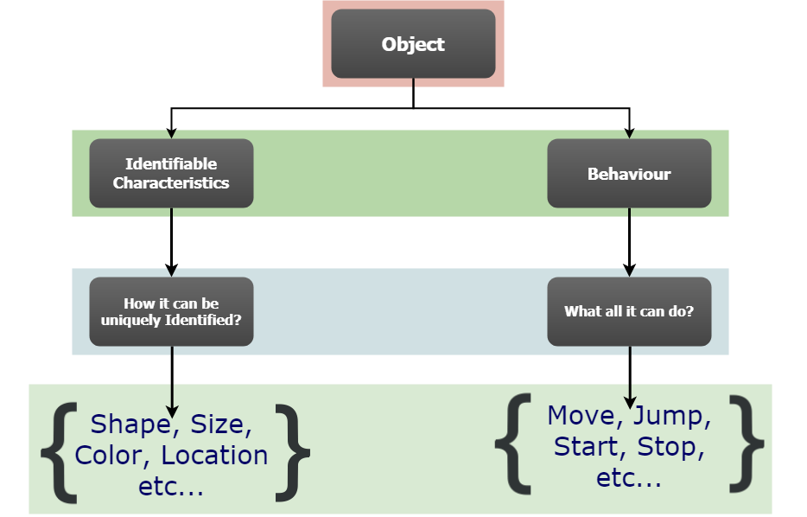

Slide 5
Catch some Static
Static parts of a class.
Classes often also contain static items - both variables and methods.
Static things are the same for all instances of an object, as opposed to instance variables that differ for each new object created.
Static example – distances.
Suppose you had some application like Google maps, and an object you kept was a ‘route’.
This object likely has ’starting point’, ‘ending point’, ‘distance’, etc… as attributes.
This class may also have a static method to convert km/mi, and a static var with the rate.
The action of converting is not tied to any instance, nor is the conversion rate.

Slide 6
Dot Notation
Calling things in an object uses dot notation.
For methods it’ll be var_name.method(), for static ones class_name.method().
“Look inside this thing, for this other thing”.
Pandas.read_csv() – look inside the class pandas for the method read_csv().
Df.info() – look inside the object df and call its method info().

Slide 7
Object Oriented Thinking
We can create objects to model things in the world that we need to capture.
Can combine attributes and abilities for a real-world thing, into an object.
Thought pattern is weird at first but makes it easier to create complex things.
A “product” in a store “is” a price, description, name, etc… and it can “do” a few things like change price.
Small and simple objects can be combined together to model more complex things.
E.g. A school’s course calendar contains many class offerings. A class offering is made up of students, instructors, rooms, resources. A registration is a class and a student. One’s transcript is a collection of completed registrations. An instructor’s workload is a set of assigned classes. Etc…
Each of these objects can also do stuff – register, change major, check prerequisites, etc…

Slide 8
Benefits and Motivations
Most complex modern software is (at least mostly) object oriented.
OOP has many benefits and reasons for us to use it, some initial ones:
Encapsulation – we can build all of the required attributes and methods “into” an object.
Abstraction – we can allow user of an object to ignore the details.
E.g. we can ask a dataframe to describe() without calculating stuff ourselves.
Reuse of Code – once we write something for an object, we never need to again.
We can focus on the higher level ideas, and embed the details in objects.
We don’t need to care about how to read a csv or excel file, pandas gives us a dataframe.

Slide 9
Data Structures

Slide 10
Data Structures in Python
All data structures do, more-or-less, the same thing – hold some data in a “package”.
It’s far easier to handle a list of products as a unit, rather than 37 billion individual items.
Most scenarios are well suited to familiar data structures:
Lists – many items, totally flexible, find items by index.
Dataframes – using tabular data, as we commonly do in data science.
Arrays – roughly a ”fixed” list, used a lot for machine learning. (Hopefully you’ll touch these in stats soon-ish).
Other times we may want or need a data structure with different functionality.

Slide 11
Shared Functionality in Objects
One of the things that makes objects useful is the ability to ‘share’ abilities.

Slide 12
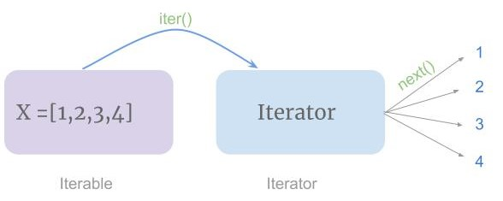
Iterability
Later in machine learning, we have some methods that can accept an array, list, or dataframe without any adaptation on our end because of this interoperability.
These data structures can be iterated through.
Can use a for loop just as we would with a list.
Each data structure provides it’s own “next” (internally, we don’t need to worry about it now), so anything asking for the “next item”, like a loop, will work.

Slide 13
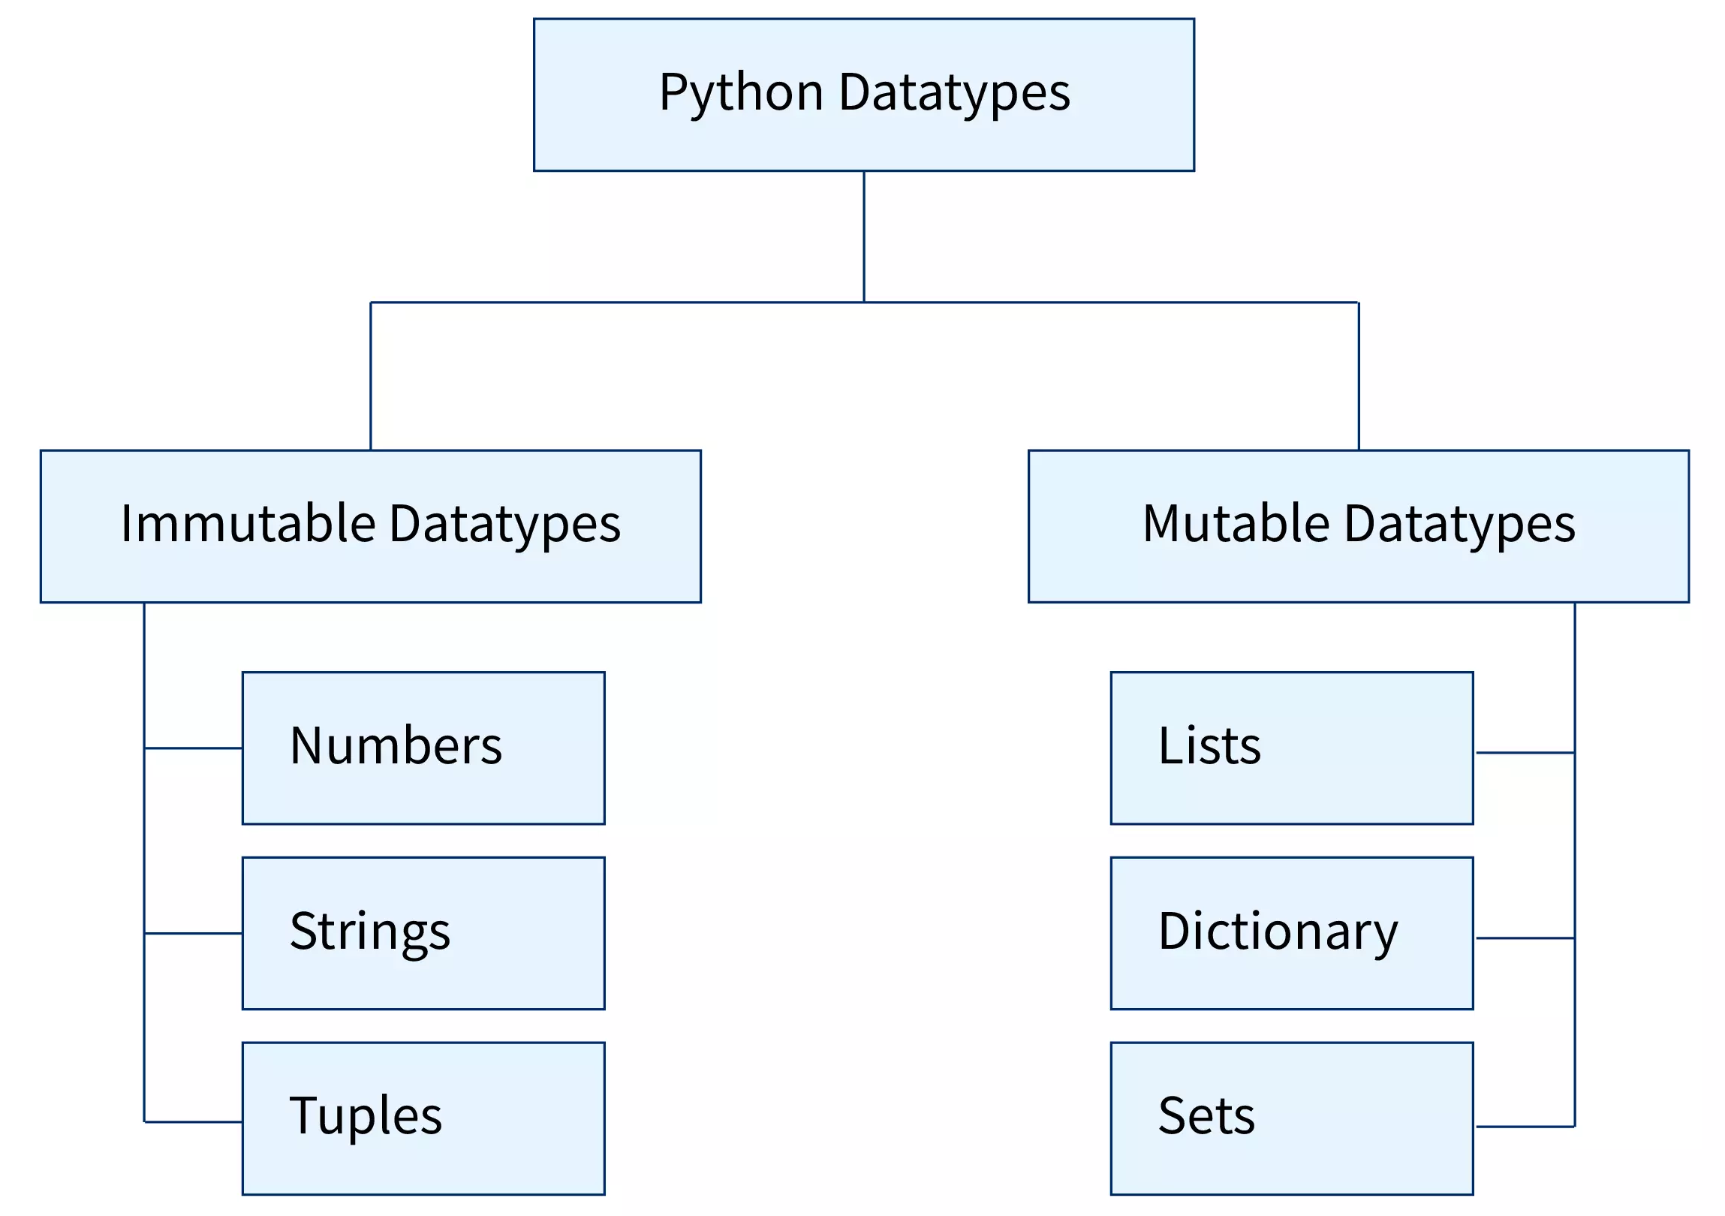
Mutability
Another concept that is important in data structures is mutability, or the ability to be changed.
Different data structures differ on if items are mutable.
Tuples are immutable – the items in a tuple can’t be changed.
Lists and Dictionaries are mutable – we can change anything.
Strings are immutable – we get a new one back if we change it.
The difference is the actual space in memory - mutable things stay where they are, immutable are created elsewhere.

Slide 14
Mutability Reasons
Why would anyone want an unchanging variable?
Immutable objects can allow for:
Provability – if we need to mathematically prove a program works (e.g. mission-critical).
Thread safe – programs that are multithreaded are easier with immutable variables.
Efficiency - since immutable things don’t change, compilers* can allocate exact memory.
This stuff can matter a lot when doing lower-level coding.
Can “fix” objects that we know will not need to change.
Compilers can rely on this non-changing rule, and optimize around it.
These concerns are usually not super relevant to us using Python for data science.

Slide 15
Mutability and You…
In most cases we see putting things in a mutable/immutable structure is minimally impactful.
Worst case Ontario, you can just make a new object with the change.
This is fast if items are small, or you aren’t doing it many times over.
There are scenarios where this isn’t true:
The previous examples of wanting immutability.
Changing a very large data (e.g. multi-GB dataframe) mutable data structure is far less costly than making a copy if it were something immutable.
One thing to be careful of are side effects of functions…

Slide 16
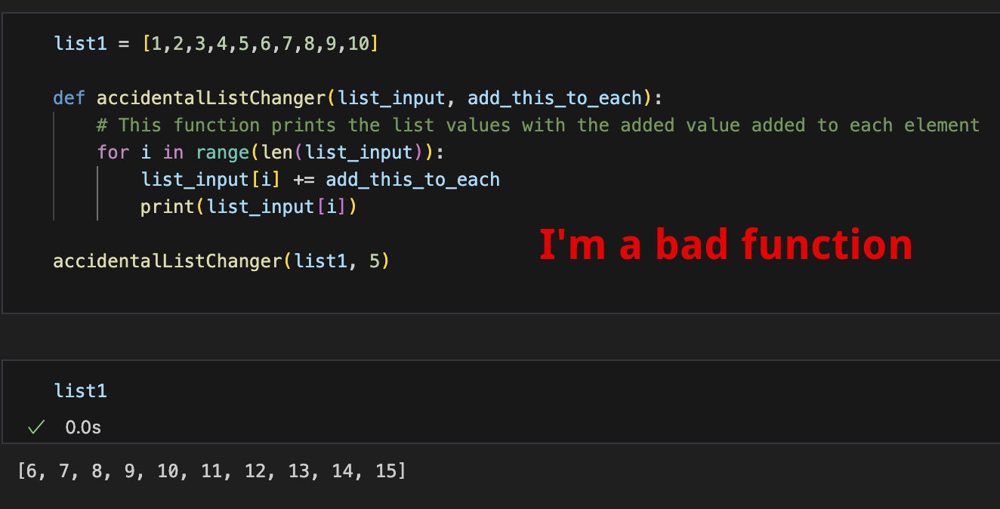
Side Effects
One thing to be aware of is the potential for side effects.
Possible with mutable data types
“Accidental” impacts of your functions.
When something is changed outside of the value returned by a function or it’s specific target.
For us, we often have data that we want to explore.
What you are starting to do in stats.
We don’t want to accidentally change data when trying to do something else.
E.g. if we have a function that plots data without outliers, we don’t want those outliers removed from the original data as a side effect of the plotting.

Slide 17
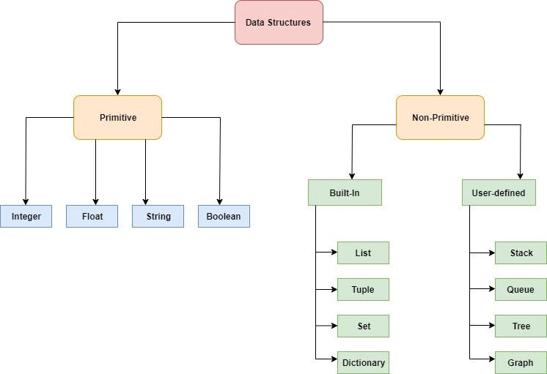

Slide 18
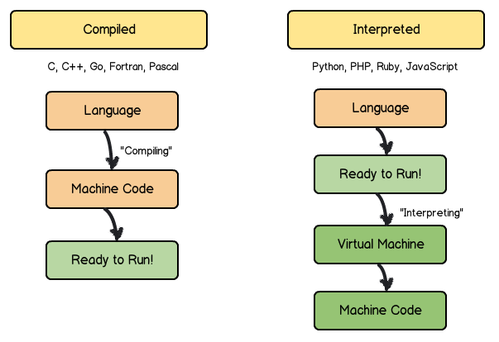
Computer Science Detour – Compliers and interpreters
Python is an interpreted language – we run code and get results.
Also JavaScript, Ruby, PHP. Sometimes called scripting languages.
Other languages are compiled – we compile our code into machine code then run that.
E.g. C/C++, Java, C#, most things that you install and run.
The compiler creates the code that the computer uses.
The compiler is very smart – it makes our code better.
It will try to optimize for efficiency, memory use, and errors.
Interpreted is easier to write, read, use, and revise.
Compiled is faster, more efficient, and better for “large” progs.

Slide 19
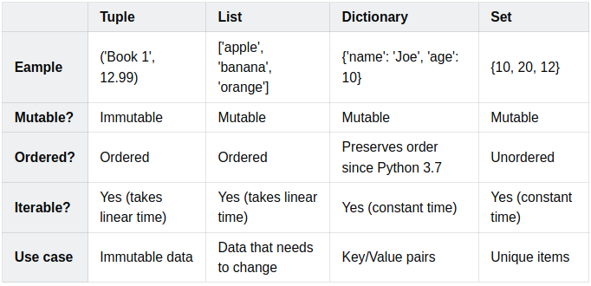
Unordered Data Structures
Some data structures hold data without maintaining indices or positions for objects.
Interactions with unordered structures is different:
Interactions with ordered data structures are oriented around the index.
Interactions with unordered data structures are oriented around the item.

Slide 20
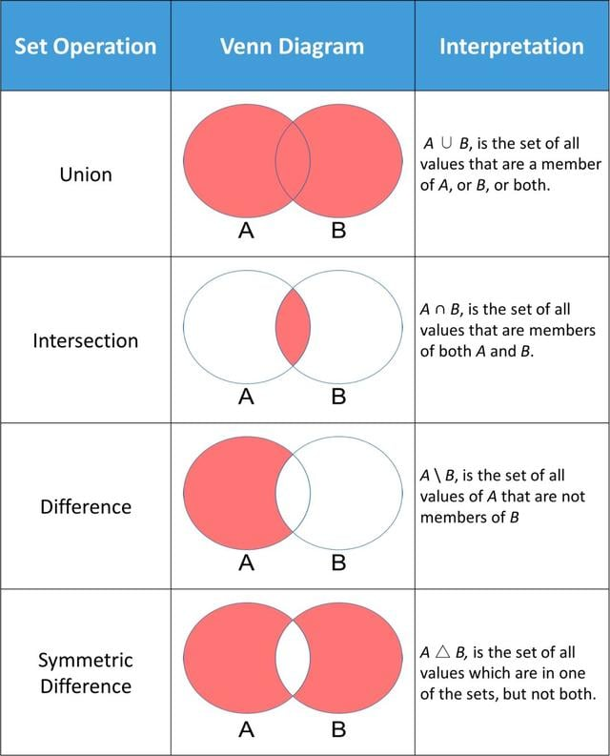
Sets
Sets are a basic unordered data structure.
Sets are largely an implementation of a math set.
Set operations allow us a one-step way to do some useful calculations on data.
This is also an example of operator overloading – sets redefine operators like “-” to work differently with them.
Operators are often overloaded for data structures.
There is a method in the class that says “here’s how subtraction works for this thing”.
E.g. adding strings concatenates them, adding sets combines.

Slide 21
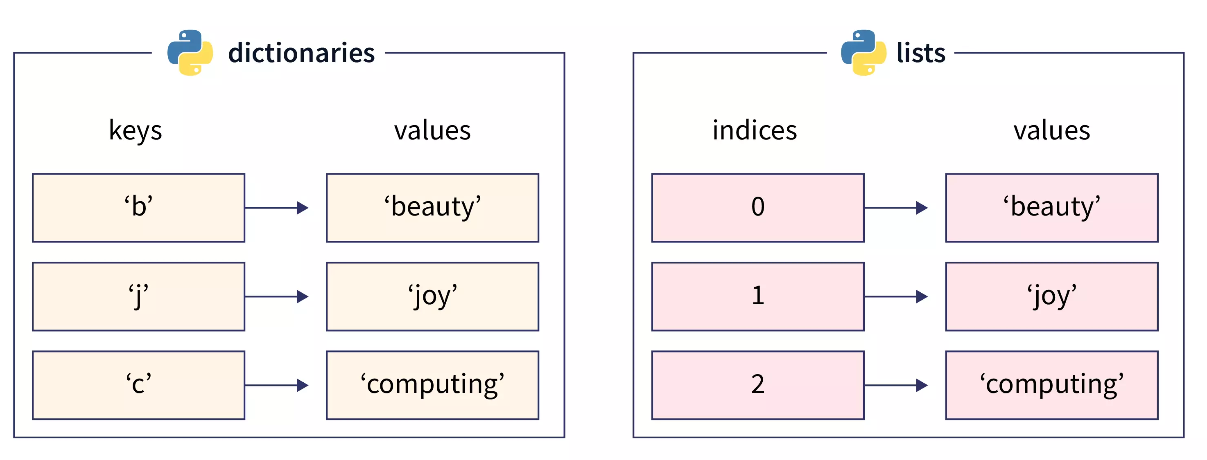
Dictionaries
Dictionaries are an unordered data structure that stores Key - Value pairs.
Dictionaries are generally used where:
We know what we are looking for – Key.
We want to know the value of it – Value.

Slide 22
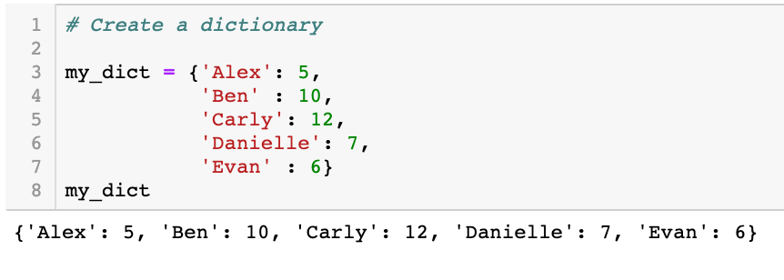
Dictionaries
Dictionaries can be made with curly braces or from another data structure.
Dictionaries have:
Items() – the key/value pairs.
Keys() – the keys.
Values() – the values.
We refer to items by key:
My_dict[“Alex”]
Dictionaries are great for looking up specific items.
Common for providing ‘bundles’ of arguments, where some are optional. E.g. seaborn.
Dictionaries are recently ‘ordered’ – meaning that things will stay in the same order, like a list.

Slide 23
Less Common Data Structures
There are some other data structures that we don’t see that often for DS work…
These aren’t fundamental built-in types in Python, but there are common.

Slide 24
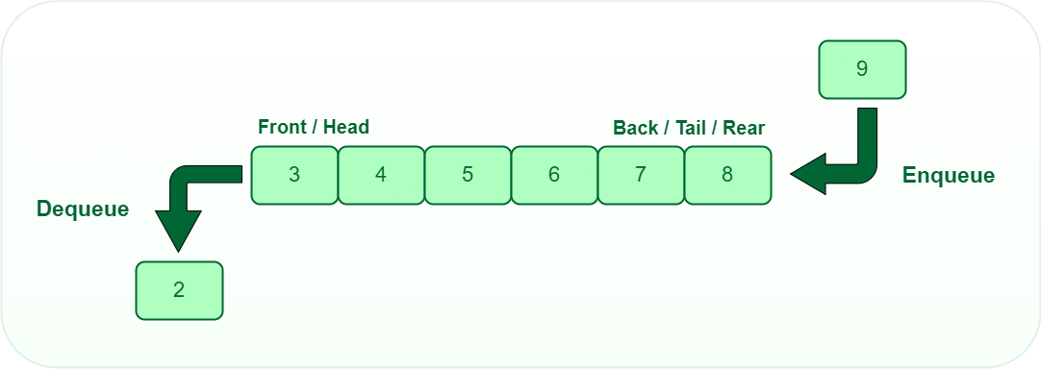
Queues
Queues are data structures that are, well… queues.
Queues are First In First Out:
We can only add items to the back.
We can only remove items from the front.
We can import a queue module.
Efficiency example – an efficient queue doesn’t shift every item one position every time something is removed, especially as they get large.

Slide 25
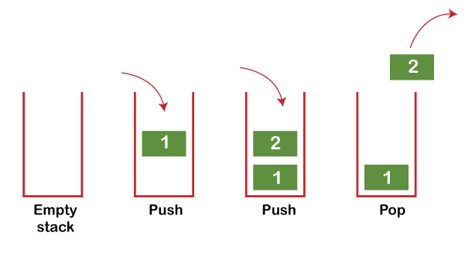
Stacks
Stacks are the opposite of a queue.
Stacks are Last In First Out.
Both stacks and queues are commonly used in processing “stuff”.
In recursion we’ll look at the Call Stack – the stuff the program is about to execute.

Slide 26
Leveraging Data Structure Properties
We can largely use any data structure to serve any purpose.
We might need to do a lot of work to make that work.
Choosing the correct data structure can sometimes make our lives much easier.
If we can’t allow duplicates, using something like a set may make sense.
If we need to track order, a dictionary is less useful than a list.
For DS applications, it is usually pretty obvious. For other scenarios, we need to think.
We can normally create one data structure from another easily.
E.g. we can write a “to_list()” or “to_dict()” function if needed.
Our new Class skills allow us to make a new data structure of container + what we want.

Slide 27
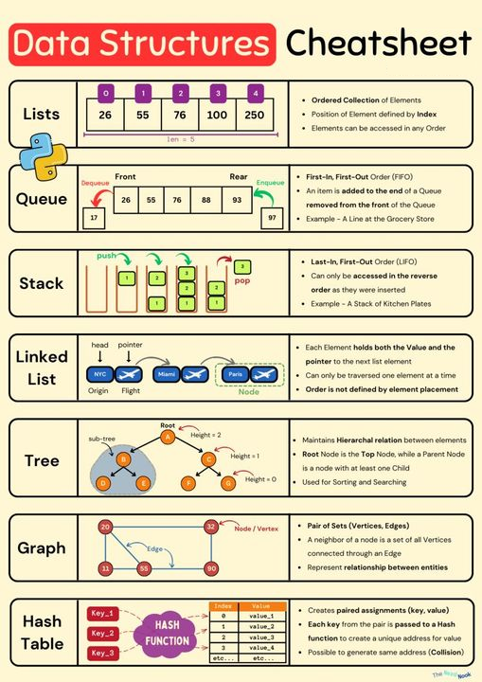
Selecting Data Structures
The ‘right’ data structure depends on usage.
Generally defined by ease or cost of doing typical actions:
Looking things up by index is fast in a list.
Searching for things by key is fast in a dictionary.
Ensuring items are unique is fast in a set.
Lists, dictionaries, dataframes, and arrays are the main ones we need to do data science stuff.
Becomes very important when data is large, and things repeat.
E.g. sorting large datasets, building tools that will be reused elsewhere.

Slide 28
Data Structure Life
In data science, we will mainly use dataframes, lists, arrays, and dictionaries.
In general, the data structures can be substituted for each other, so we can choose.
Considering the need for the data can dictate which container to use and save us time and effort.
We might write a loop for figure out which items or in two lists, or we could make them sets and it’ll do it for us with an intersection command.
If we need to process thing in some order while adding and removing, a stack or queue might be useful.
This often doesn’t matter, but sometimes can really matter.
If we use a container, and there is a lot of work involved in the logistics, maybe a different one is better.
The data structures are always well tested and often optimized for performance.
We don’t want to recreate things that data structures already do natively.

