Slide 1
Housekeeping
Lab 1 Q&A
Solution in course_material folder of repository.
Exam info:
Short answer/mc. Basics of programming – concepts, ”what does this code do”?, “parts” of python code.
It’s pretty simple overall.
Easy day!! Low theory!!! With a couple of code exercises!!!!
Commenting and docstrings.
Looping redux, with enumeration. Inc. series.
Workbooks 010/011.
Not directly correlated to a chapter in book, more general info.

Slide 2
Comments and More Loops

Slide 3

Comments
Comments are something we’ve glossed over for the most part.
Comments are additional explanation or context explaining how code works.
For now, code is simple, so it is easy to understand.
Later, code gets long, complex, and shared, so it is hard to understand.
Comments are the voice of the developer, explaining how things work.

Slide 4
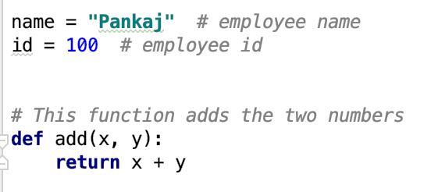
Basic Comments
Python comments can be denoted with a #
The rest of the line will be “commented out” or ignored when code is run.
These comments should be added when something could benefit from an explanation:
There’s something complex.
You did something odd or unintuitive.
Future users need to know something.
There’s ambiguity.
Some condition is needed for the code.
If in doubt, comment it out!

Slide 5
Markdown Cells
In data science we normally use notebooks for our code.
Allows us to integrate text, images, code, and results in one place.
We are generally “exploring” when doing machine learning:
Looking at data and preparing it for use.
Trying different models and observing the results.
We’d do our figuring out in a notebook, then the actual production code would be a .py
Markdown cells can also be used to add context and information.
If it is “what it means” lean markdown, if it is “how it works” lean comment.
Markdown language can be used for display customization and formatting.
Cheatsheet in the course_material folder.

Slide 6
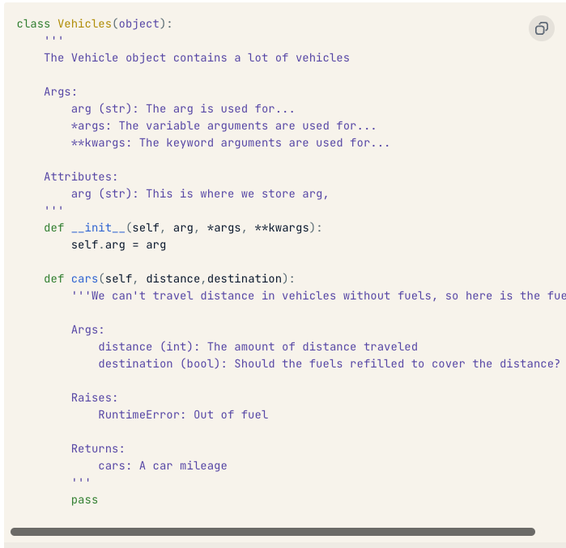
Docstrings
Docstrings are a special type of comment, that details what is in a class and method.
Docstrings are located in the first line of a class or method.
They can be multi-lined, which is denoted by the triple quote.
Docstrings are captured automatically:
__doc__ attribute or help(obj) function.
Other tools to generate doc pages

Slide 7
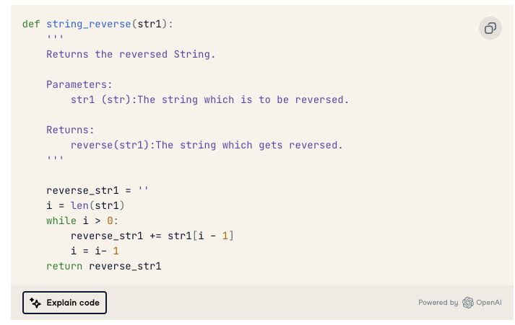
Docstring contents - Functions
Docstrings for functions contain:
A one line description of the function.
A longer description, if needed.
The parameters.
The return.

Slide 8
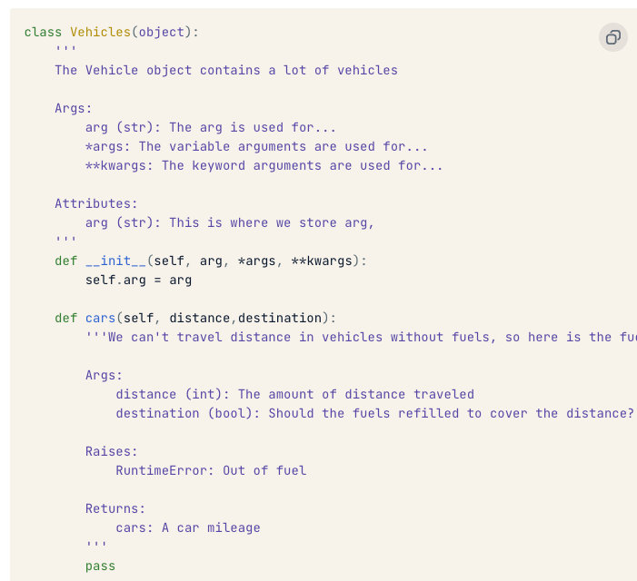
Docstring Contents - Classes
For a class, we have a similar structure.
One-line explanation.
Longer explanation.
Arguments for creation.
Attributes.

Slide 9
Commenting
We want to comment as much as is reasonable.
In larger projects, commenting will be standardized.
Everyone structures comments similarly.
Nothing will fail if we comment poorly, it just may be hard to understand later or for others.

Slide 10
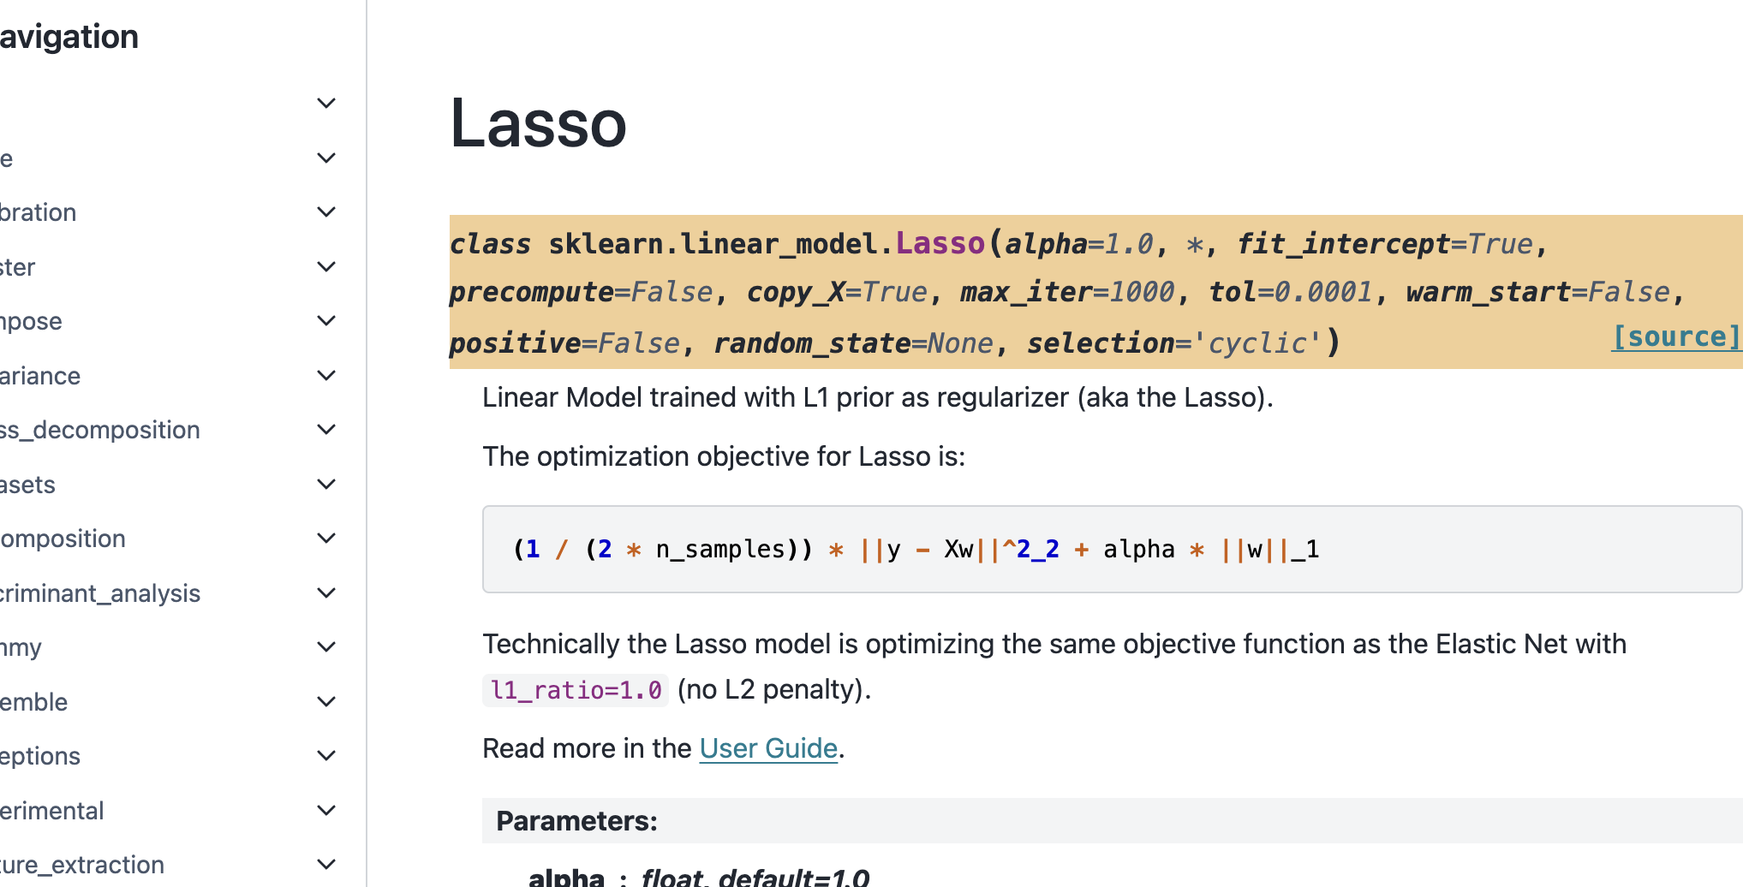
Commenting is Powerful!
Commenting is most powerful because it can be automated to provide lots of documentation.
API reference sites like sklearn are generated.
Can also be extended with some other markup tools (quarto is one I’ve seen) that allow for more tags to be added and websites, powerpoint slides, word docs, etc… can all be generated.
Can even generate different versions, inst/student.

Slide 11
Enumeration
Enumeration is another way to loop through stuff.
Enumeration is a function that takes in an iterable data structure and returns a tuple:
Index.
Item.
Allows us to loop through things like a for loop and keep the index.
Looping through any data structure is the same, as long as we can enumerate it.
Helps interchangeability.
Used in data science with larger datasets.
E.g. data that is images in folders, we don’t have a table but need to keep index.

Slide 12
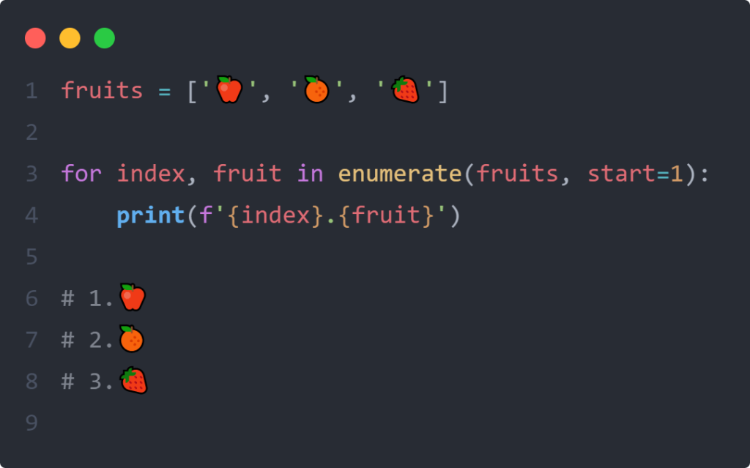
Enumeration Use
We can use the enumeration very similarly to a normal loop.
Index and item are returned.
Separately or as a tuple.
Useful if we want to track pos/count in a for loop.
Searching a dataframe and keeping index.

