Slide 1
Keeping of House
Today:
Recursion (Ch 5 think python) (Workbook 008)
Some large exercises mixed in.
Overall Context:
We’ve gone over most of the basic tools we need to ”do stuff”
We’ll circle back around to some of those concepts, with a more full set of tools, and try to build things that are more complex bit by bit.
I think it is much easier, in the long run, to learn through larger scoped tasks.
We have most of the key building blocks of programs, now need to practice.

Slide 2
Recursion

Slide 3
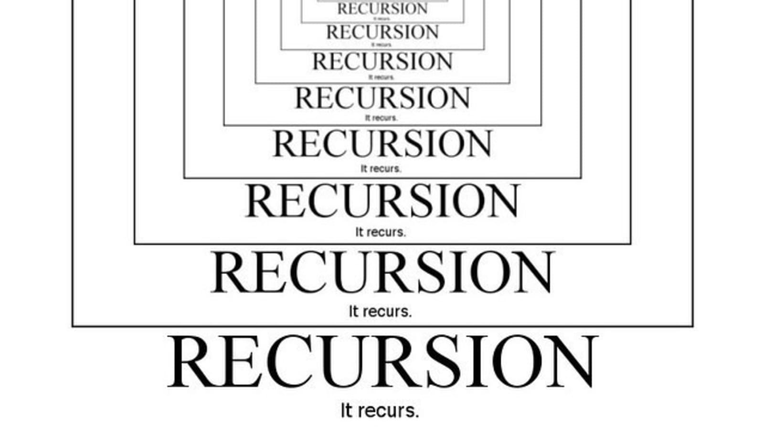

Slide 4
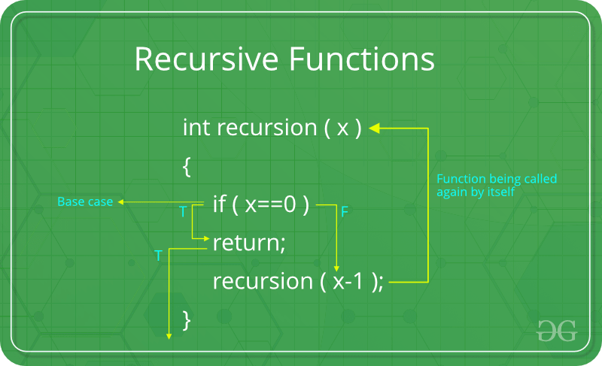
Recursion
Recursion is another method of repeating something multiple times, like iteration.
Recursion works by breaking large problems into smaller problems.
Recursive process:
If we are at a “base case”, return a value.
If we are not, return a call of “itself” with a simpler problem.
Recursion is best explored via an example…

Slide 5
Factorial!!!!!!!!
Factorials are the easiest and most common example of recursion.
Factorials are indicated by an exclamation point in math.
The factorial function gives an answer of ”all the integers >=1, up to the number, multiplied by each other”.
E.g. 5! = 5 * 4 * 3 * 2 * 1
3! = 3 * 2 * 1
We can also think of it as a nested stack of factorials:
5! = 5 * 4!
= 5 * 4 * 3!
3! = 3 * 2!
This makes it a great recursion candidate.

Slide 6
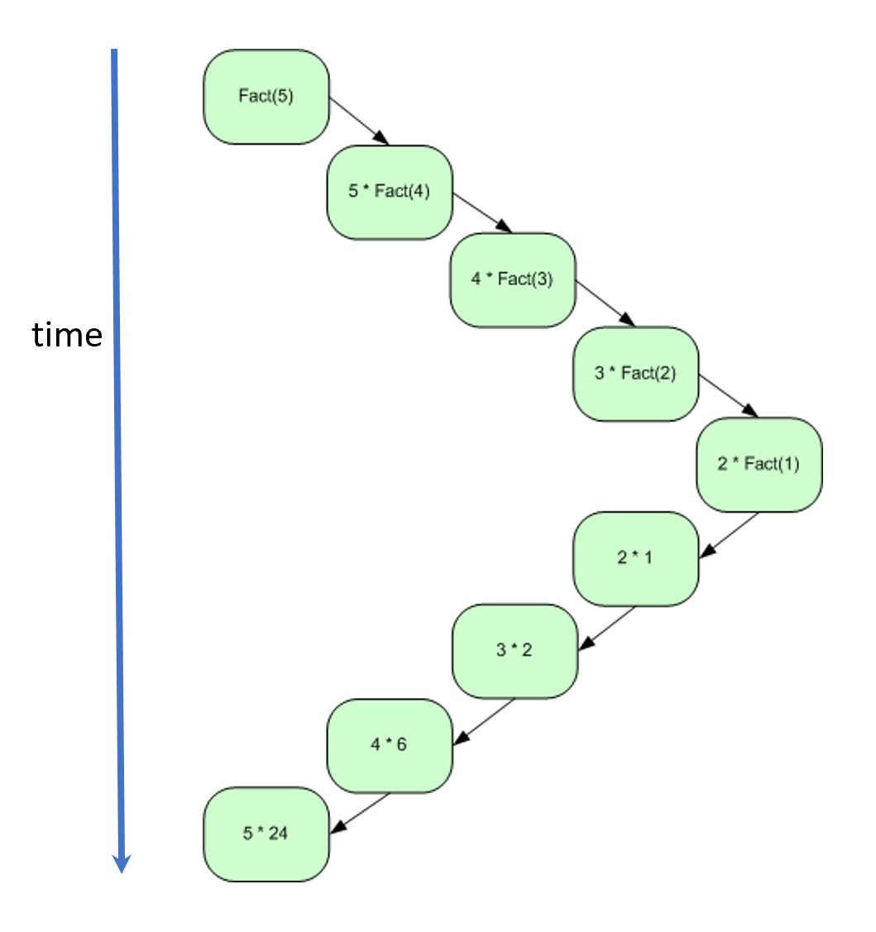
Factorial
Each “term” of the factorial can be broken into two parts:
“Current” number.
“The rest” of the numbers.
E.g. for 5! those are 5 and 4!
1! Is the base case – returns 1.
That base case value “fills in” the pending return values up the chain of unrolled recursions.
Now all the factorial cases, will have a hard value and we can calculate the answer.

Slide 7
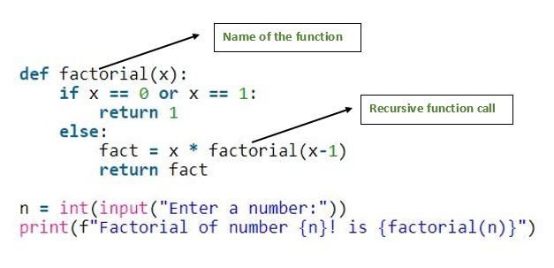
Factorial Code
Code for recursion can look simple.
The iteration is built in.
The base case returns a hard value.
The recursive case is a call of itself.
Has the “rest” as an argument.
Current value is “some value” * value of function call.
Can be a decent candidate for debugger.
We can watch the stack.

Slide 8
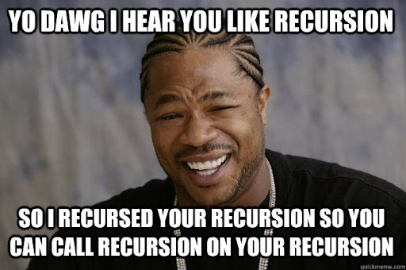
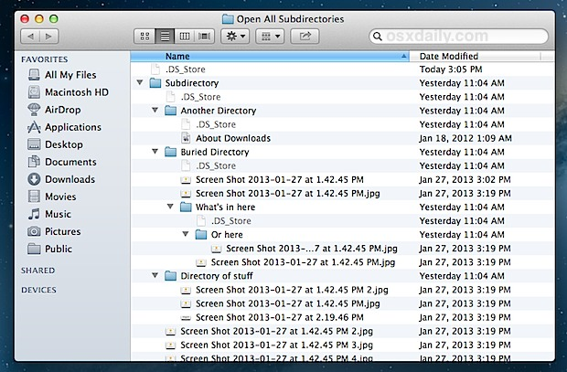
File System Navigation
A function that navigates files is good for recursion.
Steps:
Look at each file in this folder.
If you see a folder in that folder, call yourself with that folder as the argument.

Slide 9
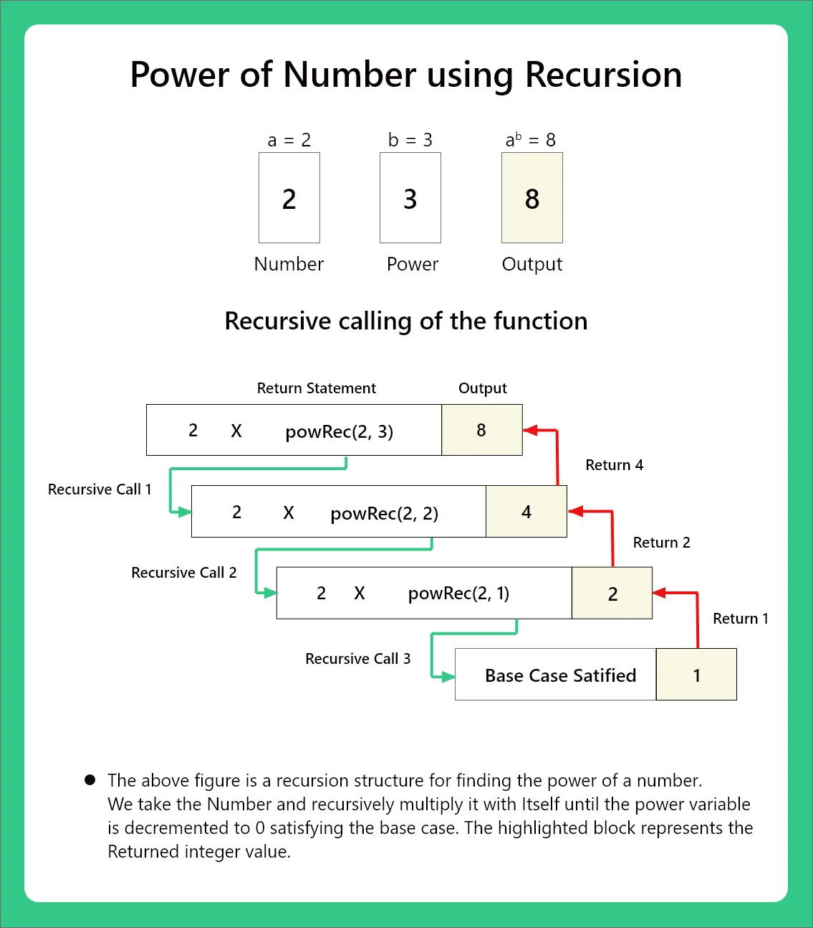
Exponents

Slide 10
Stack
Once concept that recursion touches on is the “stack”.
The stack is a stack data structure.
The stack, or “call stack”, is roughly a stack of function calls that a program needs to do.
Every function call that is called gets put on the stack.
The program executes them one-by-one.
The stack is a Last In First Out (LIFO) data structure, the most recent addition is run first.
In recursion, each of the “simpler” function calls get piled on the stack as we go.

Slide 11
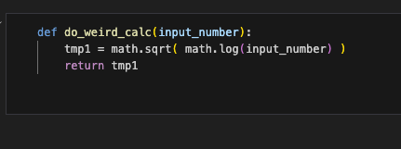

Simple stack Example
do_weird_calc(5)
Suppose we have this function, a weird calculation.
When the function is called, it goes on the stack to be executed (each one is a “stack frame”).
During execution, the sqrt function is a new call, and goes on the stack to be executed.
During that execution, the log function is a new call to be executed.
All 3 functions will be on the stack prior to finishing.
The stack executes thing LIFO, so it starts with the log.
As things are executed they are taken off the stack.

Slide 12
Stack my Recursion
The stack is something we rarely (especially for DS in Python) think about.
If doing lower-level code, this is something that is more of a consideration.
Recursion can generate many additions to the stack.
Our simple example generated 3 function calls on the stack.
Each recursion round generates it’s own function call, at a minimum.
E.g. factorial(1000) would stack 1000 function calls on said stack.
There is a possibility for “stack overflow”, or too much stuff in the stack.
Each call of a function generates objects in memory.
Also one of the more useful sites for explanations and examples.
Python has a default limit of adding 1000 recursive calls to the stack.

Slide 13
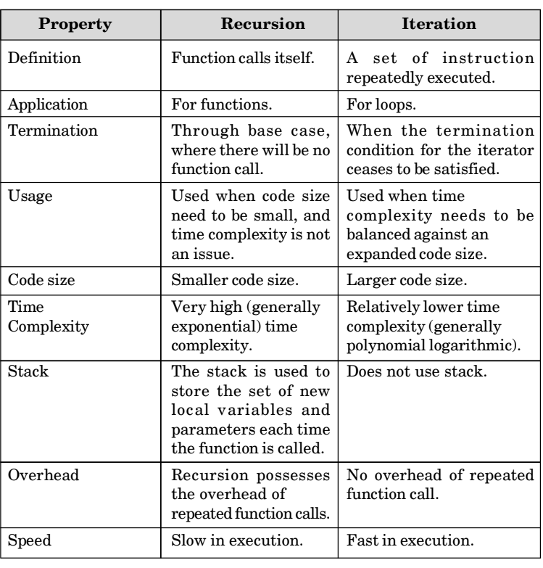
Recursion vs Iteration (loops)
Recursion is another tool to accomplish the same tasks as recursion.
We don’t really need to do recursion, sometimes it just makes more sense.
Loop/recursion are interchangeable.
Each has positives and negatives.
Recursion is usually slower and more resource intensive.
Recursion can make the structure of the code easier for some problems making it easier to understand.

Slide 14
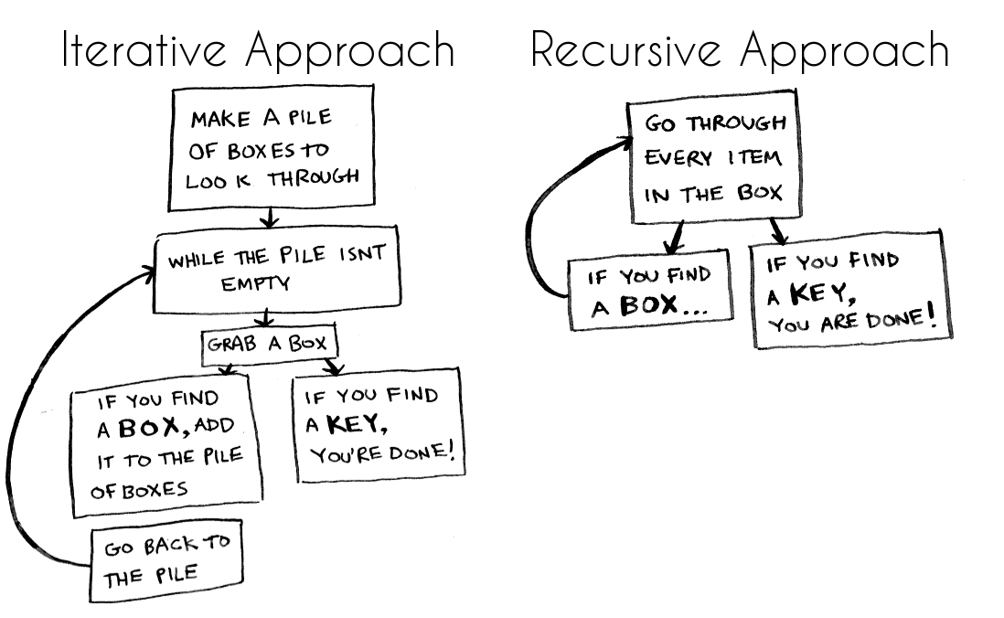

Slide 15
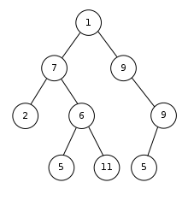
Real Recursion
In real life, recursion occurs regularly.
Trees (and linked-lists and graphs):
We’ll look at trees in machine learning.
Data structures built on the idea of going back and forth to the ”next” item.
Real world things like COVID connection following in places like Korea.
File system traversal – similar to tree navigation of up/down folder levels.
Objects like JSON – used to pass data around on the internet.
Some sorting or searching algorithms. (Qicksort – N*log(n) )
Weird languages like Haskell it is the only way to loop.
“Should recursion be used” is a debate, recursion can be resource intensive.

Slide 16
So… Do I use it?
In general, if recursion makes more sense to you in a given scenario, use it.
The choice is more driven by making sensible/clear code than objective performance in most cases.
If you are dealing with massive numbers of rounds of recursion or very complex calculations, recursion’s resource requirements might pose an issue.
Things that are hierarchical or linked based lend themselves to recursion.
In DS navigating files or trees as well as association and graph based analysis.
(Almost) always default to the choice that is easiest to read and program.
If a problem breaks down into smaller versions of itself, consider recursion.

