Slide 1
Housekeeping
Lab 2 – solutions up, common issues.
Algorithms and designing interfaces (superset of TP chapter 4 stuff). (012…)
Inputs and outputs, Encapsulation, Testing.
Practice, practice, practice…
Ideally, doing some of these larger scale exercises helps build our skills.
Identify the goal, break down problems into steps, work on building steps one by one.
Tools today help to formalize this as a concept.
Assignment – look at details. Fits into the ‘design’ ideas of these few classes.
Self managed testing and coding to requirements.

Slide 2
Stuff We should Know
Def’s Know This:
Python basics – variables, types, etc…
Functions – using, making, arguments, return values.
Data structure – index, key, ordered, mutable, choosing a good one.
Reading data – input, read, pandas.
Conditional execution – loops, if/else.
Basic debugging – check values during execution to find error.
Commenting and documentation.
Maybe Shaky on This:
Recursion - how and when to use.
Objects – creating classes and OOP.
Functions – making more complex ones.
Testing – defining how to verify that things work.
Algorithm design – make (orderly) code to accomplish ‘real’ tasks.

Slide 3
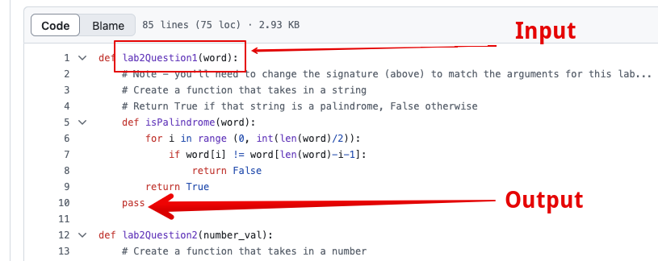
Lab 2
Sample solution in repository, you can access with the pull request/sync on web.
Mostly good, lots of 100% marks.
Some common errors:
Defining functions.
The name is prescribed (usually).
The in/out is fixed.
A few had more complex and incorrect function definitions.

Slide 4
Algorithm Structure and Testing

Slide 5
Algorithms
An algorithm is just a series of steps that achieves some goal.
Sorting a list.
Finding an item in a dataframe.
Spell checking a document.
Suggesting overly persuasive twitter extremists for you to follow.

Slide 6
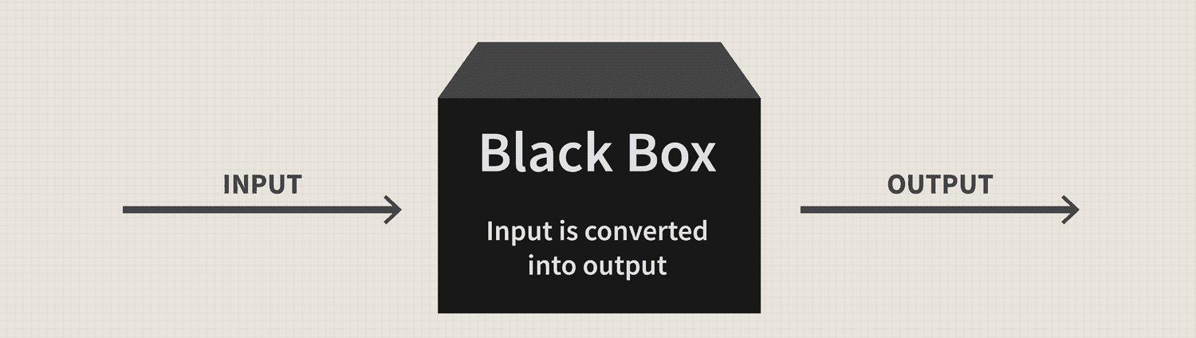
Algorithms -> A Black Box

Slide 7
Algorithms in Python
When we do things in code, we are making algorithms.
Organizing our code and thoughts can help us make this process easier.
Start with two key points:
Inputs / Starting Point
Outputs / Results
We can also wrap each algorithm into a function, mirroring this:
Parameters
Return values.
Wrapping code in a function is called Encapsulation. (Or att/meth into object).

Slide 8
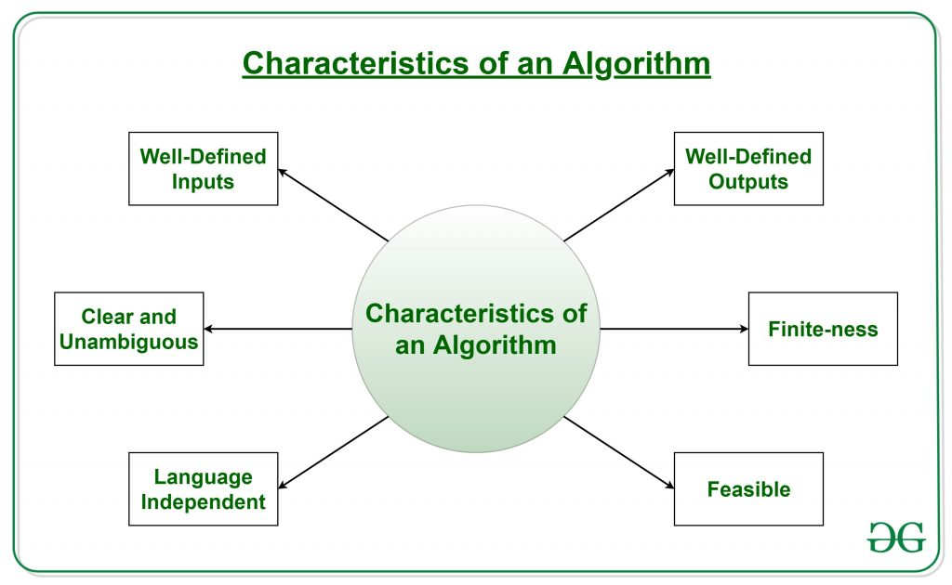

Slide 9
Constructing Algorithms
We can use these ideas to structure our algorithms.
Build a function to perform each of the key algorithms in our code.
What do we need to do? -> our function.
What data do we need to do that? -> our parameters.
What is the result? -> our return value.
These details are defined in the function’s signature.
The signature is basically the first line of our function definition.
We can add some context whilst creating functions, to help.
The signature() function in the inspect library can pull a signature for an object.

Slide 10
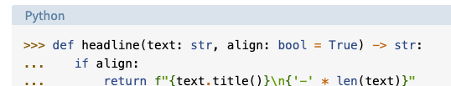
Type Hinting
To make the signatures of our functions more clear we can add some hints.
Recall, Python is a weakly-typed language, we have few restrictions on data types.
Many other languages have strict rules, if we declare an int, that must be an int.
This is unlikely to change, but this can serve as an informal check, if desired.
Hints can supplement our signatures with some info for the users.
We can hint both the parameter type and the return value.
Parameters have “:TYPE” behind the parameter name.
The return type is indicated by an “arrow” -> TYPE after the parameters.

Slide 11
Bonus Recursion Fun!
This concept is inherently recursive-ish!
Many algorithms have parts that are other algorithms!
We can deconstruct our larger algorithm into several smaller algorithms.
For example, think of the Moodle “class average”:
Calculate the average of all the student’s final grades.
To get each student’s final grade, we need a subroutine to calculate the average of all of that person’s grades.
When parts of our code are reused, complex, and have defined start/stop, that’s a good candidate to isolate it to its own function.
We can also “stub” it, or make a placeholder that returns a plausible value, so we can build the rest.
Each individual algorithm can be tested, deployed, or replaced, individually.

Slide 12
Testing
When using algorithms that are broken into functions we can more easily test.
This is called Unit Testing – testing each component on its own.
There are defined inputs and outputs, so success is “doing that”.
We can define a “test-harness”, or code to call some function to evaluate it.
Call a function several times with a set of inputs, hopefully covering all scenarios.
Compare the results returned to the known correct outputs.
In “real life” this is often done with the help of test tools/libraries, but we can make simple ones to learn.
Run some tests, capture the results, check to see if they are all correct.
If we’ve defined our tests correctly, passing means the new code is good.

Slide 13
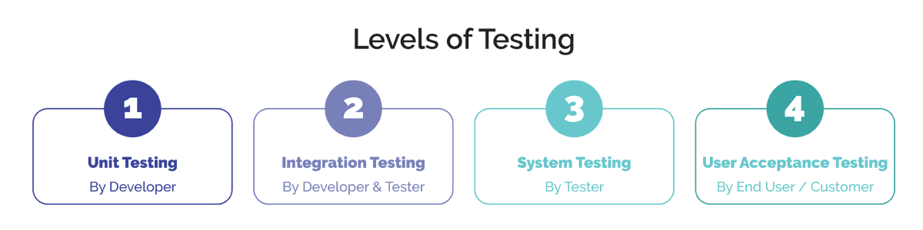
Test Types
There are several levels of testing, relating to how limited the scope is.
Lower test levels are more frequent (cheaper, easier, faster).

Slide 14
Error Catching
When creating code that does more complex things, it becomes likely we see errors.
Programs like Chrome or Tableau don’t just totally die if something goes wrong.
We can structure code to capture errors and do things to mitigate their impact.
E.g. if we are loading a file and the supplied file name is wrong, we can ask for a new one instead of the program crashing.
Depending on what the error is, we can take appropriate action.
If it was a “bad” error, we can have some code to “tidy up” before crashing.
The keywords of TRY, EXCEPT, ELSE, and FINALLY can build an “if statement-ish” framework to deal with errors.
Conceptually, this is very simple…

Slide 15
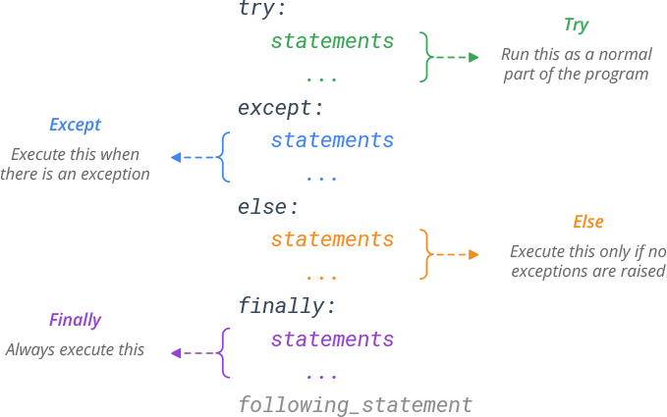

Slide 16
Error management
There are many types of errors (file access, index out-of-range, etc…) and we can set separate except blocks to deal with each differently.
Once the error is caught, it wont automatically kill your program, it is now your problem.
If the error is recoverable we can skip, change, repeat or whatever to recover.
If the error is fatal, we can do anything (logging, saving, etc…) prior to killing it.
We can do pretty much anything we can do in code, so we have flexibility.
Some very common error-generators can be helped with catching errors:
File access, data cleaning, input checking for any user input.
Common use for the loop keywords - break, pass, continue.
We often need to deal with an incorrect value in a loop, then redirect using these.

Slide 17
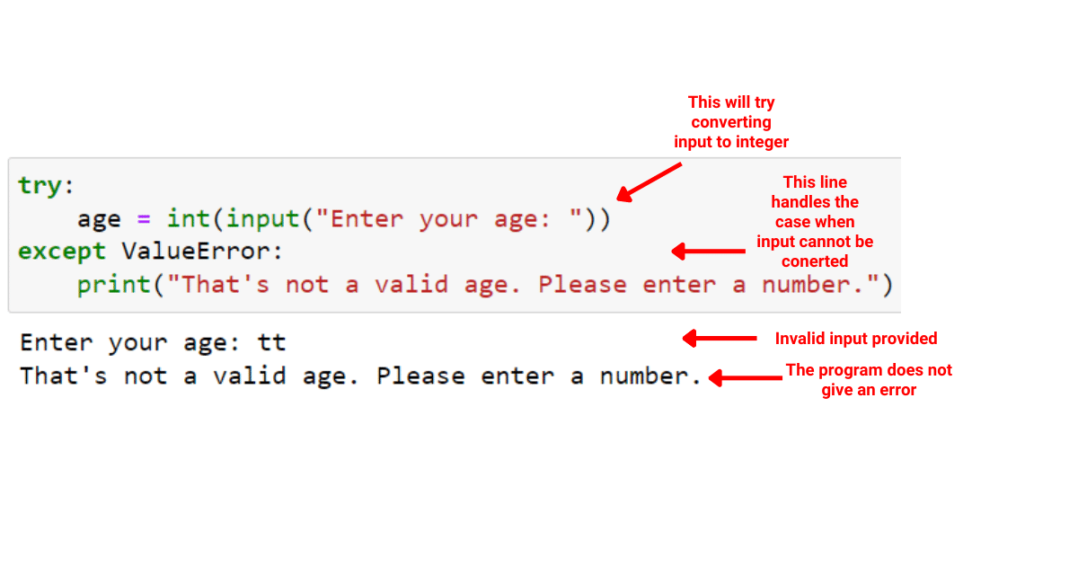
Error Catching
In ‘real’ code, the error handing in except/finally may be varied and complex:
Loop back to the start somehow, to ask for a new input/selection.
Log the error and gracefully proceed.
Substitute some placeholder.
Go down a totally different path.
You can do anything, but if you were relying on the error-value later, you need to ‘make’ it.

Slide 18

Pytest
Our testing uses a suite called pytest.
By default, and functions in a file named “test…” is run as a test.
There are more elaborate setups with more tests.
We can run these tests on demand or automatically (e.g. on commit).
If we are smart and plan ahead, we can built tests first.
Create tests that define what your code needs to do.
As long as we can pass the tests, we are good!
Makes it easier to do integration testing – does this work with the other stuff.

Slide 19
Test Driven Development
The concept of creating tests first is called TDD.
More popular in recent years.
Like OOP, helps with modularity and large projects.
As long as the requirements are met, we can keep changing code.
In many/most cases, I’d recommend this (at least to some extent):
Defining the required tests clarifies (often muddy) requirements.
This helps to understand the problem, potentially better than starting to work.
Distributing portions of work is more simple, as people know exactly what they must do.
Defines a clear goal for everyone to work towards.
The downside is that it can be hard to be complete, especially if things are open-ended.

Slide 20
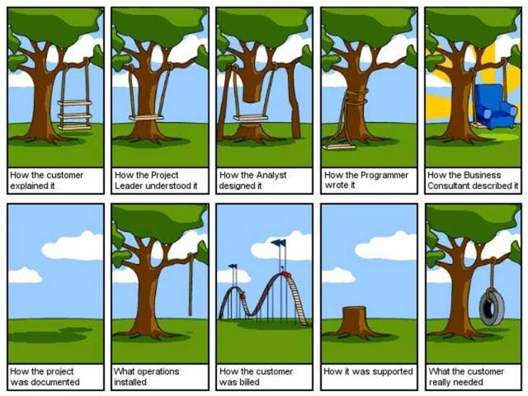

Slide 21
Break it down, Build it up
So, as a generalized process, we can:
Define the starting point (inputs) and goal (output).
Psuedocode what needs to happen, step by step.
Some steps might be really simple, like “get the length of a list”.
Some steps might be more complex, like ”remove all people shorter than average”.
The complex parts are likely their own algorithm and can be split into a function.
Define how we’d test each algorithm for success and test it.
“Hard” parts can have a simple placeholder in the interim.
Once all the parts are unit tested and working, we can make a program!

Slide 22





We supply these test cases.
List of correct results
Test Harness
Compare a test to correct answer
List of results
Our Function
List of test inputs
Inputs
Outputs
Feed one input at a time in

Slide 24
Assignment #1
Create two classes:
myProduct – represents a product, and a line of a CSV.
myInventory – represents an inventory of products, and an entire CSV table.
Fill in their ability to interact.
Add attributes to store needed data.
Add (or complete) methods to add functionality.
Show the classes working in a demonstration notebook.
Create tests to manage your progress.
Functions have in/out defined in their documentation.

