Slide 1
Housekeeping
Lab/GitHub:
Pull/sync to get updates I made (correction to test harness from end of last class).
Up to Lab 2 is updated and (hopefully) working ok. `
Today – Functions (P4E ch4, TP ch3):
Intro to functions.

Slide 2
Functions

Slide 3
What are Functions?
Functions are something we’ve used a bunch already – len(), type(), print()
Functions are blocks of code that we can call by name.
Functions often/usually have:
Arguments – inputs to the function. The things in the brackets, such as len(my_name).
Returns – the value that the function gives back as a “result”. The thing that we “use” from the function, such as my_sqrt = math.sqrt(my_number).
Neither are required, it depends on the function.
Functions can also do other, non-return, stuff – write to a file, print, update a db, etc…
Functions make our code easier to read, use, reuse, share, and test.

Slide 4
Algorithms
We often, but not necessarily, have a one-to-one mapping of algorithm to function.
E.g. “sort()” will probably do a sorting algorithm.
An algorithm is just a series of steps to do a specific thing.
E.g. sort, print, calculate the square root, etc…
The concept of an algorithm is simple, and the concept is the same in complex algorithms that train neural networks or force fascist propaganda to people on Twitter.
Algorithms typically take in some input(s), do some “stuff”, then produce some output.

Slide 5
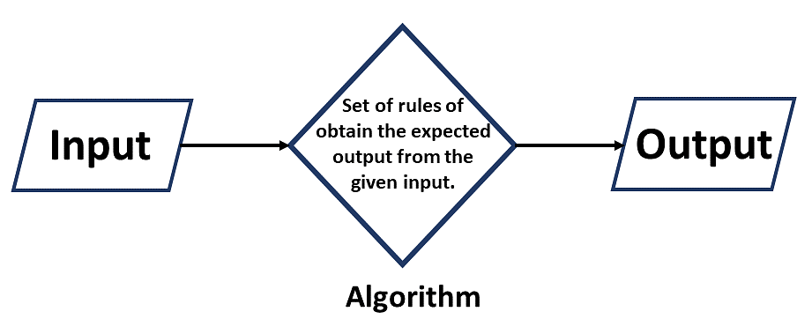
Algorithms are Simple!
Any defined process is likely an algorithm.
E.g. making coffee, starting the lawnmower, sorting items in a list, etc…
Inputs and outputs can map to a function directly.

Slide 6
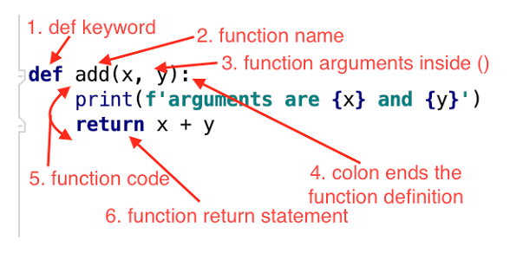
Function Syntax

Slide 7

Functional Benefits
Readability
Reusability
Modularity
Testability

Slide 8
Parameters/Arguments
Parameters are the “inputs” to a function that whoever is calling this function can supply.
We most commonly have a function to “do stuff”, and it’ll do it with whichever values are supplied in the parameters. E.g. math.sqrt, print, etc…
We also often have functions that do something (to their object), and the parameters are the “settings”. E.g. sort or groupby on a dataframe, training settings for ML models.
Parameters in the function definition can optionally be named in the call:
Allows for optional parameters to be easily implemented.
Allows for the function call to not worry about order.
Parameters can also have defaults that will be used if missing in the call.
We commonly see this on stuff we import – there’s options we usually ignore.
Parameter variable names are locally scoped – they exist only inside the function.

Slide 9
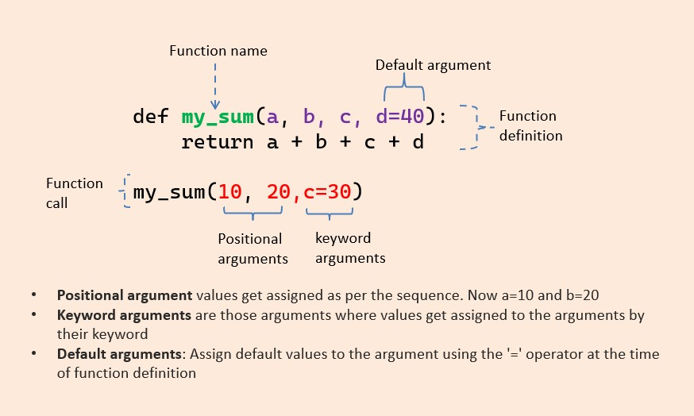

Slide 10
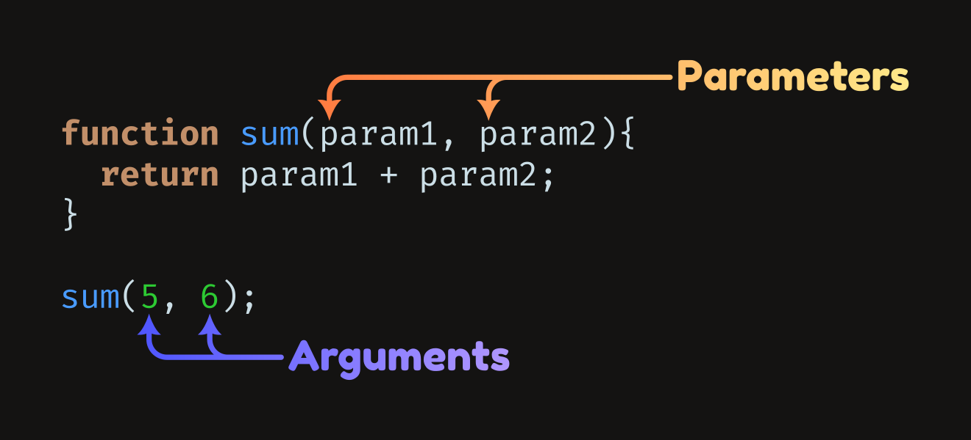
Parameters vs Arguments
We often call the inputs to functions either parameters or arguments.
Often used interchangeably.
Parameters:
The variable in the function definition.
Arguments:
The values provided when the function is called.

Slide 11
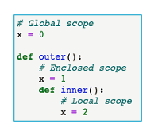
Variable Scope
Functions introduce us to variable scope.
The scope of a variable refers to where is is available.
We have 3 potential scopes:
Global – available everywhere in the program.
Enclosed – nested inside other functions.
Local – available inside a function.
Python will resolve, or look for a match, from the bottom up.
Careful on reusing variable names for scopes that can overlap.
Each separate function has its own independent scope.
We commonly reuse variable names from function to function, especially generic ones.

Slide 12
Fruitful vs. Void Functions
One key distinction in types of functions is what they return.
”Fruitful” functions return some value.
E.g. a = math.sqrt(9)
We normally set some variable to the result of the function.
When doing something like checking a condition of a loop, this is common.
Void functions do some action, but don’t return the result.
E.g. print(“hello”)
We can also return other useful info like status, if needed. Common in ML model training.
Returns with multiple values are ok, this is a common tuple use:
Return (result, status)

Slide 13
Where do Functions Come From?
The functions we use are all written somewhere:
The ones we write in our code.
The methods that are part of an object class (upper for string, sort for a list, etc…)
Methods that are in some other module that we import (math.sqrt, random.randint(), etc..)
Calling the functions can be different:
Internal methods: OBJECT.FUNCTION()
We are going inside that object and getting the “function” part of it to run.
E.g. “some text”.upper() gets that upper function as “part of” the “some text” object.
Outside functions: [library_name].FUNCTION(OBJECT)
We are getting a function from some outside place, then calling it with our data.
E.g. math.sqrt() gets the sqrt function from the math library and runs it.

Slide 14
Function “Targets”
Some functions are “targeted” at different things:
Targeted at ”themselves” – functions that act primarily on their own object.
Targeted at arguments – functions that act primarily on their arguments. E.g. print(), len(), etc..
This isn’t a super critical distinction to focus on, it’s something I found ambiguous when I learned.
This will make more sense in a week or so when we do classes.
As we get into creating classes and DS, the “themselves” ones will be more visible:
We will write functions inside of classes to “do stuff” to those objects. Eg ”sort”, “train”.
For now many/most of what we’ll see are the “arguments” ones, especially with basic data types.
We sometimes call many of these “utility” functions – things like print that act as utilities that we can reuse all over the place, in all sorts of applications.

Slide 15
Function Targets
type(ARGUMNET)

Slide 16
Why Functions?
Reusability – we can write code to do Task X once and reuse it anywhere.
Testability – we can test a function by providing inputs/outputs, and trust it works after that.
Modularity/Upgradability – we can swap out one function for another one easily.
Divisibility – it is easy to assign a function to one developer to write.
Readability – our code is cleaner, as most of the details are abstracted away in functions.

Slide 17
Where to use functions
Almost any time we might have:
Code that will be repeated.
Algorithms with defined inputs and outputs.
Algorithms that require many steps to do one specific action.
E.g. sorting things generally has a bunch of steps to do the “sort” action.
Code that requires extensive/critical testing.
There is a very low chance that you’ll be too aggressive in putting code into functions.

