Slide 1
Housekeeping
Today (P4E ch7):
File access and dataframes. (Workbooks 5-dataframes & 16-os file access)
This stuff is easy – minimal concepts, mostly just tools.
Need it/is useful for other stuff all over the place, so we’ll do it pretty early.
Objects, part 1 – if you all feel ok. Maybe theory today, code next. (This is the part where I think things really tie together more).
Lab Stuff:
If you haven’t, do the update (Sync link) to accept the pull request.
If something didn’t work out in the submission stuff, we need to sort it on this one.

Slide 2
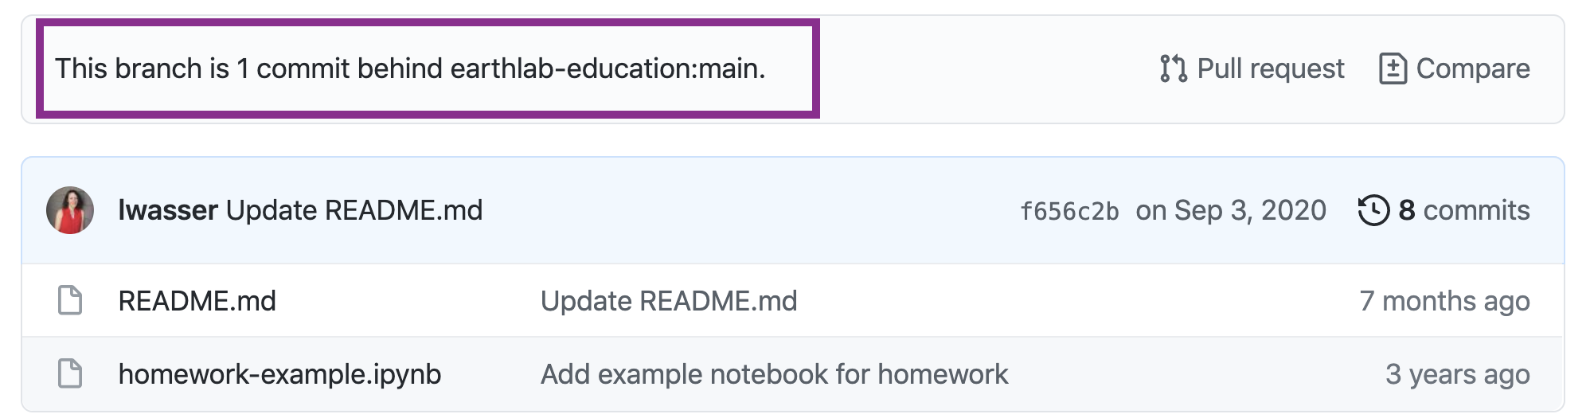
Progress:
The file stuff is easy, so it is a good chance to do some catch-up if needed.
Self-check at the end of the file.
Optional, but a good, quick-ish test.
It’s one thing, so it isn’t comprehensive, but representative.
Focus on testing your results, that’s a bigger challenge.
Labs are generally pretty easy, scores are good at a glance.
There are a couple of people who need to do the pull-request thing (I can’t mass-force it).
Click the ‘sync’ link, follow links…

Slide 3
Files and Dataframes

Slide 4
Interacting with Local Data
Our Python programs normally run within their environment.
We can “reach out” to interact with the underlying computer.
Each operating system provides some API (application programming interface) that offers a way for a “normal” program to interact with an underlying system.
For programs the load/save stuff, they connect to the API for file access.
For programs that have a GUI, they connect to the API for keyboard/mouse inputs.
For programs that use networks, they connect to the API for network access.
Each OS provides the implementation, so the details are abstracted away.
Note: Python is a very “high-level” language, meaning it is detached from the actions a computer actually takes. This allows for it to be more human friendly.
Other languages (like C) force you to do more work on the details – like manually managing RAM

Slide 5
Ways to Capture Data
We’ll look at 3 now:
User input from keyboard.
Reading and writing from files.
Reading and writing datasets through data science libraries.
Others exist for different filetypes and uses.
Each generally works the same – aim at target, specify action.
Usually pretty straightforward.

Slide 6
User Input
When running code on a command line, we can get user input directly.
When using notebooks we don’t have the direct access to user input.
We can use the input() function to request user input.
In VS Code, the text box at the top will open for input.
After hitting enter, that value will be captured, likely into a variable.

Slide 7
File Access
We can also use a library to access files from the hard drive.
Many libraries can do this.
The “base” library is “os” which provides a bunch of computer-related functions.
This is the ‘lowest level’ library we’ll see to access files.
We need to use some library to access files.
The library we use to do the file access will call on a function provided by the OS itself, and request that the OS do something, like provide a file.
OS allows us to not care about the super detailed mechanics of loading a file.
Other libraries make it more abstract – aim at file and hit ‘go’.

Slide 8
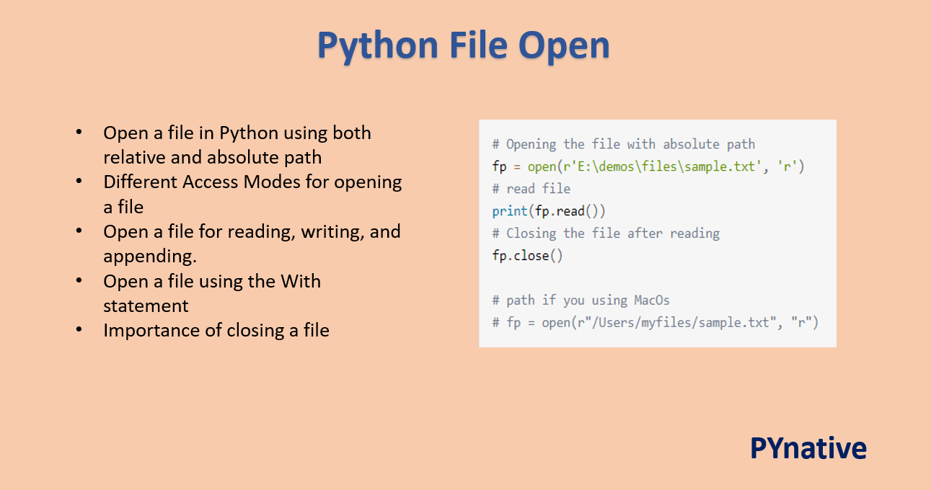

Slide 9
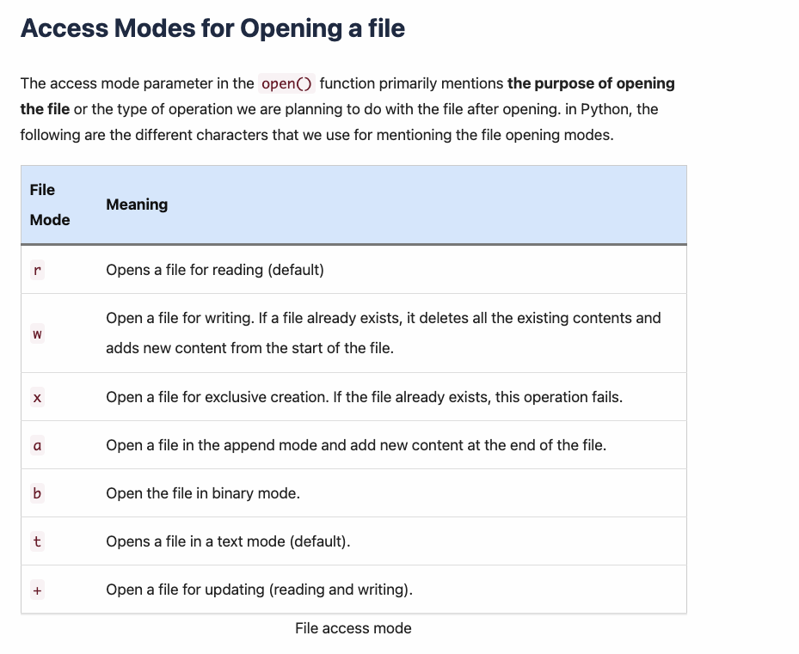
Access Modes
We can open a file in different access modes.
Each allows for different abilities to change a file, and different default behavior.
Recommended to use the minimum needed permission.
E.g. It is safer to only allow write if it is required.

Slide 10
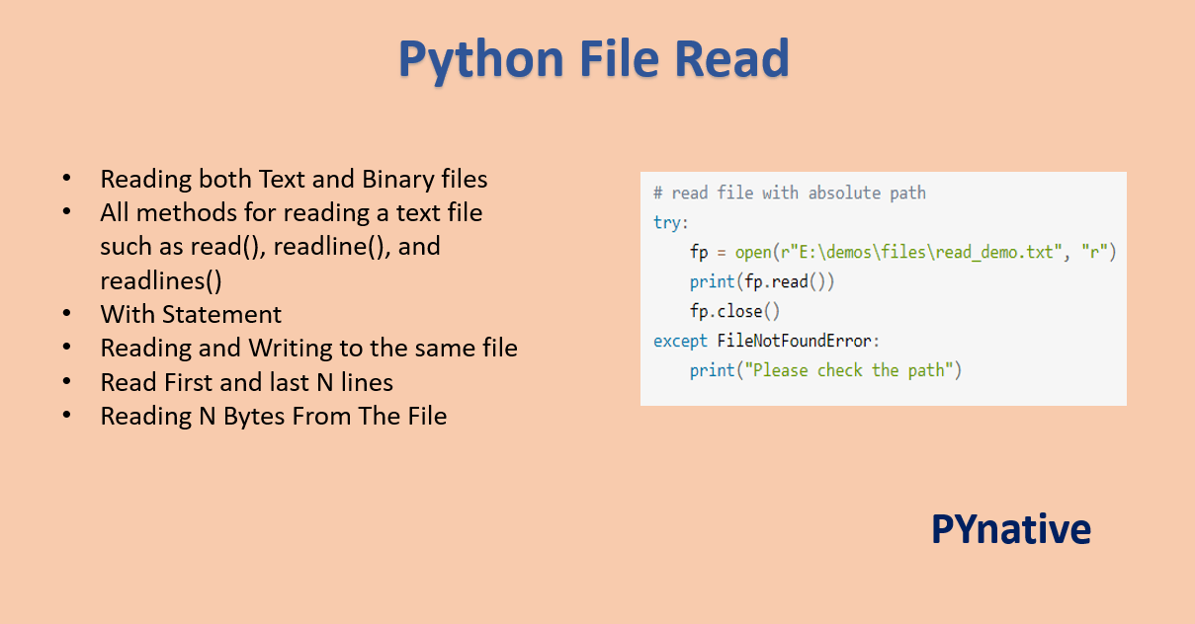

Slide 11
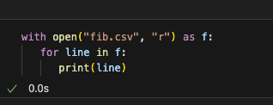
With Open
One simple shortcut we can use is “with open”.
Will automatically close the file for us.
Maintains the ”open” as long as needed, then closes it.

Slide 12
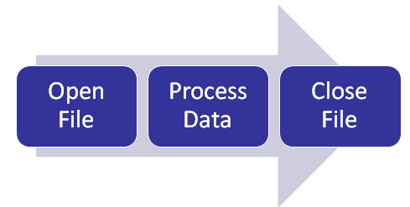

Slide 13
Dataset Access
In data science, we generally access data through a library that is specialized for that.
Read data and put it into a dataframe.
A dataframe is one of our standard data structures.
It is roughly a spreadsheet that we can access by column/row.
These libraries ’abstract away’ the details of file access.
I.e. we aim them at any datasource (CSV file, excel file, etc…) and they provide us with the same result.
We don’t need to worry about reading the data, it’s invisible to us.

Slide 14

Pandas
Pandas is one of the most common DS libraries.
Pandas provides us with a convenient data structure for tabular data – the dataframe.
A dataframe is formatted just like a spreadsheet.
Pandas also provides functions that will load data from a file into a dataframe.
We will use pandas throughout machine learning, unless the data we are using is large.

Slide 15
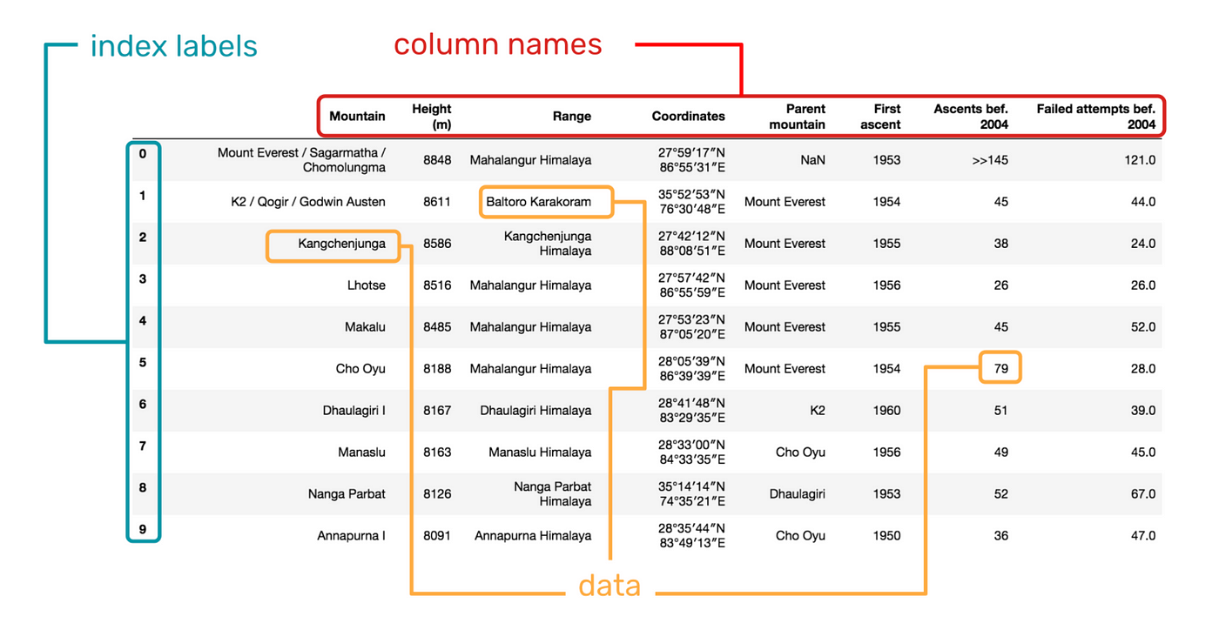
Using Dataframes
Dataframes are more flexible than the data structures we’ve looked at.
In addition to holding data in a 2 dimensional structure, dataframes can “do stuff”.
Dataframes have a multitude of methods that will do lots of work for us:
Describe() – gives a statistical breakdown of the data in a dataframe.

Slide 16
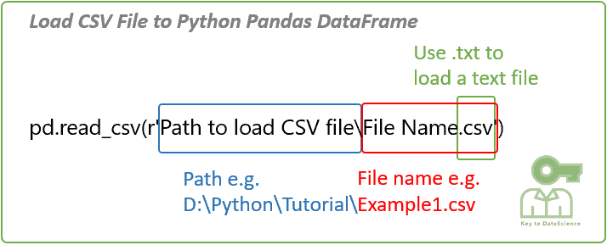
Pandas Read CSV
We can open a dataset with the read_csv() function.
There are read_otherstuff functions as well.
Can do most tabular types.
This will do all the file access stuff and just give us a dataframe.
To_csv() does the opposite.

Slide 17
Manipulating Dataframes
We often spend much of our time manipulating dataframes to prepare our data.
Some major things we can do to get started are:
Select rows.
Select columns.
Get information about the dataframe.
Group and aggregate the data.
This is the same for (probably) lots of stats, and ML next semester.

Slide 18
Manipulating Dataframes
We’ll look at this in code, it is much easier.
We can select which columns or rows we want by specifying some selection criteria.
We can get some information about the dataframe using its methods – describe, info, shape.
We can do calculations (grouping and aggregation) using functions to group the data and calculate results, like a nerdier Excel filter.

Slide 19
Using Files
We can use libraries like os, or higher level ones like pandas to input/ouput data.
Later we’ll use others to save our work when making ML models.
We can usually avoid using read/write details in data science work.
We should understand it, but it is pretty easy.
When using the OS file access, we need to manage open/close.
Open file read-write challenge:
Write some repeated action (like a function that is called) to a log, with debug details.
When writing the log, don’t overwrite it each time, add this iteration to the end.
Think of details, like date/time, that might matter in an ever-running log.

