Slide 1
Housekeeping
Today:
Doing bulk actions without loops.
Functions as objects.
Maybe args and kwargs, depending on time – it is simple.
Next week – inheritance.
Reread the class/object chapters if the ideas are shaky at all.
Ideally, read the inheritance chapter in advance. (P4E 14 – second half. TP – ch18)
I think this kind of ties together the first “half” of the concepts.

Slide 2
Working in Bulk

Slide 3
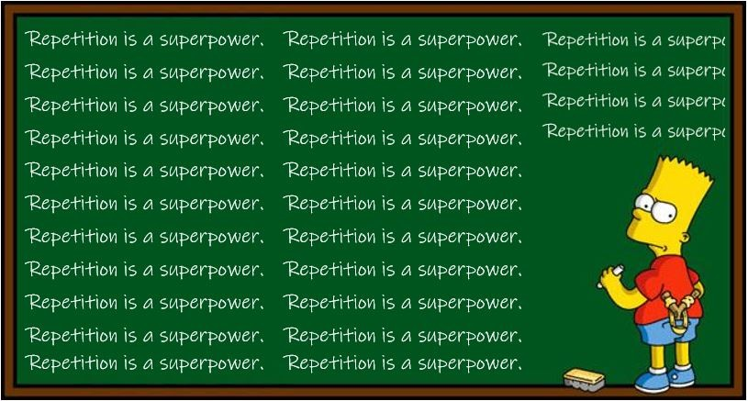
Repetitive work
One of the biggest benefits of using programming to accomplish tasks is that we can only do things once, then tell the computer to repeat it for everything.
Thus far we’ve looked a couple of ways to repeat our action:
Loops
Recursion
There are other methods, some that are especially useful when you want to do some action to an entire dataset, as we are likely to want to do.
Note: this is kind of jumbled, we have a few different ways to do things here that kind of overlap with each other.

Slide 4

List comprehension
One type of repetitive action is list comprehension.
List comprehension creates a list from some expression that produces values.
Each result of the expression is inserted into a list and returned.
Breakdown of components:
expression: The operation or value to be added to the new list.
item: The variable representing each element in the iterable.
iterable: The source of data (e.g., list, tuple, string) to iterate over.
condition: (Optional) Filtering condition.
I use the analogy select-from-where from SQL to think of the order of the parts.
Functionally the same as a loop generating values and appending to a list, but easier (I guess).

Slide 5
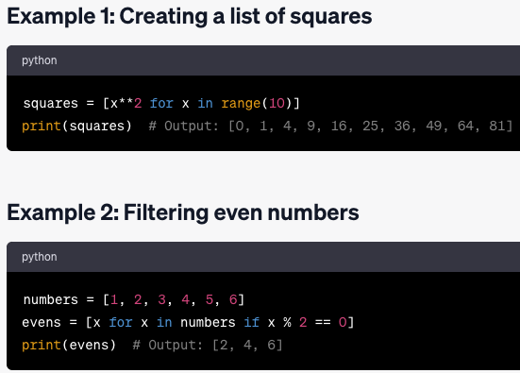
List Comprehension Examples
Best used when we want to do some action on a dataset, like a column from a dataframe.
Transformations – convert ft. to meters.
Filtering – if some info is being included/excluded, the filter can be built into the list creation.
Initialization – If we need to setup some placeholders in a data structure, we can use this. (Happens in machine learning semi-frequently, such as in some NN models).

Slide 6
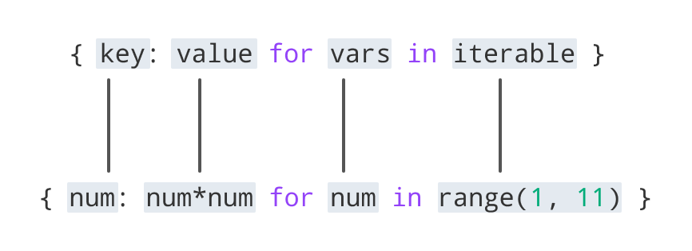
Dictionaries can be Comprehended too!
Dictionary comprehension is similar to lists.
Less common in most scenarios.
Most useful if you have separate k/v already:
One list of keys.
One list of values.
Zip them together and dictionary comprehend a dictionary.

Slide 7

Bulk actions on Pandas
We can also do actions in bulk to pandas objects – dataframes and series.
The Apply function “applies” some function to all items in a data structure, usually one column of a dataframe or a series.
The end result is the same as if we were to loop through each item.
Generally more efficient than looping.
Generally thought of as more readable and clear in some cases.
The axis parameter controls if the function is applied to each row or each column.

Slide 8
Functions…are…Objects….
In python, everything is an object.
Ints, strings, arrays, dataframes, etc…
We can pass these objects as arguments.
Functions are also objects.
Therefore, we can also pass functions around as arguments.
We can use this to make more flexible functions.
I.e. one function applies another function to something - the ‘other’ can be anything.

Slide 9
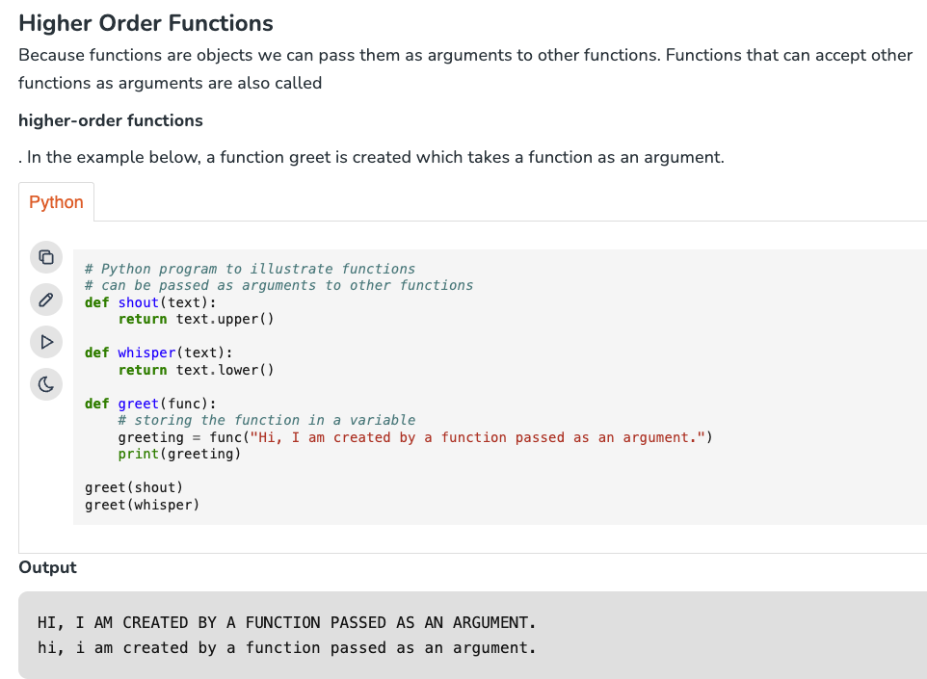
Higher Order Functions

Slide 10

Lambda
When using Apply, we can choose any (suitable) function to use.
It is common to want to do some smaller things, that may not have a function yet.
E.g. if we wanted to determine if objects are even or odd.
This code is small and simple.
Lambda functions are a tool that allows us to make small “nameless” functions that we probably only need once.
Lambda functions are only one line, so they are relatively simple.
Can be useful for things like data cleanup – we may want to transform some value in a column of data, but we probably won’t need that action again later.

Slide 11
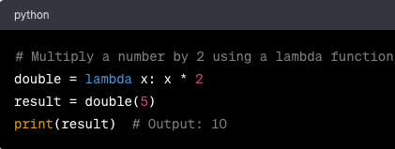
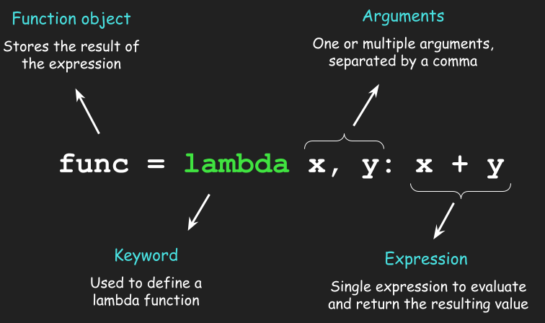
Lambda Functions
Lmabda functions are defined similarly to apply:
The arguments are the input data we’re using.
The expression is the calculation we perform to that data.
Here, we’ve stored the function into a variable, so we can reuse it if we want.
Really useful if we need to do something simple, but with more logic than something like strip().
E.g. apply tax based on some condition.
Reformat text depending on current format.

Slide 12

Applying Lambda
These lambda functions are commonly used where we just want to “do it” and don’t really need to save that function’s logic.
This is common in data preparation.
Lambda is most useful with apply/map, doing some “clear” action in its expression.
E.g. the image here checks before/after some date.
What would the results be here?

Slide 13
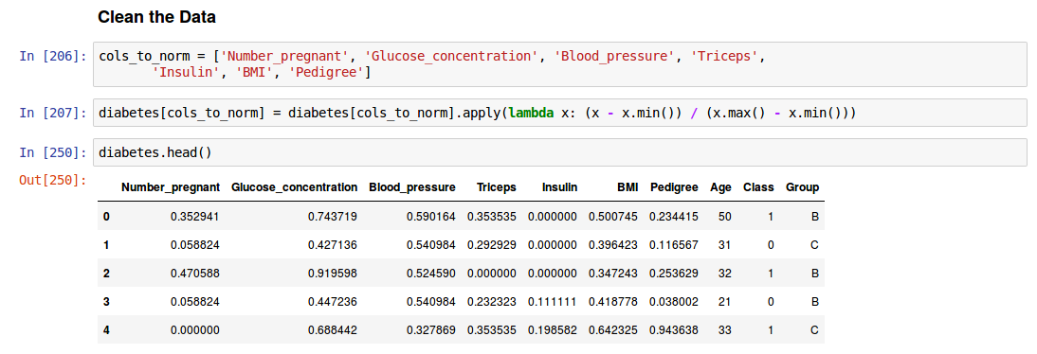
More Complex – Normalization (Do this in Stats, and Never relent to sklearn!!)

Slide 14
Interlude – Functions with Class
The apply function does something weird – it takes another function as an argument.
In Python functions (and pretty much everything) are “first class objects”, meaning:
They can be assigned to a variable.
They have an object type of “function”.
They can be nested.
They can be used like other objects – passed as arguments, returned, put in lists, etc…
We can do almost anything to a function that we can do to other objects.
Functions that accept other functions as arguments are called Higher Order Functions.
E.g. apply takes in the function that it is going to be applying.

Slide 15

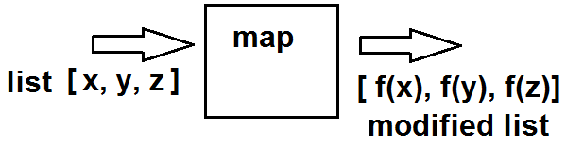
Bulk Actions in General
Apply is a function that Pandas provides, so it works on Pandas objects.
When using any iterable structure, we can use map(), which is a similar HOF.
Map applies the supplied function to every item in a structure.
Basically the same as apply, but generic.
Note: pandas also has a map function that is more or less the same, but different syntax.

Slide 16
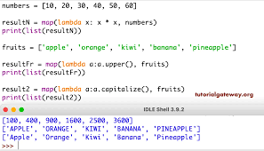
Map Usage
Map also accepts a function and a data structure.
The function can be a “normal” function or a lambda function.
Like apply, it is most useful for us when we need to do something to an entire column of data.
E.g. strip markup from phone numbers, construct a [last, first] name column, etc..
Map is Lazy – it won’t immediately calculate everything, it’ll wait until needed.
If we are squaring a list of a billion numbers, it’ll only calculate it in chunks, not 1 billion at once.

Slide 17
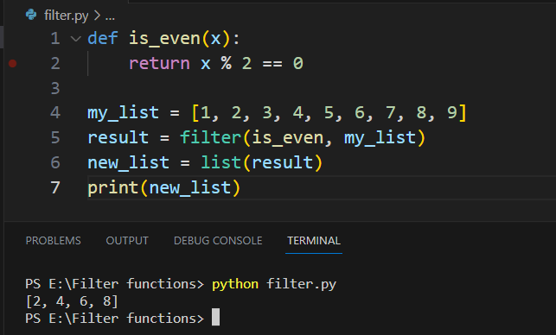
Filter
Map’s buddy is filter, which will only return the values that make a condition true.
Works much like map, but the expression must return a Boolean.
Items that make the expression true are in the results.
Items that make the expression false are filtered out.

Slide 18
Why do any of this?
These operations are generally around one order of magnitude more efficient than looping.
Over very large datasets, minor differences can compound significantly.
E.g. even in some datasets you’ll use towards the end of stats can take 10+ mins to split into 2.
This is one of the small number of things that can really
When doing actions to large sets of objects, map/apply is probably a better choice.
Vectorization, that we’ll look at in a week or two, is even faster.
Functions like map are written in C, to be fast.
The general reason for greater efficiency is that the system can better plan and utilize its resources if we tell it everything it needs to do up front, so capacity is utilized better.
The details of this are out of scope for us, we’ll look at it in a little detail with vectorization.

Slide 19
Wrapup
These functions are common and useful.
In data preparation especially they are an easy tool to do small actions.
Allow our code to be cleaner and more readable – once you get used to it.
Not REQUIRED to do anything, we could loop instead.
Guide:
If you want to do something to every item in a dataset, use map(). Remember the basics of this one, as it is generic and can be used anywhere.
If you have a dataframe/series, you can sub in apply if you want.
The body of your action can be any function, or you can lambda it if it is simple.

