Slide 1
Housekeeping
Today – inheritance and more object stuff:
Encapsulation, private/protected items, setting and getting attributes.
Inheritance – basic theory, overload/ride, polymorphism.
Assignment – ask questions if it doesn’t make sense.
Use test tools to build tests as (or ahead of) you progress.
What must I do? How do I determine it is correct? Can I write that as a test?
The test bit is the other half of the logic. You could even build tests first…
Think about test cases – both “sides”, at boundaries, invalid values, “special” inputs.
Next:
This stuff will likely take the week. Next week we’ll use the ideas to do a practice project.

Slide 2
Inheritance
It Ruins Society!

Slide 3
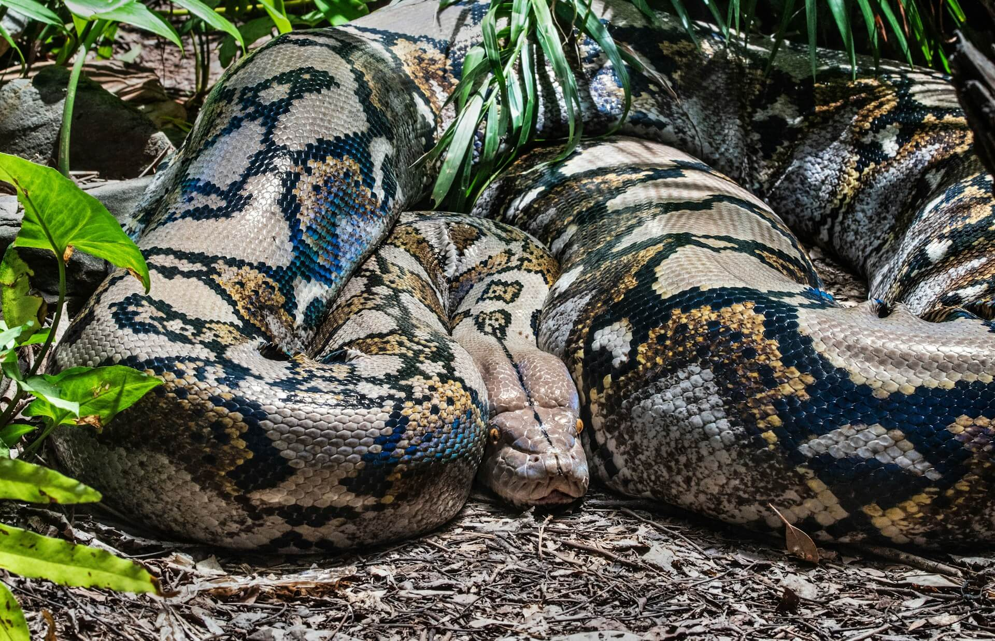
Don’t Get Bit by Python!
Python is generally pretty loose with many things.
E.g. weakly typed, few type declarations.
This is true here in inheritance.
Other languages can be very strict with terminology.
Python is more flexible, if it works, it is good.
Ideas are the same everywhere, implementation varies.
You won’t be tested on the specific small details.
If the ideas make sense and you can use them, you’re good – DS doesn’t generally need complex hierarchies.

Slide 4
Object Oriented Programming
Objects oriented programming is built on a few concepts, some we’ve looked at.
Abstraction:
We can present “user friendly” abstractions of objects, and hide the inner implementation.
E.g. we don’t need to worry about how a list is printed, we can just ask for what we want.
Encapsulation:
We can “wrap” an entire object (attributes and methods) into one unitary item.
E.g. a dataframe isn’t a “grid of values” that we interact with, we interact with the object as an item.
Polymorphism (a little bit today):
Different objects can be processed different through the same interactions.
E.g. when adding strings and integers, the same operation does different actions, without different outside code.
Inheritance:
We can create subtypes, or extend classes to make them different. More on this now…

Slide 5
OOP Building Blocks
These pillars are the foundation of object-oriented programming.
In OOP we orient our thinking and code around objects that represent ‘real’ things, and manipulating them. Contrasted with orienting our program around functions.
Building code around “capable” objects has many benefits:
Code is more reusable, as we can reuse or adjust objects in many scenarios.
Code is more readable, as we build most of the details into the objects, and present an easier interface with methods and attributes named in more plain language.
Code is easier to debug, as fewer things are “touchable” directly, rather we go through pre-made methods to do things like update variables. These have (presumably) already been tested.
In Python, everything is an object, so these thought patterns are inherent.
Data science stuff is less object oriented, in general, than ‘other’ domains.

Slide 6
State
One concept to explicitly look at when we talk about objects is their state.
The state is basically what that specific object “has”, or it’s instance variables.
The state of an object makes up what makes it unique. E.g. two Person objects have different names, ages, addresses – their state is different.
The constructor function initializes a new object, or creates its state.
Each different object that is created has its own state, that defines it.
When method calls are made to the object, we are (often) modifying its state.
In OOP our program creates the objects that model the real scenario at hand, then each step is some manipulation of the state of its objects.
E.g. a sale creates a ”transaction” object, a name change changes an attribute, loading a product on Amazon’s site reads the state of a ”product” object and displays it.

Slide 7
Inheritance
We have used classes to make objects that can hold information and abilities.
Sometimes we have classes of things that are very similar or have overlapping qualities.
For example, in an LMS like Moodle there are many types of classes:
Some are normal in-person classes.
Some are online virtual ones like this.
These classes share lots of things (id number, time, semester) but differ in others (room, sharing URL, etc..)
Each of these classes is two things – a class, and a specific type of class.
These hierarchies often exist – animal classifications, employee types, qualifications, etc…

Slide 8
Inheritance Cont.
We could make classes that model these objects, and they would be very similar.
Most of the attributes would be identical, like time, semester, course, etc…
A few things would be different, like location or ‘start class’.
We’d end up repeating logic and code between the objects.
Programmers are lazy, and repeating code is bad – there’s gotta be a better way!

Slide 9
Redoing work is Boring!

Slide 10
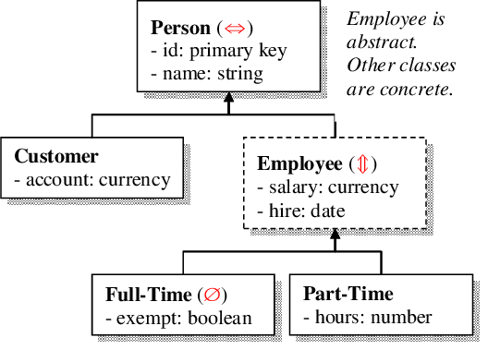
Hierarchy
Class
ILT Class
Virtual
Web Self Dir.
We can approach this problem by looking at objects in a hierarchy.
In-person and virtual classes are both classes.
In-person and virtual classes are not really the same type of thing.
We have a type of thing, a Class, that has some features.
Time, instructor, semester, course…
We have two other types of things, ILT and Virtual, that are subtypes of a Class.
Each one is a class, yet each one is a different object.
We say that an ILT class extends, is a child of, or inherits from the base class.
The parent is the base class.

Slide 11
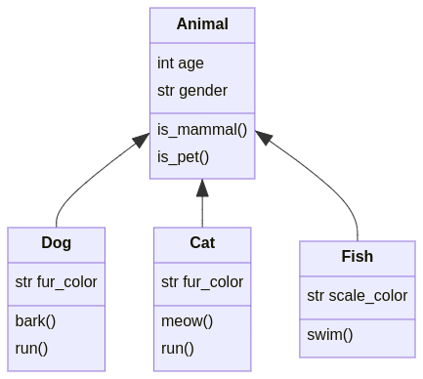
In the Animal Kingdom

Slide 12
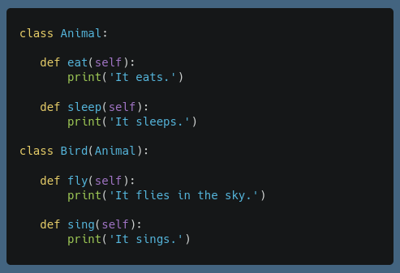
Inheritance
In programming, this hierarchical relationship is inheritance.
We can make a class that inherits some other class:
The original is called the parent class, the new one is a child.
Our new class is everything the parent is, along with whatever else we want to add or change.
Inheritance is indicated by putting the parent class in the class signature.
An Animal can eat and sleep.
A bird can eat, sleep, fly, and sing.
A bird “is an” animal, but an animal isn’t necessarily a bird.

Slide 13
Inheritance TL;DR
Inheritance allows us to make special types of existing objects.
We can ‘extend’ a thing, add the changes we want, and have a new object.
The new object is both types of objects – the base and the child, and has the info and methods of both.
E.g. - ‘hist’ objects in the thinkstats stuff (and other thinkstats objs.)
It is basically just a dictionary of values, with a little more added on.
Your grades are basically a dictionary, with a little extra logic (pass, credit, redos, etc..)
The thing inherited from is the base class.
The thing inheriting is the child class.
Allows us to model closer to how we think, share and reuse code, and test easier.

Slide 14
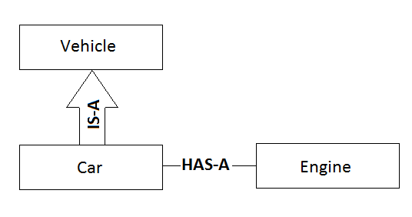
Is-a and Has-A
We say that a subclass has an “is a” relationship with its parent.
This is inheritance.
E.g. a Dog “is an” Animal.
A dog is a valid animal object, it is just also more than that.
When something holds or contains some object, we say it has a “has a” relationship.
This is composition, an object is composed of these things…
E.g. a Dog “has an” string attribute for fur color.
A dog holds another object, in this case it is a string but it could be any object, in its attributes.

Slide 15
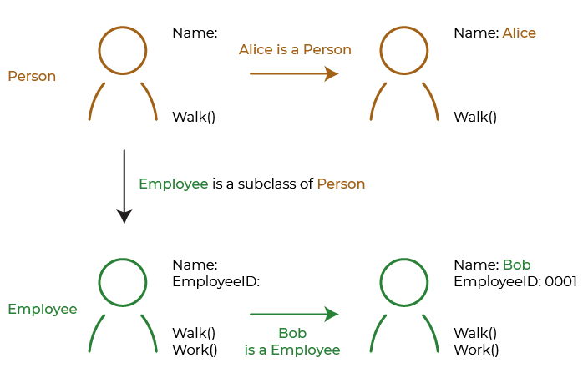

Slide 16
Making Subclasses
We can code a subclass by just putting the parent class in the class declaration.
Most things about working with a subclass don’t really change, but there are a few special considerations…
Before anything else is done in the code, the child object ‘is’ a blank parent, once instantiated. We then need to add the code to create the different bits.

Slide 17
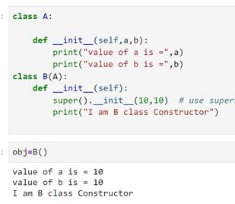
Construction and Super()
When creating an object, we call the constructor to set the initial state.
State is what the object “is” - mainly setting the instance variables.
When creating a child object, we have a 2 (or more) step process:
Make the parent.
Add the child parts.
I.e. when we create a “Cat” we are making an animal, and then personalize our animal by adding on cat stuff like meow().
The super() function call will go call the method in the parent.
Super is an inheritance specific special method that will find “this method” in the parent.
Super can also be called in other methods, and will call the parent version directly.
In a constructer we usually super(), then set any child specific attributes.

Slide 18
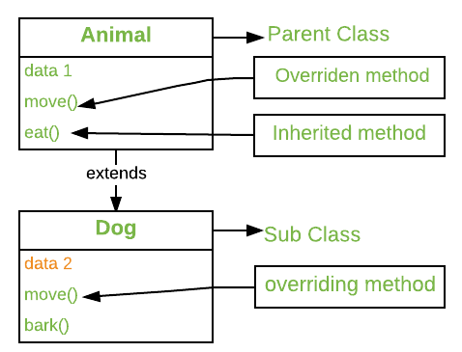
Using the Children as Objects
Once we have a subclass created, instances of it are two things:
An example of their parent, or base, class object.
An example of the child class object.
The child object will work anywhere a parent is expected – as it is one.
The child has all of the attributes/methods that the parent has.
We can choose to redefine these in our code, or leave them as is.
A parent object may or may not work where a child is expected – depends on what is called.
Also depends on how we write it, we can structure a base class to make it more likely to work.
E.g. we can’t ask a cow to meow, or a dog to moo, but we can ask each to “talk” and get their resp.

Slide 19
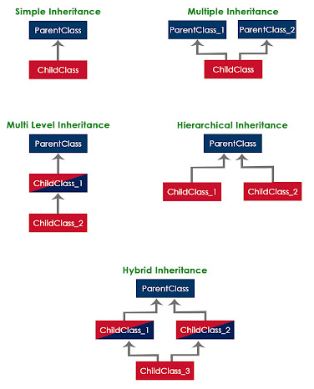
Succession – Too Much Inheritance
Inheritance hierarchies can be arbitrarily large and complex.
The flow of relationships works the same layer to layer.
Try to avoid complex ones, unless the situation merits it.
The more tree like the thing you’re modelling is, the more likely it is that lots of inheritance makes sense.
Can get hard to debug errors, as values/methods can come from many places and side effects can be very confusing.
The #1 priority is usually programmer readability.

Slide 20
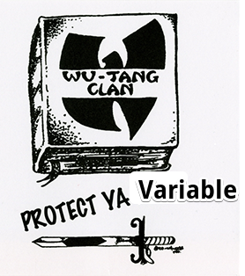
Protected Attributes
Inheritance is also the place where the third type of variable is used.
Public (normal) variables are available outside classes.
Private variables are only available within a class (nominally).
Protected variables are available within a class and its subclasses.
Like private variables from the outside, and normal variables from the subclass perspective.
For example, consider employees at Air Canada (more or less actually true):
Employees have normal attributes like name, ID, etc…
“Flight Crew” (pilots and flight attendants) add additional security permissions and ‘protected’ clearance information.
Pilots add even more private information for security clearance.
The lesser clearance level information for pilots is visible to the Pilot object, but hidden to the outside world.

Slide 21
Accessing Variables
Basic dot notation:
Attributes inside an object can be accessed through dot notation: object.attribute
Setter and getter methods.
The ‘classic’ way to access internal variables is through setter and getter methods.
These simple methods serve to either return a value, or update it.
The attribute itself is hidden, or protected, from the outside, only these methods access it.
Get entry and set entry:
Get and set entry are more hidden methods, like __str__.
We can write methods that are automatically called when using dot notation.
Can then define a ‘property’ that ties the variable to the methods.

Slide 22
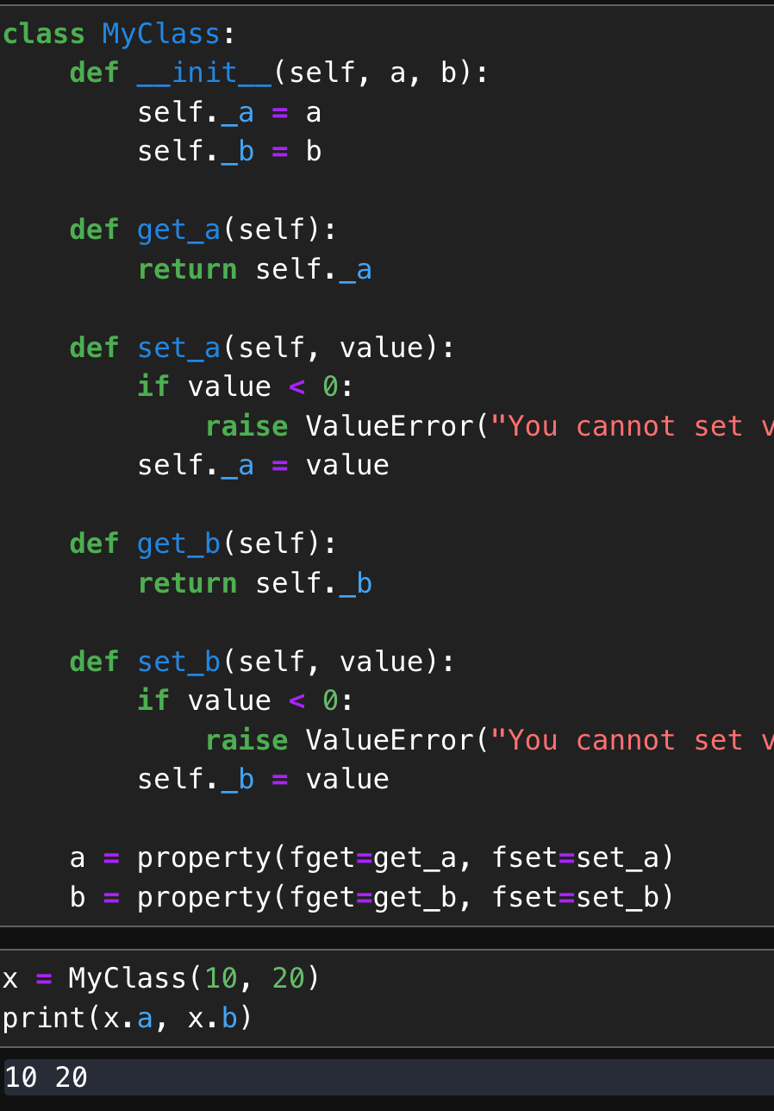
Get it and set it!
The ‘pythonic’ way to do this is to use properties as needed:
A property is an attribute, that python applies set/get/del methods to.
Effectively ‘builds in’ rules of an attribute.
Set/get methods are run transparently when the object is set/got.
Can also be triggered using decorator - @property.
Decorators wrap a function with other functionality.
Like the static method decorator.
Abstract away the usage rules of an object from an end user.
User doesn’t need to do anything different from a normal attribute.

Slide 23
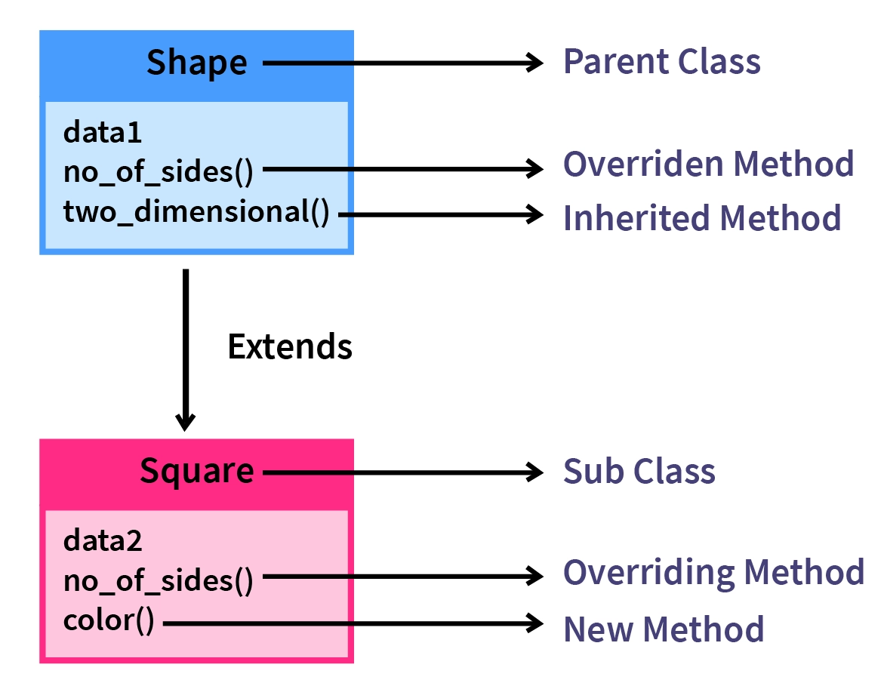
Method Overriding
Like with operators and string functions, child classes can override their parent’s methods.
If declared, the child methods will take precedence.
If the child doesn’t provide a method, the interpreter will look up the chain (including things above us) until it finds a match.
We can change or redefine behavior for a child:
We’re used to this for “generic” things like eq, str, add, etc…
Any other method that a parent class provides can be overridden in the same way.

Slide 24
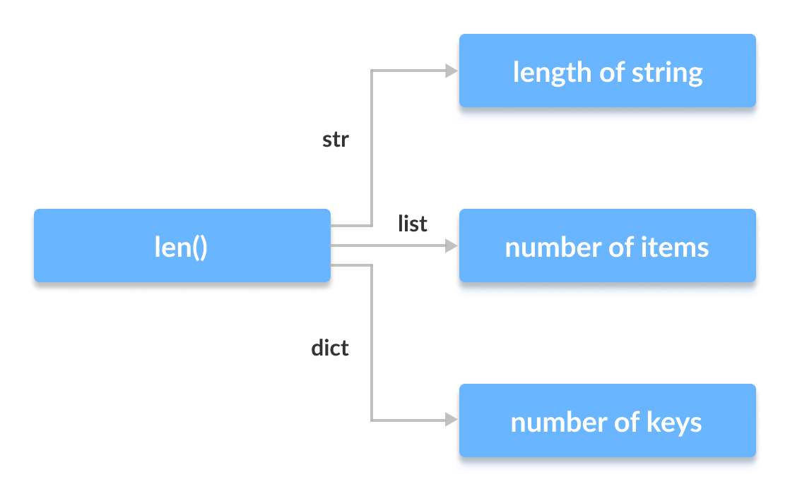
Polymorphing Yourself
The function called will be the “most specific”.
This allows us to make code more readable and testable.
The idea of len() is the same across different objects.
Better than a dict_len(), str_len(), list_len(), etc….
As long as our code meets certain expectations, it works.
We can abstract away the back-end logic:
Someone using our object only needs to understand the call.
We can figure out how our object differs and code it in.
The end result is what a user is already used to.

Slide 25
Polymorphism
When we redefine methods to work differently for different objects we are using a concept called polymorphism.
Polymorphism is the theory that a single interface can act differently with different types.
E.g. adding strings and adding integers is the same interface, different actions.
In Python, this touches on the idea of the Duck Test.
Everything is an object, and we often inherit from base classes, and we have weak types.
Methods and operators can be overridden to redefine actions for each object.
So, it is a duck as long as it can do all the duck stuff. Or if it looks and quacks like one.
Or, an object is a certain type as long as it is never asked to do something it can’t.
E.g. if we read a value from a CSV into a variable and print it, that var could be string or float.

Slide 26
Inheritance Tax
For our objects, we can just inherit them as we please.
When inheriting to extend built-in types, we may not be as direct.
In many cases, we may inherit from a different base class.
E.g. making a custom container likely inherits from some part of “collections” not a list.
Google “inherit from CLASS NAME” if unsure and the docs will show what to inherit from.
Some of these classes may be generic, or abstract:
Define the standard for the type of thing.
Require someone to create the actual item before it can be used.
E.g. ”all ordered containers must do these things, but there’s no generic ‘container’ to create…”

Slide 27
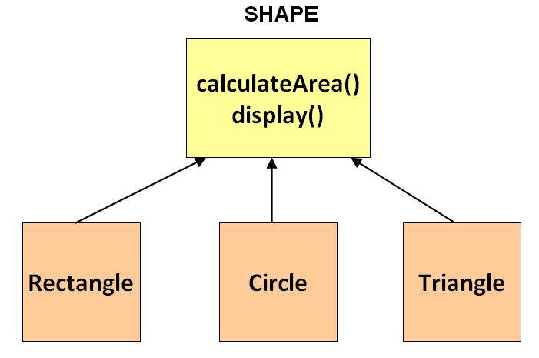
A brief break for Abstraction
Some classes are abstract – meaning they can be instantiated themselves.
A child class must be created to make objects of the abstract type.
Why?
Define what a type of object does/has, even if we can’t make one.
Set a standard that other objects can follow.
Examples:
Reality – we can’t make a mammal, but all mammals give birth, eat, etc…
Code – we can’t make a “collection”, but lists, dictionaries, etc... Are all one.
The collection class defines a bunch of data structure stuff, but we can’t make one.
We must provide an implementation of __len__, as it is required by the base class.

Slide 28
Implementation and Composition
A similar concept to inheriting (from other languages) is implementing.
Conceptually similar to the duck type idea – we can ‘implement’ something if we meet requirements.
An object can ‘implement’, or fulfill the needs of different types of objects.
I think of implementing as “can behave as a…” or “can be used as a…”.
We can compose an object that meets many needs, depending on what is ‘called’:
With the duck-typing that is in Python, we can build very capable objects. (if it quacks…)
We can implement several the things to let our class ‘be’ what it needs to be.
Because we can swap objects out for each other, lots of code works unchanged.
E.g. a pandas series can be swapped in for other data structures almost anywhere.
Allows flexibility of OOP while avoiding some drawbacks with multiple inheritance.

Slide 29
Conclusion (for Now)
Inheritance is a key building block of object-oriented programming.
There are several ‘extensions’ to this simple inheritance that we’ll look at later.
Classes can inherit from multiple other classes.
Syntactical “sugar” to make things more streamlined.
When we create objects, there is no inherent answer on what is a class and subclass.
E.g. should Amazon have books and a type variable, or fiction and non-fiction subclasses?
As a rule of thumb, if we want things to ’behave differently’ we should consider a subclass.
If some methods or actions need to work differently, we can consider a subclass.
Sensibility and logic to the programmer is more important than abstract ”correctness”.

