Slide 1
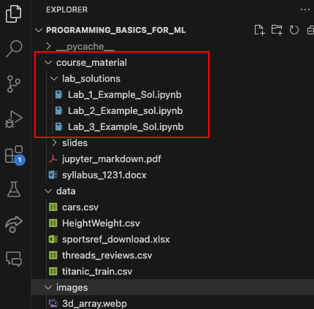
Housekeeping
Lab solutions are in the repository.
Nov 2 class is cancelled for the conference.
We’ll do the test the following Tuesday, pending your objections.
Today:
Args and kwargs – bulk arguments. Easy and simple.
Poker Card/Deck/Hand.
A realistic-ish example.
A good chance to work through an open ended problem.
We’ll carry this on later, as we get some more tools.

Slide 2
Args and Kwargs & Large-ish Inheritance/Class/Function/Fun Exercise

Slide 3
Function Arguments
We’re pretty used to seeing arguments for functions.
We can divide up the arguments into two subgroups:
Unnamed or non-keyword ones
Named Arguments.
Non-keyword arguments are those that have no label.
E.g. sum(a, b)
Keyword arguments have a label.
E.g. sum(num_a = a, num_b=b)

Slide 4
*Args
The *args argument accepts an arbitrary number of items and packages them into a tuple.
The args part can be anything, the star does the magic.
Inside the function args is a tuple of however many items are in the argument.
Useful for when there are lots of “the same” thing, and we are totally, adding, appending, etc…
We commonly do a for each item in args… type of loop to deal with the arguments.

Slide 5
**kwargs
**Kwargs is args’ buddy, it works in the same way except it takes in named arguments and produces a dictionary of arguments.
The name of the argument is the key, the value is the value.
Useful for when we have a large number of optional settings.
E.g. graphing functions often take lots of options for color, style, line width, etc…

Slide 6
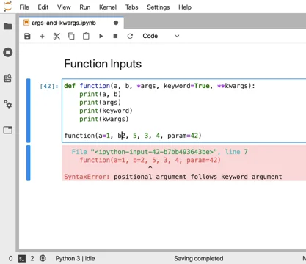
Order
Args and kwargs must go in a specific order in arguments.
Order:
Unnamed arguments
*args
Named arguments (e.g. isNegative = True)
**kwargs
This order is a universal rule.

Slide 7
Arguments, Args, and Kwargs
Args and kwargs are ways to package arguments more seamlessly.
They don’t do anything different, just with less work.
You could manually pass a list/dict easily without using them if desired.
Common in scenarios where:
Args: expectation of a data structure of data, # of elements irrespective. E.g. sum, std.
Kwargs: lots of less used arguments. E.g. display options in seaborn.
The argument order is something that always applies.
Unnamed, args, named, kwargs if using args/kwargs.
Unnamed, named if only using regular arguments.

