Slide 1
Loops
They go Around

Slide 2
Housekeeping
Questions?
Is anything in other classes (stats) a current sticking point?
Lab 1 – we’ll be able to tackle it in its entirety post-functions. Most is OK now.
Lab 0. Not due. For fun only. I forgot to clear the dates, so it showed in your calendar.
Today:
Looping
Functions
Chapters 3 + 7 in text. End of chapters have extra exercises.
Maybe some file access stuff, depending on time.
By the end of today….
Comfortable opening/editing/running notebooks. Good with flow control. OK on functions.

Slide 3
Housekeeping
Labs:
I revised lab 0 and 1, please someone test – new links on the LMS and in chat (put in the chat if you are – only need a couple of people).
If this doesn’t work I’ll have you work on it, and figure out submission differently.
To now:
Understand basics of notebooks and python, pseudocode, create and manipulate variables, use conditional statements, use some functions, simple debugging (e.g.. print var vals or use variable monitor to check), starting to read docs and implement in code.
Today:
More flow control – loops. (P4E ch5, TP ch7)

Slide 4
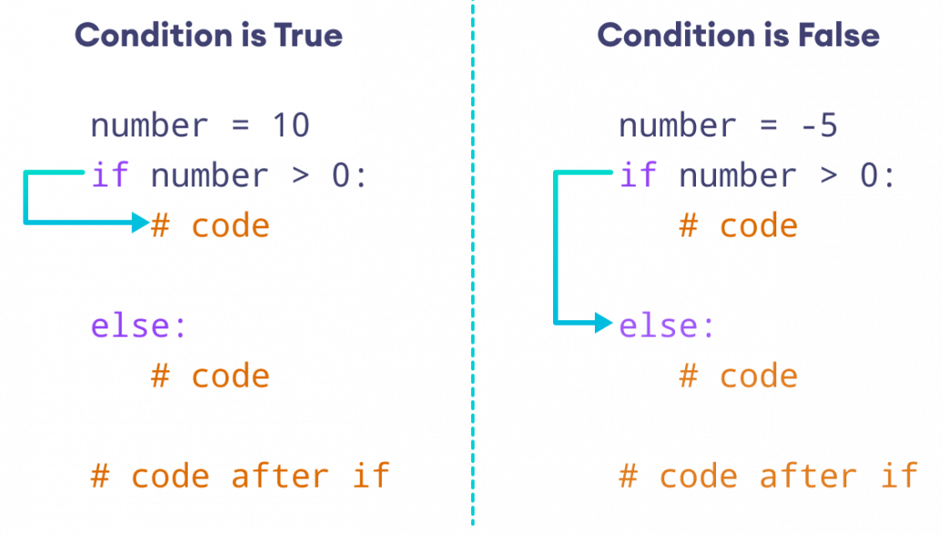
Review – If Statements

Slide 5
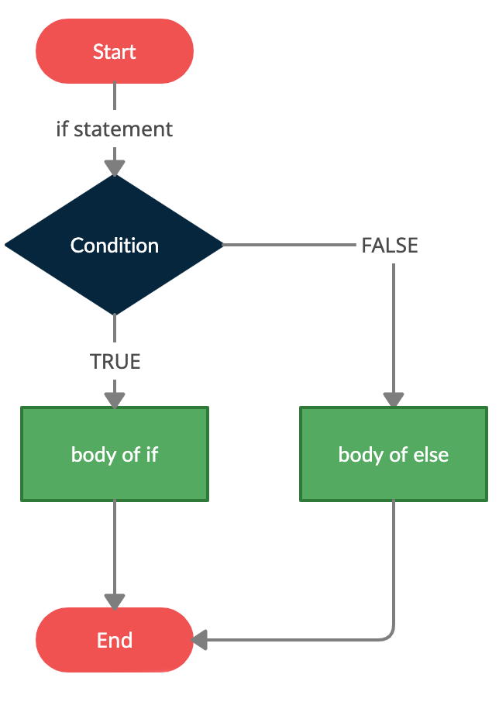
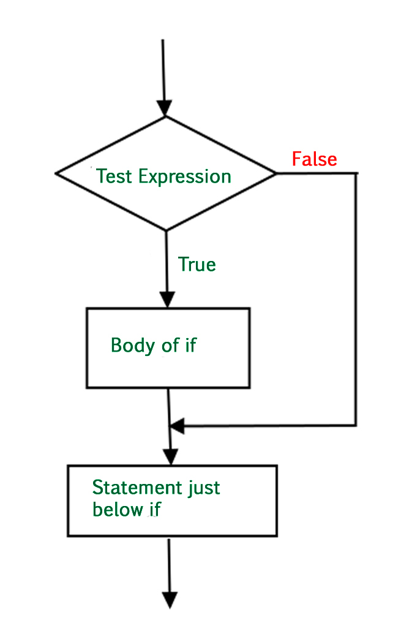
If
If statements allow code to run based on a test.
Any Boolean condition can be the test.
Evaluates to T/F in the end.
Logic can be arbitrarily complex.
Else/elif can add additional options for action.
Simple mechanics – big power!
Write code to handle any case, run it as req.
Can string statements together or make complex conditions to build almost any logic.

Slide 6
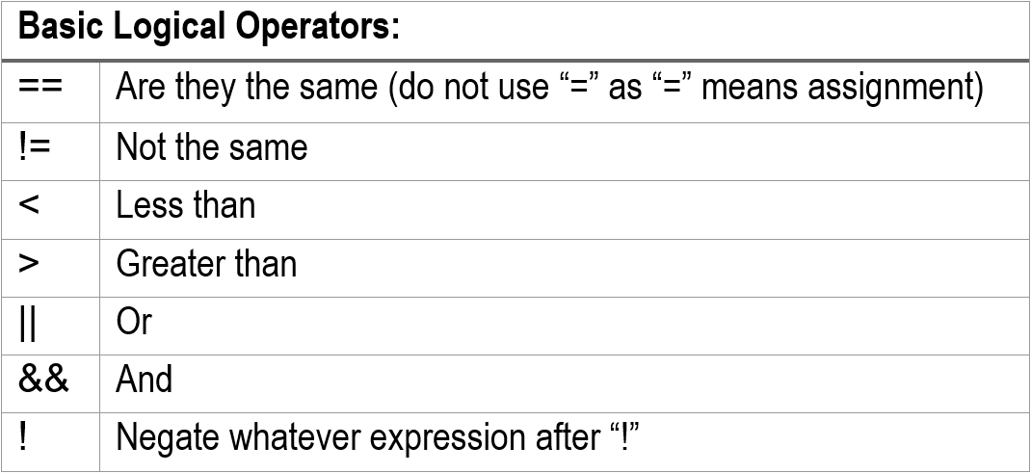
Boolean Logic
If statements are controlled by some Boolean condition.
This can be anything we can imagine, as long as it evaluates to true or false.
Often simple, is something null? Is the length over some cutoff? Is this value larger than this other one? Is this list empty? Are these two things equal?
For complex logic we can combine tests (e.g. and, or) or nest if statements.
Nesting tends to be logically simpler if complex.

Slide 7

Loops

Slide 8
Loops are Fun!
Loops are another core piece of flow control.
Loops repeat some block of code until some condition (Boolean test) is met.
Loops allow us to write some action in a block of code, then do that over and over as many times as needed.
E.g. increase the price of this list of products by 10%
Commonly used to do something a preset number of times, or do something to every item in a data structure.
Conditional statements branch, loop statements “branch” back to the start of a block.

Slide 9
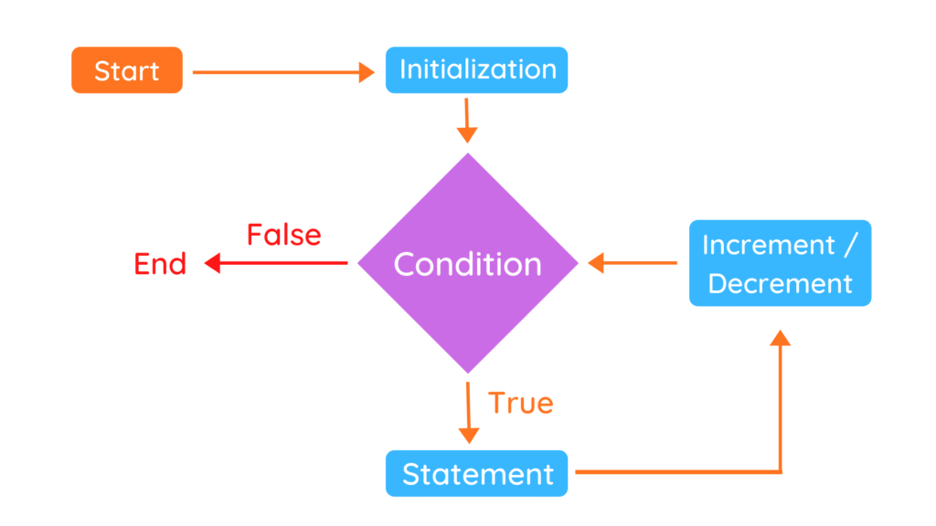

Slide 10
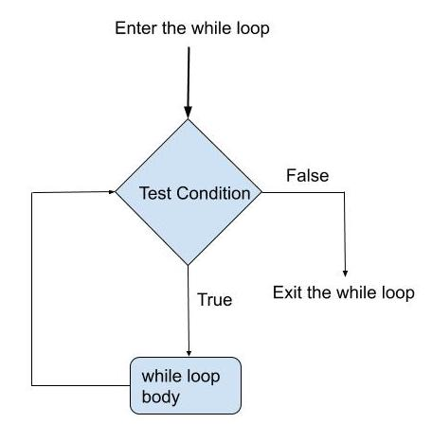
While Loops
While loops are the simplest type of loop.
Check a Boolean test in our condition.
If it is true, do the body of the loop, then repeat the test.
If it is false, exit the loop and go on to whatever is below.
Often paired with a counter.
E.g. i=0 before loop, i < length as condition, i =+ 1 at the end.
You must manage ‘progress’ through the loop.
Note: the test is performed first, so there could be 0 executions.

Slide 11
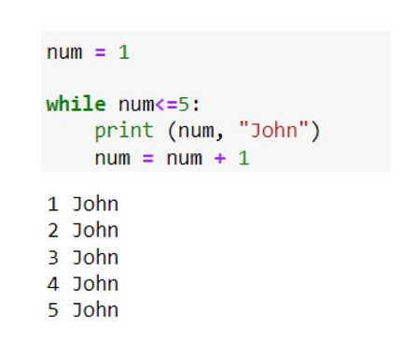
While Loop Syntax
The structure of a while loop is very similar to an “if”.
Indentation denotes the body of the loop.
While loops require that you manage the condition.
Print statements that tell you which execution you’re in are helpful to debug.
Loops can be Infinite, or non-terminating, so make sure your condition makes sense.
If there’s a counter, make sure it updates.
Common when we need to do something X times.

Slide 12
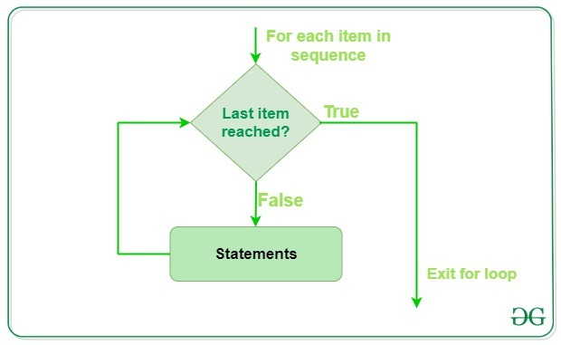
For Loops
For loops are another common loop type, probably the most common in DS.
For loops are normally done to items in a data structure – collections of objects.
“For each item in this container, do this stuff”.
Since we will end up dealing mostly with big stacks of data, this makes sense for us.
A for loop manages the ‘progress’ on its own.

Slide 13
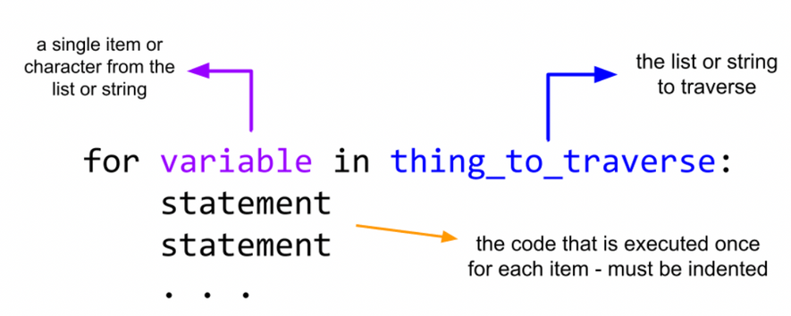
For Loop Syntax
For loops “grab” items one by one from some data structure.
We then do the body to the item that we grabbed. Repeat.
“variable” is the name of the curr. item in the loop here.
Each iteration does something to “variable”, then it advances variable to the next item for the next iteration.
The data structure itself can be anything that is “Iterable”
I.e. capable of returning its items one by one.
Lists, strings, and tuples are all iterable. Many data structures in Python are, making them largely interchangeable.

Slide 14
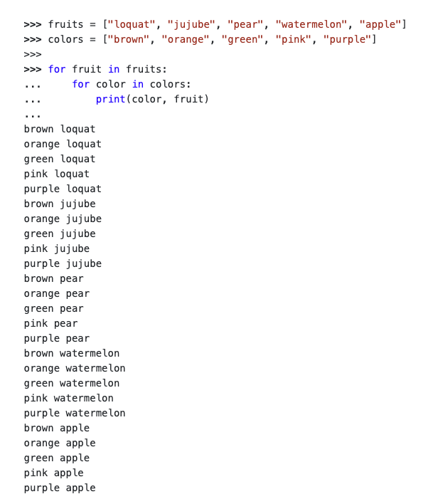
In Code
Here’s a nested example in code.
Each for loop declaration specifies:
The data structure we’re looping over (after the “in”).
The name of the specific object we grab each time (before the ”in”).
We do the thing in the body.
We don’t need to manually update a counter (unless we need it for something else).
The loop manages progress automatically.
One less thing that can fail.

Slide 15
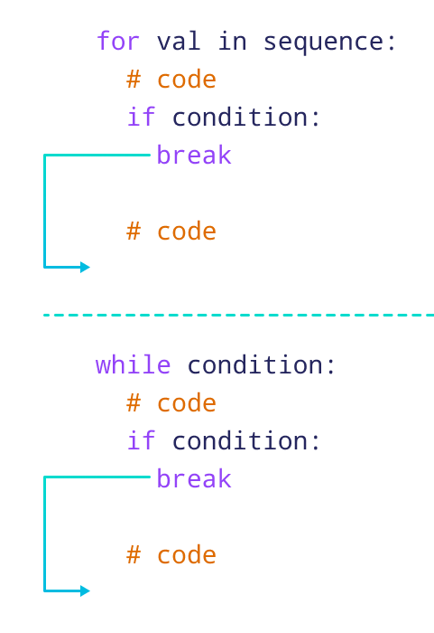
Loop Control Statements
There are also a handful of loop control statements that are less common.
Break – stop the loop’s operation.
Pass – do nothing and keep going. Often seen with unimplemented features.
Continue – skip the current iteration and continue looping at the next iteration.
These statements are less common but can be very useful on occasion.
Can provide one-off differences from the normal condition of the loop.
“If some special case, then override the loop condition”.

Slide 16
Control the Flow
Between ifs and loops we can write code that can ‘flow’ however we need.
If statements control what we do, based on some input (value of variables, input captured from user, incoming data from outside connection, etc…)
Loop statements allow us to repeat actions – do it for each object in a collection, repeat up until some specified time, keep going until something happens (common in a GUI – sit in this loop until a button press takes up to some other action).
These control devices are a prime spot for bugs – especially around cutoffs.
Build logic in pseudocode, then map to actual code.
We can use these simple things to make complex actions – it’s easier to deal with the logic and code separately, especially if the code part is confusing.

Slide 17
Loop Concerns
Loops can also introduce errors to our code pretty easily.
Some common concerns that we should think to test for are:
Correct number of executions - +/- 1, first and last items captured, infinite execution, invalid item in collection.
Print statements are the easy way to debug.
Print loop number, key values, other things that matter.
Can be every loop, every X loops, or some critical values like first/last.
Nested loops especially can explode in run time.
Particularly when we have large machine learning datasets.
One of the few things we really need to consider for efficiency…

Slide 18
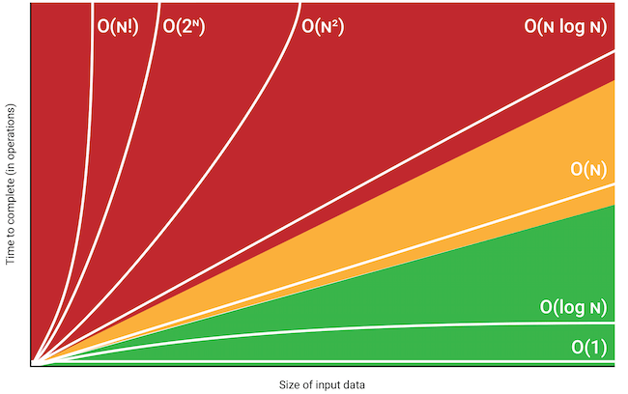
O-Notation
O Notation or Big O Notation is a way to express a rough estimate of speed of an algorithm.
Algorithm – set of steps to achieve a goal.
We don’t need to memorize this, but it is a good way to start to consider efficiency when we are looping over massive things many times.
Care mainly with large data sets, such as NN.
O(1) – it take the same time no matter what.
O(n) – it take the same time for each item.
O(n2) – it takes time times time. Nested linear.
O(2n) – it takes time to the time. Find all subsets.

Slide 19
Looping Back
Loops are another tool that will be ubiquitous for us.
Loops allow for automatic repetition and completing actions over entire sets of objects.
Looping can potentially introduce some concerns:
Execution time can run away.
Conditions can be erroneous, especially around edge cases.
We have different types of loops, depending on what we’re doing.
“For” looping through all of something.
“While” looping until some condition you define.
They can be made interchangeable, and do the same thing, use whichever is easier to understand.

Slide 20
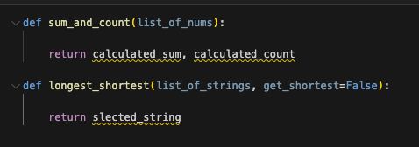
Simple Loop Tests
Try to write pseudocode, then real code (try these via a loop, not the relevant func.)
Loop to do running sum and count:
Input – List of numbers.
Output – sum of said numbers and count of number of items.
Get the longest (or shortest):
Input – List of strings.
Output – the longest string.
Bonus – make a loop to calculate the length of strings.
If you feel comfortable, you can try to write these in functions, not required though.
Make the longest/shortest switchable based on an argument if you can.

