Slide 1
Housekeeping
Conference – who’s going?
We are supposed to get counts for Mark, they need to do ticket stuff. There’s a teams poll, please do it if you don’t mind.
Today:
Overloading and overriding with inheritance.
Inheritance and objects, for an actual purpose making a poker game.
Modelling reality, basic small-scale project planning, creating object interfaces.
Test driven development ideas, overriding several operators.
Grades and other trivialities:
Labs 4 and 5 should be good to go.

Slide 2
Let’s Play Cards
We just have to do all the work First

Slide 3
WE want to make something useful!
Making lists, strings, and functions for no real reason is kind of necessary to learn.
We can learn even more when trying to apply the ideas to a real problem.
We can build a card game, eventually poker.
As we go:
Object orientation – we need to define our own objects, set att/meth, relationships.
Planning and testing – we need to make tangible things, like cards, how to we test them?
I.e. what does a card need to do to satisfy the needs of playing poker?
Revision and future proofing – we’ll expand this over time, so it’s likely we encounter bits that need to be updated or improved.
Generating an interface – each of our objects will be used, we want to make that easy.

Slide 4
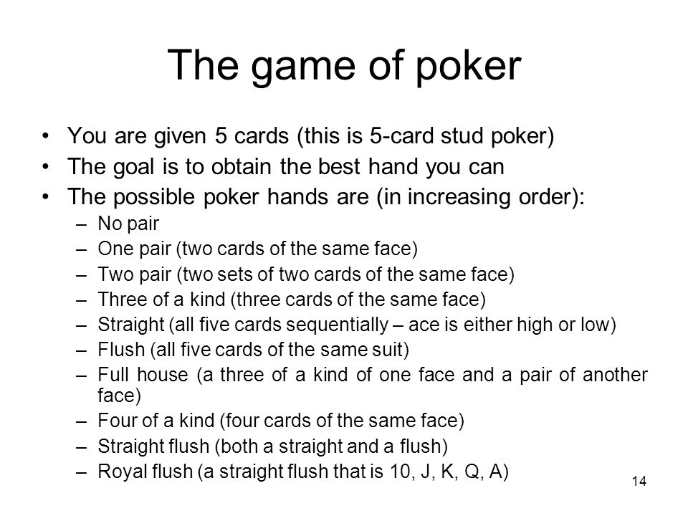
Set a Goal, and Interim Goals
Final goal – we want to make a working poker game.
Along the way, there are parts:
Cards
Decks
Hands
These are building blocks of a game.
What does each do? How do they relate?
From reality, we are modeling the objects themselves.
Start with basics – deal hands, compare, declare win.

Slide 5
Cards
Attributes:
Suit
Value
Methods:
Print
Comparison functions

Slide 6
Deck – a deck Has many Cards
Attributes:
Cards in the deck.
Methods:
Deal out hands.
Shuffle.
Number of cards (len).
Add/remove cards.
Able to be looped.
Maybe refresh to a fresh deck.

Slide 7
Hand – a hand is a Special Deck
Attributes:
Size.
Methods:
Determine score. (5cd specific)
Comparisons.
Print.

Slide 8
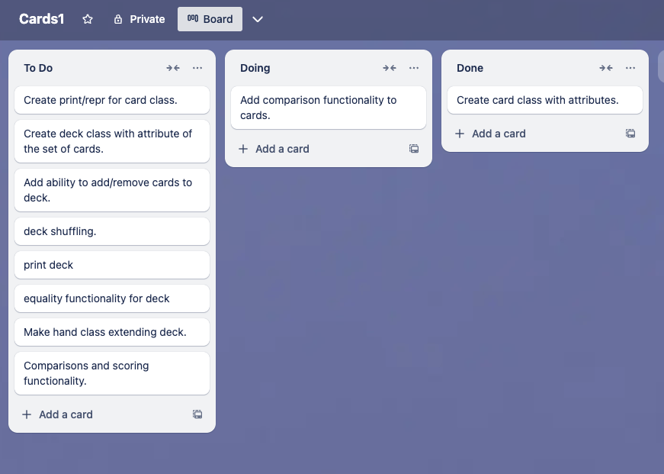
Plan with KanBan
We can manage our simple project, kanban works well for this.
Simple list of goals, broken into status.
As we develop, things may change:
New tasks, or larger ones being decomposed into smaller tasks.
Requirements are found or refined.

Slide 9
Logic thus far
I am trying to model the needs of poker into the objects in my code.
Start with two main types of objects:
Cards – each card is represented by a card object.
Decks – a grouping of cards.
The deck concept can be expanded on:
Any grouping of cards is a deck, and shares key characteristics (holds cards).
A specific type of grouping is a hand – a set of cards a player holds.
Hands add a bunch of stuff like comparisons to allow play to work.
What goes where and the relationships between objects may still change.
This could be solved differently, e.g. hand and deck don’t need to be child/parent.

Slide 10
Development Process
We have an idea now of the core objects we need and how they relate.
We can start thinking of development.
What functionality needs to be present in these things?
Make decks, compare cards/decks, shuffle into hands, etc…
Where does each part of the functionality lie?
What can we do to verify that it works – here we are checking if the things we make will both run without error and that they follow the rules/functionality of poker.
We can start at the bottom, and move up the chain.
If the card works, we can assume it’ll work when building decks, and so on…

Slide 11
Cards
A card is an object that everything else is build on, it has:
Attributes – suit and value.
Methods – print and compare.
We need to have a card that can generate a string that is usable for a ‘game’.
Test by inspection.
We need to have cards that can have their values compared:
Each card has a value, and the relative values are important here.
Test by defining lt/gt/eq and testing that sorting is correct in order (wrt poker reality).

Slide 12
Card Test and construction Note
In our current scheme, cards are very simple and very little is asked of them.
They have two attributes.
They can be compared based on those attributes.
As long as a card does this, it is good enough for us.
Everything else ”belongs” to some other part of playing poker.
E.g. a card doesn’t know there can only be 5 of it in a hand, 52 of it in a deck, or that there are 5 same suited ones in a flush.
Keeping attributes/functionality “with its owner” makes constructing large things easier.

Slide 13
Decks
Decks are compilations of cards, having:
Attributes: the collection of cards currently in the deck.
Methods: shuffle, deal, print, sort/compare(?), next (iteration), etc…
Deck needs to be able to do what is needed of it in a poker game.
“Fresh deck”, shuffle, deal, print.
How can we verify this works?
Create a full deck, check that it is full.
Shuffle, check order is different.
Deal some hands, check that the deck is missing cards, those are in hands.
“Refresh” in some way to deal the next hand (new deck? Reset values, etc…)

Slide 14
Hands
Hands are a child of a deck, also a grouping of cards.
Differ from decks because they have a specific value for that hand in poker and size limit.
The class should probably be named FiveCardStudHand or similar to be accurate.
They must do everything a hand needs to do in poker.
Compare values with other hands, add/remove cards, print.
The betting rounds aren’t really connected to the hand, it just holds stuff.
How do we test that?
Hands have poker values, sort of a set of hands for order checking.
Add/remove sounds like is a parental thing here, it is kind of like dealing?

Slide 15
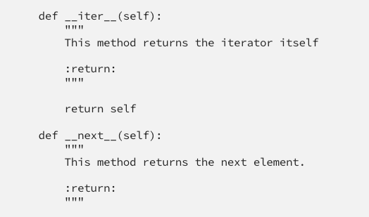
Implementation Station - Iterable
We want our decks to be iterables – meaning we can loop through.
For loops, and other functions, will work with iterables natively.
Iterable objects are capable of being iterated, meaning:
We can get objects one at a time until exhausted.
To do this we need to do two* things:
Provide iter – this just returns the self.
Provie next – this is the next thing to provide if looping.
*this can kind of vary, but stick with this for now.
If we do this, our container will be able to “act as” any other iterable container w.r.t. loops, enumeration, etc…

Slide 16
Interface Usage and Ducks
In this case, we would call the iterable an interface.
An interface is basically a set of rules that a class must adhere to.
Generally, there are specific methods that must be implemented.
In, for example, Java, the interface is a strict set of requirements and if our class declares that we will implement it then that object will be allowed to “work as” the interface thing.
E.g. we can say “this deck implements iterable” and it’ll be usable as one.
In python, we can do this informally, as we are, thanks to the duck types (and abstract classes).
The iterable requirements are next and iter, as long as those are there, our thing is iterable.
We don’t need to make it explicit, we just need to make it work.

Slide 17
Let’s program!
We have a rough outline of what we need to get started.
If this works, we should be able to make a deck of cards, deal some hands, determine which one wins, and then ‘reset’ the game to be ready for another hand.
Other concerns to test – size limits? Adding invalid cards? Comparing diff sized hands?
If these items and actions work, we can later use them to build a game.
Games have players, players have banks, players hold hands, games have decks, etc…
If the components work, we can also make a different card game more easily, how?
Not everything is defined or solved yet, but we have a framework to build on.
If something is missing, does it belong here or elsewhere (player, game, etc…?)

Slide 18
Do it Agile
We’ll use some (lightly) agile processes in creating this exercise.
Quick revisions and improvements – our code sucks now but will improve.
Adding bits of functionality incrementally.
Maintaining a set of tests to ensure we don’t break it.
This won’t yield us a game, but it will hopefully make working components.
If this works, we can expand to a persistent game with players and multiple hands.
If that works, we can add betting and a bank.
If that works, we can add multiple rounds of betting/dealing (like hold ‘em).
If that works, we can add a GUI to display the data in a more usable way.
Same logic - attributes can be pulled to display values, methods can be triggered by buttons.

Slide 19
Conclusion
Focus on the goals – the real goals of the program.
Tackle smaller portions at a time, rather than a large-scale project in one shot.
We can create objects, test them, then combine them to meet our goals.
We can have constant, but incomplete, functionality.
If we break something, we’ll know (more or less) right away.
We can think about each object we make, and defining a way for others to use it.
We need to define and regulate what someone can do, and explain to them how.
We don’t want to let/encourage people to “dig through” our objects, we need to supply the interface through which someone using our objects can utilize them.
E.g. a user should be able to compare hands to see who wins, not extract cards and determine it themselves.

