Slide 1
Housekeeping
Assignment Notes:
I thought the directions w.r.t. creating your own tests based on my examples was clear, it wasn’t.
If you have questions or want to change things, I won’t mark it until at least Friday, so do what you must…
Today – something a little different, work on some larger-scale challenges:
More poker and cards - basic small-scale software engineering and applied agile concepts.
We’ll tackle some other parts a chunk at a time:
It is valuable to grind through things, even if frustrating…
Please ask if something doesn’t make sense, it is a real thing we’re recreating, and my description is incomplete (we’re building incrementally). Reasonable assumptions are good, they may change.
DS and related projects are often small and solo, practice at ‘translating’ requirements is key.

Slide 2
Agile Software for Lazy People

Slide 3
Our Poker Game
Our poker game is in the process of being created.
Right now, our game is really, really simple – we can make a deck and deal cards.
The entire game is hard to just make directly.
We can make each individual part work, or work better, a little at a time.
Goal:
Keep a (mostly) functioning poker game (that is incomplete).
Continuously add and improve to get closer to the end goal.

Slide 4
Zooming Out…
Overall, the most important thing here is to get used to the abstract ideas of development:
Modelling real world objects and requirements in code.
Creating a plan to address these requirements, while all pieces are potentially flexible.
Coding a solution, selecting outside tools, and adding custom code while testing that it works.
Planning and implementing improvements to add functionality.
This stuff requires practice, and can often be frustrating – the process is valuable though.
It doesn’t really matter what solution you have, only that you made it.
The rules of a game are fixed and well known in reality, how we model that can vary.
Can set interim goals for sprints – dealing, declaring winners, people, bets, swaps, rounds, games, etc…

Slide 5
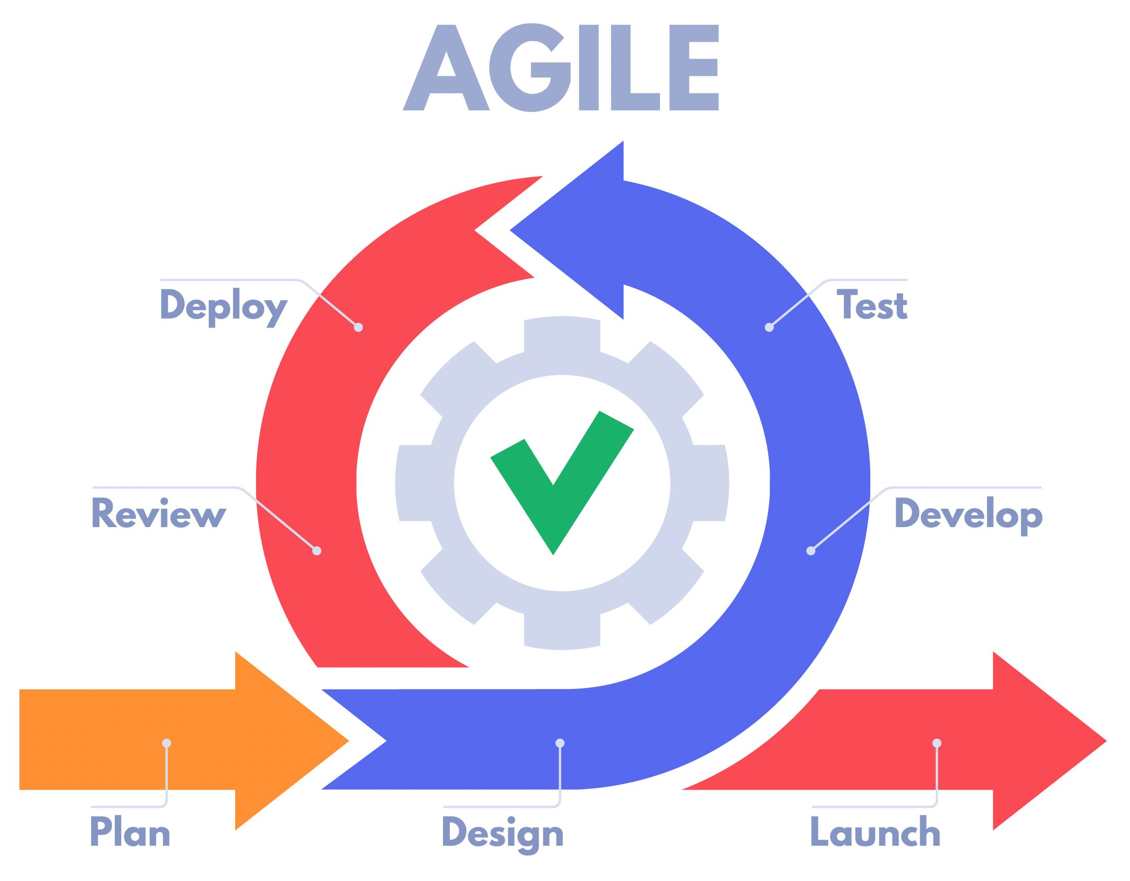
Incremental Development
Each cycle where the game is changing is short, we just have many.
The game works, it is just limited until the end.
I find this is easier for DS stuff (e.g. pipelines):
Check that each stage is correct, then add.
Here – add functionality to game, check it.
Pipes – add steps, check output (or shape, etc…)
Bugs are targeted.
Other changes trigger back testing – if modular.

Slide 6
Deck Constructor
Our deck constructor is setup right now to make a new deck.
Create the data structure to hold the cards.
Generate the 52 new cards to fill into a deck.
Shuffle the deck so that it is ready to play with.
Problem – we (should) want to create different decks.
A deck is really just a grouping of cards.
Anything that we can do with a “full deck” can also be done with part of one.
E.g. when taking cards out of a deck (like hands) those are all really just decks.
Think about splitting a list into parts, the remainders are still lists.

Slide 7
Constructor Solution
The creation of a deck will always need to make the container.
We can optionally fill it with 52 cards and shuffle (as we are now).
We can add the ability to make it out of cards (using *args).
This will allow us to make different decks – new or subsets.
We need to modify the deck to allow for different outcomes:
New deck of 52 (we’ve done this)
New deck of whatever cards are provided (need to add this).

Slide 8
Software Engineering Ideas
Figuring this all out, on the fly, is sometimes hard, that’s normal.
Bashing your head in frustration is an unfortunate side effect of learning programming.
We’ll try to focus on a simple strategy to make things easier for now:
Make it work, even if it doesn’t work well. Then improve what fails.
As it is not working, keep a close eye on what is happening. I.e. print statements.
Some ideas can help us:
Encapsulation – we want each object to be complete in what it stores and does.
Inheritance/overriding – we can only add what we want to more simple types.
If things are modular, each item to make/change is small, so we don’t have to handle large problems at one time.

Slide 9
Adding *args for Constructor
What can we do to add this?
Define what we are getting and returning:
Case 1 – new deck: Arguments – fill/shuffle options True. Return – deck object.
Case 2 – small deck: Arguments – fill/shuffle options False, Args is a tuple of Cards. Return – deck.
Define the change that we need to make:
Add the argument of args for cards.
Add a control statement to do one or the other.
Add the *args argument to the constructor, don’t use it, and make sure it still works as it was.
Add a step to the constructor to print what the args contains, without changing function.
Verify what I am getting is what I expect – a tuple of card objects.
If something goes wrong here I know it is due to passing or grabbing the args.

Slide 10
Cont.
Now I know that my constructor works and can “see” the cards that I want to use.
Define and test the control condition for full deck / small deck:
If doing a full deck, make sure that I don’t break it.
If doing a small deck, start with just printing out the cards or something easy. Return an empty deck.
I can also separate the steps of processing the input and printing it, and making the new object.
If something goes wrong here I know it was something to do with logic and argument options.
Add a step to construct the small deck, so the second option will now return the result.
I.e. replace the generation part in a full deck with taking the cards and putting them in.
If something here fails, we know it was the step off adding cards to a deck

Slide 11
With well encapsulated Functions
Define the arguments and the return value (if not specified).
This is a reason we want to split things into functions, they can be tested and reused.
Start with an empty shell of the function:
Take in arguments and look at them (print, info, length, etc…)
Return some empty or default version of whatever you need to provide. (Other code still works)
Now the goal is fixed – go from the start to the end. It generally doesn’t matter how.
Begin to work incrementally on the problem:
If there are control logic like ifs or loops, can we make an empty one. Print where you are in each.
When doing the “processing” part update print or return vals progressively to see what changes.
As we add each additional step, if things stop working, we know it was that step.

Slide 12
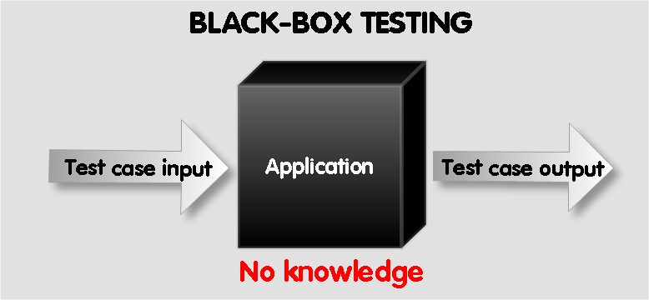
The Black Box of Software
A common term you see in software is a Black Box.
We know what goes in and what comes out, but have no idea what happens inside.
With well defined functions (and many ML models), this is also true.
The arguments are what we get as an input.
The return value is what we produce as an output.
As long as we connect A to B, who cares how?
In our own code, if we can isolate anything into its own function, this idea can help.
Also a common way to assign work to others, it is clear what has to be done.
In DS work, this largely applies – data needs to be a specified format for modelling, no matter how.

Slide 13
Last Challenge – The (Art of the) Deal
Our deck should deal out cards when we ask for them by the deal() function.
Inputs – the number of hands and cards per hand.
Output – a list of Hands of cards that were removed from the deck.
Step one – can I pull some Cards from the deck?
Use only the number of cards, and only worry about one hand.
Attempt to pull that number of cards, and print them and/or return them as a list.
Check and see that they are actually removed from the deck.
Step two – can I pull several sets of cards from the deck.
Use the number of cards and number of hands to pull the total number of cards. (2 loops?)
Construct them into a list of lists for printing/returning.

Slide 14
Cont.
Step 3 – Can I construct Decks instead of lists to return.
Change the step where each “hand” is assembled into it’s (inner) list into the construction of a new deck with those same cards.
Print the Decks (we did the str) to make sure that we have the correct things.
Step 4 – Construct the final return value, and test different scenarios.
Make the final return value into the desired format, test different numbers.
I printed the deck before, hands, and the deck after, and checked for # of items and a few specifics.
Each step here is really only pushing us a little closer to the goal.
We have a constantly evolving “outcome” that we can verify at each step.
When something fails, it is easy to pinpoint where that failure is.

Slide 15
Inherit from the Deck
We also want to make a subclass of the deck, a (poker*) Hand.
It is mostly like a deck, it is a set of cards.
A hand is different primarily because we want to add value of that hand, for poker.
So we are making something that has Deck parts to hold cards, and Hand parts to have meaning.
The Hand class needs to add value calculations and comparisons.
* I really should have named this class PokerHand not just Hand. We can have a BridgeHand, a BlackjackHand, etc… with the same logic.
Maybe if there are different games, we can look back at the deck class later for some modifications…

Slide 16
Hand Value and Comparisons
When comparing poker hands, we need to use the poker hand values.
E.g. full house, flush, straight, etc…
This is somewhat complex – there’s lots of hands, tie breakers, etc…
The idea of it is very simple though, one hand is greater than another.
Simplification for us:
Build the framework to compare hands to each other and determine winners.
The logic for generating those values doesn’t need to be accurate or complete.
I.e. we can build a simple version of scoring, use it to make the comparison logic, then that scoring logic can be expanded to match the full rules of poker!

Slide 17
Cont…
Initial scoring logic.
Poker has lots of hands, and many are weird. We can make our initial scoring logic simple.
Consider pairs, flush (all same suit).
This logic will rank these subset of hands against each other, so that lt/gt/eq work.
When the scoring logic changes, the comparison logic doesn’t need to.
The comparison just checks which is better, the “better” is provided by the scoring part, and the two can function mostly independently.
In different games, the comparison logic might be the same there too…
We can avoid getting bogged down in the complex details of every poker hand.

Slide 18
Hands
Can we do a comparison, with dummy values?
Can we do a comparison, with values coming from some toy function?
Can we do a comparison, with values coming from our simple function?
…
Can we do a comparison, with values coming from a full poker hand value function?
Once our comparisons work (not necessarily finished), other stuff will start to.
We can sort hands to determine their order, such as for the winner of something.
We don’t need a special “winner*” function, the basic sorting things will do it.
*Poker can have split pots in ties, so this is one ignored consideration we’d need in reality.

Slide 19
Now let’s Try:
Finalizing the deck (for now) with the constructor and dealing.
Create the Hand class.
Extend the deck to suit the Hand purposes.
Add scoring so we can determine winner between two hands.
Create a Game class.
The Game class holds the body of the game – make players, deal cards, other stuff like bets…
Build a simple, one-step, game. We want to deal cards and find a winner.
This will give us a working, but pretty bad, game.
Later on, we can add the other parts – betting, card swaps, etc…

Slide 20
Conclusion
Building programs that work and are complex is hard, however…
Building functions that do simple things is easy.
Complex programs are a series of (maybe many) simple actions.
An Agile-friendly approach to our simple programs fits with this:
If something is complex, break it into simpler small problems.
If one of those small problems is hard, start by making it work in simple (or trivial) cases.
If those things work, even if incompletely, we can use them to work on other parts.
Incrementally tackle one challenge at a time, and the product gets better bit by bit.
Employ a liberal use of print statements, variable viewer, logging, and/or debug tools.
Focus on “what is happening” and change things to get closer to “what we want”.

Slide 21
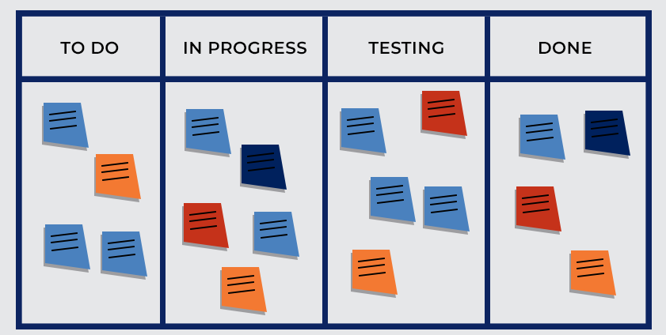
Keep it Agile!
If we break our goal into small pieces, we can manage them using something like a Kanban board.
The end goal needs to do ”all of this”.
Each “this” is something that we can add separately.
If we encounter new problems as we go, add them.
If our code is well encapsulated, different tasks are mostly independent.
Each function does one thing, making it testable and replaceable if we need to revise it for something better.

Slide 22
Kanban Man!
In my opinion Kanban is the easiest way to manage smaller projects.
It has a low overhead, we just need to list off tasks and move them spot to spot.
It is very simple to define what needs to be done, and to change it.
In data science work, we often have smaller projects that change as we go. This works well.
Even if not formally using a Kanban board, I think this thinking is beneficial.
Jira and Trello are tools that are (I think) free, if you’re looking for a tool.
Having something that works on an ongoing basis is easier (imo).
We aren’t waiting to see if things work until every part is done.
It is easier to find where failures occur, because we can use the interim program as we go.

