Slide 1

TodaY
Pipelines - Pipes, pipes, pipes, pipes, pipes, pipes, EVERYBODY!!!!!!!!!!!
Sklearn transformers basics (framework/structure, not innards of existing ones).
Using pipelines to transform data.
Creating custom transformers for geospatial stuff.
I really need you to be able to comfortably use pipelines in different ways by ~mid Jan.
We will use them almost every day, and you’ll be expected to mostly just do it.
We’ll revisit this a bunch, but hopefully we’ll be able to pickup at column transformers next semester.
Basically multipath pipelines.
The steps we’ll use will get more numerous, complex, and annoying, but the core idea never changes.
There’s a test next week! Last one! Programming will be a multi-inheritance thing of some variety.

Slide 2
Pipelines

Slide 3
Pipelines
Most data requires some preprocessing before modelling:
Categorical data usually needs to be encoded.
Numerical data usually needs to be scaled.
Empty spots need to be dealt with in some way.
Creating long series of steps to prep data can be cumbersome.
Sklearn’s pipeline can simplify and condense data prep into one function.
Create a “pipe” where each step of prep and modelling is specified and executed together:
Fit the data to the pipe instead of the model.
The model is the last step of the pipe, the prep steps are listed in order.

Slide 4
Goals
Get familiar with the pipeline class.
You’ll need to use this all the time.
Get some practice writing functions by making custom transformers.
We make functions that “drop into” some outside processes, which can feel weird.
We really need to focus on hitting a spec in what we make.
Get some practice reading documentation with sklearn documentation.
You’ll also need to use this all the time.
Get some practice with spatial data and geopandas.
If we are making transformers for practice, we might as well make them on spatial data.

Slide 5
Scikit Learn - Sklearn
Pipelines are part of sklearn, the main library for non neural network machine learning.
We use sklearn constantly next semester.
The language and structure of how things work is (mostly) consistent across the library.
What you get used to here will generally help, so even unfocused familiarity is good.
Practice reading and using documentation!
The sklearn api documentation is generally pretty good, there are examples and user guides.
For almost everything, there is a stackoverflow, blog, or video explaining it with a better eg.
Try to get used to “I need to do something”->”look for how”->”read API for thing”->”do it”.
There’s no consequence so try to experiment a bit – extend or change, test and see…

Slide 6
Using Pipelines
Pipelines can contain most or all of our prep steps.
Makes code easier to read and maintain.
Automatically apply the processing to the data as part of the model.
The pipeline is an object.
We create it by making an object then defining steps.
Use it by feeding the data to it, then we “use” it instead of data to feed the data to the model.
The pipeline takes in data, does each step, and results in the transformed data. (i.e. the pipe ‘is’ the final data).

Slide 7
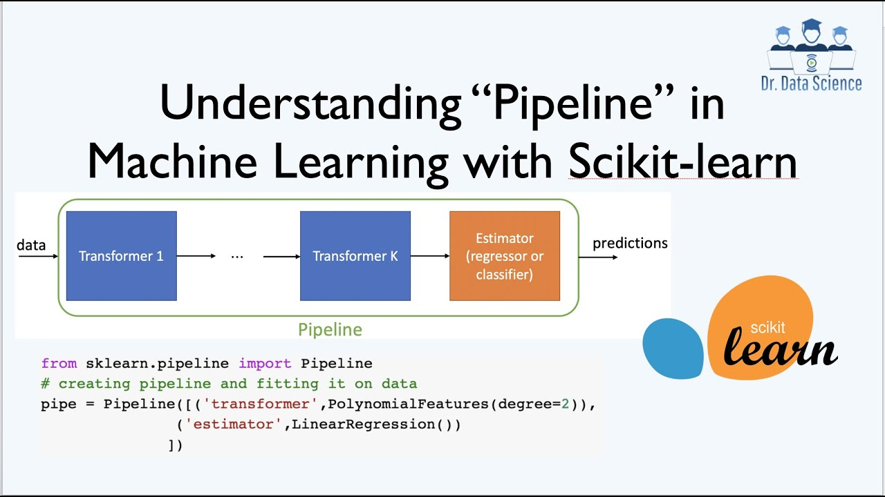

Slide 8
Keep ‘em Separated
The term pipeline is used all over the place in CS and ML.
Anything that moves data and does some work while doing so.
Commonly ETL pipelines to consolidate data from several sources in a warehouse/lake.
Here, we are specifically referring to the sklearn pipeline.
This is a specific thing, part of sklearn.
If we say “pipeline”, just assume a sklearn pipeline unless otherwise noted.
It could be part of a bigger pipeline to move data from sources -> DB -> sklearn pipe.

Slide 9
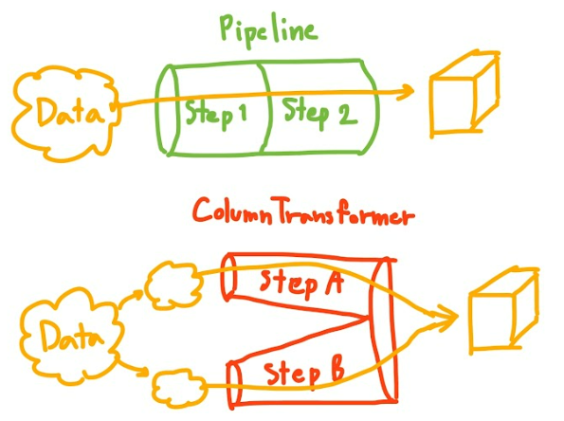
Warning!!!
Pipelines are simple, like, well…. pipes.
All data goes straight through a pipeline, hitting all steps.
We can branch, but require another tool.
For now, we just care about pipes:
Each pipe (generally) only deals with one data type – numeric, categorical, time, etc…
If we have mixed data, we must split it.
We can have an unlimited number of pipes, connected in any configuration.

Slide 10
Leaking out of the pipe
The pipe is the thing we generally submit to the ML algorithm.
The pipe returns the transformed data, so the pipe “becomes” our data. (Kind of).
We don’t really look at the output much, it isn’t user friendly.
If we capture the output, we get an array.
We can remake a dataframe from the data, the original columns are in df.columns.
Side Note: generally we end up with a wall of numbers, as ML models need numbers.
We have to encode the categorical data at some point in the pipe.
Double Side Note: pipelines have just been improved in the last revision to work with dataframes more natively, so some of this might become easier right away.

Slide 11

Pipeline Steps - Transformers

Slide 12
Transformers – They’re Robots in Disguise
Each step in a pipeline is done by an object called a transformer.
There are several things in ML called transformers (like ChatGPT), they aren’t (generally) related.
Each transformer does one thing – a transformation on the data.
Imputer – fill in missing values.
Scaler – ensure all columns are on the same scale.
Each transformer produces an output of a set format from an input of a set format.
Input – 2D datasheet (one value per column, consistent data types, one instance per row).
Output – same same, but transformed.

Slide 13
Transformer pieces
Each transformer is an object that meets certain strict-but-open requirements:
Transformers extend a couple of specific base classes (that we don’t really need to care about).
Transformers have two specific classes that do the work – fit and transform (and fit_transform).
Transformers can handle data that is in a 2D iterable.
The structure is strict – transformers must do those things or we get an error.
The details are open, we can do whatever exact thing we can imagine that fits this.
Stages – fit, transform, fit_transform:
Fit – setup the transformation with whatever config is needed. E.g. determine scale for scaling.
Transform – do the transformation and return the result. This is where the work is done.
Fit_transform – do both, in order. We can all this without making it, it’s automatic.

Slide 14
Transformers
There are premade transformers for most common things.
We can use them with an import, many are in sklearn somewhere.
Data prep things like impute, encode, scale have at least one existing option.
In general, these are written to be fast, so they are better than handmade ones.
We can make a custom one if we have odd needs.
The custom and prewritten parts are easy to weave together.

Slide 15
Transformers and Pipelines
A normal process of making a pipeline involves a few steps:
Explore data to find the things that need fixing.
Create a pipeline to process the data.
Add steps to address each part of the problem.
Evaluate if you’ve made your data ‘clean’.
The pipeline is generally a mix and match series of steps, where we pick steps based on what we decide we need from looking at data.
Outside of specific things, the transformers already exist.

Slide 16

Customized Transformers

Slide 17
Transformers can Do anything
Most things are handled by existing transformer steps.
If we have something special, we can make our own:
For today – we’ll do some geographical transformations on the data.
Some types of places where we may want to:
Feature construction – if we want to generate something like “time between records”.
Specialized imputation – the real-life scenario has some other imputation rules.
Odd transformations – calculate a credit score or stats things like storing ln of data.
Generally, putting prep stuff in the pipeline is better, if possible.
The pipeline is automatic, so it is way easier and less likely to make a mistake.

Slide 18
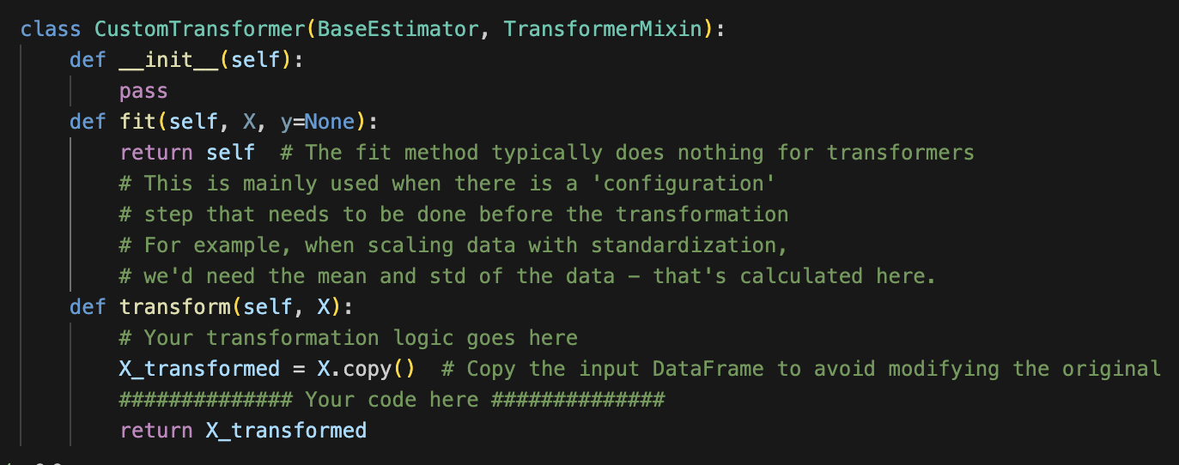
Making a Custom Transformer
Inheirit – base estimator, transformermixin.
Init, fit, transform.
Init – setup object. Including config.
Fit – learn config from data.
Transform – apply transformation.
Fit often just returns itself.
If there is no config, this does nothing.
E.g. if you delete blank rows, there’s no setup based on the data needed.

Slide 19
Pipelines of Predictions
Another feature of using a pipeline is to ensure that new data is processed correctly.
If we scale, encode, transform training data we also must do data we’re predicting.
E.g. if we calculate a credit score and use that as a feature to a model to approve a loan, new loan applications need that same credit score as a feature to enter to that model.
If we make the processing in a pipeline, we can just put new data through it too.
There’s no possibility of skew/error from mis-preparing data.
If we did it by hand, we’re way more likely to make a mistake – there’s lots of details.

Slide 20
In real Life
Sklearn pipelines, and the idea of a pipeline in general, are common.
Pretty much anything moving data will have some kind of pipeline involved.
Pipelines can allow us to define a process rather than directly clean data.
The pipeline automatically deals with any data as it comes into the system.
In real life scenarios:
Data is processed in model creation and the pipeline is defined.
As new data comes in to be predicted, the data goes through the same pipe.
If data is ‘harder’ our pipes become smarter – we can have pipelines that can do much more to data if needed. If we are scraping data or something, the cleanup might be intense.
If this stuff, and the equivalent database ETL stuff gets you going, consider data engineering.
This general area is huge, exists in most big companies, is often mystic, and likely more LLM resistant.

Slide 21
Conclusion
Pipelines and transformers are our new best friends.
Most (smaller) data is managed through pipelines like this.
The sklearn pipeline is fairly standardized, so we can get transformers, examples, extensions, etc…
Different pipeline steps and tools can be strung together infinitely.
Get comfortable – pipes are pretty simple, but we use them constantly.
Start reading the sklearn docs for pipelines – the docs are good and we refer to them a lot.
If you feel this is easy:
Take the titanic data, but don’t separate the categorical and numerical parts.
Look up columntransformer and try to implement one to deal with that data.

