Slide 1
Housekeeping
Some assignment stuff:
Old one is marked, new one is up.
Today - Refactoring, APIs, design patterns:
Simple topics and examples.
Design considerations and MVC ideal.
Note: no class on the 12th, it is a NAIT holiday.
Test…

Slide 2

Its Democracy Day!!!
Do you want a test on Thursday? Or a week later?
Similar to last one – 35ish MC, ~2 code challenges.
Concepts since then – objects, inheritance, error handling, containers, etc…

Slide 3
Some Stuff for Later…
We need to do stuff for practice, what that stuff is can vary a bit.
If there’s code parts from stats/db that don’t make sense, we can dig into those.
I’ll probably need a heads up, depending on what it is.
We’ll definitely spend some time on sklearn pipelines, which are part of stats.
I asked to make sure they cover it this year, I’ll apologize to him later.
We’ll cover it soonish, you can say something in stats to skip it, or let him cover it again.
We’ll also do some more with visualizations with seaborn.
All the ML stuff uses seaborn for the visualizations, so it’ll make that easier.
The seaborn documentation is good, easy to read, with lots of examples, so it is good practice.

Slide 4
Assignment Notes
Generally good.
Dealing with the messy data is annoying and realistic – there are multiple answers.
Overall strategies (mostly to help maintenance and troubleshooting):
Generic rules over specific items.
I.e. what is ok, vs trying to fix one specific issue.
E.g. get the digits out of currency vs remove this specific character.
There’s likely a function for that... Type checking or other common things.
Try/catch block size – what specifically needs the try/catch, and can that minimize impact of errors.

Slide 5
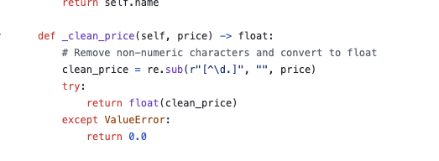

Generic over Specific
Something like this is probably better in the long run than removing specific characters.
Extracting what we want vs.
Removing what we don’t.
If text encoding, currency, etc… changes, which one is easier?

Slide 6
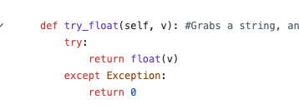
There’s a Function for that…
Most common things already exist.
E.g. this could be type or isinstance.
Also, checking “in” a container.
It’s common for people to make their lives harder by redoing things more than they really need to.

Slide 7
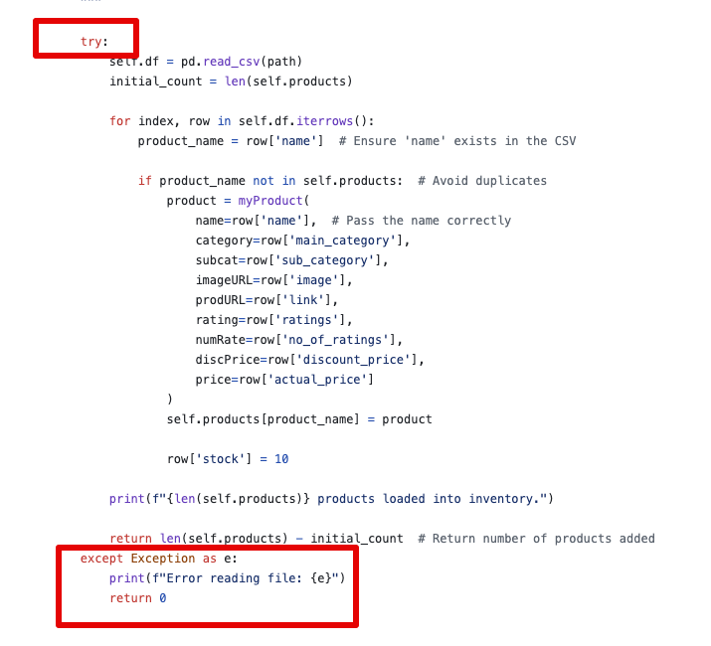
Try/Catch
One error will fail the whole file.
Could be done inside the loop, per line.
This is annoying to do on small progs.
Real software has lots of exception catching.
For us in DS, we mainly need in data prep and cleaning.

Slide 8
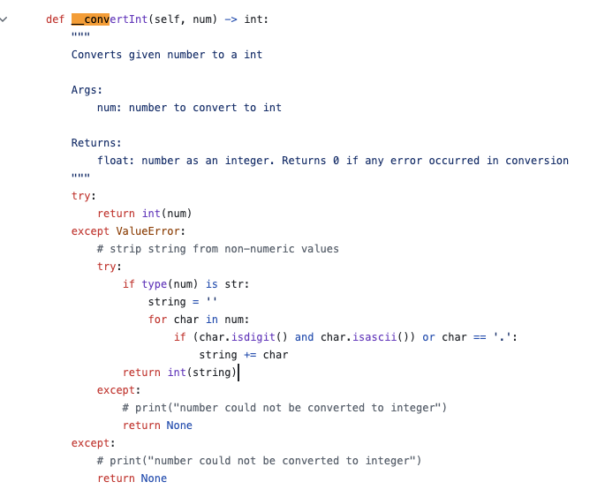
Purpose built Functions
Sometimes it makes sense to make specific functions.
E.g. this cleans and converts.
We can test this specific thing on its own.
In a fully developed program.
A function to process some value, like price.
If needed, we can swap it out – e.g. different currency, formats change, etc...

Slide 9
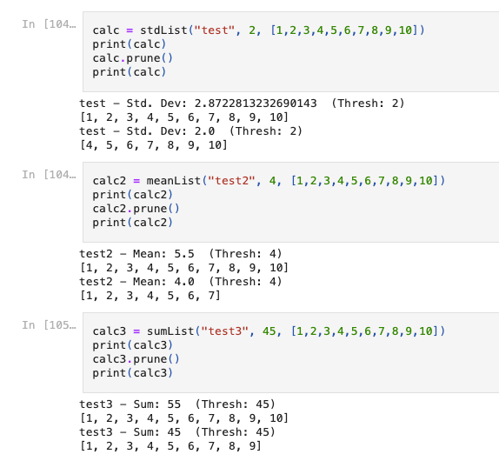
Next Assignment
Also reads and processes some data.
Inheritance, abstraction, and child classes.
Based on eventual output:
You read some data and output a CSV.
Similar to data prep things that we need in DS.

Slide 10
Refactoring

Slide 11
Our Card Game…
Our card game has been a slowly evolving software engineering project.
Pretend I’m the client, my desires are everchanging and unclear.
We have built the functionality bit by bit, starting from very basic parts.
Because of this, the structure of the code isn’t ideal.
Some parts overlap or are redundant because our needs evolved.
Some parts are no longer needed as they’ve been superseded.
We didn’t build it with one solid goal, we started and then added bit by bit.

Slide 12
Refactoring
Refactoring is rewriting code to be more readable, organized, or maintainable without changing the actual functionality.
Refactoring is an umbrella concept, and can include things such as:
Renaming variables or functions for consistency.
Moving a method from one class to another.
Changing static status for items (e.g. if a method doesn’t need to have a “self”, remove it).
Generating functions from repeated blocks of code.
Refactoring is the programming equivalent of cleaning up messy data.
This isn’t a process that has an “end”, it’s like editing for a writer.

Slide 13
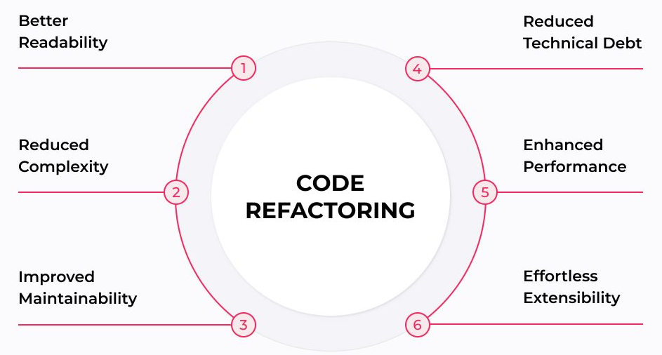
Refactoring Benefits

Slide 14
Problems with Agility
Agile software development generally maintains a working partial solution.
Frequent revisions or improvements to things that are already written.
Solutions created targeting a partial set of objectives.
Target solution is changing after things have already been created.
Agile means that we should expect to have code that can be problematic.
Solutions are inherently done in a piecemeal fashion.
Things are ‘patched’ to make individual parts work at a time.

Slide 15
Problems – smells and Anti-Patterns
Two common problem types in refactoring are code smells and antipatterns.
Code smells – common things that may cause an issue.
Generally not inherently wrong/erroneous, but risky.
Anti-patterns – common solutions/practices that are risky.
Higher level design choices that may work, but are likely to be problematic.

Slide 16
Smells
Code smells are basically things that give you pause if you think about maintaining something.
They aren’t mistakes, but they aren’t the best choices:
Dead code.
Lazy elements (a class that doesn’t really add any value).
Confusing or overly complex Boolean logic.
Can be classed into subcategories:
Bloating code, obscuring functionality, extra complexity.

Slide 17
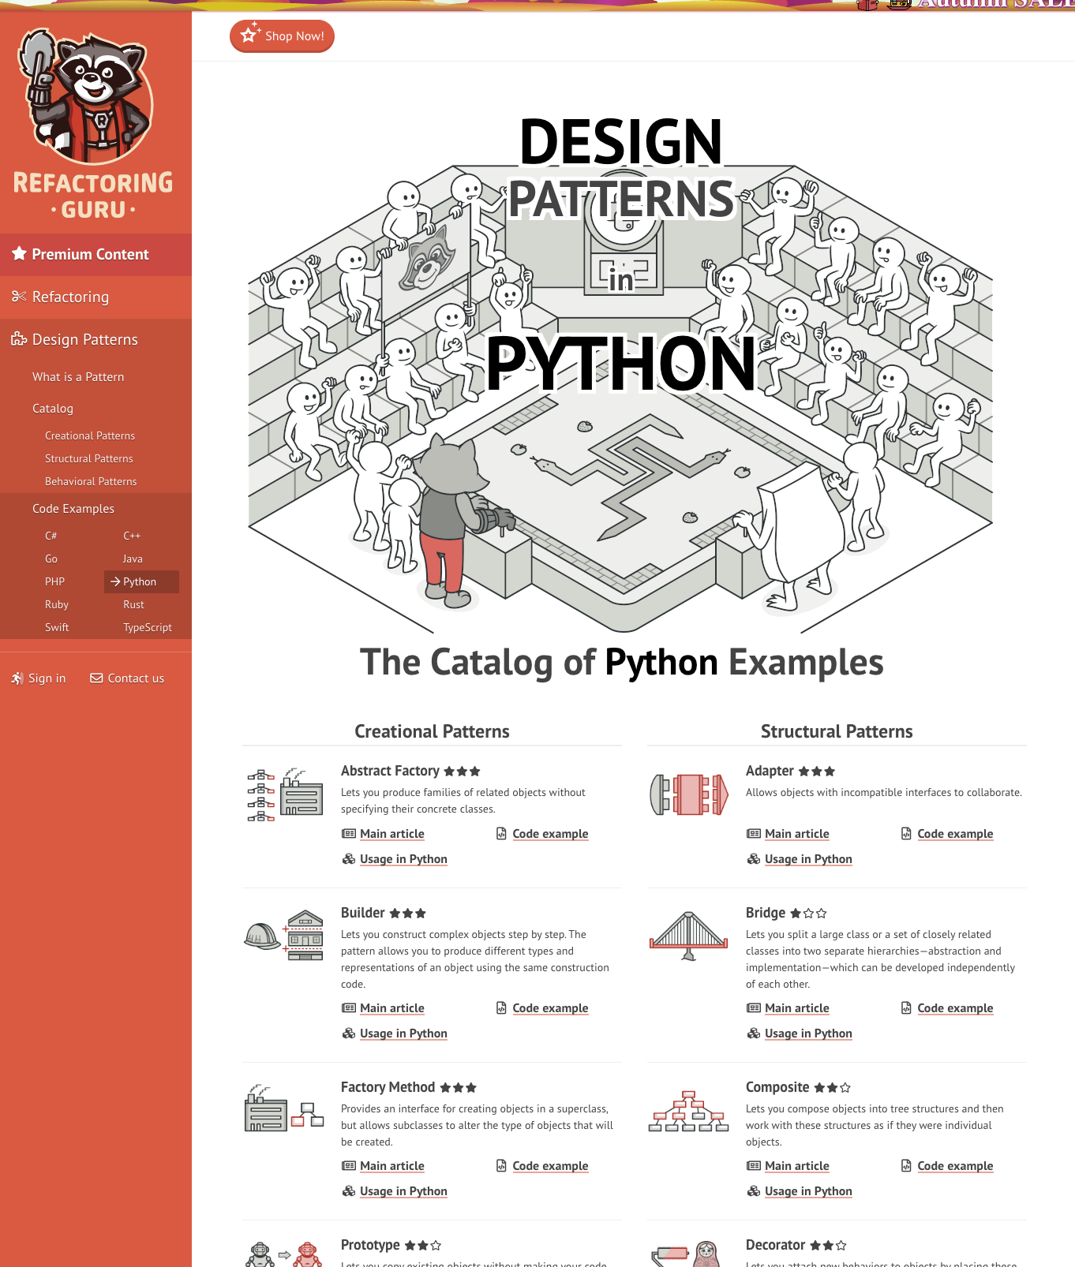
Design Patterns
A design pattern is a general strategy to solve common problems in code.
For example, abstract classes, decorators, observing something, using an iterator for change.
These types of problems occur regularly, so there are standardized approaches to deal with them.
The problems aren’t really phrased in real-world terms, they are in programmer language.
E.g. we need to trigger an action when X changes.
We apply these without calling them out explicitly.

Slide 18
Anti-Patterns
Anit-patterns are larger in scope, similar in meaning to smells.
A solution/design which is a poor way of solving a problem.
Poor generally meaning unclear, hard to maintain, or confusing.
Almost always have stupid names.
These may lead to working solutions, but testing and maintenance is harder.
God object – wrapping too much functionality into one object.
Onion – wrapping old code in new code to make it work, not updating the internals.
Cut-and-paste – rather than properly reusing code, functionality is copied.
Lava flow – code does something, and is used and reused without people understanding it.

Slide 19
Follow the Pattern
Things that are designed using good patterns are generally easy to use and update.
Things that follow bad practices aren’t.
Part of refactoring is ensuring our solutions follow good practices, not just work.
If we have good tests, we can check that we don’t break stuff as we go.
Working is priority number 1, but not the only thing – problems beget problems.
In a perfect agile world, we’d be constantly solving problems, then making those solutions into well written and clear code.
This revision is, at best, inconsistent – most companies would rather solve new problems.
Integration tests see if the thing still works, unit tests will narrow down what failed.

Slide 20
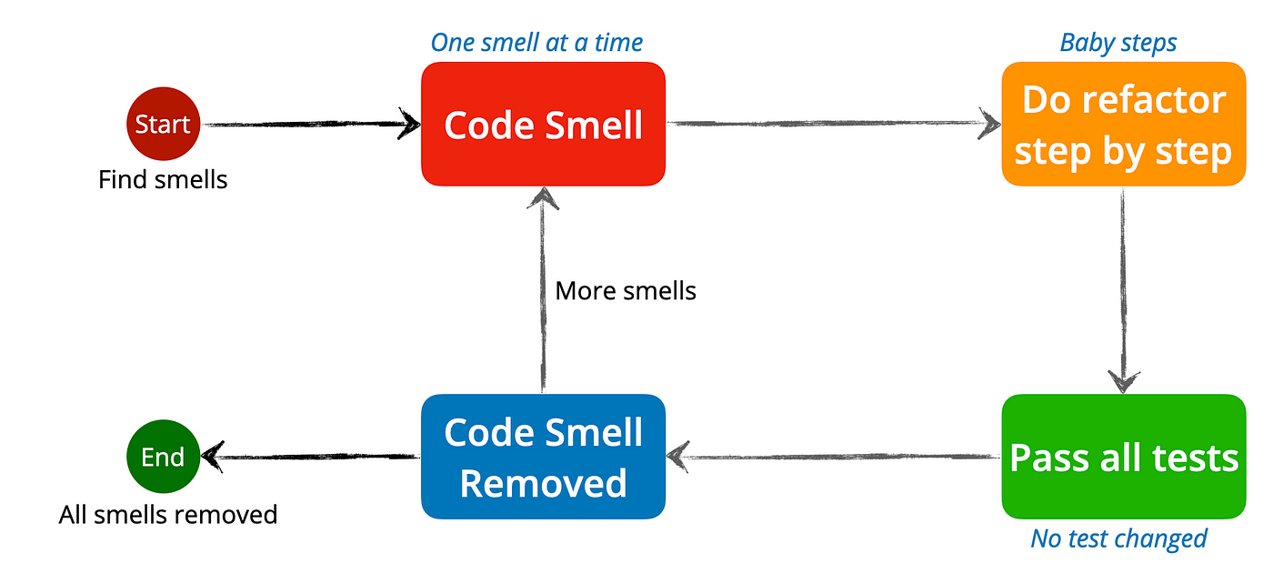
Refactoring Test-Driven Code
Refactoring holds the most potential benefits for messy code.
It is way more difficult to deal with messy code though.
Code that is well designed makes reorganizing it easier.
Functions can be replaced easily.
Tests will still work.
Moving chunks around is easier.

Slide 21
Basic Refactoring Steps
Refactoring documentation often refers to problems as “smells” – things to correct.
We don’t have a specific set of things to do, we just need to make it smell good.
This is something that is easier with feel and experience.
(In other languages indentation and spacing is a big one for readability, but since indents matter in Python, we’re less likely to have issues)
In data science applications, our most complex code bits such as a data pipeline are also things that we can test for functionality relatively simply.
For data pipelines, checking that the data is the correct structure does most of the work.
For training models, examining results, or making new predictions, we can check if it happens.
We should usually be able to refactor post exploration. (E.g. make a function to clean phone#)

Slide 22
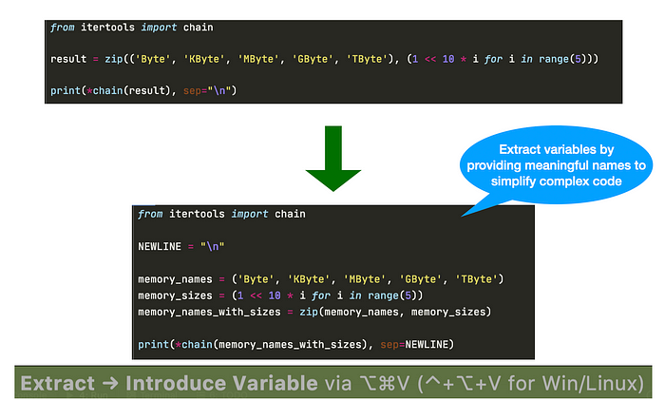
Simplifying with variables

Slide 23
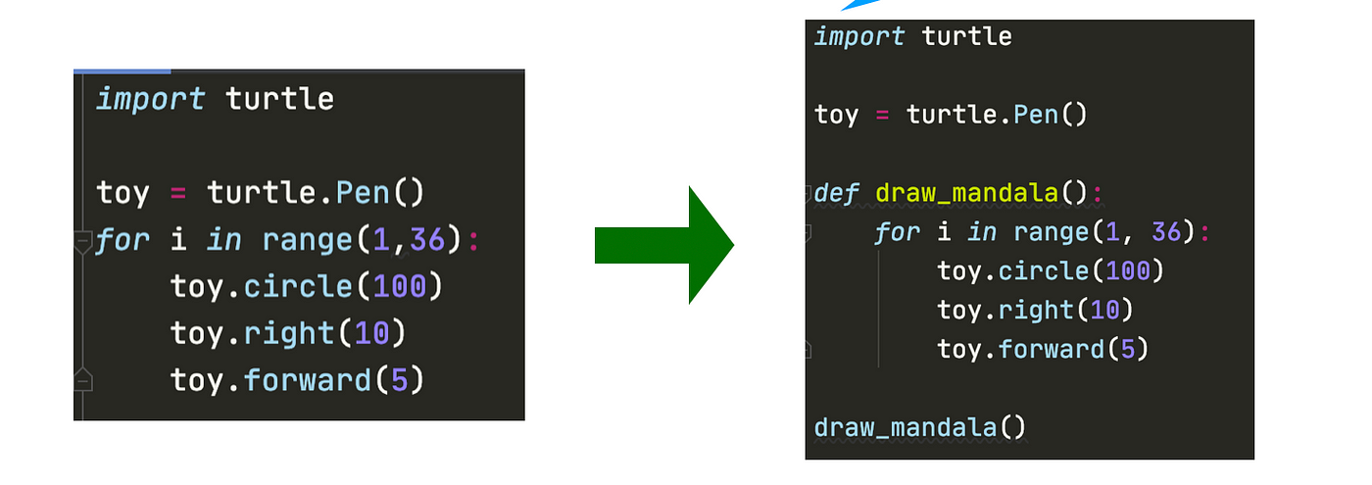
Code block to Function

Slide 24
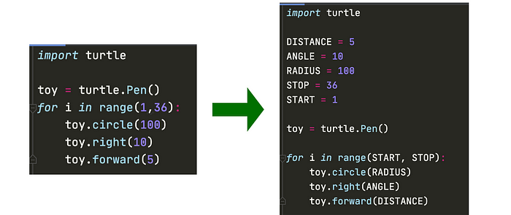
Adding Constants

Slide 25
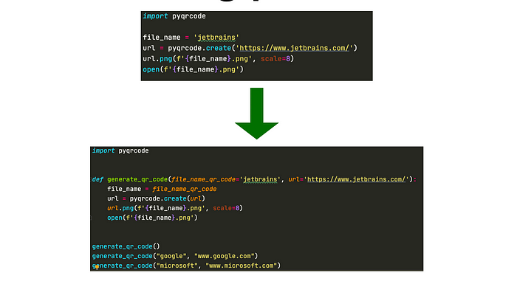
Parameterization

Slide 26
Automated Refactoring
This isn’t something that we’ll delve deeply into, but many tools exist.
Extract parts of code that can be made into a function.
Many IDEs have assorted built-in tools to refactor.
VS Code can extract methods and variables or rename things in bulk
Other plugins can provide more functionality.
I randomly saw a link to a VS Code plugin from MS that looks useful, Gather:
“Gather analyzes notebooks and helps users extract only the relevant code segments needed to re-create a particular cell output. ”
I just saw this a couple of days ago, I haven’t used it much, it is simple.

Slide 28
Game Changes
During the refactoring process we’ll make a change to help work with the GUI.
Make all inputs/outputs go through the game object.
GUI buttons will trigger a method call to the game object, which will then do everything internally.
All usage of the other objects, such as the hands of cards and the bank balances, will need to go through a request to the game object.
We are making things more abstract and “user oriented” with these changes.
The GUI interface doesn’t need to worry about internals, only about “user side” actions.
Using the game logic will now be more detached from the details.
I’ll organize some GUI code, extract some methods, add constants, and move things.

Slide 29
Interface Creation
While refactoring we can also think of constructing an interface for our game.
Our GUI based notebook is the “controller” of the game.
The code in the .py is the logic of the game.
We could swap out the controller, as long as it sends the same commands.
Everything (well designed) works like this:
The interface presents options for what we can do, how to do it, and what to expect.
The details of how any of that happens is irrelevant.
To use something, we only need to care about the interface with it.
If we document with docstrings and comments, that can be rolled up with doc tools.

Slide 30
Application Programming Interface
An API is a published standard of how to interact with a system.
Most objects, functions, and programs have the exact same concept:
There is a specific set of things that this object does.
There is a specific set of ways to interact with it.
When we use a published library we are complying with their API.
The documentation tells us exactly what classes and methods we can call and what they do.
Connecting to some other real program (a web server, some vendor application, our Moodle site, a data warehouse) is the same:
There is some API that tells us how to create a connection, send commands, and interpret responses.

Slide 31
Model View Controller
We can extend this idea to think more about separation of parts of code.
One framework for this is MVC – Model View Controller.
MVC says that we should break the logic of our program into 3 separate parts:
Model – the data. This is more logical when working with databases, but for us it is the classes the store our deck of cards and players.
View – the presentation of the data, such as our widget GUI.
Controller – the “brain” of the program, such as our poker logic.
Each of these parts can change independent of each other:
E.g. our widget GUI can be replaced with a real GUI for a different view.
Similar concept to abstraction and encapsulation we are used to – a black box approach.

Slide 32
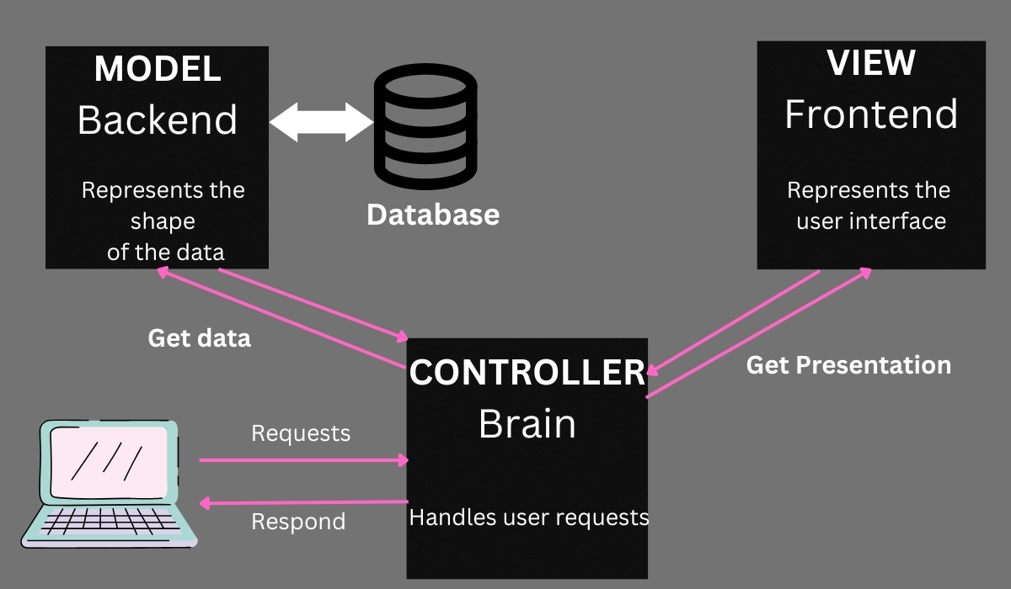

Slide 33
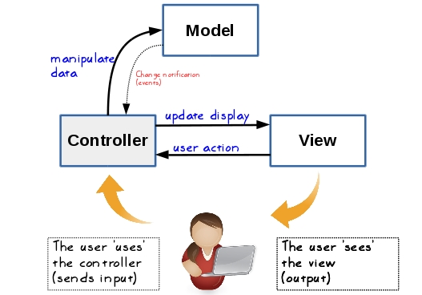

Slide 34
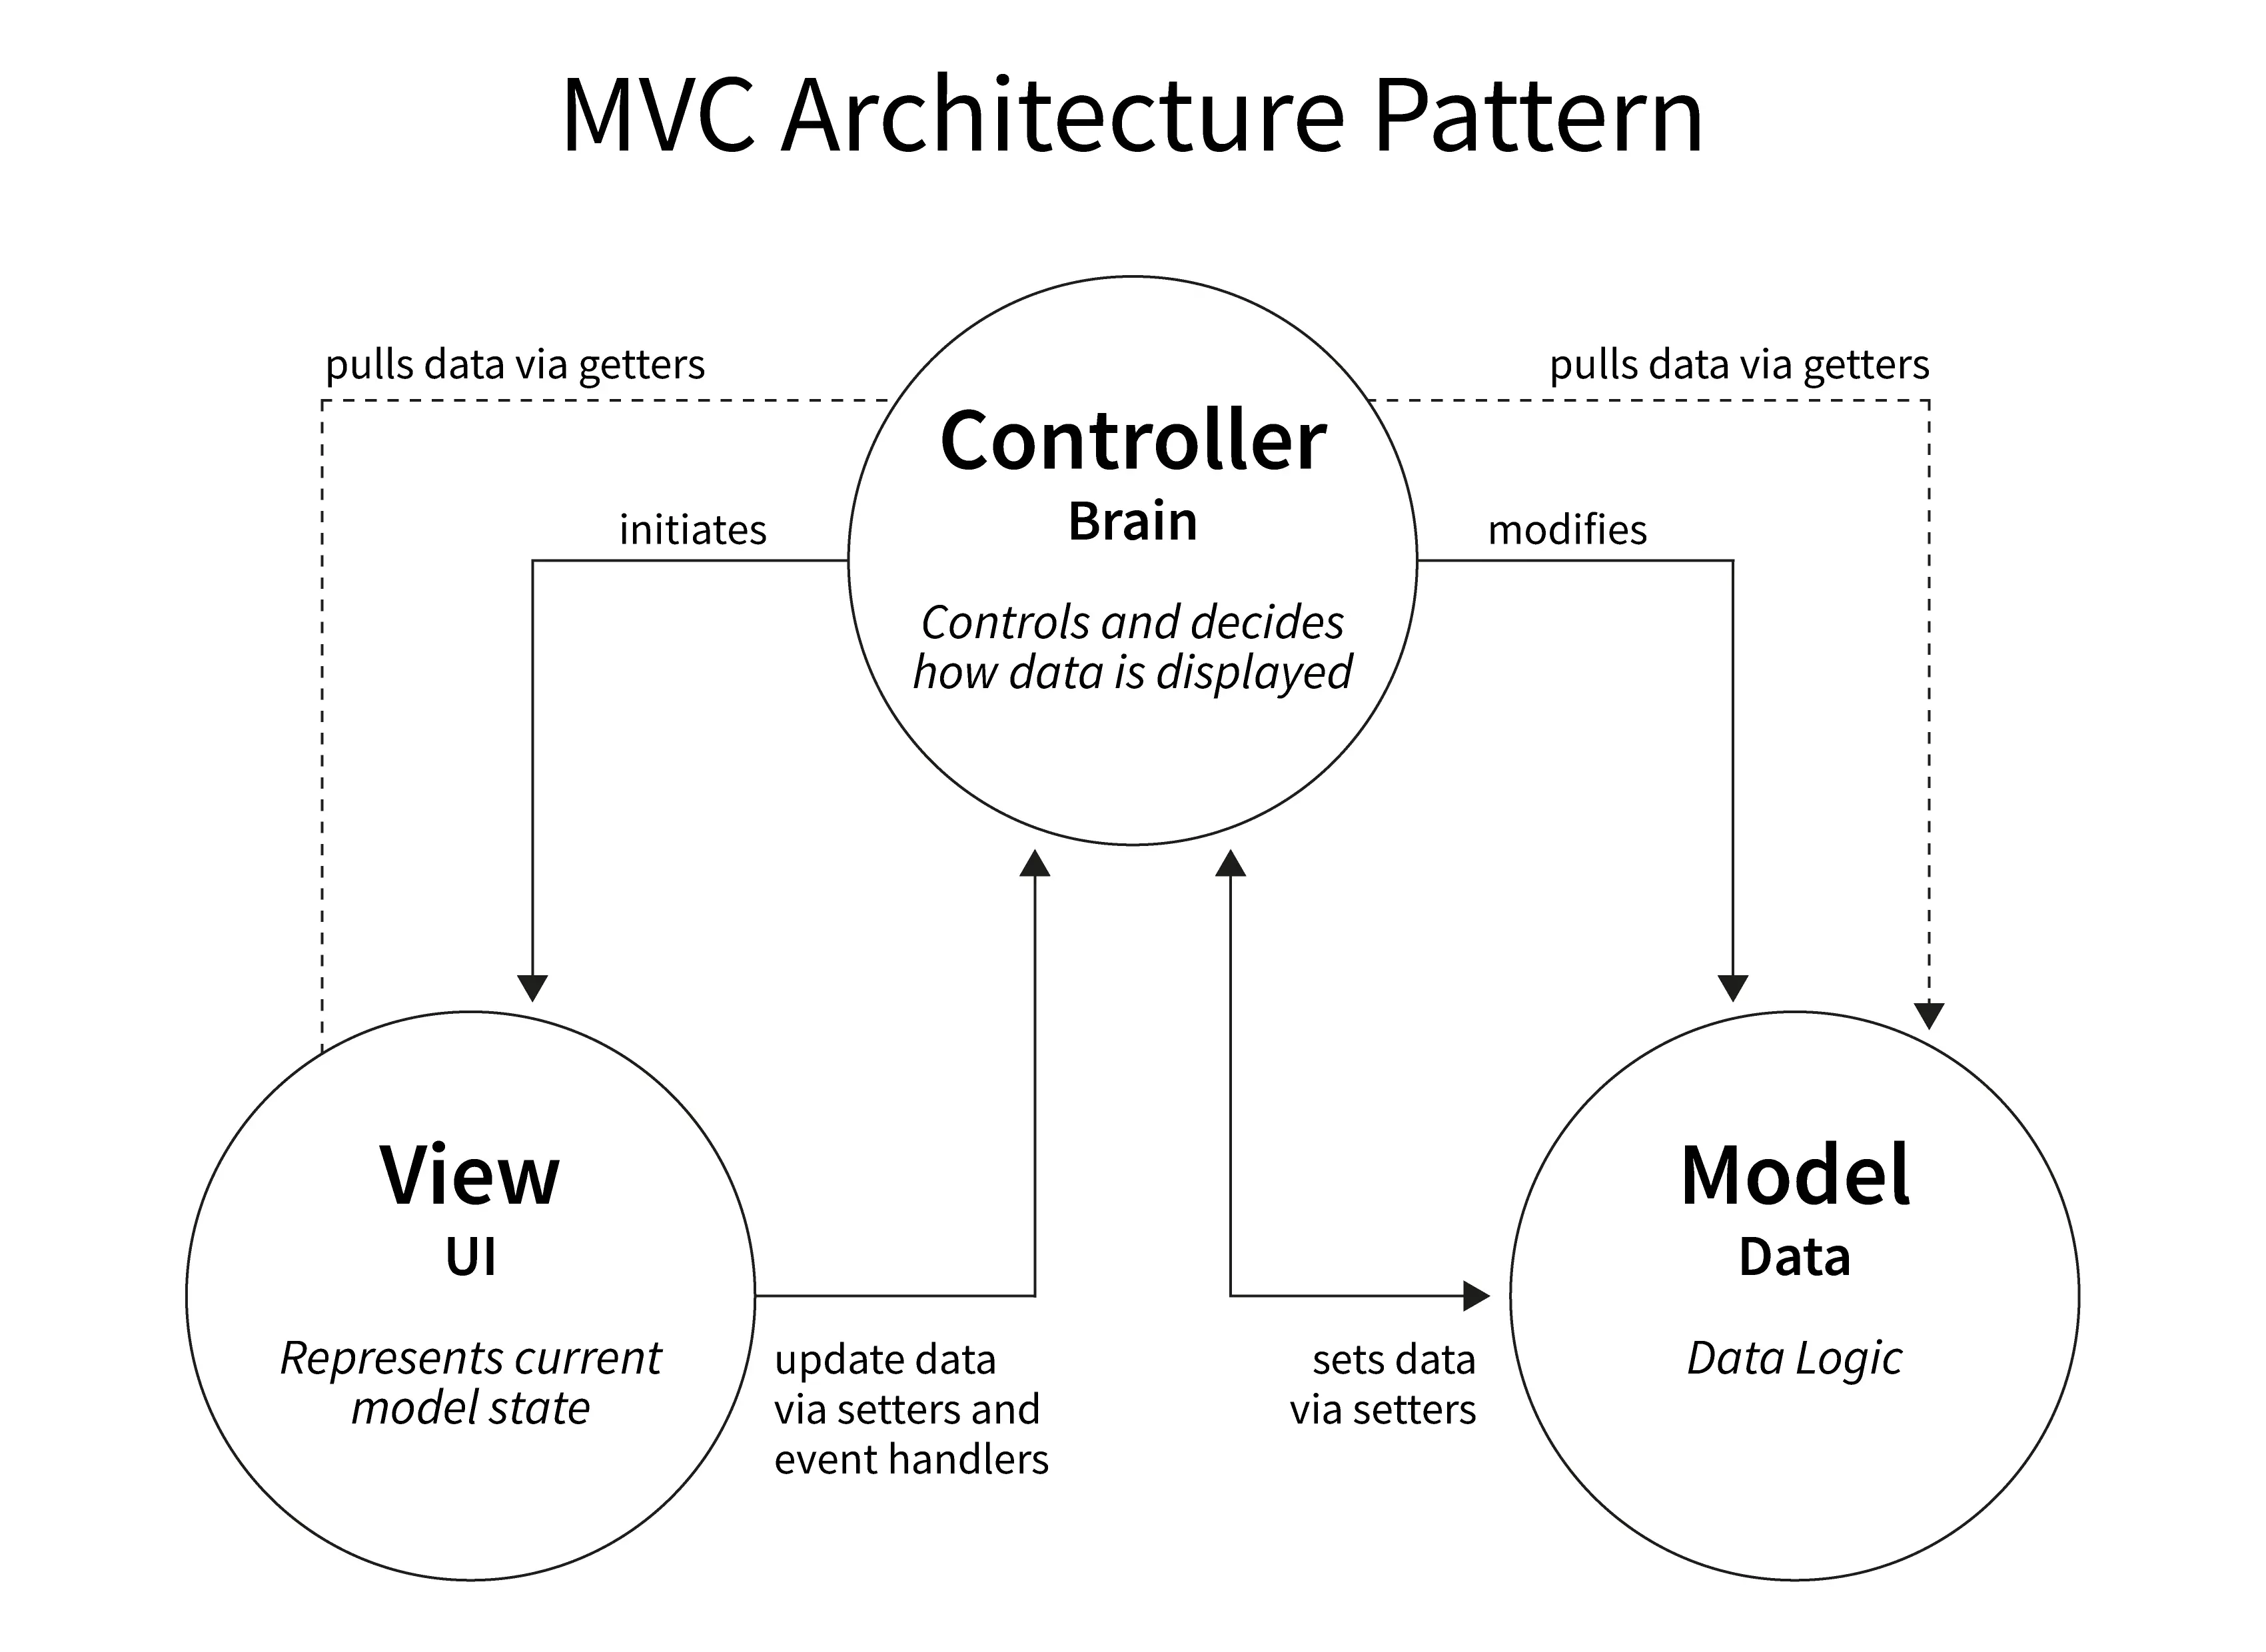

Slide 35
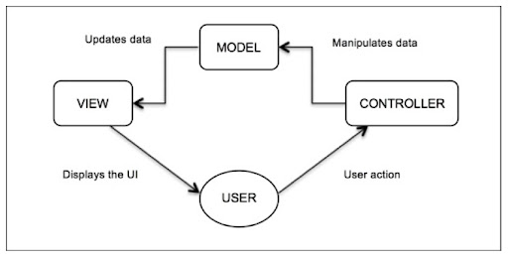

Slide 36
Applying MVC…
The model/view/controller concept is a simple thing to follow conceptually.
Each portion should be separate:
e.g. we don’t have code to display values wrapped up in our other code (like an object we make).
E.g. a __str__ function doesn’t print, it returns a string to be displayed as desired.
The user isn’t directly interacting with data, they send actions to the controller.
For our cards example:
We want to work towards the point where any action is a function call to our game.
Get the data out of the model and present it in any view we choose.
Calls to bet/fold/whatever are made through the API we make for the controller.
The data that is impacted by all of this is held inside our objects, and is only impacted as above.
The only change if we want a GUI is the view presents differently and the controller inputs diff.

Slide 37
MVC Ideas and Software Design
The concept of MVC is applied very commonly in software development.
In most/all cases the thought patterns of this can help us.
Focus on input/output, then figure out how to connect the two.
If we are writing a function, it gives us an easy way to define tests.
If we are building larger chunks, it leads us to define a standardized interfaces.
In data science, we want to maintain a similar separation in many places:
The data should be its own thing, not connected to any other part of the process.
The model and its training should be able to be swapped, so we can compare.
The resulting predictions are independent of the pipeline used to make them.
Each part can be swapped out for another with the functionality maintained.

Slide 38
For the Near Future
Of all the programming stuff we talked about, DS will generally demand more from:
Dealing with data structures, we’ll be making more complex ones later on for large data.
Manipulation of results, values, etc… in arrays/df/series/other…
Pipelines/grid search and their basic construction (later).
Some inheritance and object-oriented stuff, though not everywhere.
We don’t really need to write super clean or complex code to make things work.
Better code will make everything easier and faster, and allow you to do more with less frustration.
Working with others is much, much, easier if you have clear code.
In most cases – the stakes of design/refactoring are low (things will work), but we want to think about how we could do it a bit better each ‘round’.

