Slide 1
Housekeeping
Today – slight reordering:
We’ll do strings/regular expressions (#20)
Revisit the cards thing with test-driven development next week.
If the modelling stuff from last time is hard/slow, that’s fine and normal.
Practice – building towards a game of poker (or variant, or other game) is good.
The thinkpython book has several exercises at the end of chapters 14-17.
Other “stuff” – real things, old code things you understand, etc… are good practice objectification candidates.
When you hit problems search, read, ask – hitting roadblocks is normal, beating them gets easier.
Reminder – one week from today there’s no class for that analytics conference.

Slide 2
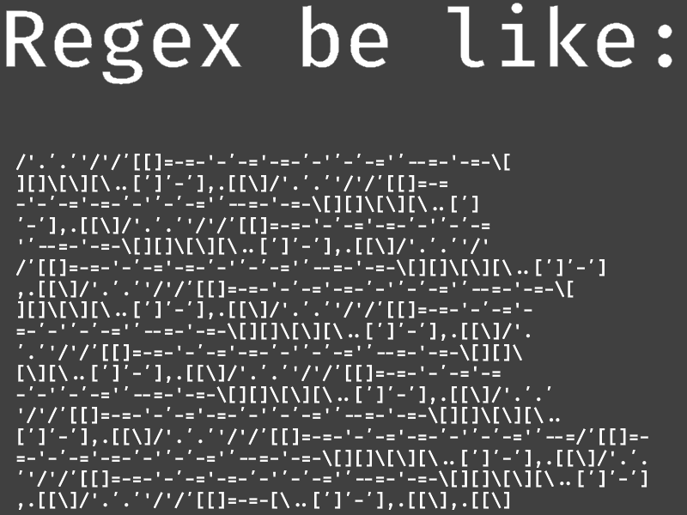
Regular Expressions

Slide 3
Strings
We’ve dealt with strings in several different ways.
We can process strings with lots of tools and functions:
Use idicies to slice by position.
Methods like strip(), isalpha(), or left().
Comparisons.
All of these things deal with the actual value that we have in a string.
What if we want to look at the format or structure of some text instead?
Does text fit some pattern like a postal code or phone number?

Slide 4
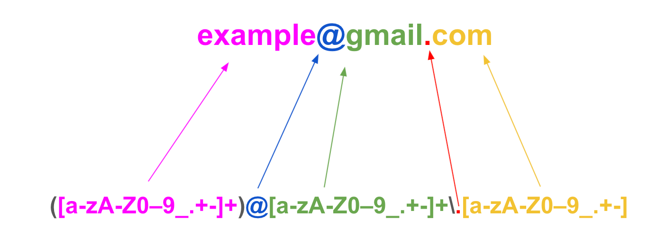
Regex – Text by Pattern

Slide 5
Regular Expressions (RegEx)
Regular expressions are a set of tools that allows us to match text by pattern.
Define the structure of what we want to match, and the regex will check for matches.
In addition to defining specific characters/words that need to match, we can set criteria:
Any letter or number.
A piece of punctuation.
Any letter except a certain set.
A set number or order of characters or words.
A specific character, flanked by text in a specific way (e.g. phone number).
Regex is similar to SQL – define criteria, get results.

Slide 6
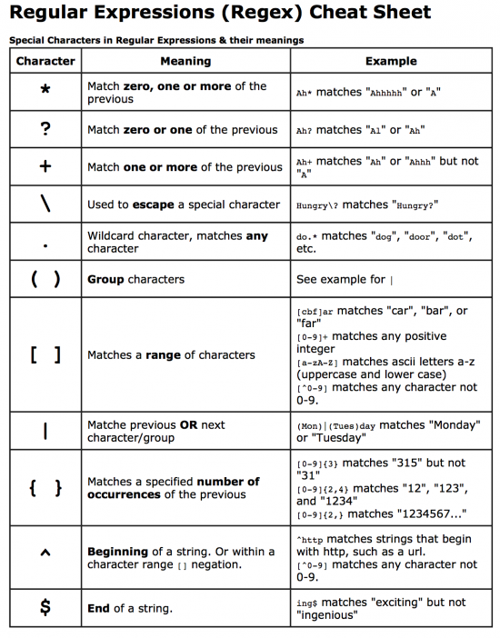
Common Regex Patterns
Regular expressions are made up of “patterns”
Literal matches
Character classes (e.g., [0-9], \d, \w)
Quantifiers (e.g., *, +, ?)
Anchors (e.g., ^, $)

Slide 7
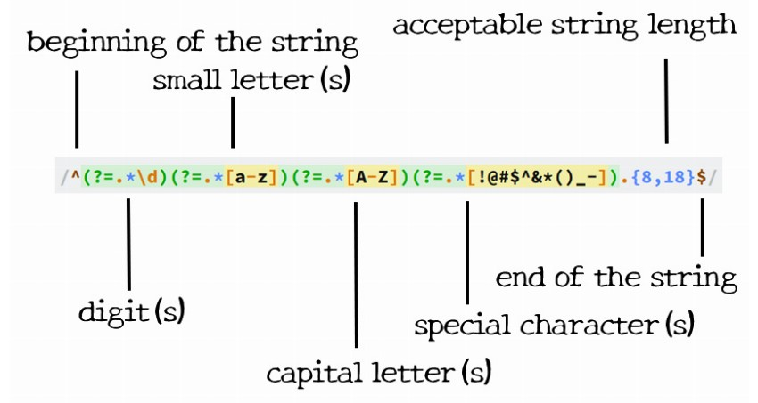
Advanced Regex Techniques
Regex can be made to capture almost any pattern in text that we can define by rule.
The difficulty of making some of the complex ones might be high.
They can get really hard to debug, or even read, when very complex.
Logic with ”or” statements and flexible patterns can yield advanced and cryptic patterns.
We don’t care much about elaborate regex expressions, we can focus on simpler ones.
We can collapse very complex things down to multiple expressions, or supplement with non-regex logic.
Complex password pattern

Slide 8
Benefits of Regular Expressions
Regex functions tend to be well optimized in languages.
Often written in a language like C for speed.
Speed isn’t the primary reason to use regex, but it is likely faster than a loop.
Regex is universal.
We can copy/paste regex to any other application.
Regex is concise.
Advanced text filtering can be done in one line of code.
Regex is provable.
The regex logic is a mathematical language – we can prove the results.

Slide 9
Drawbacks of Regular Expressions
Regular expressions can become hard to debug or read when complex.
Very large patterns can become problematic (though this is probably not an issue for us.)
Small errors in regex logic can lead to hard to find issues.
Learning curve to start using regex expressions, or expression that are more complex than the most basic ones.

Slide 10
Real Applications and Use
Regex is commonly used when processing text.
Most useful finding strings that meet a specific pattern/format, but with variable details.
Form entry – address, postal code, phone number, etc…
“Smart” text extraction – e.g. pulling values out of free text.
Regular expressions are universal across languages.
We can define a regular expression in Python code, and it is the same everywhere.
Regular expressions can be proven:
I.e. a mathematical proof can be made that a regex returns the correct results every time.
Since regex is a strictly defined language, we can verify correctness of code.
This can be important in mission-critical scenarios – e.g. code that runs a nuclear plant.

Slide 11
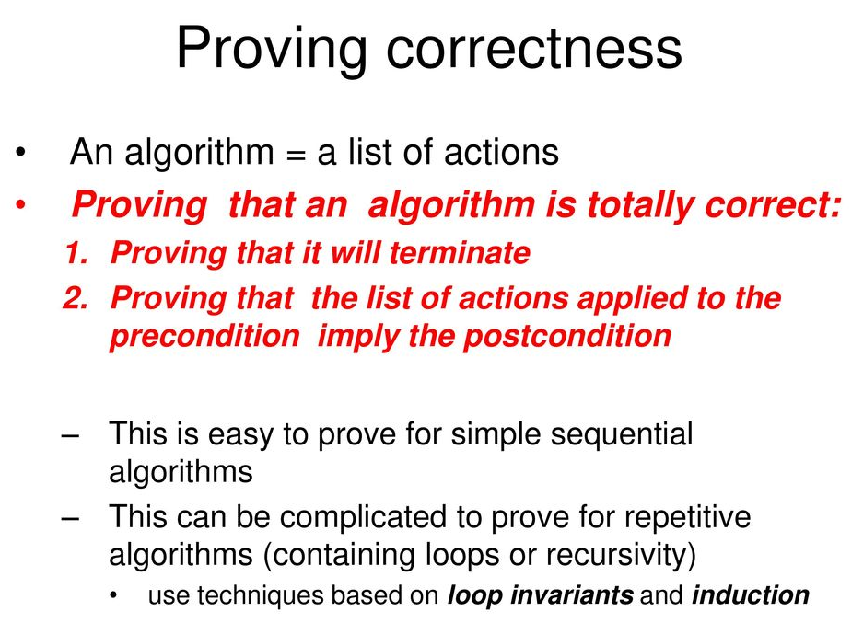
Side Note - Proofs
In computer science theory work, and in scenarios where code really can’t “be wrong” we may prove an algorithm works.
A proof is a mathematical demonstration that the outcome of code will be what is expected.
Idea is similar to recursion – what are the possible cases, when do they occur, and can I check that the correct one happens.
Tests show that code practically works, proofs show that it can’t not work.

Slide 12
The value of Formal Correctness
In most code we can ‘verify’ it through tests (or even less…)
In mission critical things, we may want and need to do a bit better.
Space shuttle control systems, insulin pumps, SCADA, self-driving cars (I’d hope, but…).
Code that can be proven to work is valuable here, as you can guarantee that it won’t have a bug.
Applies mainly to smaller algorithms/modules rather than full programs, for practicality.
Think of a control system of a physical device, and verify that the code running it does the right thing. E.g.
Throttle control system in drive by wire – prove that inputs change value properly, and values are valid.
Pacemaker – prove that the “pacemaking” is correct based on inputs.
Counterexample – Stuxnet bug used to destroy Iranian centrifuges by spinning them too fast.

Slide 13
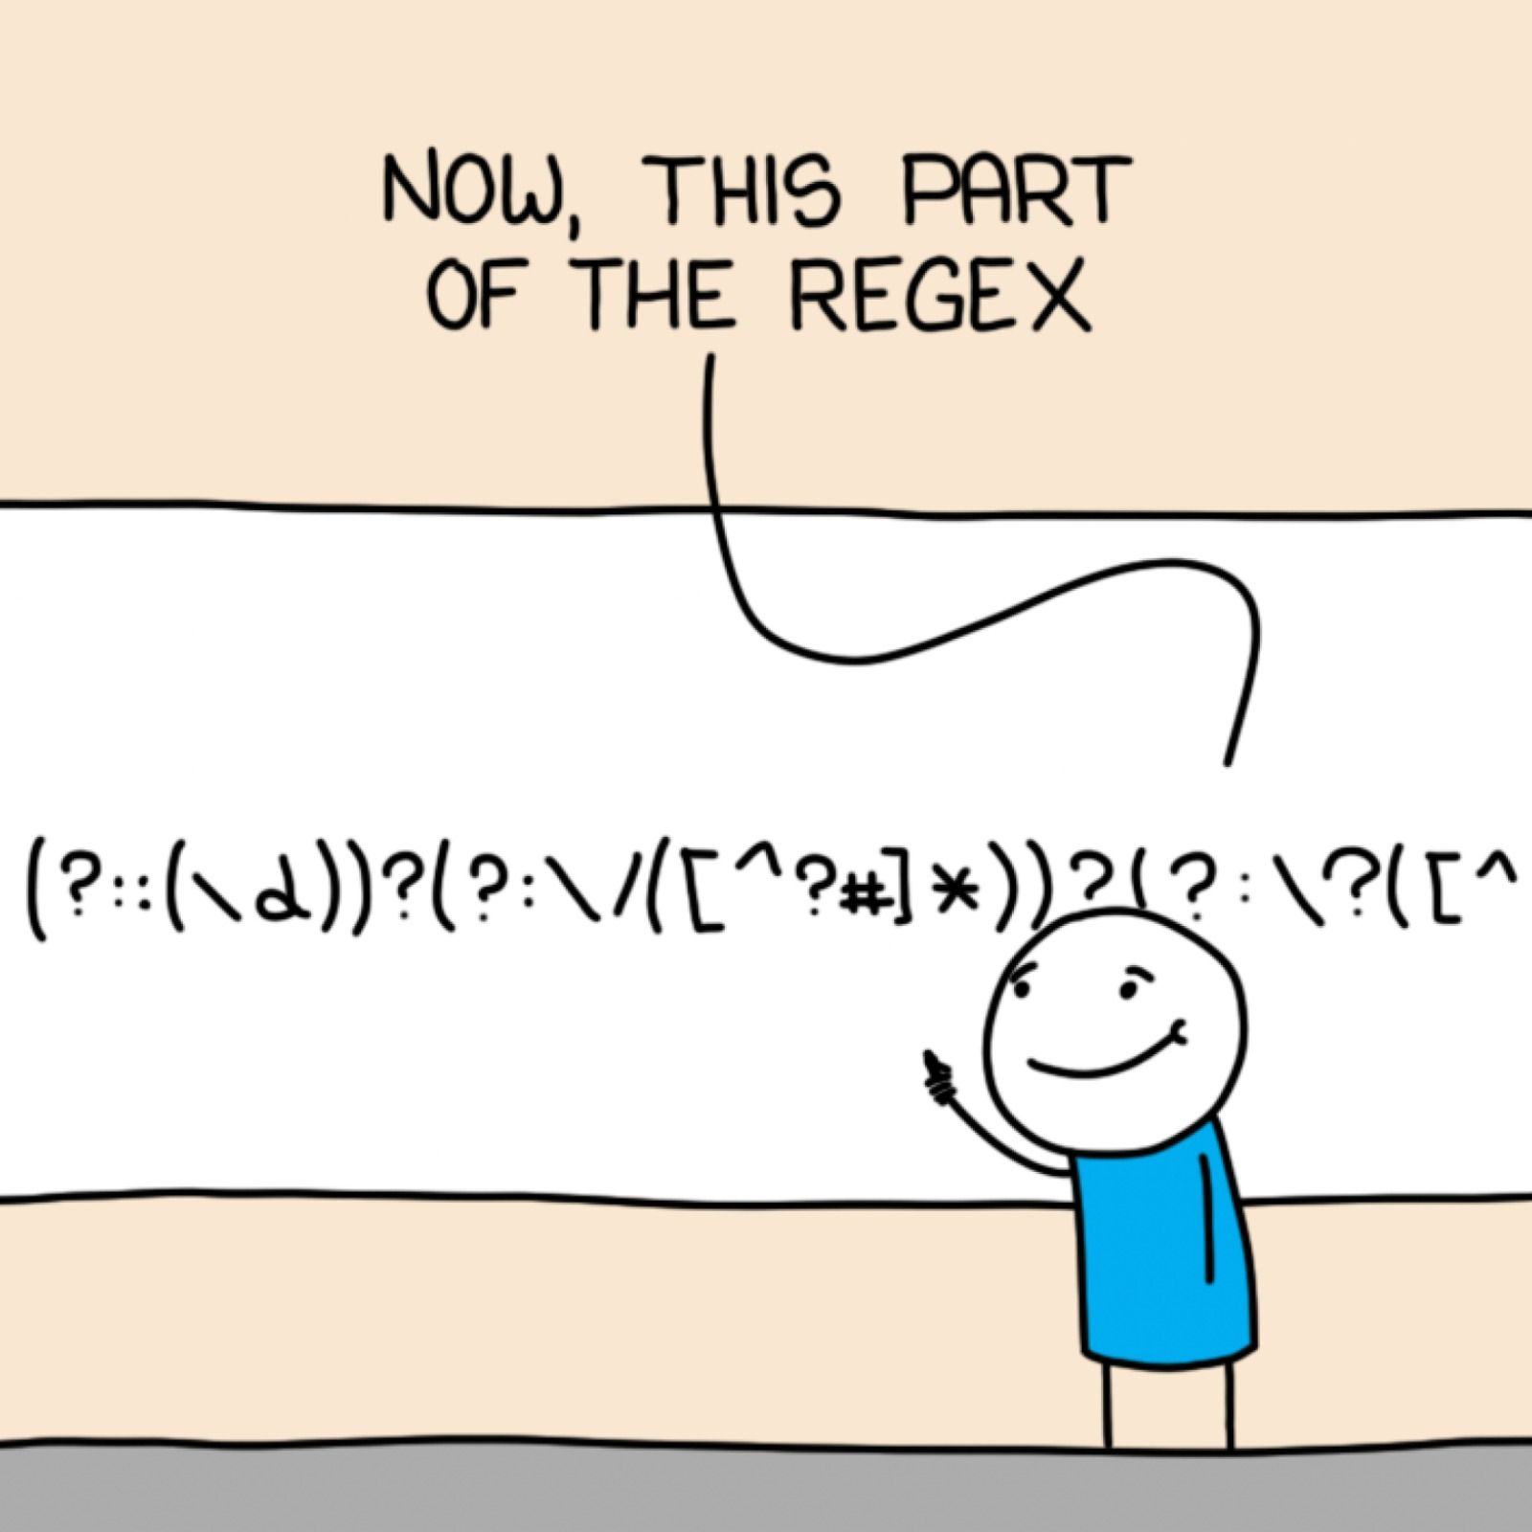
Back to Regex…

Slide 14
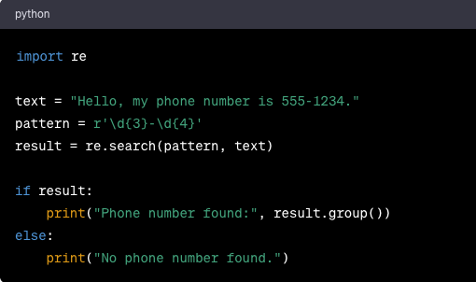
Examples – Phone Number Pattern
This regex pattern identifies if something is in phone number format.
3 numbers
A dash
4 more numbers

Slide 15
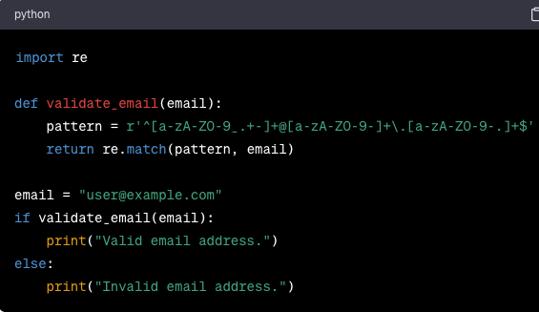
Example – Email Addresses
This pattern looks for email addresses.
Some letters or numbers at the start.
An @ sign.
Some more letters or numbers.
A dot.
Some more letters of numbers.
The end.

Slide 16
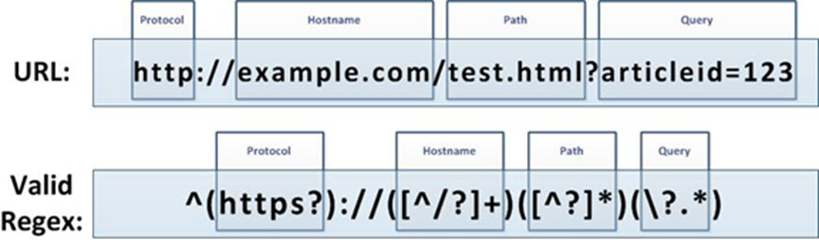
Example – URL Pattern
This pattern matches a specific format for a URL.
Useful for things like web scraping – finding certain types of links, like images.

Slide 17
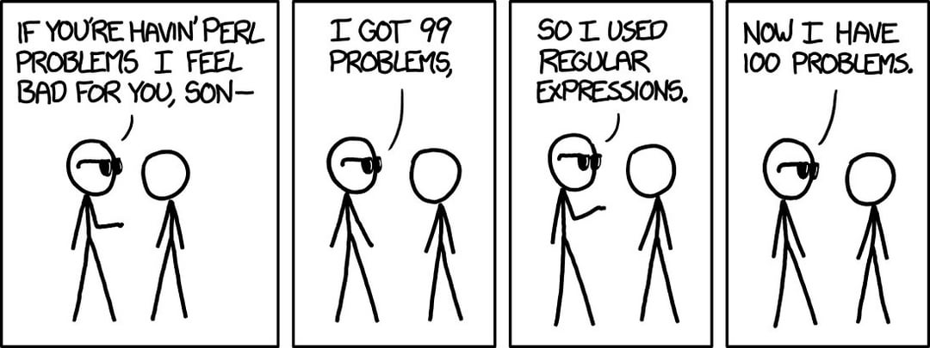
Regex can be… Not Fun
I learned this from a professor who only coded in Perl and used bizarrely complex regex for everything you can imagine, so I have an irrational hatred of it.
For text-pattern based things, it is great.
I.e. is it the right format?
Before committing, question utility:
Is the regex readable and changeable?
Would it be easier in normal code?

Slide 18
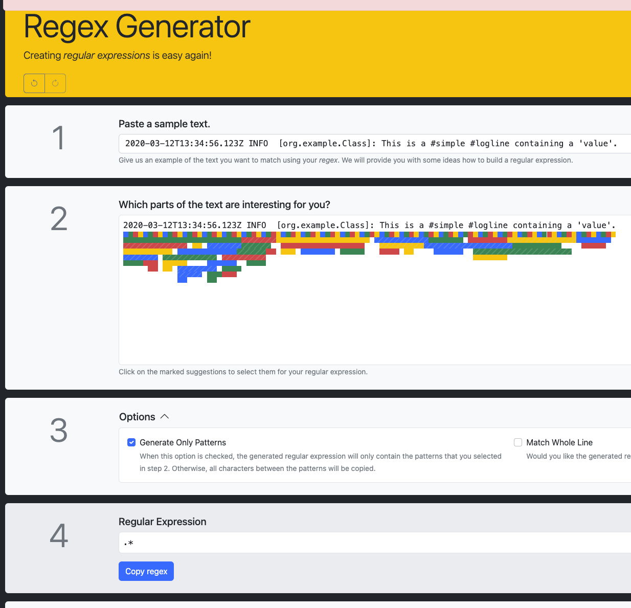
Help is on the Way…
There are online tools that can help you.
This is actually a good application of AI.
The details of regex are complex, messy, and easy to make a mistake.
But, it is totally rules based.
For common things, like emails, phone numbers, reading some logs, parsing html/xml/json, there are likely some premade patterns somewhere online.

Slide 19
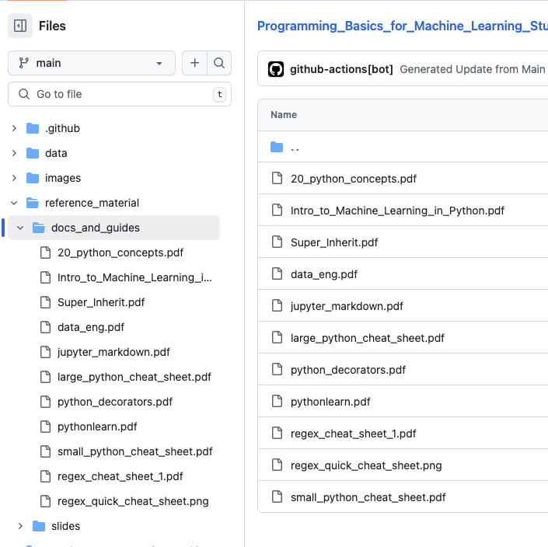
Regex Cheat Sheets
There are a bazillion regex (and other things) cheat sheets online.
I put a couple, along with a few others, in the repository.

Slide 20
Conclusion
Regular expressions are a shortcut to some string processing we’re used to.
Can wrap up more complex loop/if logic into simple concise statements.
Regex is a standardized language for processing text that is the same everywhere.
We don’t really need to use regular expressions that much in DS, but they might help.
We can create a loop/if based logic that can do whatever a regular expression does.
Can help if matching text patterns in data pipelines – we can build in “transformer steps”.
I wouldn’t spend a lot of time knowing this in depth, as long as you are able to use/read regex if needed, with the help of the internet and some time.
The basic idea of wildcards, patterns, and text matching should be clear though.

Slide 21
Work on Stuff!!!!
Cards and modelling real things in an Object-Oriented Program:
Try to get the functionality to what we did in the “part 2” notebook.
Think – what objects? What do they know? What do they do? How do they interact?
Be basic – don’t solve things all at once, break them down into smaller components.
If something doesn’t work/make sense, please ask – it is not an easy thing to do the 1st time.
Regex:
Try to do the exercises.
Ideally, in a week from now, the basics of making a card-like program should be ok, if sometimes still hard.
Ask if you’re stuck or confused.

