Slide 1
My Fantasy Team is a Travesty Update
Today (START AT 12:10 for today. I have something that’ll take up about 7 or 8 mins):
More (the last big part of) inheritance and objects, abstract classes and methods. (book 021)
Review of stuff up until now – workbook 020, as well as the card stuff.
Review/Catch-up/Consolidation times right now:
Use this time of slowish progress to make sure the basics up until now make sense.
If you need some help on something, please ask! We can find different examples/views.
It is normal and good to forget/need refreshing, then ultimately expand on the same concepts.
The card thing is a good overall wrap-up/summary exercise that touches most things.
Classes, functions, ‘where to put stuff’ (design), containers, variables, static stuff, testing.
Focus on inputs/output – where to start, what’s the goal, break that into tiny steps and go.

Slide 2
Housekeeping
Assignment:
I’m still marking, it was my mom’s 70th over the weekend, and wrangling old people is time consuming.
Review exercise workbook:
There are parts that should touch on all of the larger things that we’ve gone over.
Each part is pretty open ended, you can solve it in several ways.
If something is easy for you, don’t worry about it. If it is hard, work on that, ask questions, and if you need another exercise there are some in the book, I can make one up, or we can find something.
Also, check the end of chapter exercises, we’ve covered (virtually) the entire book.
With a few specific exceptions, we have covered the concepts in the text(s) – read for depth.
Read it and see if things make sense, if you hit a point of do what to the what? That’s probably what to review.

Slide 3
Review Stuff

Slide 4
Small notes
__repr__ is a function that provides a representation of an object, in string form.
This is meant to give unambiguous info to developers, while str is meant to be readable.
The structure is identical to str, return a string representation of an object.
Many objects return something like: <__main__.Foo object at 0x7f80665abdd0>
Make classes once, don’t repeat them.
If I ever have multiple copies in code it is to demo things as we work, i.e. “now we’ll add…”
In reality, don’t do this. It is bad and confusing – if we run the wrong class def, that’ll be active.
Check types and validity when loading data from a file (ideally think in ‘steps’).
Most datasets will have some sort of issue, largely a numeric column being treated as strings.
Describe, info, value_counts and others will show the current state.

Slide 5
Small Notes Cont…
In general, we want a function to do one thing (or outsource substeps to other functions).
If we want to modify Item X in a list, and the user says what X is, it is probably better to have a function that modifies X, and takes X as an argument than to have the first step in that function be to ask the user for X.
If our modify function was used elsewhere, we may want to be able to use it directly, without user input. E.g. what if we had a function to “apply 10% discount” to all items.
Conceptually want to separate parts of code – logic, interactions, display, data/storage.
Error checking – places where we are likely to have errors:
Dealing with outside data, we generally expect that to have errors or inconsistencies. Boundaries, invalid*.
Do things in smaller chunks, test if that works, then move on.
You can, right now, build far more complex things than you think if you do it incrementally.

Slide 6
Output Verification
The next assignment will check the output of your code.
I.e. you’ll be given a specified output format and data, and what your code generates will need to match that formatting and structure.
The idea is simple, we have your outputs and the correct answers.
There is a “scoring” function that compares the two, if they match, you’re correct.
The same as all of the scoring things in sklearn that you probably use in stats by now.
In building your assignment you’ll have a smaller set to check:
A different set of inputs and correct results that you can run and score.
The actual scoring function that I’ll use.
Make it work with the sample data and it’ll work for any data!
This is really strict in that a small error makes it fail, that’s kind of normal in many cases.

Slide 7
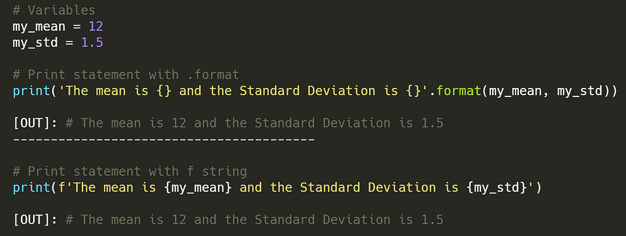
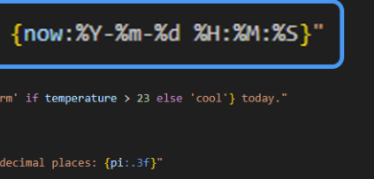
F-Strings
F strings are probably the easiest way to mix text and variables.
F strings follow a format of:
Prefaced, before the quote, by an ‘f’.
Variable names are embedded in curly braces within the text.
“Unbroken” quotation of text.
Variable values are inserted at the relevant spot.
Avoid the start/end string, commas, format(), and concats of regular strings.
Colon: format can control formatting.

Slide 8
Inheritance #2

Slide 9
Assignment 1 key Points
Data processing and cleaning.
Several problems with messy data, most notably the rupee sign.
The sign will likely cause a column to be interpreted as a string/object.
Solution – info to get type, if it is not a number we know it is not processed properly, start cleaning – slice off that mark, pull out numbers, etc… Identify issue, then define solution.
This is something we normally need to consider for each value – like in stats making models.
Top rating.
If the data is saved in a container in the Inventory, we just need to sort.
If we need to sort, we can define __lt__ in the objects (products).
So, if we can compare products, and we have a collection of them, we can sort.

Slide 10
Assignment 1
Container structure:
Each product contains one product – many attributes for each.
The inventory is a container of products – we need some internal container (dict, list, etc…) to hold many products, as well as the other functionality of the objects.
I used a dictionary:
Product name as key, product and stock level as tuple in the value.
This isn’t “correct”, the values can be arranged differently.
Need to track what each attribute “belongs to” – stock is not a product thing.
Could be a “stocked-product” object to sit there.
Similar to the refactoring in databases – including the “connecting” table/object.
Keeping this type of stuff straight is useful in loading datasets later on.

Slide 11
Asn 1
Testing and building the process.
Can I read a line of data?
Can I take that line of data and make an object from it?
Can I add all the data from that line that I need to my object?
Can I add methods/functionality one by one?
Can I combine these product objects into a list or something, so they can be sorted or looped?
Can I make an object that holds a bunch of these product objects?
Does the functionality like compare work between products in our container?
Can I add methods/functionality one by one to the container object?

Slide 12

More Inheritance

Slide 13
Variable Types
In Python, we often pay little attention to the type of object we use:
Different iterable data structures are largely interchangeable.
We might not convert text data we’ve imported, unless needed for a calculation.
For example, if we are printing some values in a list, we can just have print(item) without worrying about what the item is.
If we want to print an item, it (normally) “knows” how to print itself.
Ever one of those items is “capable” of what is asked of it, no matter the type.
This is one of the benefits of OOP – we don’t need to know how to do something, the item knows.
In this case, all the objects are ”strings” for this purpose – they do the needed string stuff.
I.e. Each object can do whatever we need a string to do (here – not always), so what’s the difference?

Slide 14
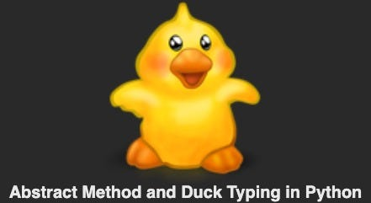
Duck Types
These show examples of Duck Typing:
If it walks like a _____, and talks like a _____, then it is a _____.
As long as an object can do what is asked of it, then it is as good as one of those objects.
I.e. if we have a function that finds the largest number in a list, and we give it a Series, that function will (probably) work, so a Series “is” a list in that case. It quacks and walks like one.
In the card game stuff we made an iterable – as long as it does iterable stuff, it is one.
In other programming languages this isn’t true, you need to declare a type for each object.
E.g. float a = 4.56 rather than a=4.56 like we’d do now.
We don’t need “An X”, we just need something that can do that stuff.

Slide 15
Abstract Base Classes (ABC)
Abstract base classes are a tool to help make inheriting functionality easier.
ABCs are classes that define some functionality, but can’t exist as their own thing.
I.e. we can’t instantiate a new object of an ABC class, it must be extended.
ABCs compliment Duck Typing:
We can “implement an interface” of an ABC to make it “act as one” of what we inherit.
When asking things like isinstance(), this will make them provide the right answer.
“As long as we provide this stuff, then our object can function as this object”.
As long as we implement whatever is “needed” then our object will act as the ABC.

Slide 16
ABC Implementation
Any object that provides __iter__ and __next__ is an iterable.
Officially, “An object capable of returning its members one at a time.”
So, an iterable isn’t a specific thing, it is a set of requirements that a thing meets.
Anything that complies with the requirements is effectively an iterable.
Objects can meet the requirements of multiple types of functionality at one time.
The ABCs are basically certificates to signify that an object is qualified to be something.
E.g. my dad’s a welder, he tests to signify that he is a “pressure welder”, “titanium welder”, “contained space welder”, “aluminum welder”, “b pressure welder”, etc…
He’s not different, but he’s now “usable” in any of those roles as he meets the requirements.

Slide 17
Collections

Slide 18
Collection Class ABC
Many ABCs exist in the collections, which are how data structures are implemented.
There are ones for Sequences (lists), Mappings (dicts), etc…
We can extend from some ABC base to make a new data structure.
In that data structure there are some things we must implement for it to work.
There are other things we get for free from the inheritance.
This data structure will be usable wherever the other structures are.
If making a new data structure, this is normally better than extending the built-in types.
There are things done to the built-in one for performance that make them “weird” in some cases.
We can build our object on top of one of these, and use most of the premade functionality.

Slide 19
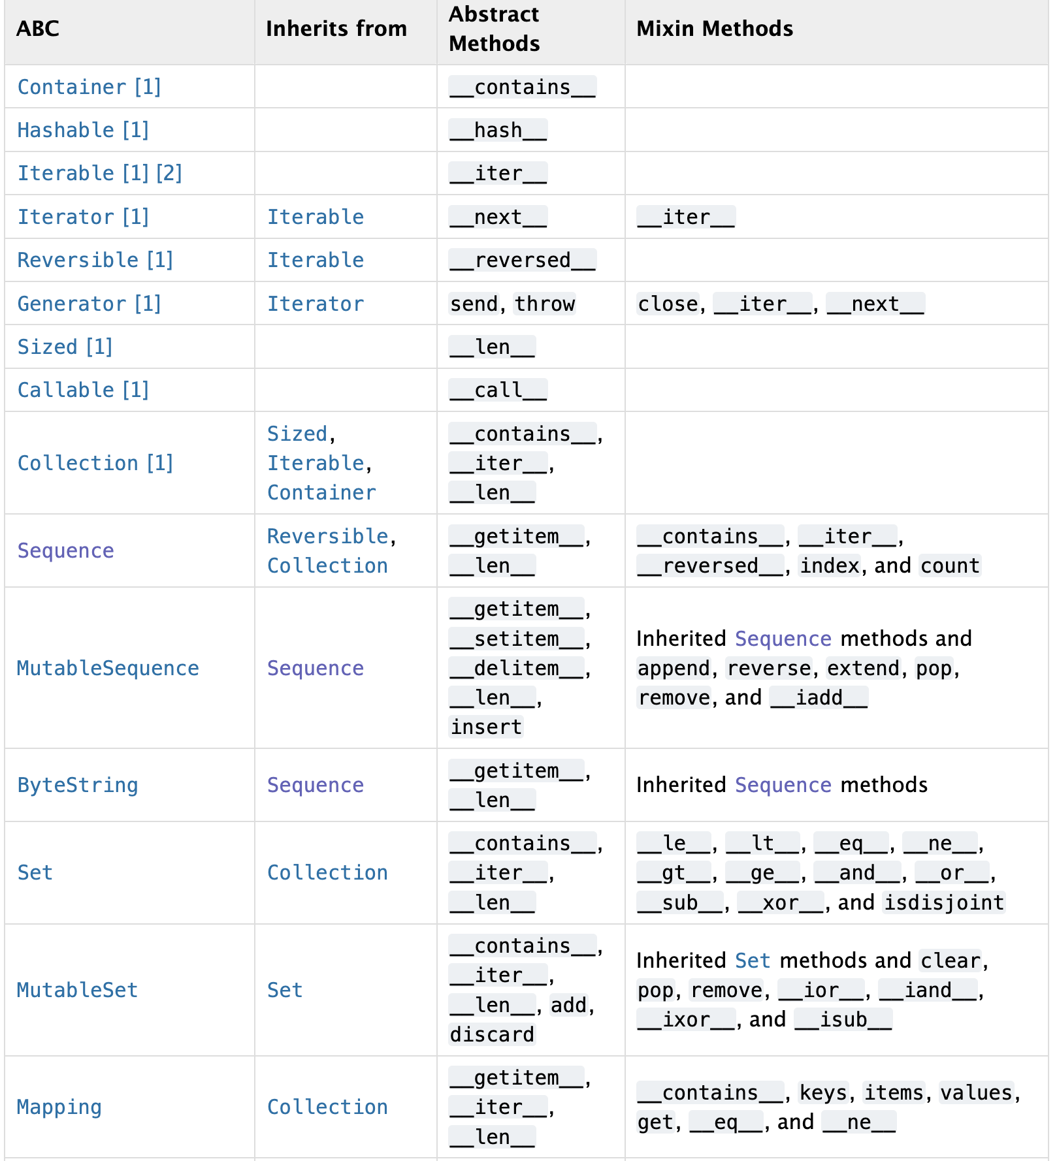
Implementing ABCs
To use an ABC we need to implement all the abstract methods listed.
These are ones that are empty in the parent.
If we think about it, this is the stuff that is unique that we need to make it work.
The mixin column is what we “get” for free.
Mixins are something we can ignore the details of.
We are effectively also inheriting default implementations of all this stuff.
We can use it or override them as needed.

Slide 20
Decorators
Absctract methods use Decorators, a label that adds functionality to items.
The static method labels that we’ve used before are a decorator.
The decorator is like a configuration switch, that tells Python to do something different.
In parent classes, abstract methods have a @abstractmethod decorator.
This indicates that this MUST be implemented to allow a class to be instantiated.
In general, decorators are fairly commonly seen in more complex code.
If we’re comfortable with what the limited subset that we see do, that’s fine.

Slide 21
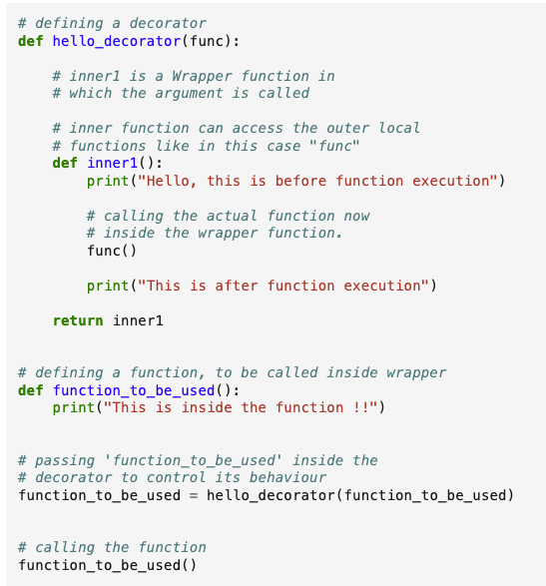
Deconstructing Decorators
Decorators are something we’ve seen popup occasionally.
Static methods, properties, etc…
Decorators allow for a function to be ‘wrapped’ in another, changing its function.
They don’t enable different functionality, just allow it to be done in a different way.
“Direct” decorator use is pretty simple.
Such as the ways we’ve used it before.
Self-directed may be easier, but confusing.
Understanding code using this ‘sugar’ can be harder, esp. at first.

Slide 22
Method Resolution Order
When inheriting from multiple locations we can quickly make things confusing.
Most notably if we have different classes with the same named method.
If there is a conflict, we need to know which one to call.
The order default will be bottom up, and left to right.
If something exists in a subclass, that’ll be called before a parent class.
If something is inherited from multiple locations, the one listed first is used.
This can get very complex in some cases, it isn't something that is super important for us.

Slide 23
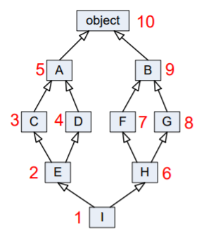
It Can Get Messy…
Very large inheritance hierarchies are possible, though likely not worth the hassle.
“Pure” object-oriented development would have large hierarchies.
Person -> Employee -> IT_Employee -> Programmer→ SR_Developer.
Functionality would be defined once, then inherited.
Objects would be a compilation of many parents.
Many scenarios will truncate this, possibly with a “type” and/or conditionally used variables.

Slide 24
In Python
In Python, the flexibility of ABCs, duck typing, and weak types avoid many major issues.
I.e. we can accomplish the same goals as that hierarchy, in an easier way.
Drawback of flexibility – risk:
While it is easier to do these types of hierarchies in pyhton, there’s other risks.
The hard checks prevent certain problems that we can have in python.
E.g. we are doing math, and a value works fine “as a” float, until there’s an invalid record that can’t cast to a float.
We can mostly avoid this in practice:
If the “is a” relationship is strong, we likely want to inherit.
If we need an object to “be able to do X”, then we can implement/duck type.

Slide 25
In Data Science…
In most of our model development work in data science heavy use of objects is not mandatory.
We need an OK understanding because we are using objects, but don’t usually need to make many classes.
Model development, data exploration, cleaning, and testing can be coded with/without classes.
It is up to you if/when to wrap things into classes, (functions for that matter).
Where OOP concepts may come more into play is in deployment.
If interacting with other systems (e.g. DB->pipeline->model->predictions->business thing) it becomes more likely wrapping objects into formal classes is better/easier/needed.
Testing and maintenance is generally much easier if things are encapsulated.
Organizations will normally have some sort of standards on how things are structured.
As a rule of thumb, if it is reused several times – function. If it is “grouped several times” – object.

Slide 26
Some DS Examples
More ‘advanced’ ds libraries/projects likely require more OOP in most cases.
When dealing with large datasets like images, the data pipelines can involve lots of work.
Create new classes that can translate a subset of data to provide the correctly formatted input.
Base does main functionality, children deal with variation – subFolderDataset, httpDataset, databaseDataset…
Each object provides a consistent input (defined in the parent) even though each is given a different source, and must take different actions there (list files, download stuff from the internet, do an sql query, etc…).
Any dataset object can be passed in, and they will work interchangeably.
This isn’t required, but I’d argue that it may be easier to make and maintain.
For custom purposes – objects for visualizations or results (data, details, config) like thinkstats.

Slide 27
Neural Network Examples
Neural networks often require/suggest making objects for parts of the process.
More common to generate and pass around objects.
Custom models or functions to make models for accuracy scoring.
Dataset objects.
Pipeline transformation objects.
We need to make some object that fits into some larger process.
The details are totally up to us.
We need to fit within the expectations for that type of object.
This is probably the most important practical skill for a new employee in a larger team/ecosystem – fit the spec.

Slide 28
Closing
More advanced usage of inheritance (and “language flair”) can be a blessing and a curse.
We can model reality more closely in code, minimize duplication, and improve flexibility and reuse.
We might make things more confusing and hard to debug if not careful.
Things become less literal – we rely on functionality that we can’t see written in front of us.
We need to be ok with object inheritance at a basic level.
Know and understand the relationships, be able to call the correct methods and interchange objects.
Create classes in cases of no or simple inheritance.
The more complex stuff is more of a nice-to-know thing.
If you do a lot of coding you’ll probably see it, also in some examples that are more complex online.

