Slide 1
Programming
The Beginning

Slide 2
Logistics
We’ll Start classes at 12:05, to let people login
Today (P4E – Ch2 + start of Ch3. ThinkPython – Ch2):
Review/questions – variables, VS Code, Python, GitHub basics
Data Structures & Conditional Execution
Lab repositories – I need ~2 or 3 testers to try, I’ll need your GitHub emails first though.
The first parts feel a bit disjointed, after a week or two we’ll have covered enough basics to have more of a logical flow. This part is a bit dry, I know.
By next time:
Logic and looping.

Slide 3
But First, More GitHub
First, try to “pull” my updates.
Source Control -> 3 dots -> pull.
We may need to resolve conflicts for some, that’s fine, we’ll stop and do so here.
We can publish your version of this repository on your github.
Requires that you “fork”, or create your own personal branch from my tree.
If you click “commit” (the check) it will ask if you want to branch.
It will publish from your computer to your own GitHub profile page.
Workflow will be Me -> my rep. -> your PC (pull) -> your GH (commit/push).
This will end up causing a few random errors over the semester.
Try not to modify future files, that’ll minimize conflicts.

Slide 4

Variables

Slide 5
Variables
Last time we started to play around in Python notebooks and focused mainly on variables.
Variables are what our program “knows”, or the values that are held in its memory.
Variables have:
Names that we use to refer to them in our code.
Values that are the actual thing that we want to remember.
Types, depending on if they are numbers, strings, or some other object.
Our programs will create some variables holding the info our program uses/needs, then do some stuff to those variables, and finally use or view the results.

Slide 6
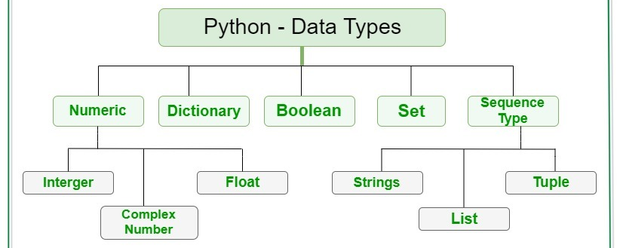
Variable Types
Variables can ‘hold’ any type of ‘thing’ – or object.
Python is ‘weakly typed’, meaning that we don’t need to predeclare a variable to only hold a “string” or “integer”.
Several basic, or ‘primitive’ variables are built into Python. They are building blocks.

Slide 7
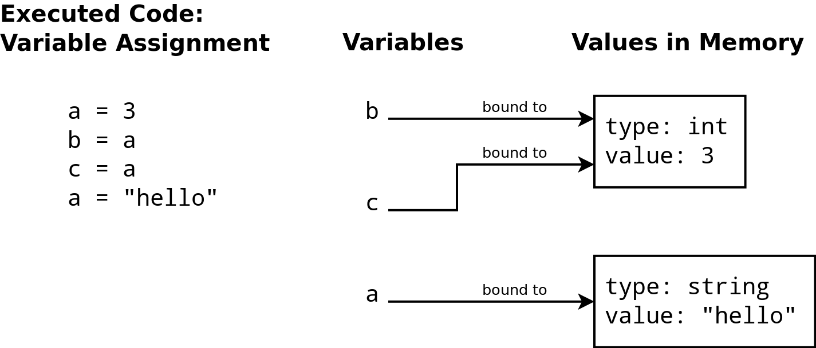

Slide 8
Object Orientations
This will make more sense in a couple of weeks, but I want to bring up the idea of objects.
In Python, everything (numbers, strings, lists, etc…) is an object.
Each object holds data + functions – or things that it can ‘do’.
An object is an example of a class:
We have classes, or types of things that can exist. Strings, integers, Booleans, and other objects we’ll create soon etc... Are all different classes, or types of things that can be made.
Each individual thing we make is an object, of a particular type.
Each of our variables refers to one object.
This is “object-oriented programming” – we create objects of different types, then do things to them.

Slide 9
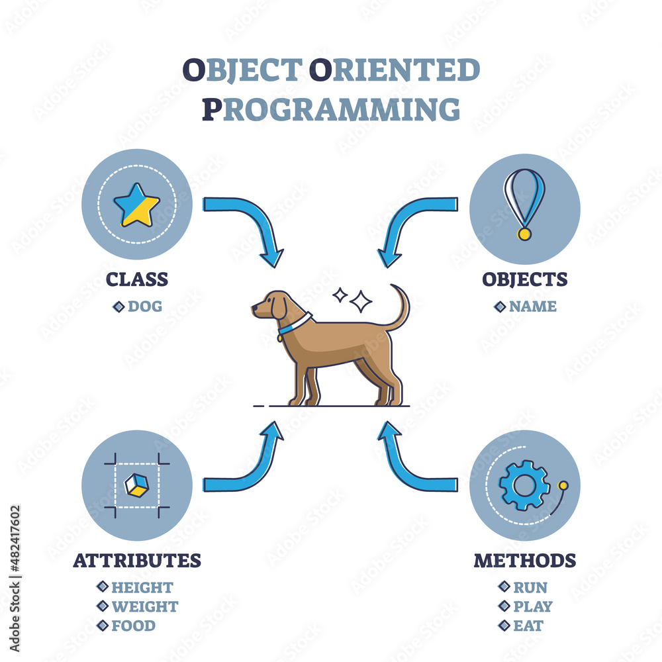
Object Hierarchy
We can make complex objects by combining other objects.
For example, your ‘Student’ object in NAIT’s system is made of your name, id, address, etc… Along with more complex stuff like a list of your credits and grades.
This is how (most) complex software is built – we build slightly more complex objects from simpler ones, and repeat…

Slide 10

Data Structures

Slide 11
Data Structures
Another type of object we can assign to a variable is a Data Structure, or an object that holds other objects. Think of them as containers that hold objects/variables.
We’ll look at Lists and Tuples now, you’ll encounter others soon.
Data structures are common when we have more than one of something.
E.g. we can have a list of products in an order.
Data structures add another layer to referring to a variable:
The data structure itself is a regular variable, referred to by it’s name. E.g “customer_list”.
The data structure also provides some way to refer to which object inside the container.
For lists and tuples we use an index – the position number in square brackets.
Container_variable_name[position_number_of_object]

Slide 12
Data Structure Choice
There are several different data structures, we’ll look at others later.
In python, data structures are often mostly interchangeable – we can swap between them with few or no other changes or impacts to code.
They are primarily differentiated by:
The ease of certain operations.
The speed to do certain things.
In short, some are good at finding an object by value, some prevent duplicates, some can access all items quickly, etc…

Slide 13
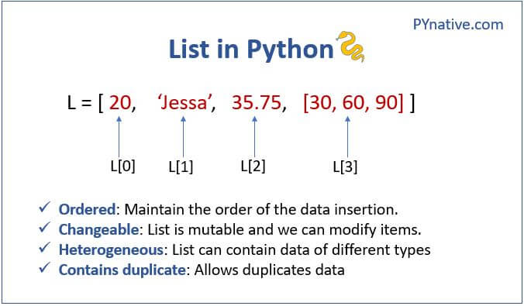
Lists are Cool!
Lists can contain any number of any item.
The items can be other data structures or complex objects.
We can access items via their index.
The list itself is an object, inside of it are other objects.
Lists are 0-indexed. (The first position is 0)
Can add to list via the .append(OBJ) method.

Slide 14
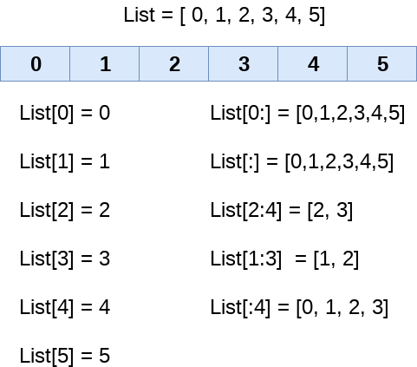
List Indexing
We can also slice portions of a list:
The left side of the colon is the start (inc)
The right side is the end (non-inc)
Blank is “no constraint” on that end.
It’s good to be comfortable with this, especially when we get to multiple dimensions (it comes up in NN a bit), but it isn’t urgent to be fluent.
Lists can return their length, most d.s. have some “length” type function to give the size.

Slide 15
Using Lists
Lists are the most common data structure that we use.
We can put anything into a list, or remove/rearrange.
We can get things easily by an index.
They are reasonably quick, but not super fast (arrays – later).
Lists are the workhorse of the data structure world.
We commonly use lists to:
Hold multiple versions of something – e.g. a course roster has a list of students.
Compile things from some data source – e.g. we need to extract the price from a DB of products.
Handle a generic number of things – e.g. we can have a function to add ‘everything in a list’ instead of a specific number of items.

Slide 16
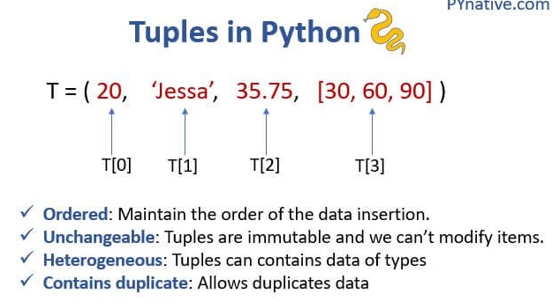
Tuples
Tuples are commonly used to package together a small number of objects that “belong” together logically.
E.g. two floats for latitude and longitude, two strings for first and last names.
Declared like a list, but with round brackets.
Tuples are immutable – they can’t be changed. A new one needs to be created.
Tuples have the same index system as lists do.

Slide 17
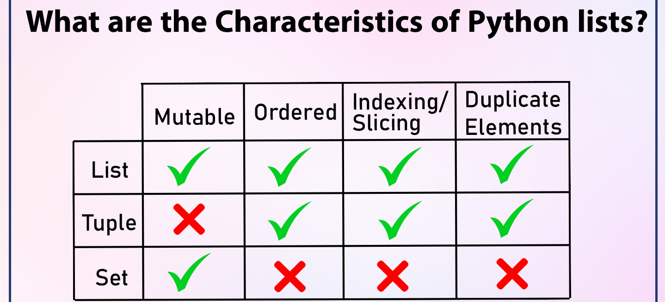

Slide 18
Data Structure Use and Reuse
Data structures are very common, we rarely want to hold many individual items as their own distinct variables, if there are many of something, we want it in a list or similar.
Many data structures, including a list and tuple, are iterable:
Means that they can provide their items one at a time.
Important in looping.
Data structures allow for more generic code that is more reusable:
Things can be written to get “the next” or ”the first” item from a data structure and do something to it.
Never need to hard code what we are grabbing, just the next in the stack…
Add/remove are generic actions, we don’t need to care about the details – more abstraction is usually good.

Slide 19

Controlling Program Flow

Slide 20
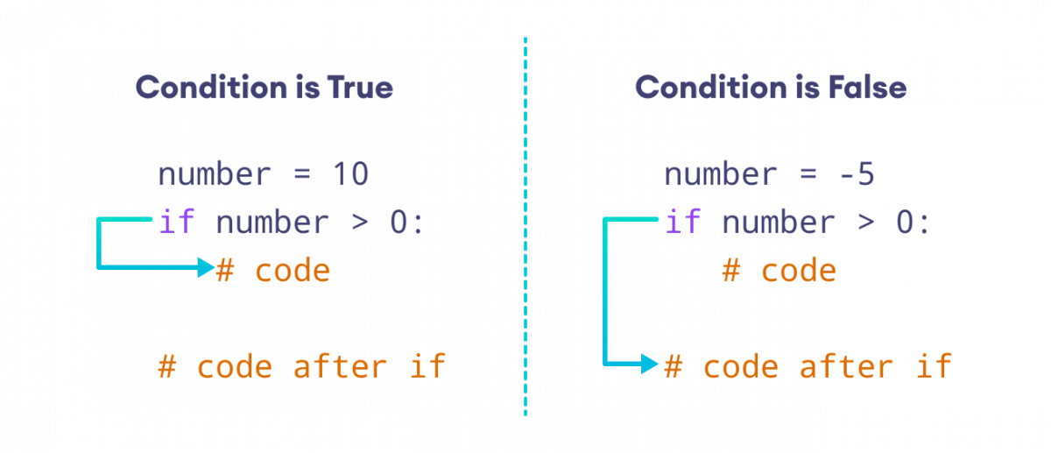
Conditional Flow
One of the most important things we need to make useful programs is the ability to have conditions in our logic flow.
I.e. do one thing is some cases, something else in other cases.
The core idea in conditional flow is the “if” statement:
Conditional statement – something that can evaluate to true or false.
Different actions to go in either case.
This allows our programs to “decide”
Indentation is critical here (and in Python):
Everything indented is “in” the if clause.
The end of indentation ends that clause, and starts “after”.

Slide 21
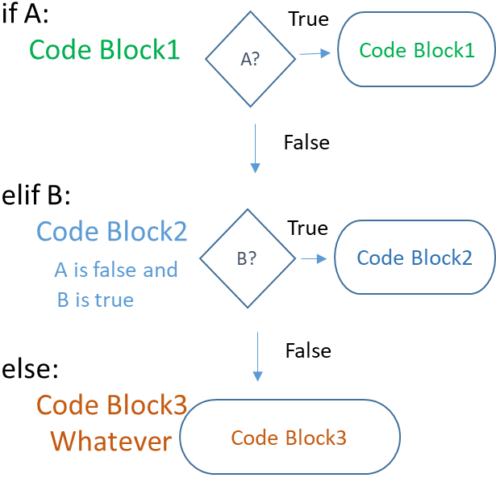
What Else?
If statements usually, but not always, finish in an “else” clause.
The else clause will execute if the ”if” (or elifs…) does not.
Elif, or “else, if” bridges the gap between the if and else clauses.
Elif is another “if” statement, dependent on the one before it.
This will perform the if check only if the previous if or elif was false.
The typical structure is:
If
Elif
…
else

Slide 22
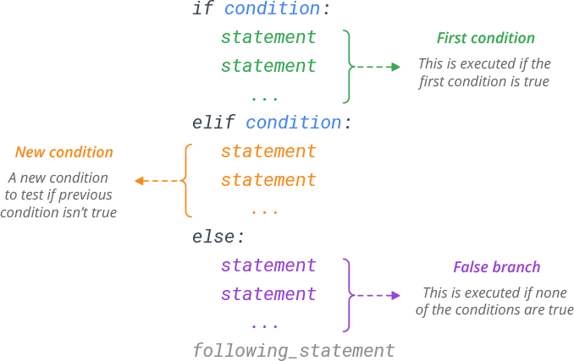

Slide 23
Boolean Logic
Conditional execution depends on Boolean logic.
Each condition must evaluate to True or False.
Most conditions are simple (i < length), but not all are:
Conditions can have multiple possible outcomes – multiple elif.
Conditions can have complex logic – nested or compound conditions.
Think – heart attack risk:
Depends on multiple factors – age, sex, weight, BMI, blood cholesterol, etc…
Risk level determinations need complex logic – “this” or “this”, ”this” or “this and that”, etc….
E.g. risk is high if you have diabetes and are BMI > 30, or if blood pressure and weight are high…

Slide 24
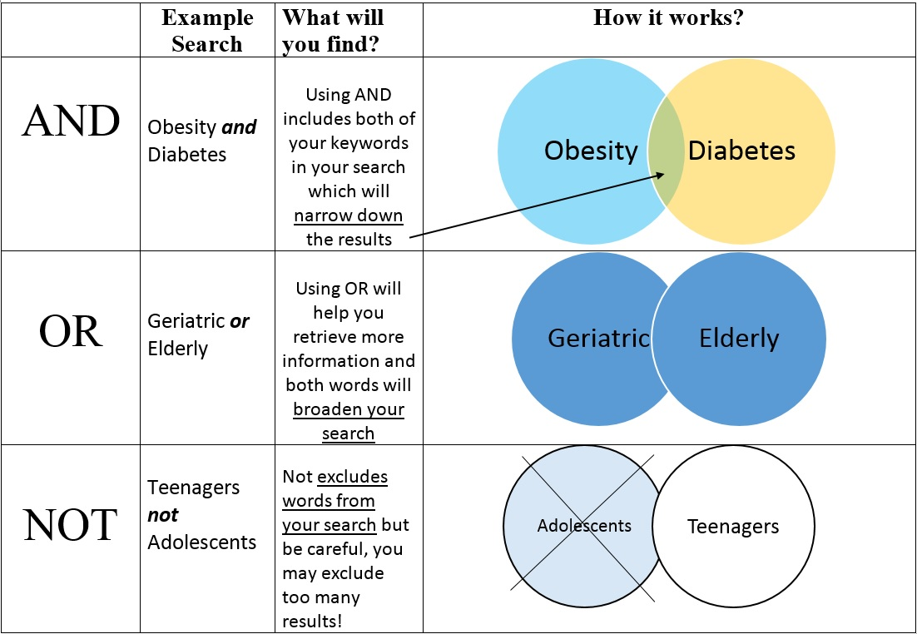
Priority is:
NOT
AND
OR

Slide 25
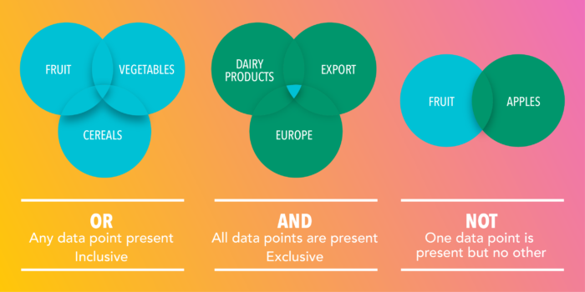

Slide 26
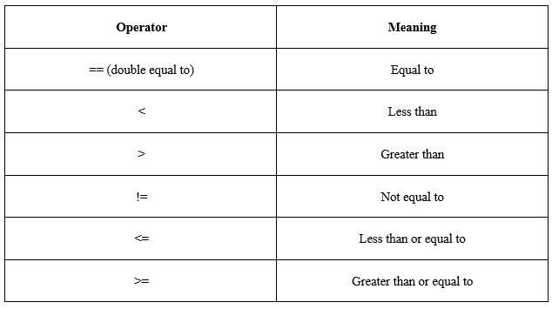
Relational Operators
The logical conditions can be anything that evaluates to true or false.
Relational operators are what we can use to make comparisons.
E.g. i < len(list) is a common comparison if repeating in a loop.
Note: comparisons use == double equal. One equal sign is assignment.

Slide 27
Boolean Fun Time!!!!
We’ll try some exercises to test our logical mettle.
We can also peek at running Python from the command line.
From VS Code, click Terminal -> New Terminal.
Type “python” and hit enter.
This is a python live interpreter. Each line we type and enter is like a one-line notebook cell.
You can run one of the statements to check it. You can also use a notebook cell.
Try to think it through, then run a check in Python.

Slide 28
Free Logic Puzzles!!!
True and True
False and True
1 == 1 and 2 == 1
"test" == "test"
1 == 1 or 2 != 1
True and 1 == 1
False and 0 != 0
True or 1 == 1
"test" == "testing"
1 != 0 and 2 == 1
"test" != "testing"
"test" == 1
not (True and False)
not (1 == 1 and 0 != 1)
not (10 == 1 or 1000 == 1000)
not (1 != 10 or 3 == 4)
not ("testing" == "testing" and "Zed" == "Cool Guy")
1 == 1 and not ("testing" == 1 or 1 == 0)
"chunky" == "bacon" and not (3 == 4 or 3 == 3)
3 == 3 and not ("testing" == "testing" or "Python" == "Fun")

Slide 29

Refresher – Pseudocode and Testing

Slide 30
Testing
Conditionals are one of the first things that are likely to need substantial testing.
We want to think about how we’d test as we create more complex things.
Consider how we verify if it works or not as we think about how to do it.
Likely along the decision boundaries or edge cases, especially for complex logic.
For conditionals, we can consider:
What is each ”normal” outcome?
What is on the “edges” of each condition? Are there “holes”, especially with complex logic?
What are values at the limits in any direction?
What happens with an unacceptable input?

Slide 31
Testing and Debugging
Testing code is a very large and complex topic, but it doesn’t need to be.
We can start with some simple tools now:
Construct test data – e.g. for a conditional, try one of each outcome, things along the edges of the decisions, and limits/odd values. We can then run these and see if it is correct.
Print statements – we can weave in print statements to tell us useful things, then comment them out when it works. E.g. print which “if/elif” clause we are in, along with the values.
Break apart code into blocks – we can break lines of code into individual blocks and execute them one at at time. Isolate things line by line. Combines well with the variable viewer.
Debugging pairs with reading documentation to allow you to do anything you heart desires!!!

Slide 32
Pseudocode
As logic starts to get complex, a good idea is to think in pseudocode – of an English/programming hybrid.
Try to break down the steps of what you need to do, but ignore the syntax.
Suppose we want to return the sum of the square roots of two numbers.
Temp 1 = root(number 1)
Temp 2 = root(number 2)
Result = temp 1 + temp 2
Each line is the correct step, we can then look up how to write that in code.
Break each step down into the smallest pieces you can logically, write some “code” of what those steps are, translate this into actual real code, repeat if one step was more complex than you originally thought.

Slide 33
Documentation

Slide 34
Conclusion
Conditional code is critical in allowing our programs to be smart.
If/elif/else provides us a lot of flexibility.
Understand Boolean logic for conditions.
Think of potential spots for error.

