Slide 1
Housekeeping
Exam:
Programming Q3 – removed from marks, taken as up to 1 bonus mark, I fail programming.
Otherwise, pretty good.
Mark totaling in LMS is slightly off, I need to figure out adjusting weighting without breaking it.
Today:
Arrays – like lists, but more rigid.
Easy and pretty simple – we need arrays mainly later next semester.
Multidimensional data structure introduction.
Some theory of computing background knowledge.
Generally – we’ll spend a bit of time looking at objects/classes/functs in more depth.

Slide 2
Arrays

Slide 3
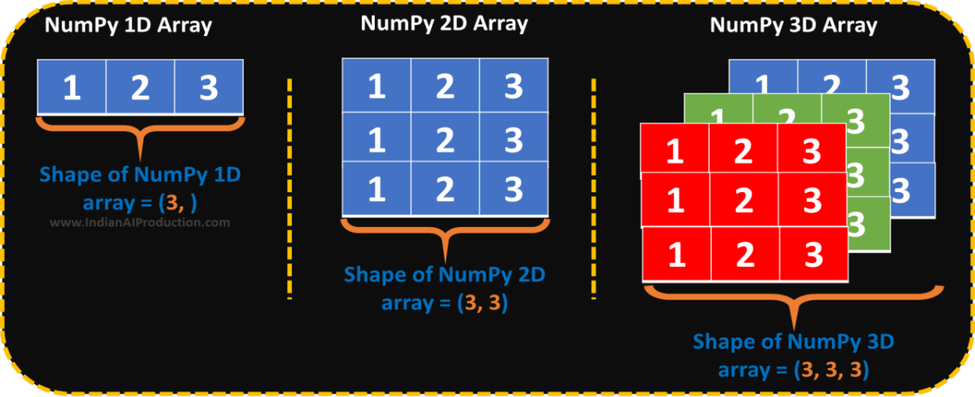
What’s an array?
An array is a data structure that is largely like a list, with some differences:
Arrays are of a fixed size.
Arrays have a fixed data type.
Arrays can’t be changed, but the objects in them can be.
Arrays are iterable and can be used with “normal things like for loops.

Slide 4
But… Why?
Arrays are one of the building blocks of data structures.
More relevant for lower-level languages than in Python.
Arrays are of a fixed size, and are placed into a window of that size in memory.
The ability of a list to grow requires resources, an array is set.
Arrays can be way faster as you can address memory locations directly.
Python manages the memory locations for us, but behind the scenes it is fast.
An int is normally 32 bits, so an array of ints has values at “0”, “32”, “64”…
A list needs to find “the next item” each time.
Before things like lists existed, we didn’t have a choice.

Slide 5
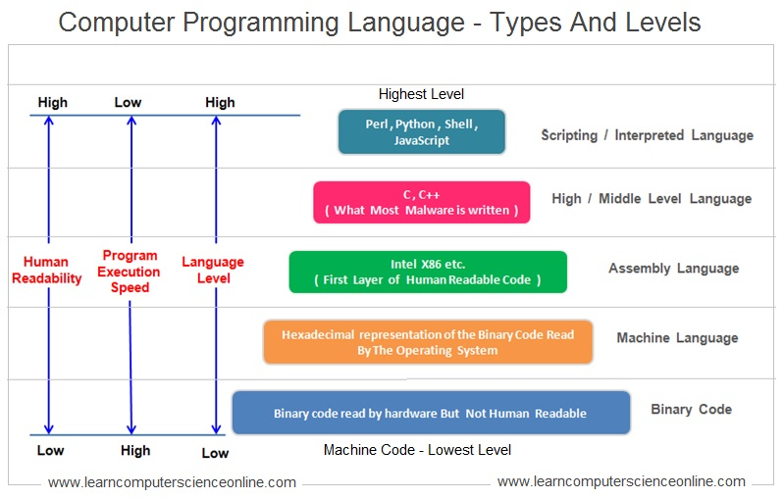
Language Level

Slide 6
Levels of Abstraction
Programming languages (and concepts) have varying degrees of abstraction.
Higher levels are things that are made to be understandable to humans.
Languages like JavaScript, Python, or C#, and C++ (mostly). Easier to debug. Slower.
Concepts like lists, objects, and inheritance. Abstract representations of real things.
Seen in code that is meant to be understood and shared, where perf. Isn’t critical. (Loose).
Lower levels are things that are made to be understandable to computers.
Languages like assembly, Basic, C (kind of). Harder to debug. Faster.
Lacking abstract representations in favor of specific locations in memory or code.
Often seen more in things that need to be efficient – i.e. ML libraries are written in C++.
The tools we use for data science are high-level, we focus on concepts.

Slide 7
Levels and Arrays
We can think of where arrays came from hand-in-hand with thinking about the language.
Assembly (and below)
We move data into and out of a spot (a physical address) in memory. Hard and annoying!
Low level languages.
We maintain a pointer to the correct spot in memory. Annoying and easy to mess up.
Gain abstractions like indexing.
High level languages.
No need to worry about memory locations at all. Language handles logistics, we have limits.
Higher level data structures like Lists.
No constraints from physical memory are needed (though they may be desired).

Slide 8
Code Execution
Computers are machines and they only understand machine code.
Languages need to be “translated” down into machine code to actually run.
This is broadly true, there can be more than one step. Code->assembly->machine.
Interpreted languages like Python.
The interpreter reads the python code and generates machine code on the fly.
Things run in a generated environment that is a virtual machine on the computer.
Compiled languages like C++.
The complier translates the entire program to machine code to generate an executable.
Helps efficiency – compliers can find many ways to improve performance.
Compiling can/does make executables – exe etc type files.

Slide 9
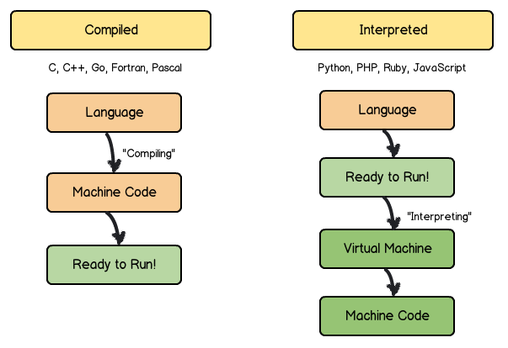
Compiled vs. Interpreted
Compilers make code for a machine.
Generally recompile for other use.
Need to compile, then run - can be big!
Interpreted code has intermediate “environment”
Code is portable – mac/pc/whatever.
It is slower.
Can make custom environments for each thing.
The envs on your computer can be different.
Software can ‘package’ its own env – autotests.
Run and rerun on the fly, no compiling.

Slide 10
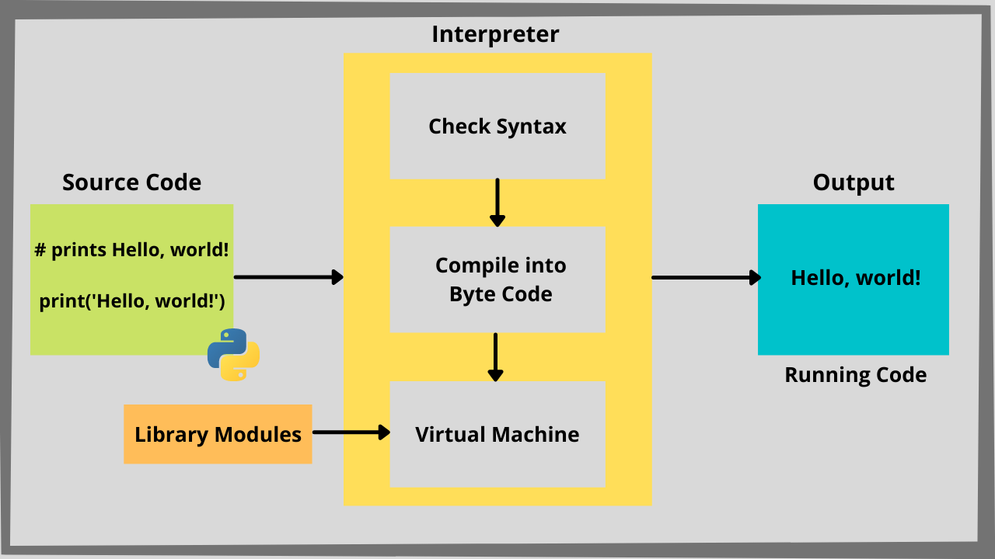
Python Execution
Python code executes by being combined with libraries into a virtual environment.
Byte code is the intermediate version of code that the interpreter generates.
Anything in the code or libraries “exists” in the world of the program.
A separate version/selection of libraries can be included in each code package.
This environment will be the same each time it is created, no matter the machine.
If we install python, any machine can “look the same” to code.

Slide 11
Tl;Dr
There are certain places where the physical limits of hardware matter.
When doing things like ML models, we want fast – arrays and code in C.
When doing things like exploring and building, we want easy – notebooks, interpreted code, portability.
In our ML work, python is easy for the up front work, and most of the processing is written in another language behind the scenes.
We can choose the most advantageous tool for the job:
C would be “easier”/faster to do ML in, since we don’t need to have different languages.
The work of the data scientist would be far slower and less productive.
We use what works best, and build bridges to allow them to connect to each other.

Slide 12
Building the Array
We can build the concept of the array up from this.
Start with several memory addresses with our data.
Add the ability to treat the data as one object, with indexing offsets. (an array)
Add the ability for the array to manage it’s own “innards” – memory, length, etc… (mem management)
Allowing it to be dynamic size and/or type (a list).
We add an additional layer of abstraction, or remove some detail we need to manage ourselves at each level, making it easier to use.
Easier is better in most cases. Making code readable and fixable is more important than fast.
For places we need speed, we can sub in something more simple, like an array.

Slide 13
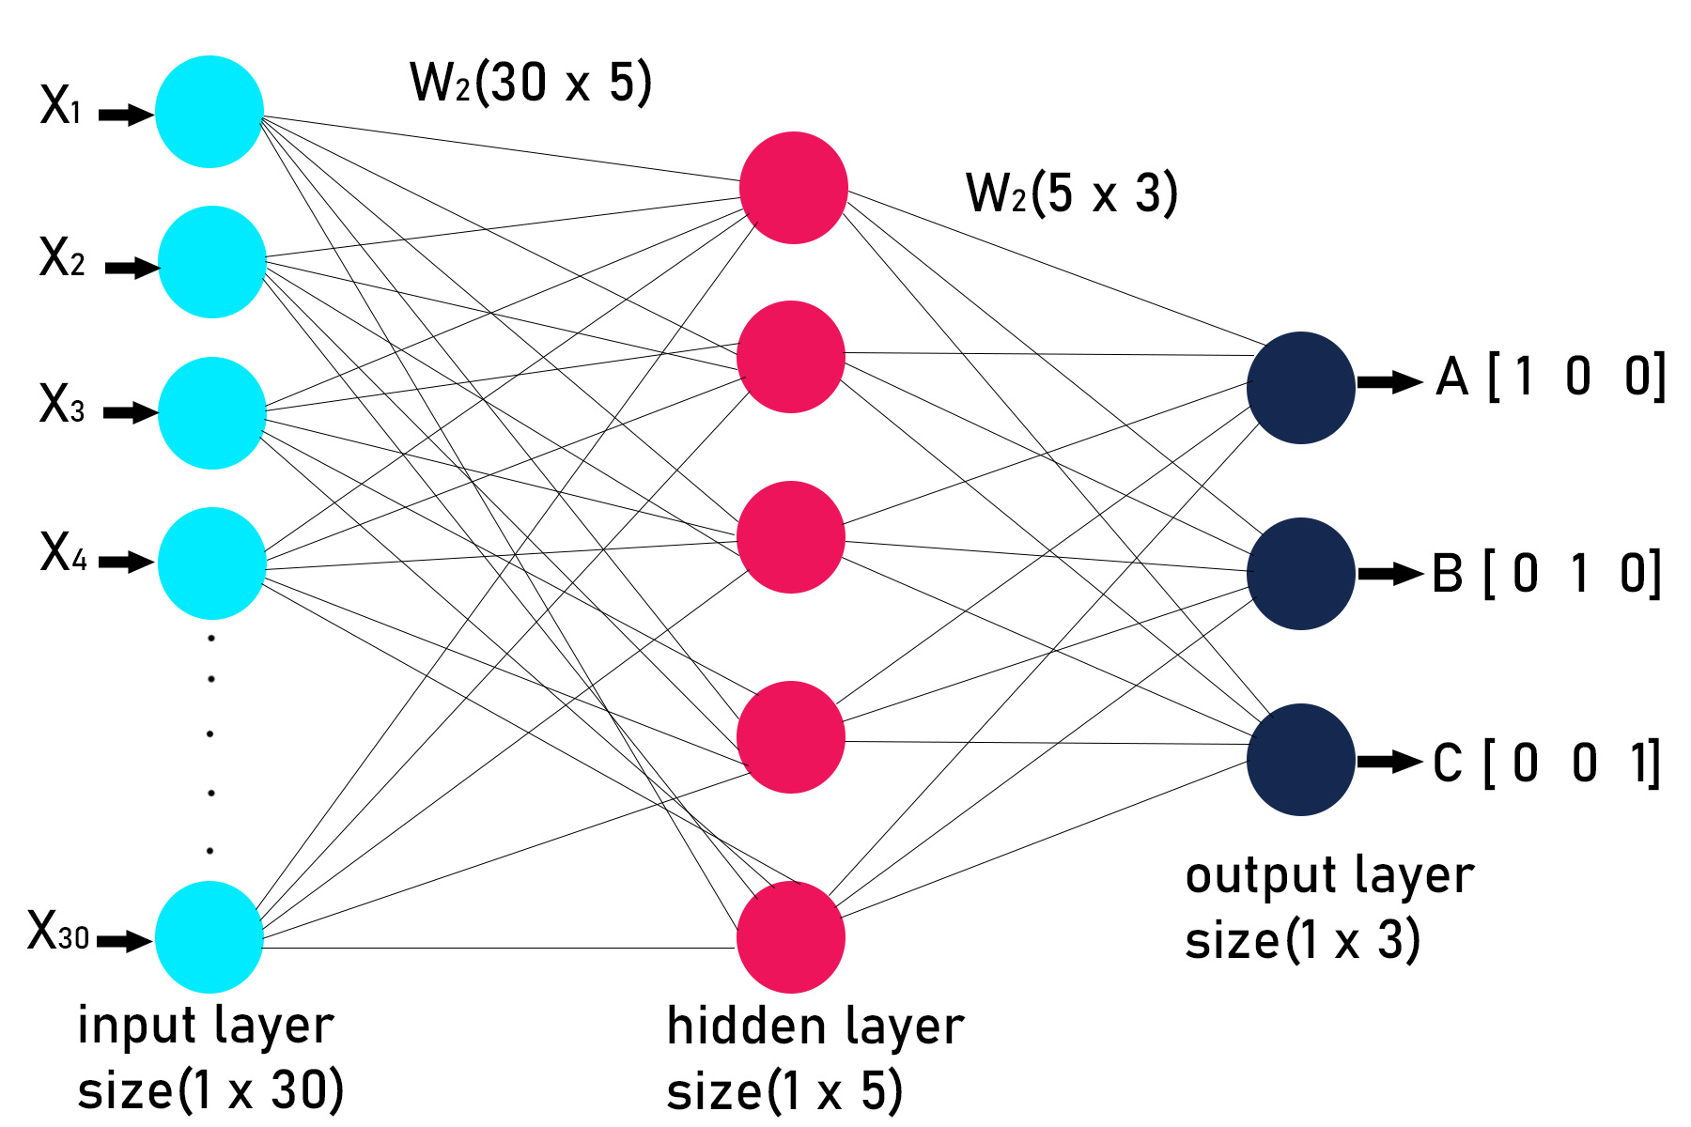
Python Arrays
The arrays that we use are provided by a package called numpy.
Commonly imported with a “np” alias.
Numpy is a scientific computing package.
Commonly used and often required for machine learning work.
Data fed into a model is often an array, even if we prepare it before making it an array.
When doing lots of calculations inside a model, the speed matters.
We want to get the benefits of the array (speed).
The limitations of an array are between positive and neutral – fixed type and length.
Arrays are normally created from other data (for us at least), or empty/default in the size of some other dataset (e.g. neural networks).

Slide 15
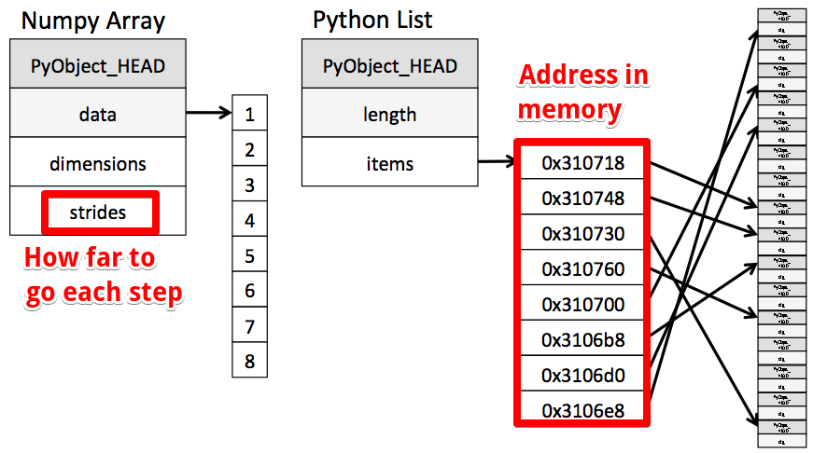

Slide 16
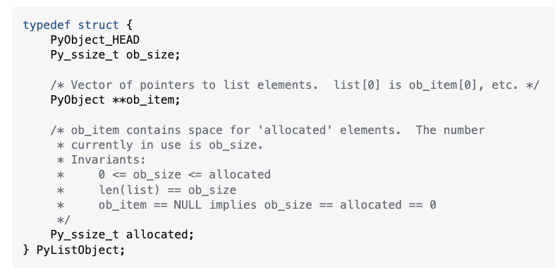
Context - List Implementation
This is the main part of lists class in python, though written in C.
Stuff is implemented in C because it is fast.
Built-in python stuff is usually faster because of this.
There is an API provided, that we call.
The list is just a bunch of locations in memory.
The location can be anywhere, hence expansion.
E.g. a list of this class would be a list of your street addresses, so we could go grab you on demand.
This is slower than an array, it is more work to access.

Slide 17
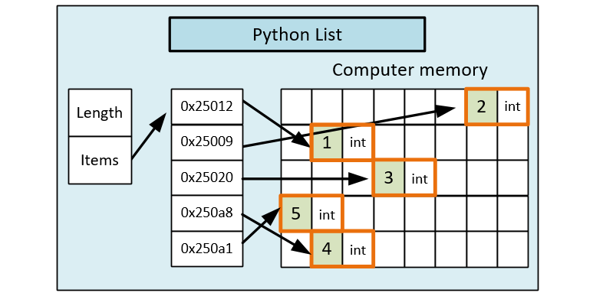

Slide 18
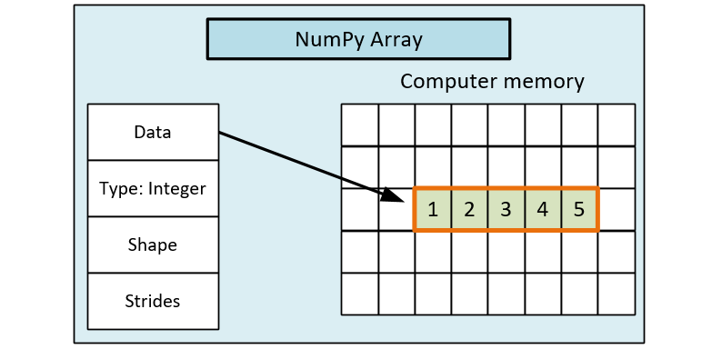

Slide 19
Multi-Dimensional Arrays
Arrays can also exist in 2+ dimensions.
Each dimension adds an additional “[ ]” or “,” for that dimension’s index.
array2D[0][0] or array2D[0,0] both get the first element.
Commonly seen with images – a normal image is X * Y * 3 (RGB color depth).
Similar to a list of list, but all dimensions are “full” – no different length rows.
Can get annoying to manipulate manually.
Operations and logic is still the same.
It becomes hard to impossible to visualize the data as we manipulate it.
In practice, we usually rely on set operations – flatten and then reverse that flatten.
We can slice and dice an array to get a part of it…

Slide 20
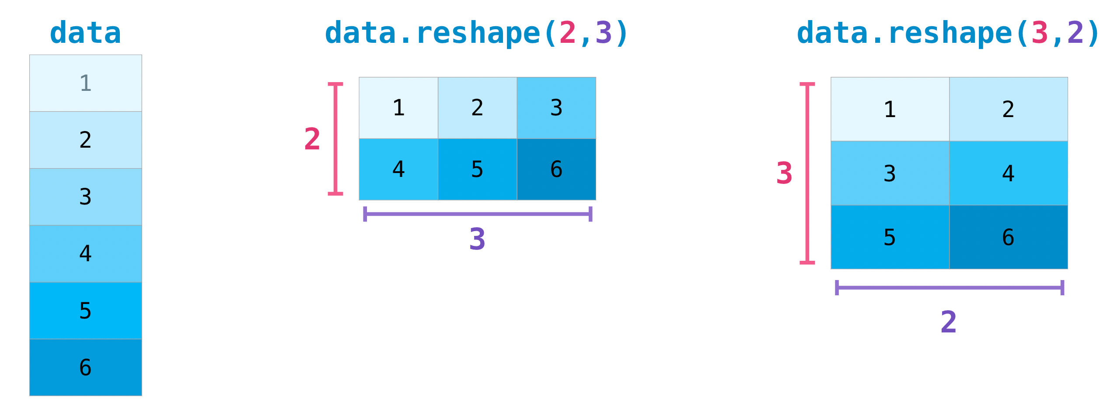
Reshaping
We can reshape arrays when needed, such as flattening an array for a ML model.
The reshaping always counts left to right, then down.
Reshaping is determinative, so as long as we do it right, things maintain order.

Slide 21
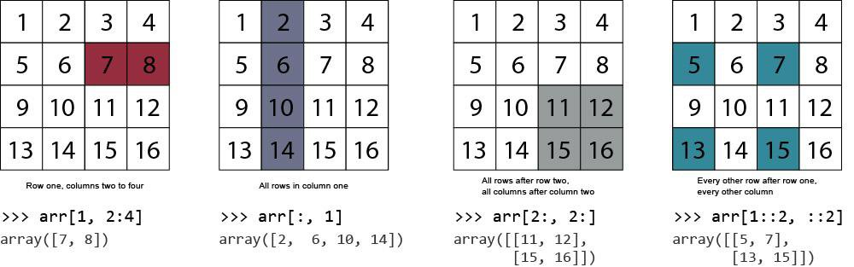
Slice and Dice
We can slice using the “:” to span range for each dimension.
The “::2” changes the stride, or gets every “X” item.
This can be pretty annoying and error prone, so if needed, we need to test well.
This isn’t something that we need to do extensively, but it does come up.

Slide 22
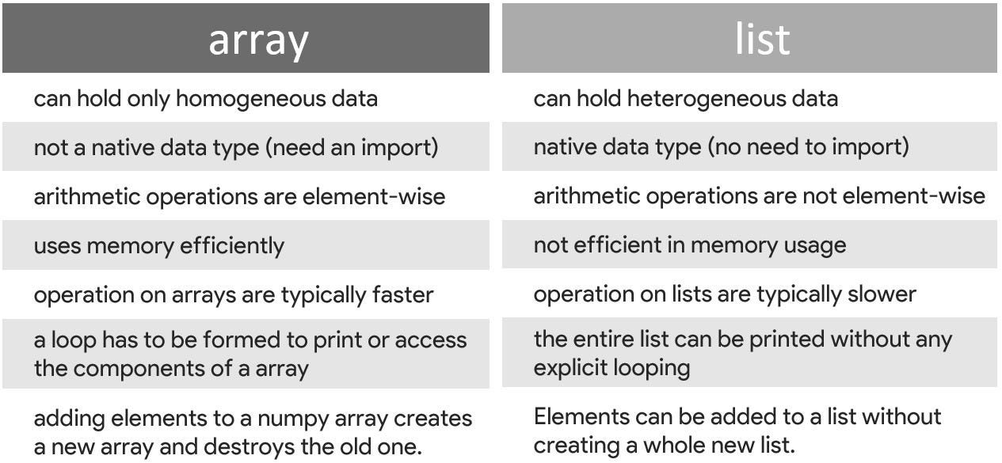

Slide 23
Array Conclusions
Arrays are something that are a core concept of computing in general.
With high-level languages, we can usually side-step the restrictions of arrays.
Inability to grow, inflexibility in what it can hold.
Lists, vectors, etc… are all easier to use as they handle some details for us.
In data science, we generally interact with arrays when feeding data to a model.
The ML algorithms “want” an array of the data.
The set data types are not an issue, nor is the inability to grow.
The speed and direct math operations are very useful for mass calculations.
Arrays are mostly interoperable with our other data structures.

