Slide 1
Classes and Objects

Slide 2
Objects and Variables
We started with a look at variables – the things we create in programs that hold all our useful data.
Each variable had two parts:
Variable name – how we refer to it in code.
Object – each variable “points” to some object that exist in the memory of our program.
These objects have been numbers, strings, lists, etc…
Each object has “stuff” inside of it – attributes and methods (functions).
We can use the variables window in VS Code to see all the variables in our program, and the objects they point to.

Slide 3
Objects
In Python, pretty much everything is an object.
Objects have attributes, or variables that hold their info.
E.g. a ”book” object on Amazon’s site has a title, author, etc…
Objects also have methods, or functions that they can execute.
E.g. a dataframe has a “head()” function that returns the top X rows of data.
Recall – each object is an instance, or one specific example, of some “class”.
E.g. There is a generic class of dataframe that defines it and each one we make is a new creation of that “model” of object.
E.g. A “Ford F-150” is a class. It has attributes* (engine, paint color) and methods (start the car, turn). If you buy one, yours is one instance, or example of an F-150. Yours has its own values.

Slide 4
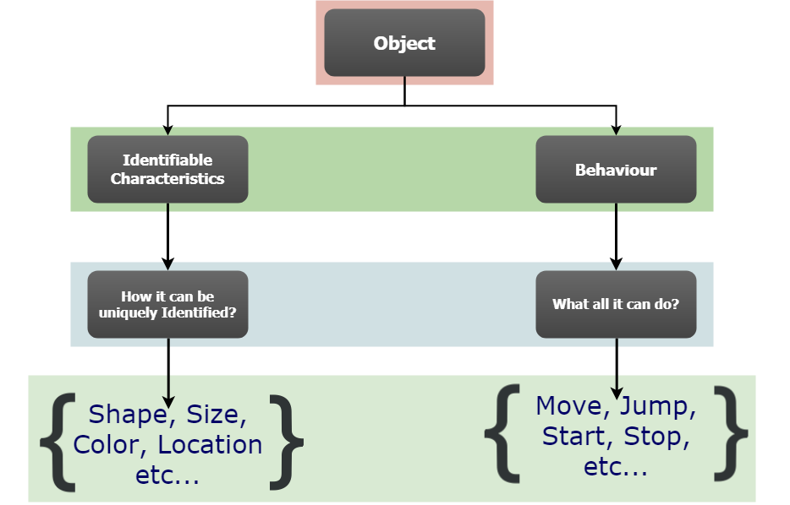

Slide 5
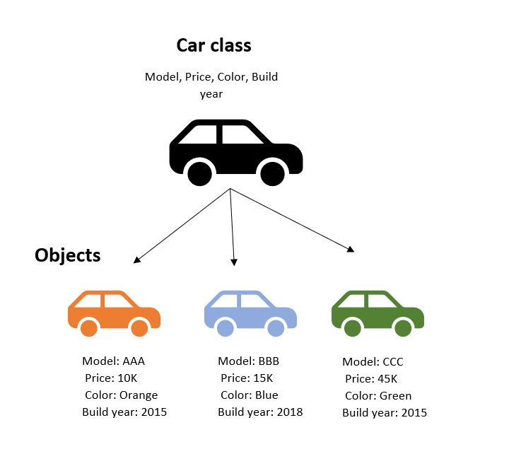
Classes and Objects
Classes define what an object is.
E.g. We can create a class of “car”, then declare many variables that point to instances of cars.
Each instance of a class has its own attributes.
We write the class when we define what an object is. We create instances when we use it.
The class is effectively a template for that type of object.

Slide 6
Using and Making Objects
We generally make objects to mirror the real things we are modelling in code.
E.g. a store has ‘product’ objects, a school has ‘students’ and ‘courses’.
Generally a customizing of existing objects to match what we care about.
Objects have attributes – normal strings, numbers, etc…
We can group all of those attributes ‘into’ the object.
Objects can usually do things (or have them done to it), we can put those things into methods – functions inside the object.
E.g. a string can upper(), a dataframe can agg(), a student can graduate(), a product can disc().
The methods are the functions that are var_name.FUNCTION()
Can make one any time it makes sense to treat something as a ‘thing’.

Slide 7
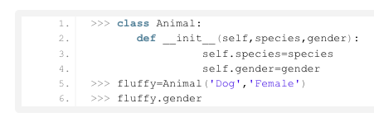
Constructor
Classes are created using the class keyword.
The syntax structure is mostly like a function.
Classes start with a constructor – a special “magic” method that serves to create each new instance of a class.
Constructors are named “___init___()”
The constructor does the initialization or setup for the new object to exist.
This usually consists of setting the attributes for that instance.

Slide 8
Check yo’ Self
When creating classes we often have the keyword “self”.
Self refers to the object that is created itself.
In the constructor, the self.ATTRIBUTE lines are declaring the instance variables.
These instance variables are the attributes that are specific to that instance.
E.g. Color, make, price, etc… can all be different for each individual car.
The self says “get this from myself” for a value.

Slide 9
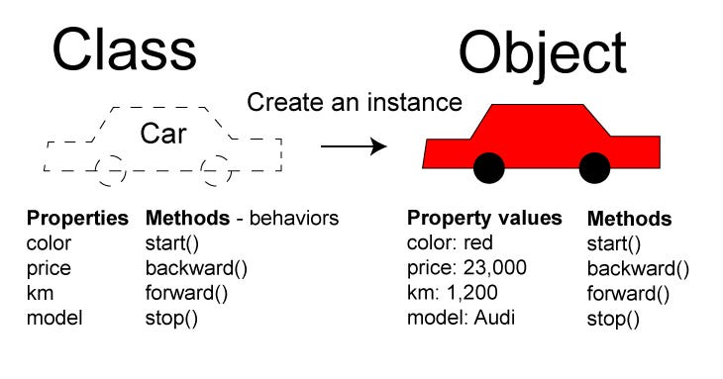

Slide 10
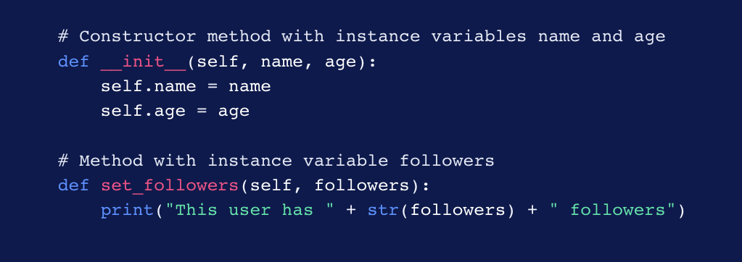
Self
The self keyword is used for all the instance variables in a class.
Self is also the first parameter for (most of) the methods in a class.
This parameter directs those functions to act on the object that they are a part of.

Slide 11
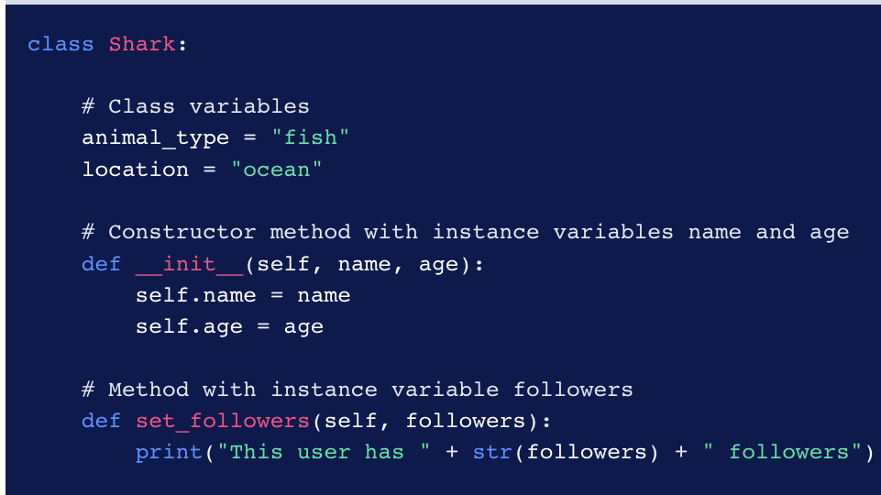
Class/Static Variables
Every instance variable is unique to each instance.
Class (static) variables are variables that are universal for a class.
Commonly used for constants that apply everywhere and rarely change.
E.g. a school registration system could have a class size limit in the “class_offering” class.
Declared inside a class, but outside of any function.
Referred to by CLASS_NAME.VARIABLE_NAME
Class – all sharks are this, instance – this shark is this.

Slide 12
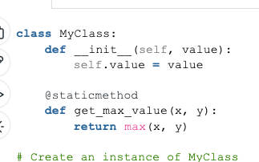
Static Methods
As with variables, we can also create static methods.
Static methods are not tied to an instance, they are generic functions that live inside a class.
Can’t refer to any instance variables, as they are not in an instance.
Do not have the self reference in their arguments.
Often used for utility functions:
“read_csv” in Pandas, sqrt in Math.
Referred to by CLASS_NAME.METHOD_NAME
E.g. pd.read_csv(), np.MATH_THING(), etc…
Declared with a decorator…
@staticmethod

Slide 13
Decorators
A decorator is something that wraps a function in another function.
Allows for some additional functionality.
Makes even more abstraction possible.
We’ll worry about the details more in the future.
For now, it just makes a function static.
These can make things fairly confusing to read.

Slide 14
Inheritance and Class Hierarchy
One thing we’ll set aside for later is the idea of inheritance.
Classes can exist in a hierarchy – e.g. a dog and a cat are both animals.
This allows us to more easily model the world, makes maintenance easier, and allows for more modular code. E.g.:
In a college, we may have an “employee” class with attributes name, wage, phone, etc…
We can create “instructor” and “admin” classes which are employees and inherit all of the attributes and methods of an employee. I.e. each instructor is a sub-class of employee.
The sub-classes add only the specific bits – i.e. instructor schedule, vacation processing…
This makes it easy to ”extend” things, we inherit and add the custom bits.
No need to rewrite a “change address” function for instructors, the employee one applies.

Slide 15
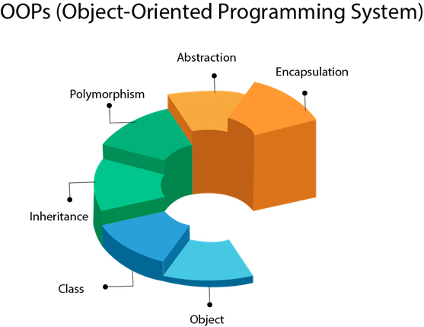
Object Oriented Programming
This is part of OOP.
Roughly:
We create objects mirroring reality.
We manipulate them in code.
Most general-purpose code is written this way.
Maps closer to how we think of real scenarios.
Allows for relatively easy modification and testing.
Allows for things like swapping out data structures in loops seamlessly…

Slide 16
Basic Classes and Objects
Creating classes allows us to make code that is easier to use.
If we have anything that has 2 or more attributes or can “do something”, it may be better as a class:
E.g. Suppose we are keeping track of loan balances for customers at our loan shark business
We could keep a list of (name, amount, kneecaps remaining) tuples, and write code to update this.
E.g. grab the correct person, get the balance, lower it with a payment.
Or we could write a “deadbeat” class that has attributes for the info, and methods to “add_payment()”.
More abstraction = easier to build complex things.
As with functions, we can create something once, test it, then reuse it as needed.
We don’t need to think of the details of how each thing works, letting us focus on more important things.
Python is called a high-level language – many of the gory details are invisible to us. It’s easier to do complex things.

