Slide 1
Housekeeping
Today:
File access and dataframes.
Objects and classes, part 1.
Work/question time (lab 1).
Notes:
There’s a few quizzes on Moodle, those are formative, or practice.

Slide 2
Progress:
Overall, we’ve covered most of the foundational concepts we need.
Notebook interface, functions, variables, basic types, flow control, objects.
We’ve looked at and used things at a basic level, not in depth yet.
We can hopefully start working towards higher level challenges.
Goals defined broadly, where we have to figure out our own solution leveraging the basics.
Think, pseudocode, research, code, test, debug, repeat.
We’re going reasonably fast, and leaving some details, on purpose.
I think it is a lot easier to build basic skills and comfort, which is where we are hopefully close to now, then expand that and dig deeper in the context of larger problems.
We’ll loop back on some other stuff and explore in more detail, in the context of classes.

Slide 3
Files and Dataframes

Slide 4
Interacting with Local Data
Our Python programs normally run within their environment.
We can “reach out” to interact with the underlying computer.
Each operating system provides some API (application programming interface) that offers a way for a “normal” program to interact with an underlying system.
For programs the load/save stuff, they connect to the API for file access.
For programs that have a GUI, they connect to the API for keyboard/mouse inputs.
For programs that use networks, they connect to the API for network access.
Each OS provides the implementation, so the details are abstracted away.
Note: Python is a very “high-level” language, meaning it is detached from the actions a computer actually takes. This allows for it to be more human friendly.
Other languages (like C) force you to do more work on the details – like manually managing RAM

Slide 5
User Input
When running code on a command line, we can get user input directly.
When using notebooks we don’t have the direct access to user input.
We can use the input() function to request user input.
In VS Code, the text box at the top will open for input.
After hitting enter, that value will be captured, likely into a variable.

Slide 6
File Access
We can also use a library to access files from the hard drive.
Many libraries can do this.
The “base” library is “os” which provides a bunch of computer-related functions.
We often use Pandas for smaller datasets in data science.
Pandas is a library that mainly provides the data access/management for data science work.
We can’t really access a file directly.
The library we use to do the file access will call on a function provided by the OS itself, and request that the OS do something, like provide a file.
Allows us to not care about the mechanics of loading a file.

Slide 7

Pandas
Pandas is one of the most common DS libraries.
Pandas provides us with a convenient data structure for tabular data – the dataframe.
A dataframe is formatted just like a spreadsheet.
Pandas also provides functions that will load data from a file into a dataframe.
We will use pandas throughout machine learning, unless the data we are using is large.

Slide 8
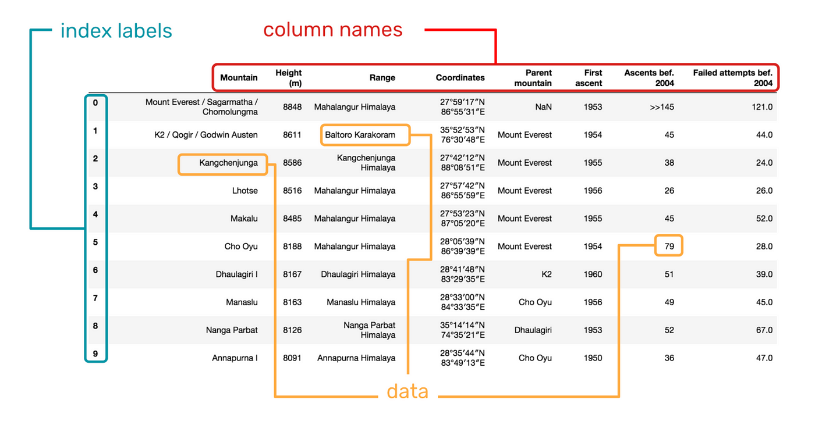
Using Dataframes
Dataframes are more flexible than the data structures we’ve looked at.
In addition to holding data in a 2 dimensional structure, dataframes can “do stuff”.
Dataframes have a multitude of methods that will do lots of work for us:
Describe() – gives a statistical breakdown of the data in a dataframe.

Slide 9
Manipulating Dataframes
We often spend much of our time manipulating dataframes to prepare our data.
Some major things we can do to get started are:
Select rows.
Select columns.
Get information about the dataframe.
Group and aggregate the data.

Slide 10
Manipulating Dataframes
We’ll look at this in code, it is much easier.
We can select which columns or rows we want by specifying some selection criteria.
We can get some information about the dataframe using its methods – describe, info, shape.
We can do calculations (grouping and aggregation) using functions to group the data and calculate results, like a nerdier Excel filter.

