Slide 1
Housekeeping
PLEASE DO THIS FIRST - We’ll start at 12:10
For assignment 2 – survey on what is easy/hard thus far.
Please be honest, it won’t make grading or difficultly all that different.
https://app.sli.do/event/7Eg2R9QEkgJZ3BwAcaX3eQ (#3143798, pw: emy5gn)
Also a link under the Class Meeting thing on moodle.
Lab 4:
We’ll go over the details quickly, ask about anything that’s weird.
Today (easy and simple! Kind of):
Regular expressions – processing text by pattern.
Review and callbacks – if anything recent doesn’t make sense, please ask.
Particularly with the poker example, with is open ended and likely more confusing.
We’ll do more poker stuff

Slide 2
Regular Expressions

Slide 3
Strings
We’ve dealt with strings in several different ways.
We can process strings with lots of tools and functions:
Use idiocies to slice by position.
Methods like strip(), isalpha(), or left().
Comparisons.
All of these things deal with the actual value that we have in a string.
What if we want to look at the format or structure of some text instead?
Does text fit some pattern like a postal code or phone number?

Slide 4
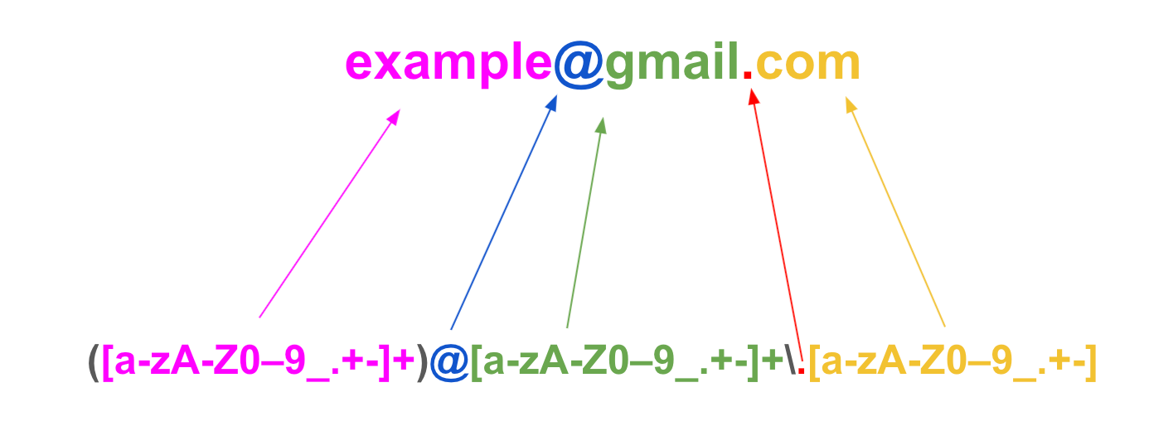
Regex – Text by Pattern

Slide 5
Regular Expressions (RegEx)
Regular expressions are a set of tools that allows us to match text by pattern.
Define the structure of what we want to match, and the regex will check for matches.
In addition to defining specific characters/words that need to match, we can set criteria:
Any letter or number.
A piece of punctuation.
Any letter except a certain set.
A set number or order of characters or words.
A specific character, flanked by text in a specific way (e.g. phone number).
Regex is similar to SQL – define criteria, get results.

Slide 6
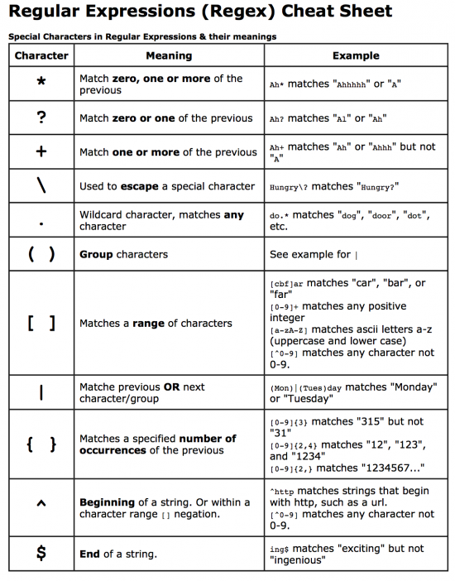
Common Regex Patterns
Regular expressions are made up of “patterns”
Literal matches
Character classes (e.g., [0-9], \d, \w)
Quantifiers (e.g., *, +, ?)
Anchors (e.g., ^, $)

Slide 7
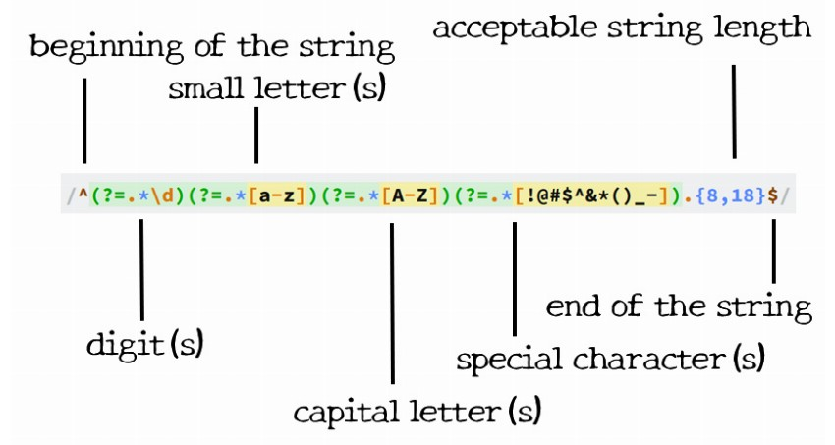
Advanced Regex Techniques
Regex can be made to capture almost any pattern in text that we can define by rule.
The difficulty of making some of the complex ones might be high.
They can get really hard to debug, or even read, when very complex.
Logic with ”or” statements and flexible patterns can yield advanced and cryptic patterns.
We don’t care much about elaborate regex expressions, we can focus on simpler ones.
We can collapse very complex things down to multiple expressions, or supplement with non-regex logic.
Complex password pattern

Slide 8
Benefits of Regular Expressions
Regex functions tend to be well optimized in languages.
Often written in a language like C for speed.
Speed isn’t the primary reason to use regex, but it is likely faster than a loop.
Regex is universal.
We can copy/paste regex to any other application.
Regex is concise.
Advanced text filtering can be done in one line of code.
Regex is provable.
The regex logic is a mathematical language – we can prove the results.

Slide 9
Drawbacks of Regular Expressions
Regular expressions can become hard to debug or read when complex.
Very large patterns can become problematic (though this is probably not an issue for us.)
Small errors in regex logic can lead to hard to find issues.
Learning curve to start using regex expressions, or expression that are more complex than the most basic ones.

Slide 10
Real Applications and Use
Regex is commonly used when processing text.
Most useful finding strings that meet a specific pattern, but with variable details.
Form entry – address, postal code, phone number, etc…
“Smart” text extraction – e.g. pulling values out of free text.
Regular expressions are universal across languages.
We can define a regular expression in Python code, and it is the same everywhere.
Regular expressions can be proven:
I.e. a mathematical proof can be made that a regex returns the correct results every time.
Since regex is a strictly defined language, we can verify correctness of code.
This can be important in mission-critical scenarios – e.g. code that runs a nuclear plant.

Slide 11
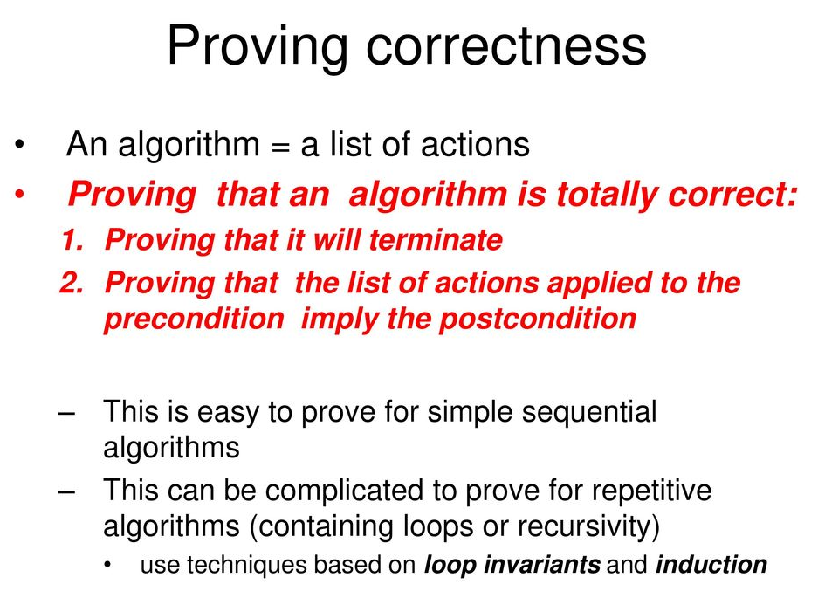
Side Note - Proofs
In computer science theory work, and in scenarios where code really can’t “be wrong” we may prove an algorithm works.
A proof is a mathematical demonstration that the outcome of code will be what is expected.
Several techniques.
Idea is similar to thinking about recursion – what are the possible cases, when do they occur, and can I check that the correct one happens.

Slide 12
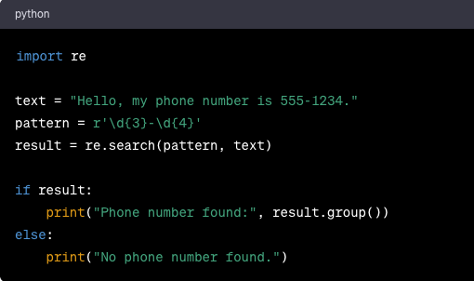
Examples – Phone Number Pattern
This regex pattern identifies if something is in phone number format.
3 numbers
A dash
4 more numbers

Slide 13
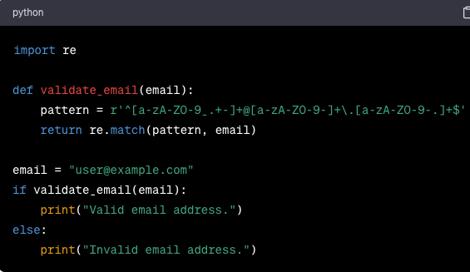
Example – Email Addresses
This pattern looks for email addresses.
Some letters or numbers at the start.
An @ sign.
Some more letters or numbers.
A dot.
Some more letters of numbers.
The end.

Slide 14
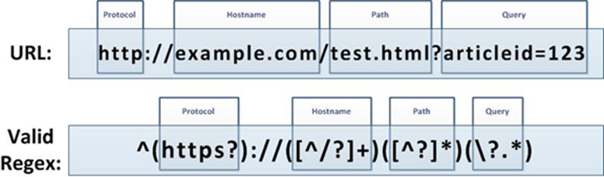
Example – URL Pattern
This pattern matches a specific format for a URL.
Useful for things like web scraping – finding certain types of links, like images.

Slide 15
Conclusion
Regular expressions are a shortcut to some string processing we’re used to.
Can wrap up more complex loop/if logic into simple concise statements.
Regex is a standardized language for processing text that is the same everywhere.
We don’t really need to use regular expressions, but they might help.
We can create a loop/if based logic that can do whatever a regular expression does.

