Slide 1
Housekeeping
First:
Please ask if you’re doing assignment stuff and have hit issues.
This is the last concept – we’ll do a little more card stuff next time w/ UI, but nothing new.
Today:
Searching and sorting.
Generally, pretty simple, little code for you, several examples.
Passing functions in functional coding, more big O, size/speed/cost thoughts. (ch13)

Slide 2
Searching, Sorting, and Stuff

Slide 3
Sorting
11 | 9 | 17 | 5 | 12
Suppose we have some numbers that we want to sort into ascending order.
What do we do?
We can likely intuit some reasonable answer, likely something like:
Compare the first value to others.
Place it in its spot.
Or some variant due to ordering…
Whatever you thought of is a sorting algorithm.

Slide 4
Selection Sort
One very simple algorithm is the Selection Sort algorithm.
Find the smallest element in the data.
Swap it with the first element.
Increment the starting point by one, repeat.

Slide 5
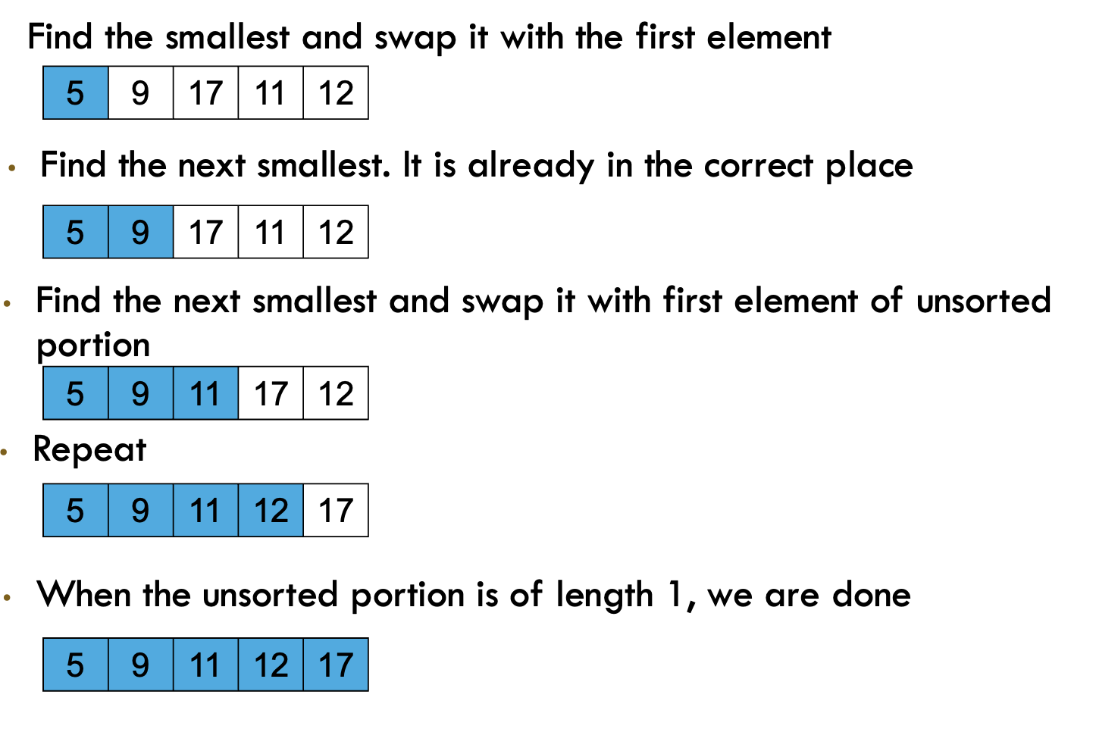

Slide 6
Selection Sort Performance
We can think of the time that it takes to do this in terms of caparisons performed in the sorting process.
Selection sort steps:
Finding the smallest element requires N-1 comparisons (each element against each other).
Finding the next smallest requires N-2 (each against each item remaining).
Next requires N-3….
As N grows we need to do ~N comparisons per item times ~N items.
The performance is N^2 or O(n2).
This is an approximation, we ignore the details and focus on order of magnitude.
This is probably pretty slow for large datasets…

Slide 7
Merge sort
Mergesort works by splitting the data in two, then recombining the results.
This should trigger fond memories of… recursion!!!
Base – one item, return it.
Recursive – return the result of the two halves, in order.

Slide 8
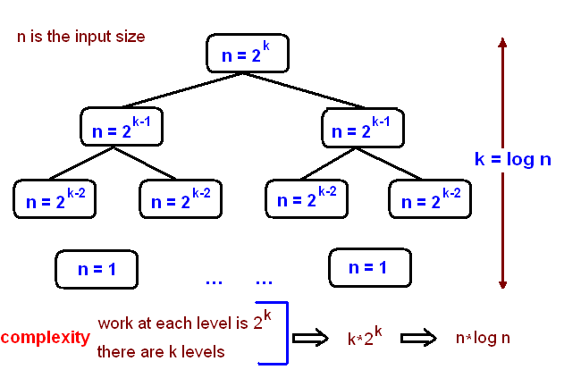
Merge sort Big o
Merge sort performance tends better as data grows.
The splitting of data in two is a good indication that the performance may be logarithmic in some way.

Slide 9
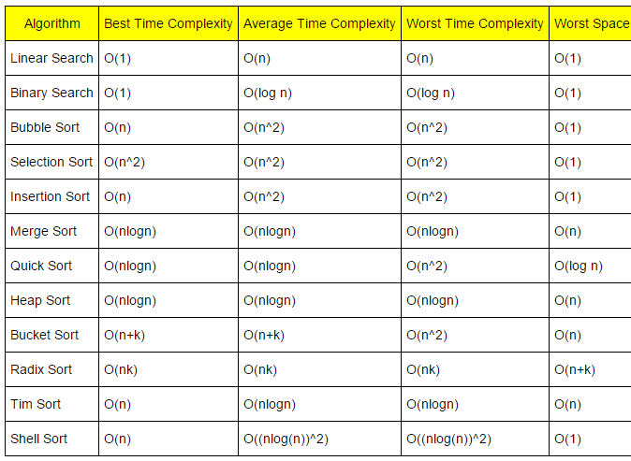
Big O Approximations
The Big O notation is meant to capture a rough estimate of time.
The exact details are ignored as they don’t matter much when things grow.
Nested looping is the one thing to really try to avoid.
For sorting we can think of the number of comparisons as the driver of speed.
Other algorithms are similar – accessing data is an “action”.

Slide 10
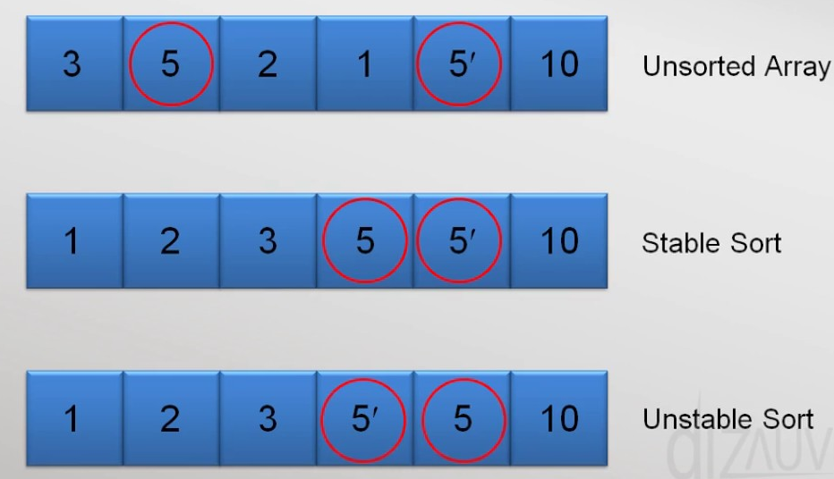
Other considerations
Memory is another consideration when sorting.
Some algorithms sort in-place, or they don’t need to store more data in memory.
Others increase memory usage.
If using very large data, this can be a consideration that matters.
Stability
If we have ties, the order of the ties may be kept (stable) or ignored (unstable).
This may matter, in some cases. In DS we often split/combine large datasets.
Stable sorts maintain order when there are ties.

Slide 11
Other Sorting Algorithms
There are lots of sorting algorithms out there.
If you’re ever “lucky” enough to take math-computer science, nerds love ‘em.
The Wikipedia page for Sorting Algorithms has a solid list.
This used to matter more as resources were precious.
Sorting is generally a solved problem for most cases we may encounter.
The default sorts are fine for all by a few edge cases.
We don’t sort all the time in data science work.
If we are able to define lt and eq for our classes, we get the rest for free.
It is special cases – frequent sorts, large data, edge case distribution where we may care.

Slide 12
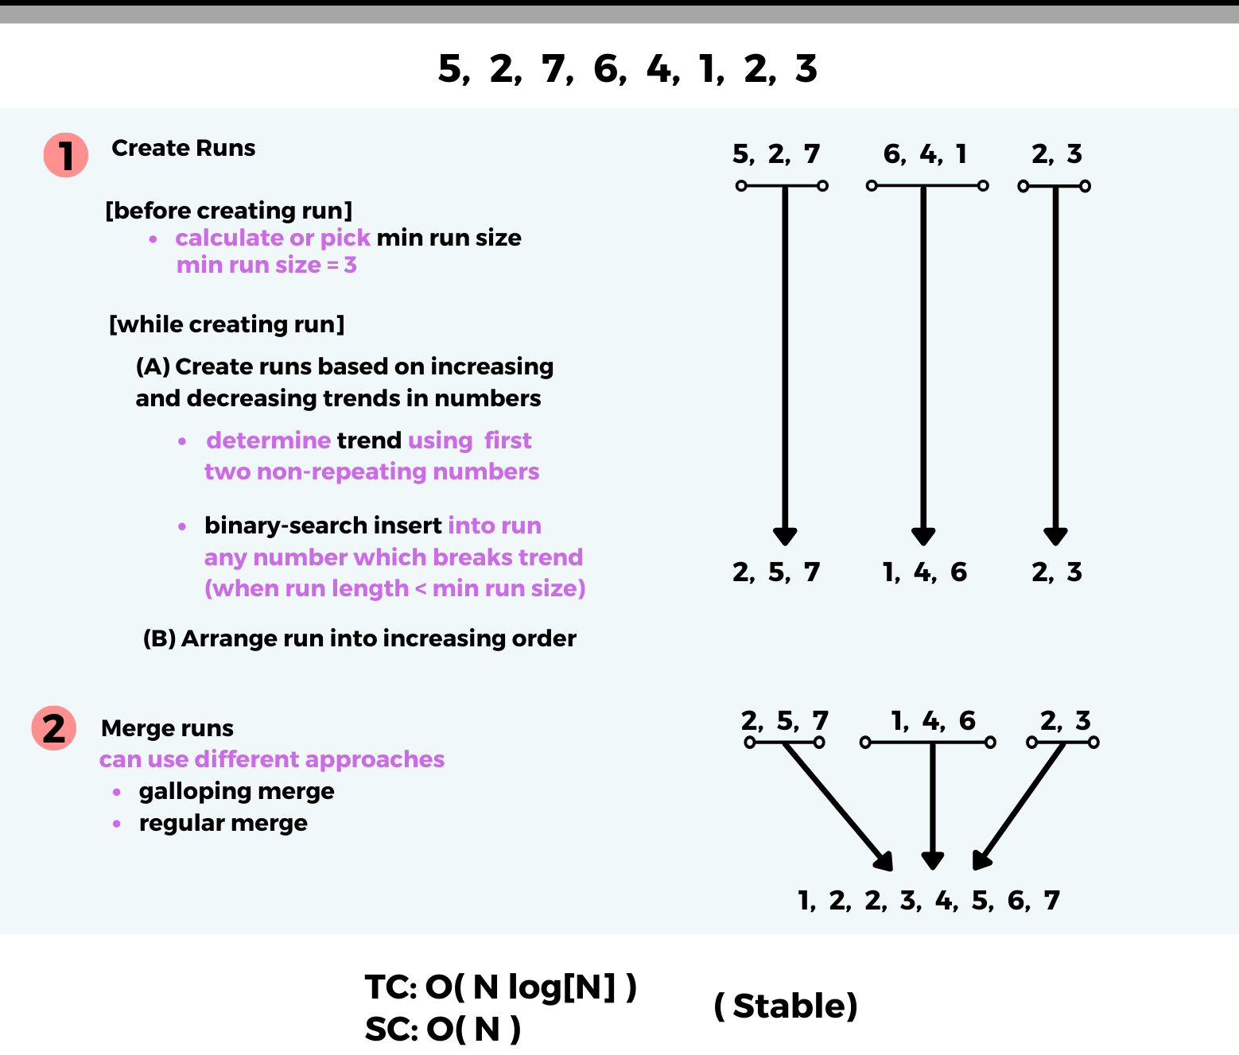
In Python?
Python's sorted method uses a hybrid sorting algorithm called Timsort.
It was made by Tim.
This generally performs well in most cases.
A hybrid of merge and insert.
Data often has sorted parts, this saves time on those parts.

Slide 13
So what do I use?
For the most part sorting is a solved problem, we can use the built-in tools.
There are specific edge conditions where algorithm matters:
“Natural” start of the data is worst case scenario for an algorithm (maximizes actions)
Specific resource constraints such as memory size.
In real scenarios, lots of large/expensive sorts are major decisions:
Likely solution will be specific to exact demands in that case.
Likely some combo of storing data in a db with an index, maintaining interim datasets (to batch resorts), and bulk operations to make changes.
E.g. LMS HR data – learners indexed by ID. Changes queued in custom ds, processed at night.

Slide 14
Searching
Closely related to sorting items is searching for them.
Just like sorting, performance can vary widely.
Suppose we have:
A data structure of numbers.
One value we want to find in that data structure.
What can we do?

Slide 15

Linear Search
Basic searching for an item is a Linear Search – we check every item to see if it is what we are looking for.
This is, obviously, O(n) – for each item we need to do a thing.
In small cases - no worries, mate! In very large datasets, crikey!

Slide 16
Binary Search
It is far quicker to search for something in a sorted list.
We can eliminate half of the possibilities after each check.
Binary searching tends towards O(log(n)).
Each comparison divides the amount of data to look at by ~2.
If we pay the cost of sorting a data structure, searching is fast.
That sort, or maintaining the order as items are inserted, has a cost.
Balance is determined by real world details.

Slide 18
Hash
Hashing is something we don’t need to focus on in massive detail.
Hashing is a mapping performed by a (hash) function.
An object goes into that function.
A value is returned that can be used “like” an index to specify location.
Each object gets a unique hash (there can be conflicts, that’s out of scope).
That hashing action always takes the same amount of time – O(1).
We can add, remove, or retrieve an item in O(1) time.
Requires objects be “hashable” – most items are, data structures may not be.
I.e. they can be put through the function and generate a value.
Hash based things are fast at items like lists are fast at indicies.

Slide 19
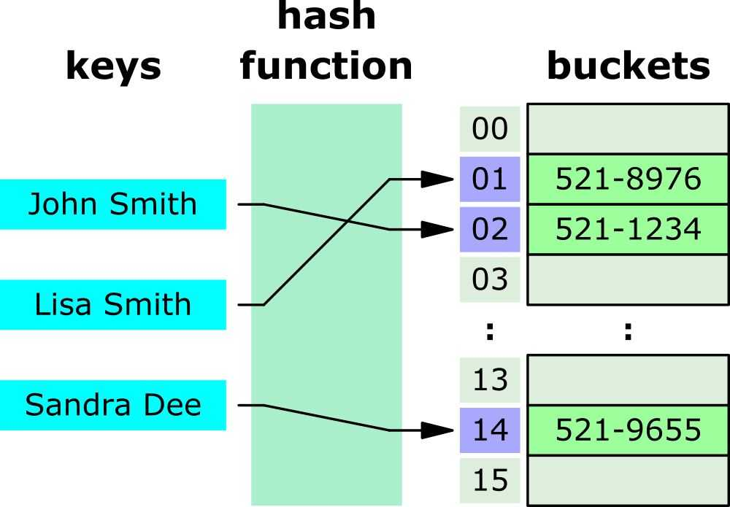

Slide 20
Data Structure Selection
What we need to do with data determines the correct choice of how to store it.
For us in DS, we use DF and arrays, moving to specialized things as data grows.
For other scenarios, other demands dictate what to use:
If things are constantly being added (people registering for a raffle) – a list is good.
If we need to see unique items – a set is good.
We need to do lots of math – an array is good.
Frequent retrieval of arbitrary values – a dictionary may be good.
These structures are generally interchangeable, but using their strengths helps us.
We can avoid writing code to simulate what other structures do naturally.

Slide 21
Conclusion
Sorting is something we do, know about, can think about, but is kind of minor for us.
Default to built-in and using method overriding.
O-notation is something we can consider as we look at it more:
If we have a lot of data (as we will), am I doing something risky?
Will this duplicate data, do I have nested loops, etc….
There are data prep scenarios in the machine learning part where we need to think of it.
We should think about the “number of actions” when doing heavy work.
In cases where we are doing something costly (e.g. n2+), consider alternatives.
Choice of other options should depend on what we want and what we have…

