Slide 1
Today
Assignment stuff:
Ask up front if you have anything quick.
If there’s something you want to dig into more, please ask at the end.
Today’s excitement!!!!
Ipwidgets for basic interactivity/GUI.
Callbacks, registration, listening functions. (This is important in the future).
The UI stuff is not something you’re evaluated on, its mainly an exercise in tackling new libraries and adapting our code to the library. That’s needed.
In future data exploration stuff, you could use some of this to make your lives easier/better as a UI might help. It might be useful on the first ML assignment, though it isn’t mandatory.

Slide 2
UI and Widgets

Slide 3
Interacting with Programs
Right now our programs have very little interactivity.
Mostly run from top to bottom.
We can add things like input() to get some data.
Most programs don’t work like this, they have an interface.
Text interfaces generally suck for most people.
We can (relatively) easily add some interactive bits to our ‘normal’ code.

Slide 4
Graphical User Interfaces (GUI)
A GUI is how we interact with most programs as a user.
I.e. we click buttons and type values in some type of window, not a command line.
To create a user interface we use some library that provides most of it.
The library has UI elements – buttons, text boxes, menus… that we can use and customize.
We don’t need to do the hard work, just connect the UI to our code.
There are lots of UI libraries.
We’ll use ipwidgets, which provides some webpage-like interactivity.
Other libraries like tkiner or pyqt provide a similar basis on which to build ‘real’ apps.
The code isn’t overly complex, but it does change somewhat…

Slide 5
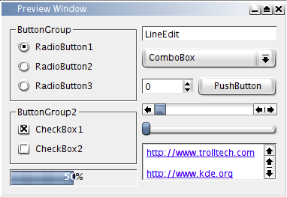
Actions
382 × 263
When using a GUI the execution of code tends to be based on user actions.
In “backend” code things just run.
We need to build things to respond to action, not run in sequence.
This is done through the idea of a callback.
Define an action that will happen in a function.
Attach that function to a UI element.
The library ties those two together, so the function is called.
Our code is built to respond to UI element changes.

Slide 6
UI Widgets
Each widget, or UI element, has properties and our code responds to them.
When a button is pushed, a value is changed, or a box is checked, we do something in response.
We normally just “sit” or endlessly loop waiting for something to happen.
Later, in the machine learning stuff, we’ll use this concept more:
We have long loops to train models.
We can register callbacks to do certain actions during that process, like write a log, save a copy, or stop if the results are good enough.
So a GUI based app is largely a big loop, with a function for each element.

Slide 7
Using Widgets
Our widget-based UI isn’t a full GUI, it is more like a webpage.
We can embed any of the widgets in our notebook’s display.
We can weave those widgets in with our needs, for example:
Exploring correlations – choose x and y for a scatter plot.
Checking distributions – swap between values for a histogram.
Looking at many features – use tabs to change what we see on the fly.
Performing multiple trials – use input widgets to get settings/config without changing code.
In our “backend” code – we may want to make a function per action, then deal with changes there.

Slide 8
GUI wrap
This stuff isn’t of critical importance to us, but it is of interest.
If we ever need to change a variable or configure something, simple widgets can help.
We commonly change and rerun stuff when exploring data.
If we need to present results, this is helpful.
Organize output, allow for customization, and incorporate parameters.
The callback concept is important.
This is good practice for translating from documentation without it being critical.

