Slide 1

Predictive Analytics Foundations
Lecture 2

Slide 2
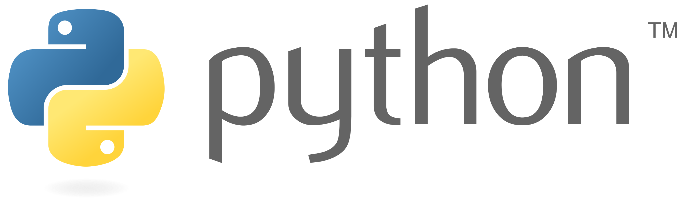
Lecture 2
History of Python
Installing & Running Python
IDE
Hands-on

Slide 3
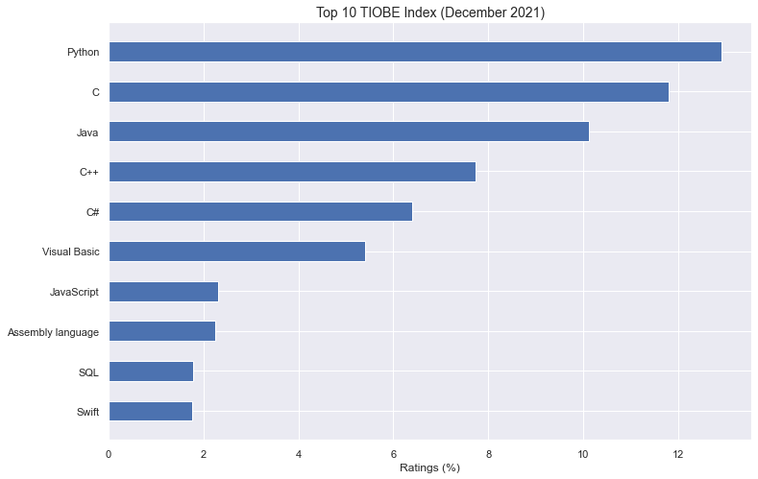
Data Science Programming
Notes:
https://www.datasciencecentral.com/best-languages-for-data-science-and-statistics-in-one-picture/
https://www.datacamp.com/blog/top-programming-languages-for-data-scientists-in-2022

Slide 4

Brief History of Python
Created in 1991 by Guido van Rossum (now at Google)
Named for Monty Python
Useful as a scripting language
script: A small program meant for one-time use
Targeted towards small to medium sized projects
Used by:
Google, Yahoo!, Youtube
Many Linux distributions
Games and apps (e.g. Eve Online)

Slide 5

Python’s Benevolent Dictator For Life

Slide 6
Lecture 2
History of Python
Installing & Running Python
IDE
Hands-on

Slide 7
Installing Python
Windows:
Download Python from http://www.python.org
Install Python.
Run Idle from the Start Menu.
Mac OS X:
Python is already installed.
Open a terminal and run python or run Idle from Finder.
Linux:
Chances are you already have Python installed. To check, run python from the terminal.
If not, install from your distribution's package system.

Slide 8

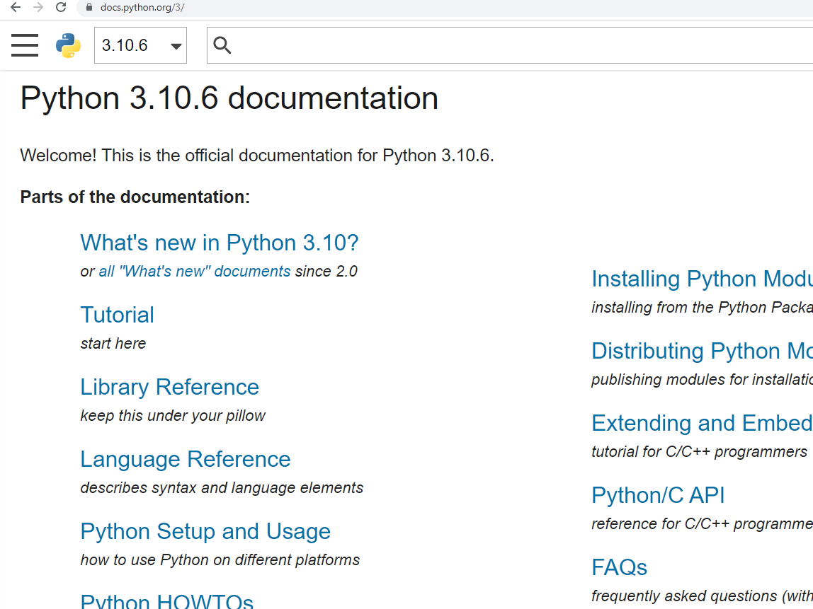


http://docs.python.org/

Slide 9




The Python tutorial is good!

Slide 10
Lecture 2
History of Python
Installing & Running Python
IDE
Hands-on

Slide 11
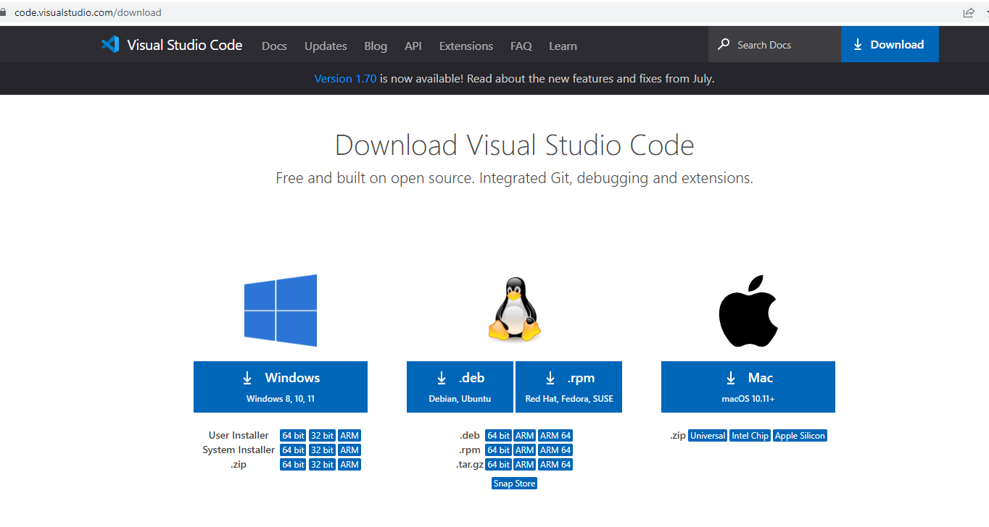
Installing VS Code

Slide 12

What about Jupyter?

Slide 13
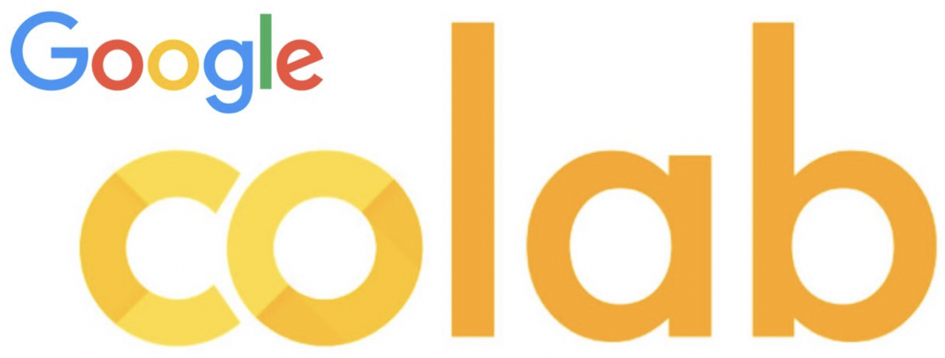
Google Colab

Slide 14
Lecture 2
History of Python
Installing & Running Python
IDE
Hands-on

Slide 15
Interpreted Languages
Interpreted
Not compiled like Java
Code is written and then directly executed by an interpreter
Type commands into interpreter and see immediate results
Java:
Code
Compiler
Runtime
Environment
Computer
Python:
Code
Interpreter
Computer

Slide 16
The Python Interpreter
Typical Python implementations offer both an interpreter and compiler
Interactive interface to Python with a read-eval-print loop
>>> map(square, [1, 2, 3, 4])
[1, 4, 9, 16]
>>>

Slide 17
Lecture 2
History of Python
Installing & Running Python
IDE
Hands-on

Slide 18
A Code Sample (in IDLE)
x = 34 - 23 # A comment.
y = “Hello” # Another one.
z = 3.45
if z == 3.45 or y == “Hello”:
x = x + 1
y = y + “ World” # String concat.
print(x)
print(y)

Slide 19
Enough to Understand the Code
Indentation matters to code meaning
Block structure indicated by indentation
First assignment to a variable creates it
Variable types don’t need to be declared.
Python figures out the variable types on its own.
Assignment is = and comparison is ==
For numbers + - * / % are as expected
Special use of + for string concatenation and % for string formatting (as in C’s printf)
Logical operators are words (and, or, not) not symbols
The basic printing command is print

Slide 20
Basic Data Types
Integers (default for numbers)
z = 5 / 2 # Answer 2, integer division
Floats
x = 3.456
Strings
Can use “” or ‘’ to specify with “abc” == ‘abc’
Unmatched can occur within the string: “matt’s”
Use triple double-quotes for multi-line strings or strings than contain both ‘ and “ inside of them: “““a‘b“c”””

Slide 21
White Space
Whitespace is meaningful in Python: especially indentation and placement of newlines
Use a newline to end a line of code
Use \ when must go to next line prematurely
No braces {} to mark blocks of code, use consistent indentation instead
First line with less indentation is outside of the block
First line with more indentation starts a nested block
Colons start of a new block in many constructs, e.g. function definitions, then clauses

Slide 22
Comments
Start comments with #, rest of line is ignored
Can include a “documentation string” as the first line of a new function or class you define
Development environments, debugger, and other tools use it: it’s good style to include one
def fact(n):
“““fact(n) assumes n is a positive integer and returns facorial of n.””” assert(n>0)
return 1 if n==1 else n*fact(n-1)

