Slide 1
Supervised Learning

Slide 2
Machine Learning Lingo
What? | Parameters | Structure | Hidden concepts
What from? | Supervised | Unsupervised | Reinforcement | Self-supervised
What for? | Prediction | Diagnosis | Compression | Discovery
How? | Passive | Active | Online | Offline
Output? | Classification | Regression | Clustering
Details?? | Generative | Discriminative | Smoothing

Slide 3
What is classification?
A machine learning task that deals with identifying the class to which an instance belongs
A classifier performs classification
Classifier
( Textual features : Ngrams )
( Age, Marital status,
Health status, Salary )
( Perceptive inputs )
Test instance
Attributes
(a1, a2,… an)
Discrete-valued
Class label
Category of document? {Politics, Movies, Biology}
Steer? { Left, Straight, Right }
Issue Loan? {Yes, No}

Slide 4
Classification learning
Training
phase
Testing
phase
Learning the classifier
from the available data
‘Training set’
(Labeled)
Testing how well the classifier
performs
‘Testing set’

Slide 5
An example application
An emergency room in a hospital measures 17 variables (e.g., blood pressure, age, etc) of newly admitted patients.
A decision is needed: whether to put a new patient in an intensive-care unit.
Due to the high cost of ICU, those patients who may survive less than a month are given higher priority.
Problem: to predict high-risk patients and discriminate them from low-risk patients.

Slide 6
Another application
A credit card company receives thousands of applications for new cards. Each application contains information about an applicant,
age
Marital status
annual salary
outstanding debts
credit rating
etc.
Problem: to decide whether an application should approved, or to classify applications into two categories, approved and not approved.

Slide 7
Machine learning and our focus
Like human learning from past experiences.
A computer does not have “experiences”.
A computer system learns from data, which represent some “past experiences” of an application domain.
Our focus: learn a target function that can be used to predict the values of a discrete class attribute, e.g., approve or not-approved, and high-risk or low risk.
The task is commonly called: Supervised learning, classification, or inductive learning.

Slide 8
The data and the goal
Data: A set of data records (also called examples, instances or cases) described by
k attributes: A₁, A₂, … A_{k}.
a class: Each example is labelled with a pre-defined class.
Goal: To learn a classification model from the data that can be used to predict the classes of new (future, or test) cases/instances.
Notes:
Induction is different from deduction and DBMS does not not support induction;
The result of induction is higher-level information or knowledge: general statements about data
There are many approaches. Refer to the lecture notes for CS3244 available at the Co-Op.
We focus on three approaches here, other examples:
Other approaches
Instance-based learning
other neural networks
Concept learning (Version space, Focus, Aq11, …)
Genetic algorithms
Reinforcement learning

Slide 9
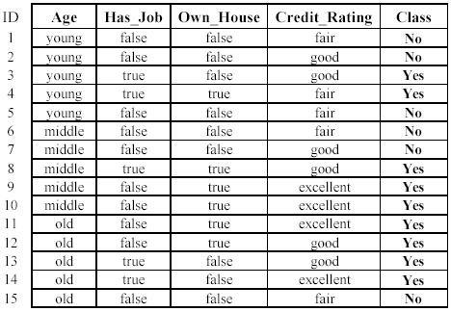
An example: data (loan application)
Approved or not

Slide 10
An example: the learning task
Learn a classification model from the data
Use the model to classify future loan applications into
Yes (approved) and
No (not approved)
What is the class for following case/instance?

Slide 11
Supervised vs. unsupervised Learning
Supervised learning: classification is seen as supervised learning from examples.
Supervision: The data (observations, measurements, etc.) are labeled with pre-defined classes. It is like that a “teacher” gives the classes (supervision).
Test data are classified into these classes too.
Unsupervised learning (clustering)
Class labels of the data are unknown
Given a set of data, the task is to establish the existence of classes or clusters in the data

Slide 12
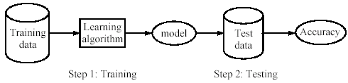
Supervised learning process: two steps
Learning (training): Learn a model using the training data
Testing: Test the model using unseen test data to assess the model accuracy

Slide 13
What do we mean by learning?
Given
a data set D,
a task T, and
a performance measure M,
a computer system is said to learn from D to perform the task T if after learning the system’s performance on T improves as measured by M.
In other words, the learned model helps the system to perform T better as compared to no learning.

Slide 14
An example
Data: Loan application data
Task: Predict whether a loan should be approved or not.
Performance measure: accuracy.
No learning: classify all future applications (test data) to the majority class (i.e., Yes):
Accuracy = 9/15 = 60%.
We can do better than 60% with learning.

Slide 15
Fundamental assumption of learning
Assumption: The distribution of training examples is identical to the distribution of test examples (including future unseen examples).
In practice, this assumption is often violated to certain degree.
Strong violations will clearly result in poor classification accuracy.
To achieve good accuracy on the test data, training examples must be sufficiently representative of the test data.

Slide 16
Generating datasets
Methods:
Holdout (2/3rd training, 1/3rd testing)
Cross validation (n – fold)
Divide into n parts
Train on (n-1), test on last
Repeat for different combinations
Bootstrapping
Select random samples to form the training set

Slide 17

Evaluating classification methods
Predictive accuracy
Efficiency
time to construct the model
time to use the model
Robustness: handling noise and missing values
Scalability: efficiency in disk-resident databases
Interpretability:
understandable and insight provided by the model
Compactness of the model: size of the tree, or the number of rules.

Slide 18
Evaluation methods
Holdout set: The available data set D is divided into two disjoint subsets,
the training set D_{train} (for learning a model)
the test set D_{test} (for testing the model)
Important: training set should not be used in testing and the test set should not be used in learning.
Unseen test set provides a unbiased estimate of accuracy.
The test set is also called the holdout set. (the examples in the original data set D are all labeled with classes.)
This method is mainly used when the data set D is large.

Slide 19
Evaluation methods (cont…)
n-fold cross-validation: The available data is partitioned into n equal-size disjoint subsets.
Use each subset as the test set and combine the rest n-1 subsets as the training set to learn a classifier.
The procedure is run n times, which give n accuracies.
The final estimated accuracy of learning is the average of the n accuracies.
10-fold and 5-fold cross-validations are commonly used.
This method is used when the available data is not large.

Slide 20
Evaluation methods (cont…)
Leave-one-out cross-validation: This method is used when the data set is very small.
It is a special case of cross-validation
Each fold of the cross validation has only a single test example and all the rest of the data is used in training.
If the original data has m examples, this is m-fold cross-validation

Slide 21
Evaluation methods (cont…)
Validation set: the available data is divided into three subsets,
a training set,
a validation set and
a test set.
A validation set is used frequently for estimating parameters in learning algorithms.
In such cases, the values that give the best accuracy on the validation set are used as the final parameter values.
Cross-validation can be used for parameter estimating as well.

Slide 22
Classification measures
Accuracy is only one measure (error = 1-accuracy).
Accuracy is not suitable in some applications.
In text mining, we may only be interested in the documents of a particular topic, which are only a small portion of a big document collection.
In classification involving skewed or highly imbalanced data, e.g., network intrusion and financial fraud detections, we are interested only in the minority class.
High accuracy does not mean any intrusion is detected.
E.g., 1% intrusion. Achieve 99% accuracy by doing nothing.
The class of interest is commonly called the positive class, and the rest negative classes.

Slide 23
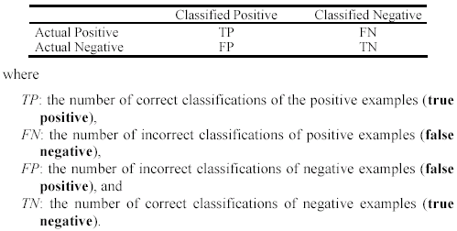
Precision and recall measures
Used in information retrieval and text classification.
We use a confusion matrix to introduce them.

Slide 24

Precision and recall measures (cont…)
Precision p is the number of correctly classified positive examples divided by the total number of examples that are classified as positive.
Recall r is the number of correctly classified positive examples divided by the total number of actual positive examples in the test set.

Slide 25

An example
This confusion matrix gives
precision p = 100% and
recall r = 1%
because we only classified one positive example correctly and no negative examples wrongly.
Note: precision and recall only measure classification on the positive class.

Slide 26
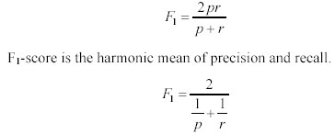
F₁-value (also called F₁-score)
It is hard to compare two classifiers using two measures. F₁ score combines precision and recall into one measure
The harmonic mean of two numbers tends to be closer to the smaller of the two.
For F₁-value to be large, both p and r much be large.

Slide 27


Receive operating characteristics curve
It is commonly called the ROC curve.
It is a plot of the true positive rate (TPR) against the false positive rate (FPR).
True positive rate:
False positive rate:

Slide 28


Sensitivity and Specificity
In statistics, there are two other evaluation measures:
Sensitivity: Same as TPR
Specificity: Also called True Negative Rate (TNR)
Then we have

Slide 29
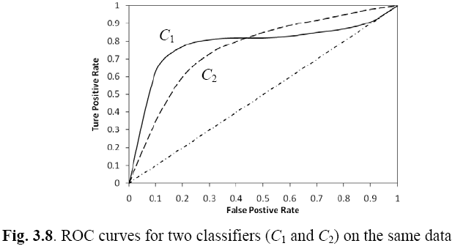
Example ROC curves

Slide 30
Area under the curve (AUC)
Which classifier is better, C₁ or C₂?
It depends on which region you talk about.
Can we have one measure?
Yes, we compute the area under the curve (AUC)
If AUC for C_{i} is greater than that of C_{j}, it is said that C_{i} is better than C_{j}.
If a classifier is perfect, its AUC value is 1
If a classifier makes all random guesses, its AUC value is 0.5.

Slide 31
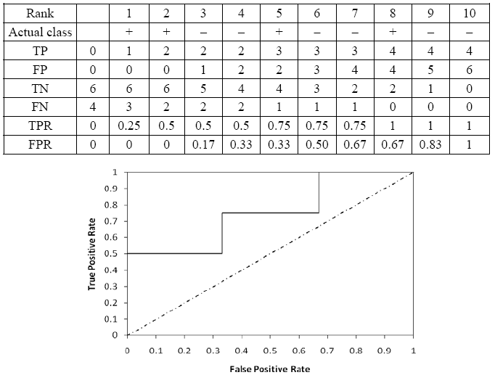
Drawing an ROC curve

Slide 32
Another evaluation method: Scoring and ranking
Scoring is related to classification.
We are interested in a single class (positive class), e.g., buyers class in a marketing database.
Instead of assigning each test instance a definite class, scoring assigns a probability estimate (PE) to indicate the likelihood that the example belongs to the positive class.

Slide 33
Ranking and lift analysis
After each example is given a PE score, we can rank all examples according to their PEs.
We then divide the data into n (say 10) bins. A lift curve can be drawn according how many positive examples are in each bin. This is called lift analysis.
Classification systems can be used for scoring. Need to produce a probability estimate.
E.g., in decision trees, we can use the confidence value at each leaf node as the score.

Slide 34
An example
We want to send promotion materials to potential customers to sell a watch.
Each package cost $0.50 to send (material and postage).
If a watch is sold, we make $5 profit.
Suppose we have a large amount of past data for building a predictive/classification model. We also have a large list of potential customers.
How many packages should we send and who should we send to?

Slide 35
An example
Assume that the test set has 10000 instances. Out of this, 500 are positive cases.
After the classifier is built, we score each test instance. We then rank the test set, and divide the ranked test set into 10 bins.
Each bin has 1000 test instances.
Bin 1 has 210 actual positive instances
Bin 2 has 120 actual positive instances
Bin 3 has 60 actual positive instances
…
Bin 10 has 5 actual positive instances

Slide 36
Lift curve
Bin 1 2 3 4 5 6 7 8 9 10

Slide 37
Eager Learners

Slide 38
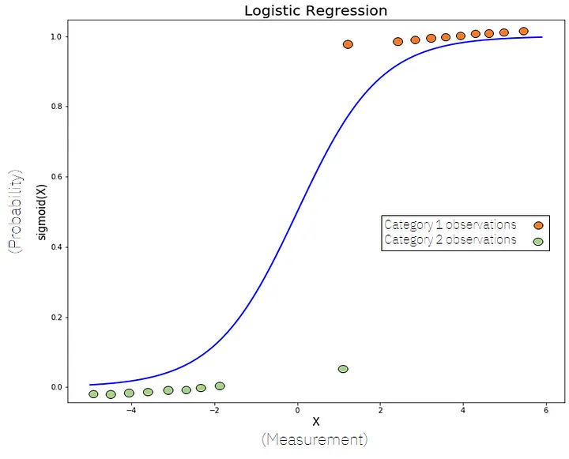
Classification
Classification puts records into groups.
We examined logistic regression through the logit function.
The model doesn’t directly predict the label, it predicts the probability of that label, then translates that to an output.

Slide 39
Lazy learners

Slide 40
Lazy learners
‘Lazy’: Do not create a model of the training instances in advance
When an instance arrives for testing, runs the algorithm to get the class prediction
Example, K – nearest neighbour classifier
(K – NN classifier)
“One is known by the company
one keeps”

Slide 41
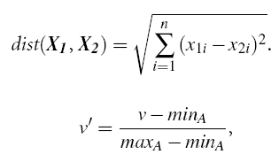
K-NN classifier schematic
For a test instance,
Calculate distances from training pts.
Find K-nearest neighbours (say, K = 3)
Assign class label based on majority

Slide 42

K-NN classifier Issues
How good is it?
Susceptible to noisy values
Slow because of distance calculation
Alternate approaches:
Distances to representative points only
Partial distance
Any other modifications?
Alternatives:
Weighted attributes to decide final label
Assign distance to missing values as <max>
K=1 returns class label of nearest neighbour
How to determine value of K?
Alternatives:
Determine K experimentally. The K that gives minimum
error is selected.
How to make real-valued prediction?
Alternative:
Average the values returned by K-nearest neighbours
How to determine distances between values of categorical
attributes?
Alternatives:
Boolean distance (1 if same, 0 if different)
Differential grading (e.g. weather – ‘drizzling’ and ‘rainy’ are
closer than ‘rainy’ and ‘sunny’ )

Slide 43
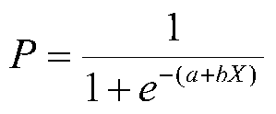
Classification and Gradient Descent
Our classifying models produce a class as their label – usually 1 or 0.
The internal calculations produce a probability:
The probability of a 1 occurring.
The “closeness” of our predicted probability to the true value is our loss.
Just like in a linear regression, we:
Set the weights (still the slope and intercept, but the logit arranged ones)
Observe the cost of the model.
Use gradient calculations to “attribute” the cost (error) to the weights.
Update the weights to move “downwards” on the cost curve.
Repeat until stopped or optimal.

Slide 44
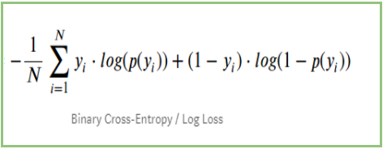
Cost in Classification
Regression gradient descent used MSE to measure cost.
Classification gradient descent has different cost calculations.
For binary classification, we use log-loss:
Average log of the “correctness”.
A.k.a. binary cross-entropy.
Like MSE looks at closeness to correct in regression, this does in classification.
Not accuracy based, closeness of prediction based.

Slide 45
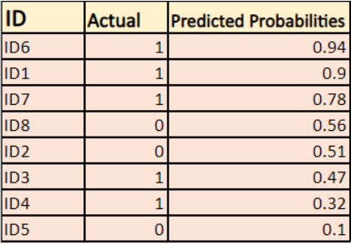
Step 1 – Model Predicts

Slide 46
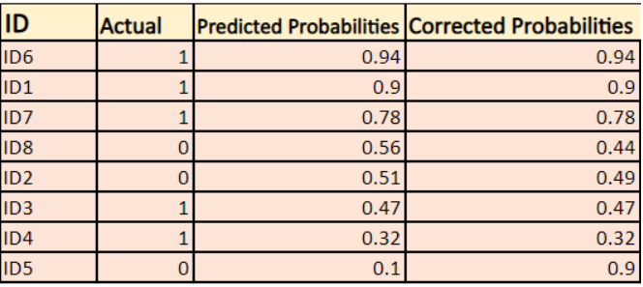
Step 2 – Correct Probabilities

Slide 47
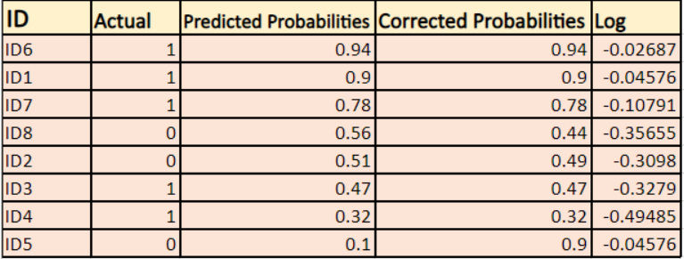
Step 3 – Take Log

Slide 48

Step 4 - Tally

Slide 49
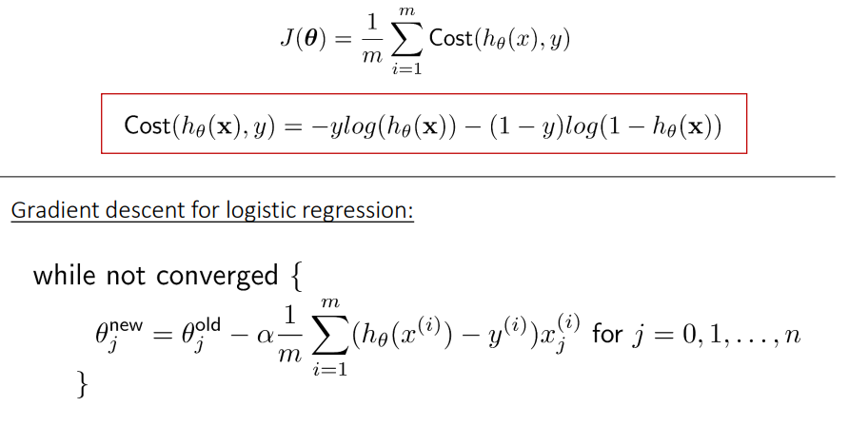
Step 5 – Gradient Descent Update Weights

Slide 50
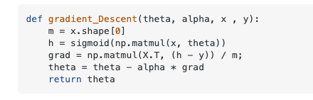
Gradient Descent – One step
Theta = weights. (e.g. slopes and intercept).
Alpha = learning rate. (HP)
X,y, = features, target.
H = post activation prediction value.
The result of the current model’s prediction.
Grad = gradients:
Matrix multiplication, this is the partial derivative step.
The calculus magic part – cost with respect to weights.
We take the total cost (error), and ”assign” responsibility to weights by this step.
Weights are then updated to lower the overall cost, the next round will predict with the new weights…
FYI for now, becomes more important to understand with neural networks.

Slide 51
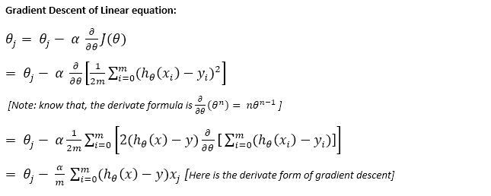
Step 5 – Gradient Descent Update Weights

Slide 52
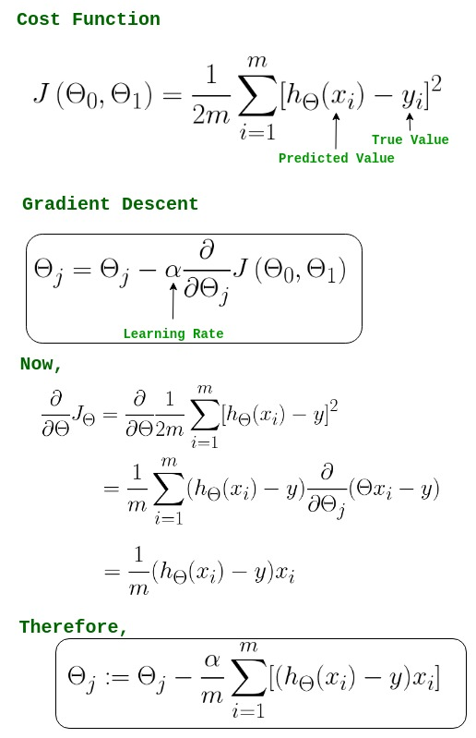
Step 5 – Gradient Descent Update Weights

Slide 53
Classification and Gradient Descent
The process of gradient descent

Slide 54
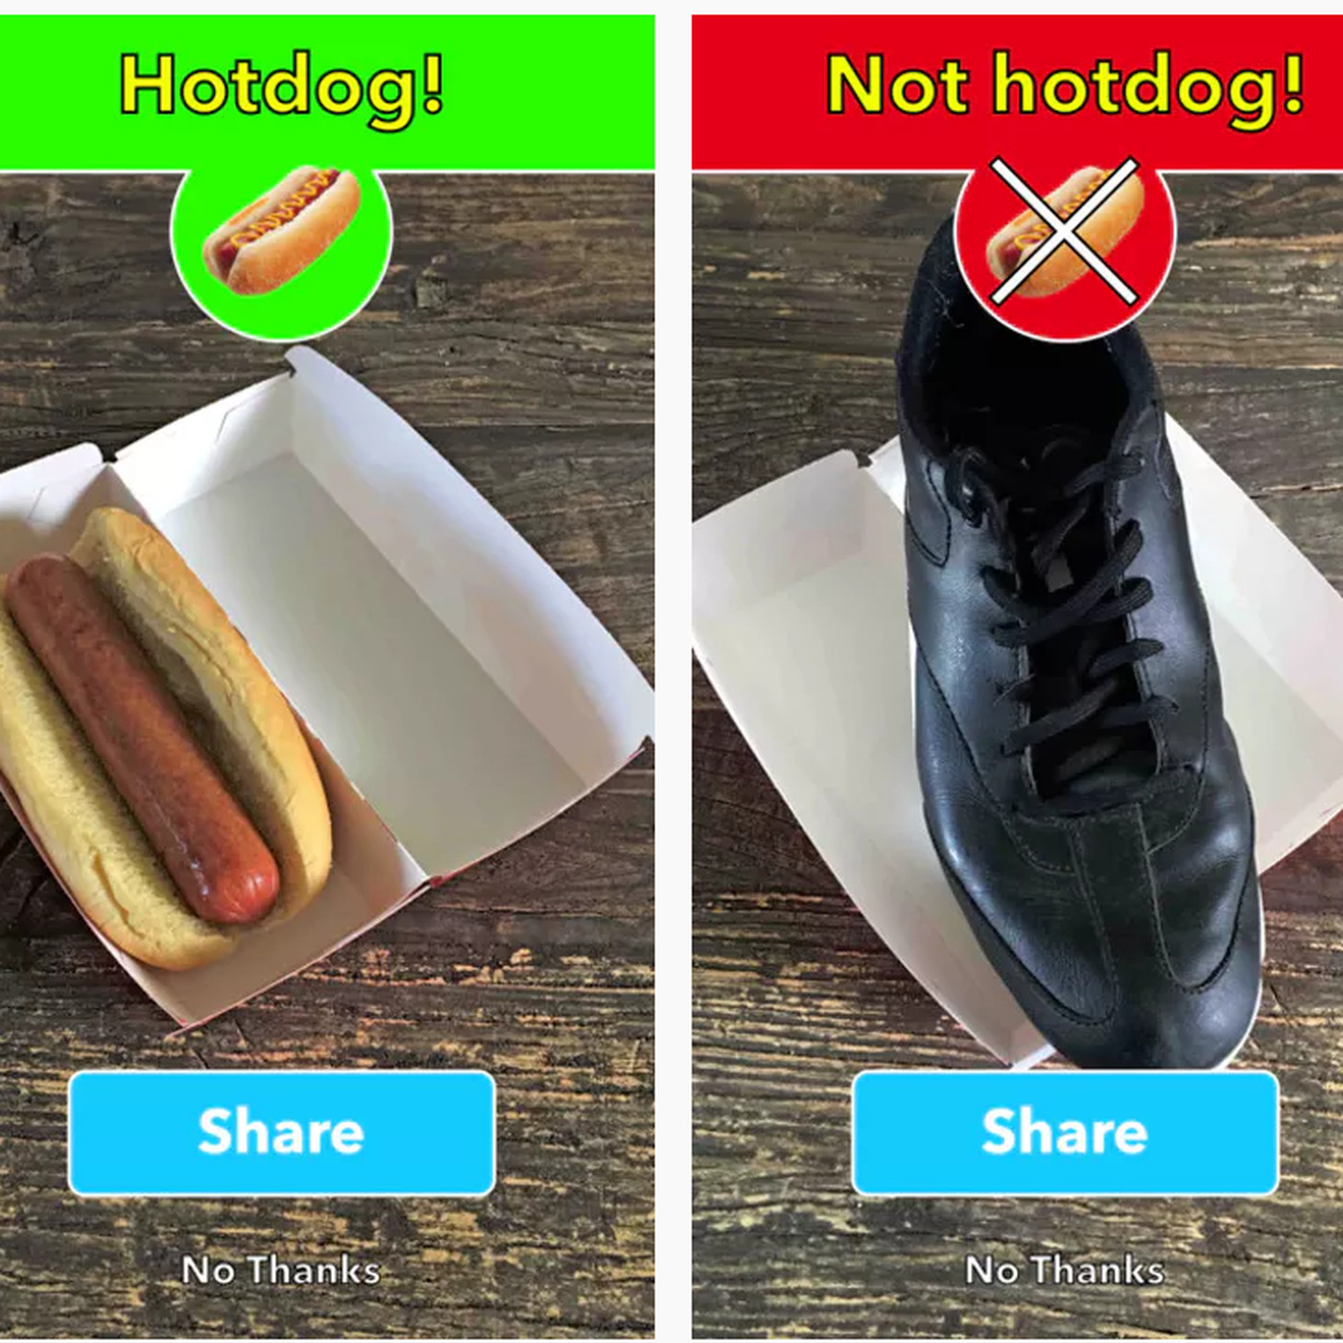
Multi-way Classification
Many problems aren’t simple A/B, e.g. image recognition.
We can also classify into an arbitrary number of classes.
The approach we’ve used only works two ways, so we have a few approaches...

Slide 55
Multiway Classification
One vs rest/all:
One classifier is created for each class.
Every record is tested for each class, yes/no, one by one.
One vs one:
One classifier for each pair of classes.
Selects class by looking at which one wins the most votes.
Multinomial:
A score for each class is calculated.
The highest score class wins.

Slide 56
Multiple Class Classification
Multinomial classification is the one from the previous page that is different.
Rather than yes/no, multinomial (as it is also known) classifiers say “which one”.
Involves a multi-step process:
Set the weights for the model.
Generate the logits for each class.
Use “Softmax” to translate the logits to probabilities.
Use ”Cross Entropy” to calculate the loss.
Use gradients to “attribute” loss back to weights.
Adjust weights and repeat.

Slide 57

Step 1 – generate Logits
The outcome of the internal logistic regression calculation is the logit.
Note – not the outcome label.
In a binary classification, our error is just the distance from the true value – 1 or 0.
Only one value (and compliment) is needed.
In a multinomial classification we have several logits – one per outcome class.

Slide 58
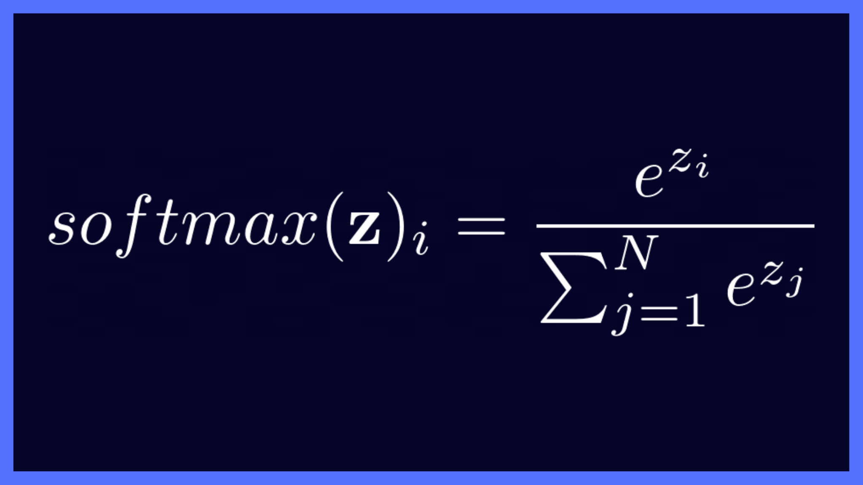
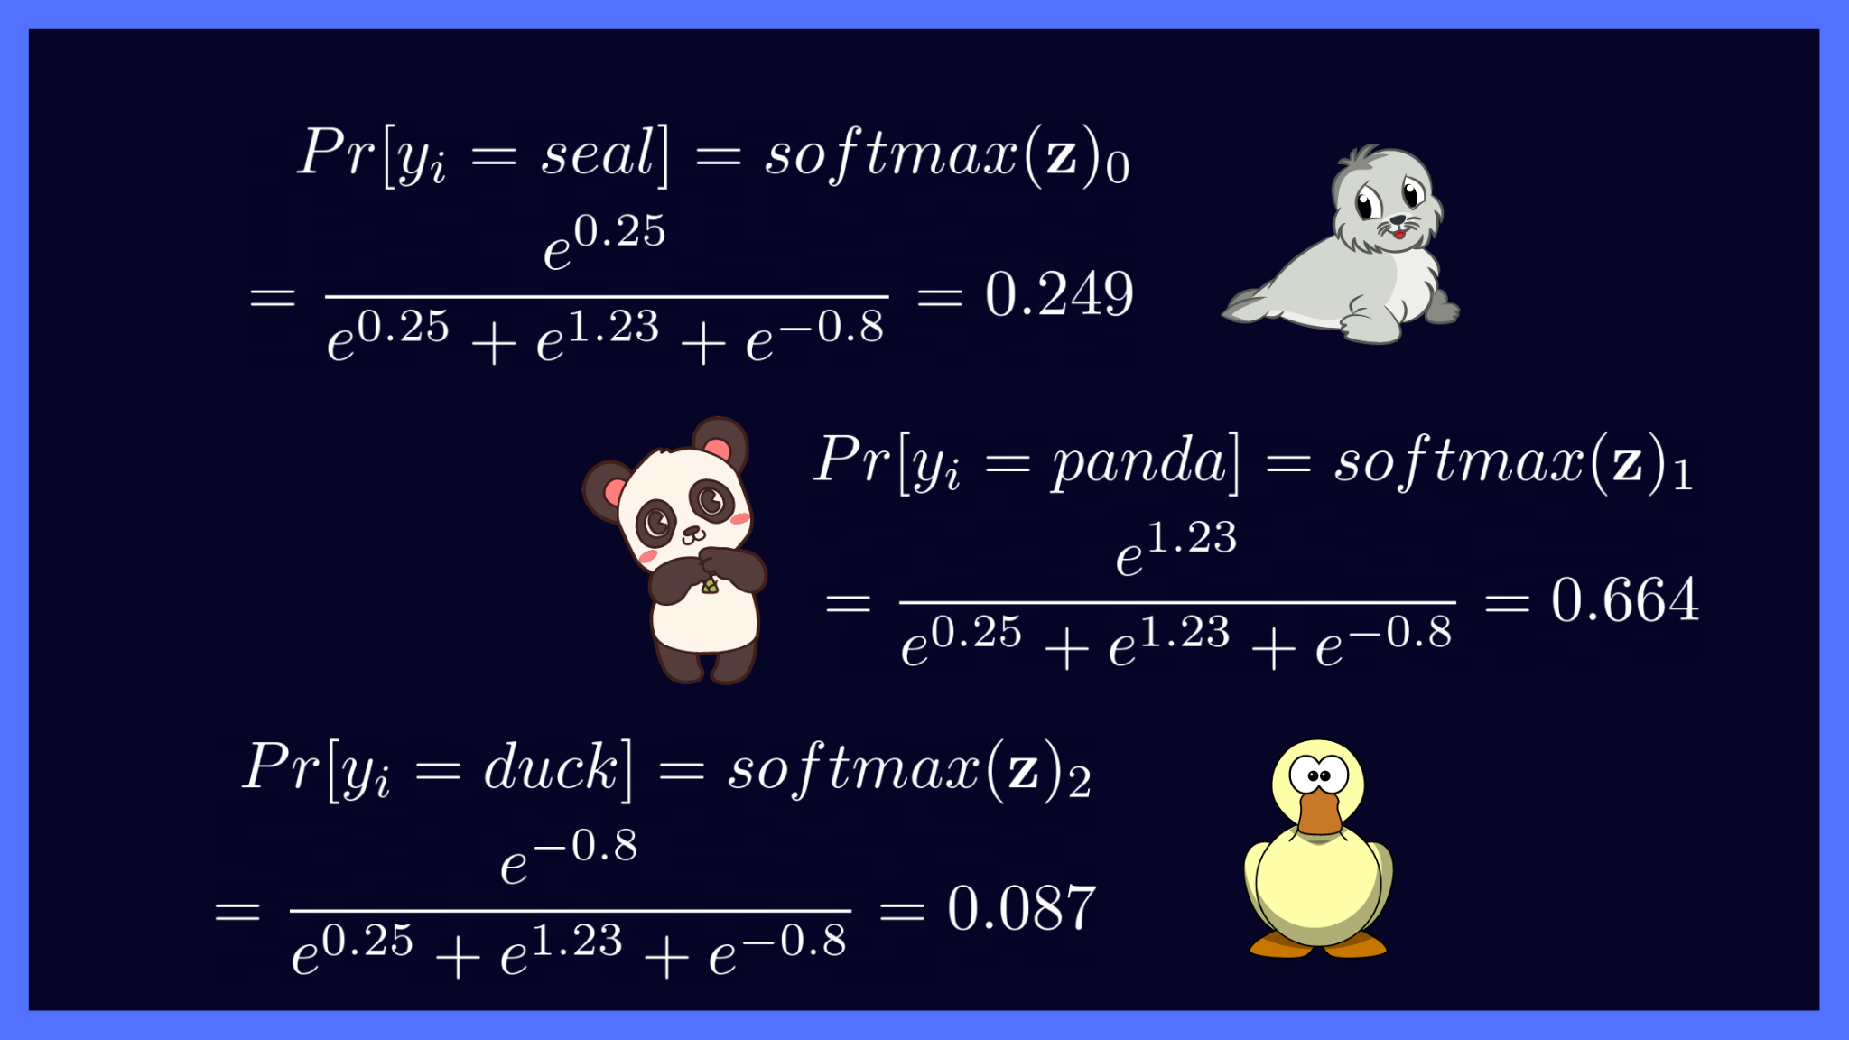
Step 2 – Softmax
The softmax function takes those logits and translates them to probabilities.
All probabilities sum to 1 – we are not assigning multiple labels.
The most likely outcome is the label.
The softmax (and sigmoid) are also known as activation functions.
This will matter with neural networks.
Sigmoid took the logit and produced binary probs, softmax takes the logit and provides multiclass probs
In the image, .25, 1.23, and -.08 are the outputs of the model.

Slide 59
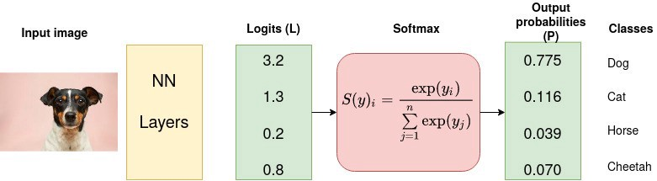
Softmax Example (Replace NN with Log. Reg.)

Slide 60
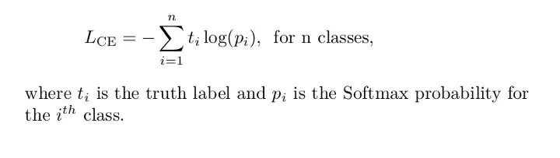
Step 3 – Labeling: Cross Entropy
Cross entropy is probably the most common loss function used with multiple classification.
Cross entropy is the multiple class version of log-loss.
One the loss is calculated we can gradient descend as normal.

Slide 61
Conclusion
Logistic regression introduces us to a few things:
Alternate cost functions – depending on the scenario, we can switch between cost calculations.
Multiple class predictions – processes mostly the same, but the prediction processing is different.
In sklearn, regularization (L2) is enabled by default.

