Slide 1
Housekeeping
Thus far..
Variables, conditional execution (if/else/elif), data structures, loops.
Slides in GitHub
Today (workbook 004 from repository):
Functions – more details to fill in the context. (P4E Chapter 4)
Reading from files on disk. (Read P4E Ch7, except 7.7. This part is more for context than critical knowledge.)
“Direct” file access now.
Next week we’ll look at the “data science” way to read data, that we normally use.
This is pretty easy and simple, and needed for lab 1.
P4E exercises – each chapter has some (mostly easy) exercises. Good practice…

Slide 2
Functions

Slide 3
Side Note - User Input
When running code on a command line, we can get user input directly.
When using notebooks we don’t have the direct access to user input.
We can use the input() function to request user input.
In VS Code, the text box at the top will open for input.
After hitting enter, that value will be captured, likely into a variable.
My_age = input(“Please enter your age:”)

Slide 4
What are Functions?
Functions are something we’ve used a bunch already – len(), type(), print()
Functions are blocks of code that we can call by name.
Functions often/usually have:
Arguments – inputs to the function. The things in the brackets, such as len(my_name).
Returns – the value that the function gives back as a “result”. The thing that we “use” from the function, such as my_sqrt = math.sqrt(my_number).
Neither are required, it depends on the function.
Functions can also do other, non-return, stuff – write to a file, print, update a db, etc…
Functions make our code easier to read, use, reuse, share, and test.

Slide 5
Algorithms
We often, but not necessarily, have a one-to-one mapping of algorithm to function.
E.g. “sort()” will probably do a sorting algorithm.
An algorithm is just a series of steps to do a specific thing.
E.g. sort, print, calculate the square root, etc…
The concept of an algorithm is simple, and the concept is the same in complex algorithms that train neural networks or force fascist propaganda to people on Twitter.
Algorithms typically take in some input(s), do some “stuff”, then produce some output.

Slide 6
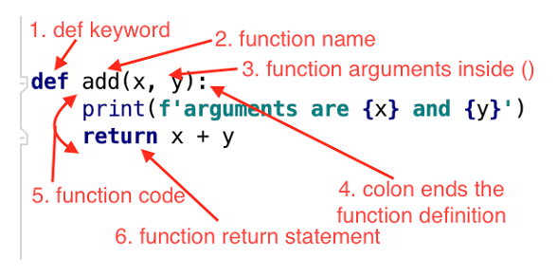
Function Syntax

Slide 7

Functional Benefits
Readability
Reusability
Modularity
Testability

Slide 8
Parameters
Parameters are the “inputs” to a function that whoever is calling this function can supply.
We most commonly have a function to “do stuff”, and it’ll do it with whichever values are supplied in the parameters. E.g. math.sqrt, print, etc…
We also often have functions that do something (to their object), and the parameters are the “settings”. E.g. sort or groupby on a dataframe, training settings for ML models.
Parameters in the function definition can optionally be named in the call:
Allows for optional parameters to be easily implemented.
Allows for the function call to not worry about order.
Parameters can also have defaults that will be used if missing in the call.
We commonly see this on stuff we import – there’s options we usually ignore.
Parameter variable names are locally scoped – they exist only inside the function.

Slide 9
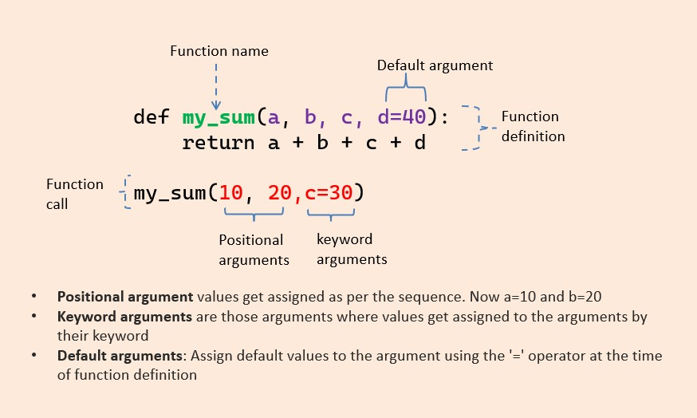

Slide 10
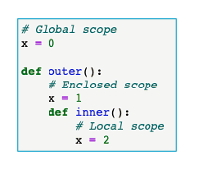
Variable Scope
Functions introduce us to variable scope.
The scope of a variable refers to where is is available.
We have 3 potential scopes:
Global – available everywhere in the program.
Enclosed – nested inside other functions.
Local – available inside a function.
Python will resolve, or look for a match, from the bottom up.
Careful on reusing variable names for scopes that can overlap.
Each separate function has its own independent scope.
We commonly reuse variable names from function to function, especially generic ones.

Slide 11
Variable Scope and You
A rule of thumb is that a variable is visible only “inside” the thing it is declared in.
For example:
A “normal” variable is “in” the program, so we see it everywhere.
A variable inside a function is visible in that function.
(Later) A variable inside a class is visible in that class.
Reusing variable names and relying on scope works, but has risk.
Counter_1, counter_2, etc… is probably better than being confused on what counter is.

Slide 12
Fruitful vs. Void Functions
One key distinction in types of functions is what they return.
”Fruitful” functions return some value.
E.g. a = math.sqrt(9)
We normally set some variable to the result of the function.
When doing something like checking a condition of a loop, this is common.
Void functions do some action, but don’t return the result.
E.g. print(“hello”)
We can also return other useful info like status, if needed. Common in ML model training.
Returns with multiple values are ok, this is a common tuple use:
Return (result, status)

Slide 13
Function “Targets”
Some functions are “targeted” at different things:
Targeted at ”themselves” – functions that act primarily on their own object.
Targeted at arguments – functions that act primarily on their arguments. E.g. print(), len(), etc..
This isn’t a super critical distinction to focus on, it’s something I found ambiguous when I learned.
This will make more sense in a week or so when we do classes.
As we get into creating classes and DS, the “themselves” ones will be more visible:
We will write functions inside of classes to “do stuff” to those objects. Eg ”sort”, “train”.
For now many/most of what we’ll see are the “arguments” ones, especially with basic data types.
We sometimes call many of these “utility” functions – things like print that act as utilities that we can reuse all over the place, in all sorts of applications.

Slide 14
Where to use functions
Almost any time we might have:
Code that will be repeated.
Algorithms with defined inputs and outputs.
Algorithms that require many steps to do one specific action.
E.g. sorting things generally has a bunch of steps to do the “sort” action.
Code that requires extensive/critical testing.
There is a very low chance that you’ll be too aggressive in putting code into functions.

Slide 15

Files and Input

Slide 16
Interacting with Local Data
Our Python programs normally run within their environment.
We can “reach out” to interact with the underlying computer.
Each operating system provides some API (application programming interface) that offers a way for a “normal” program to interact with an underlying system.
For programs the load/save stuff, they connect to the API for file access.
For programs that have a GUI, they connect to the API for keyboard/mouse inputs.
For programs that use networks, they connect to the API for network access.
Each OS provides the implementation, so the details are abstracted away.
Note: Python is a very “high-level” language, meaning it is detached from the actions a computer actually takes. This allows for it to be more human friendly.
Other languages (like C) force you to do more work on the details – like manually managing RAM

Slide 17
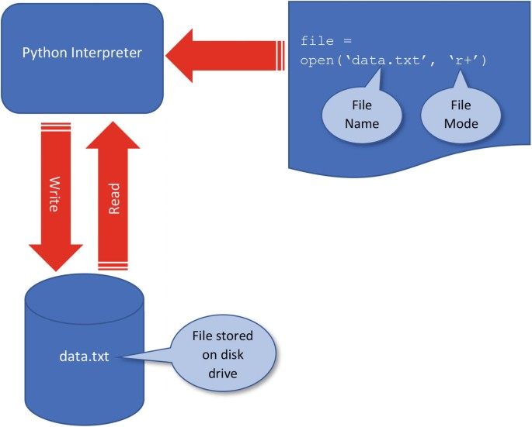

Slide 18
File Access
We can also use a library to access files from the hard drive.
Many libraries can do this.
The “base” library is “os” which provides a bunch of computer-related functions.
We often use Pandas for smaller datasets in data science.
Pandas is a library that mainly provides the data access/management for data science work.
We can’t really access a file directly.
The library we use to do the file access will call on a function provided by the OS itself, and request that the OS do something, like provide a file.
Allows us to not care about the mechanics of loading a file.

