Slide 1
Housekeeping
Lab 3 – we’ll do it after reading week. It’ll be a short and simple regression.
Today:
More linear regression.
Models.
Error metrics from residuals.
After reading week we’ll do some actual machine learning stuff.

Slide 2
Errors

Slide 3
Key Terms – We need to Know Them!
Data – the rows of data that we are using, usually a dataframe.
Target – the thing we want to predict, Y. E.g. price, sales, loan payback….
Features – the things we know ‘ahead of time’ and use to predict. E.g. income, customer data…
Machine learning algorithm – the math that turns data into a model, a.k.a. ’training a model’.
So far we’ve seen Linear-Least Squares – making a line of best fit. (Linear Regression)
All these algorithms learn to predict Y from Xs – the math behind it can vary widely.
Models – models (in ML) turn a set of inputs to a prediction of the output.
We insert one row of features (X values) and get one prediction of the target (Y value).
Training Data – we need data with features and target to ‘train’ the model.
The training process (using data to make the model) and using it (making predictions to use) are separate. We really focus on the first, the second is what would happen if our model is good.

Slide 4
Data and Estimates
So far we’ve looked at two main types of ”things”:
Empirical data – real values. Generally a sample of a population.
Models – a representation of some data. Analytical distributions and the line of best fit (regression line) are both models.
A model is a simplified representation of the data.
How good is a model? So far, we’ve mainly looked to eyeball it.
The models always differ from the empirical data somewhat.
We want to use our models to make predictions:
If we do, how can we measure if those predictions are accurate?

Slide 5
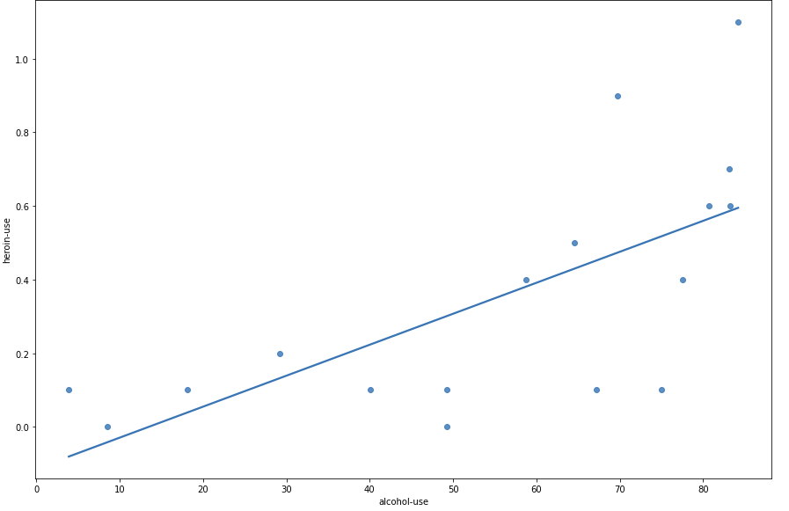

Slide 6
Errors
When matching empirical data to analytical distributions our match is never perfect.
Each point is “off” the analytical distribution by some amount.
The less the total amount of “off” is, the more closely matched the distribution.
Predictions work the same way:
Predict what a value should be.
Measure our error.
Summarize these errors to estimate overall accuracy.

Slide 7
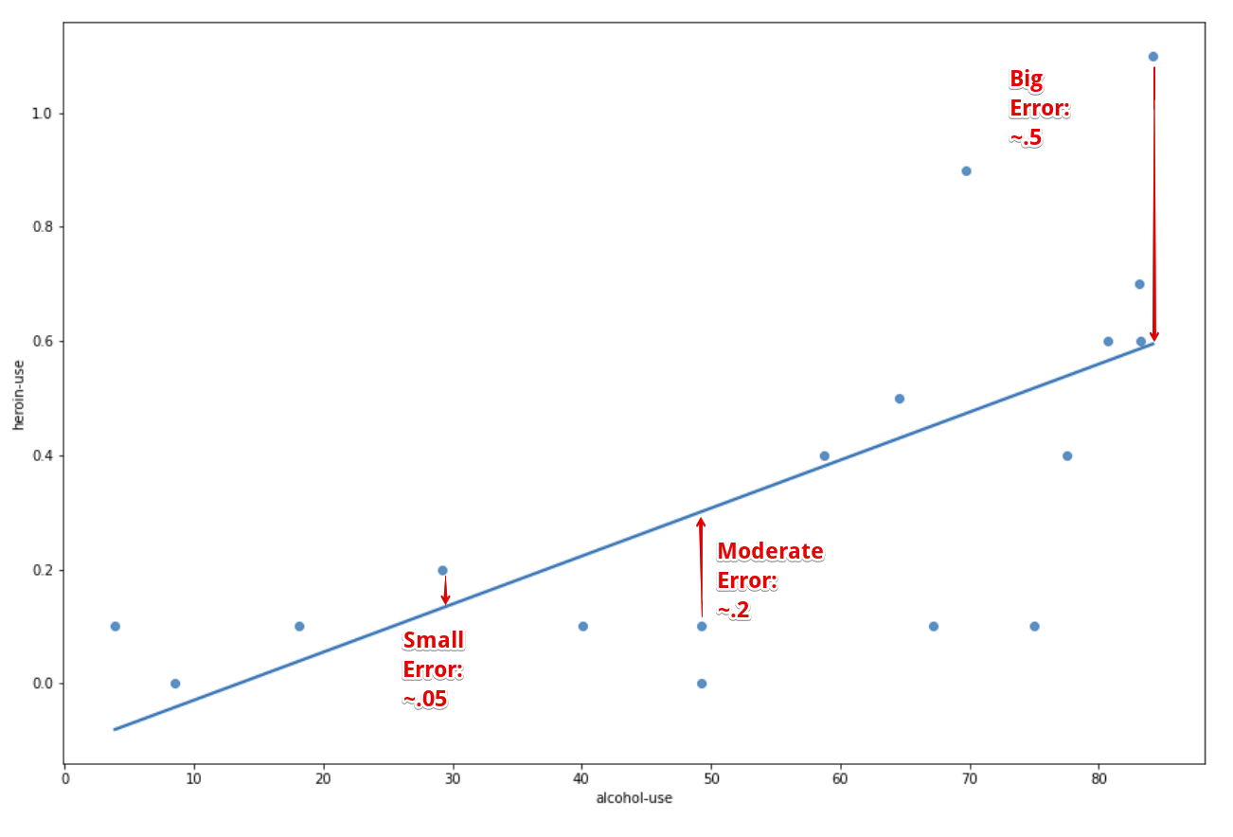
Residuals
A residual is how much one prediction is off from reality.
Each point in our data has its own residual – how “off” was the model vs that real value.
Here – LoBF is a prediction.
Next – Analytical model is a prediction.

Slide 8
In Analytical Distributions
The idea of error works in the same way when matching empirical vs analytical distributions.
Empirical is the real data.
The analytical distribution is the prediction.
E.g. Consider matching a lognormal looking distribution to the lognorm analytical one:
Empirical data tells us how many values we have in a bin.
The analytical distribution tells us how many we expect (if the data follows that dist).
The difference between the two is the residual, or amount of error.

Slide 9
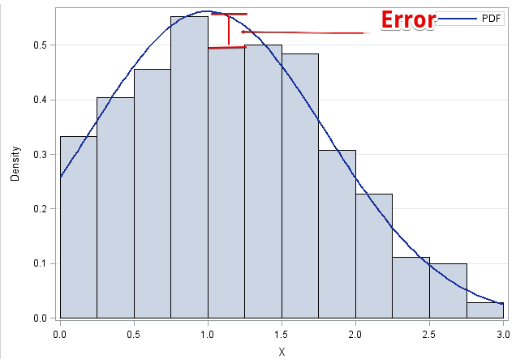

Slide 10
Simple Residuals
A residual is just the amount of error from one prediction.
It is measured by taking the difference between Real Value and the Predicted Value.
In our examples now:
Real Value is the actual Y value from the data.
Predicted Value is the line of best fit’s (regression line) Y output at that X value.

Slide 11
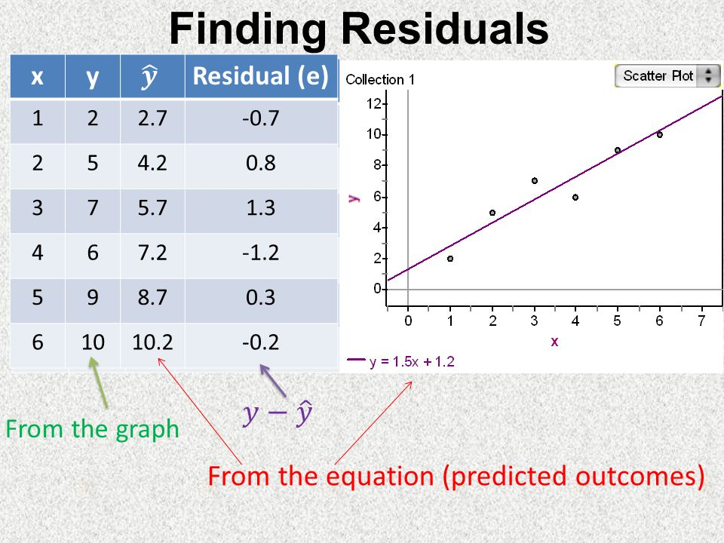
Calculating Residuals
If we have an expectation (analytical model, ML prediction, guess) and a true (empirical) value, we can calculate the residual.
At each empirical point, how accurate is the model?
We get one residual for each row of data (point):
Y_predicted – Y_actual

Slide 12
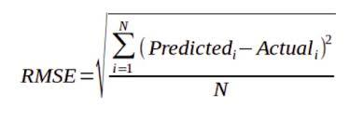
Summarization of Errors
When dealing with many points, a list of residuals is impractical.
Think of a dataset with 10,000,000 rows – a list of that many residuals is impractical.
We can summarize residuals into one measure of error.
There are several ways to summarize error, e.g.
MSE – Mean squared error. Square residuals and average them.
RMSE – Root mean squared error. Take the square root of MSE.
MAE – Mean absolute error. Average the absolute values of the residuals.
RMSE is the most common error measure for us, MSE is generally used in calculations.
Lower error amounts tell us that the model and the empirical are similar.

Slide 13
Why Squared?
The error measures either squared or took the absolute value of the residual.
Squaring does a couple of things:
Eliminates negatives. We get a measure of the magnitude. (MAE* also does this.)
Penalizes large residuals.
Having residuals that are small are good, even though they’ll never be perfect.
Having large residuals indicates massive misses.
MSE/RMSE tends to reward models without many large residuals.
Few large misses.

Slide 14
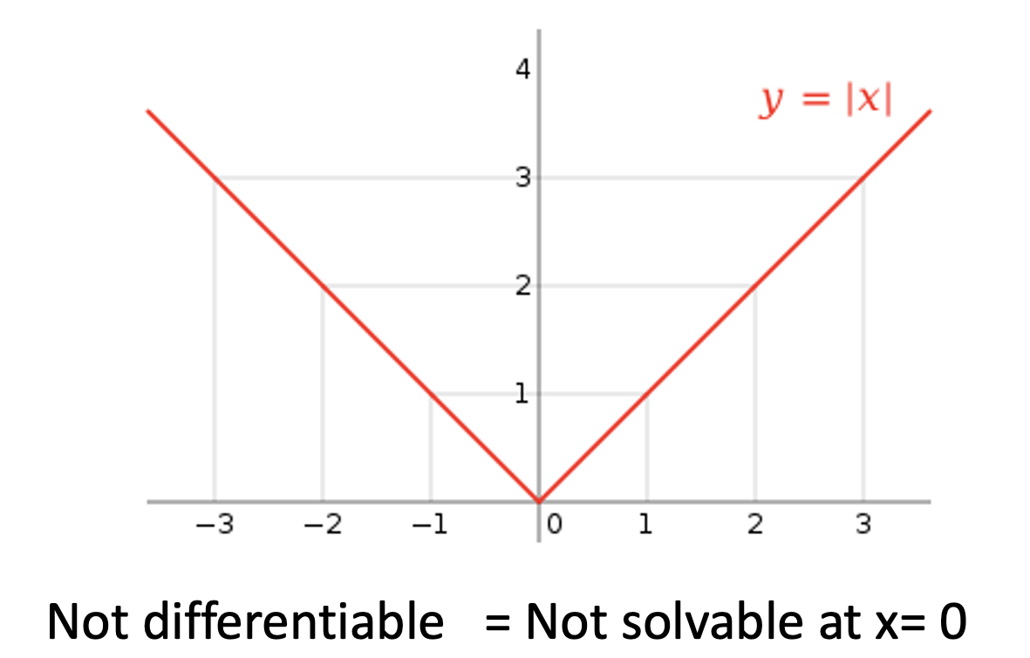
Why Not Absolute Values?
Using squared errors is preferred over absolute value errors for several reasons.
Penalizing large misses more is generally good.
For math reasons we don’t care too much about, math on absolute values is much slower:
Actual algorithms rely on taking the derivative (calculus for the slope), which doesn’t exist at 0.
Taking the derivative for squared values is easy.

Slide 15
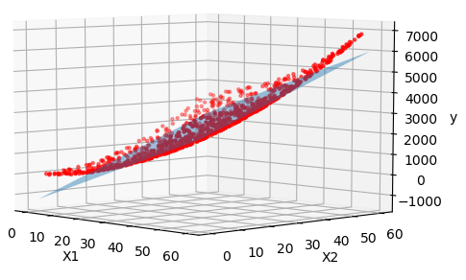
In More Dimensions
In real applications, we probably want to use more than one input to predict an output.
The same concepts apply there, just harder to picture.
Here we have 2 inputs (X1, X2), one prediction (Y).
The line of best fit is now a plane.
One prediction results from imputing X1 and X2, then finding that spot on the plane.
The residual is the distance on the Y axis between plane and point. (Y_predicted – Y_real)

Slide 16
Back to Correlation and R-Squared
Error (e.g. RMSE) is a main way to judge the quality of a model.
The RMSE is roughly the “expected amount of error per prediction”.
Our model is a prediction of the target, and the RMSE is a summary of how close each of those predictions is.
We want a model that has “high predictive value”, or the predictions we make are close to the real values – this is what allows the model to be useful for real predictions later.
We could also say that the lower the MSE is, the better the model “explains” the target.
There is another metric, R-Squared, that is commonly used to evaluate models.
R2 is also based on the residuals, but it is derived differently.
The R2 focuses on the amount of variance that the model explains vs the amount that it doesn’t.
I.e. the target literally varies from the mean, R2 is how much of that the model tells us.

Slide 17
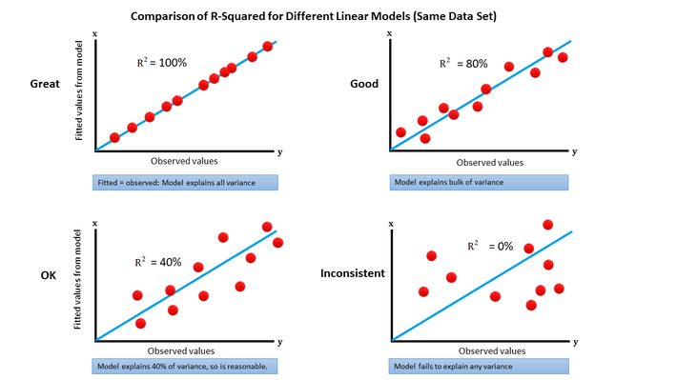

Slide 18
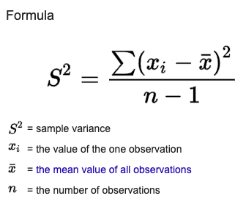
R2
The idea of R2 is based on correlation and variance.
Variance is the expected value of the squared deviation from the mean of a random variable.
A.k.a. variance tells us how much a value varies from the mean of that data.
In two-dimensions, if the correlation is 1, then X ‘explains’ all of the variance in y.
If we know X, we know everything about Y, exactly what the value will be.
The lower the correlation is, the less exactly we know Y from the model’s prediction.
We can combine these to get a metric that looks at this variance and tells us how much is explained by our model vs how much we miss (caused by other stuff, randomness, etc)

Slide 19
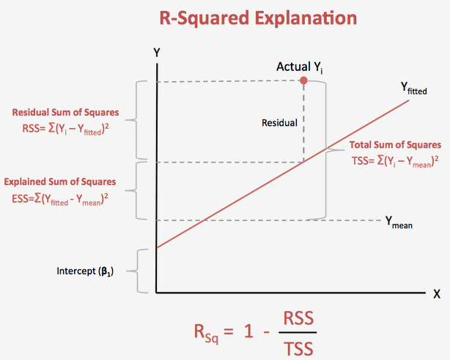
Explained Variance
The amount that a value varies from the mean is the TSS line.
Total variance of the data.
The distance between that value and our model prediction is the RSS.
What the model missed.
The leftover is the ESS – explained.
What the model captured.
R2 is the proportion of that variance we have in the model’s predictions.

Slide 20
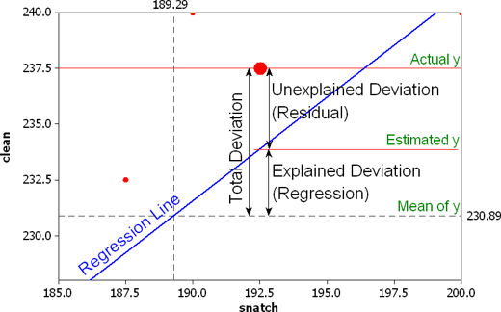
R Squared Calculations
The R2 value is the percentage of variance of Y that is captured in the model’s predictions.
The smaller the residuals are, the smaller the RSS is, the larger the ESS is.
I.e. if we have small residuals, our model is telling us almost exactly what the target is.
R-squared is also the square of the Pearson correlation.
R2 is also known as the coefficient of determination.

Slide 21
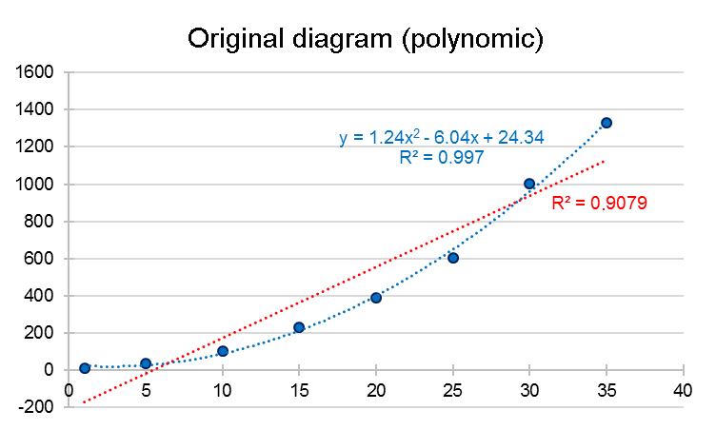

R-Squared Usage
R2 is very useful as it is a value between 0 and 1, so we can compare.
RMSE values depend on the actual numbers in the data, R2 is on a fixed scale.
R2 effectively grades a model on a percentage scale.
R2 isn’t technically a direct measure of error, even though it is similar.
R2 measures “goodness of fit”, or how well the model fits the data.
In a simple linear regression, this may not seem obvious, but in later models we’ll see more clear examples of what fits data and what doesn’t.
A model that better “fits” the data will perform better.

Slide 22
Errors
Moving forwards, error is a critical metric for us.
We want to build models to make predictions.
Error indicates how well we are doing.
Less error = closer match between expectations and reality.
We’ll build an error calculation from scratch and look at the library functions.
This stuff carries over directly to the error calculations we need for ML.

